Slide 1

TRAINING CONTENT
Ansible
YOUR NEXT DESTINATION
OF SOFTWARE OUTSOURCING
Image Placeholder

Slide 2

Ansible Session-05

Slide 3
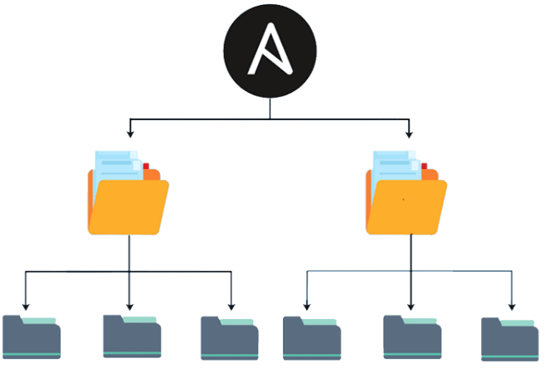
Ansible Session-05
What are roles in Ansible?
In Ansible, roles are a way of organizing your playbook and keeping it modular and reusable. A role is a collection of tasks, files, templates, and variables that are grouped together in a structured way, allowing you to easily reuse and share code across different playbooks.

Slide 4
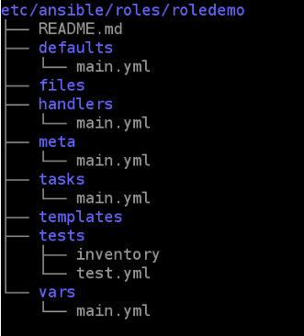
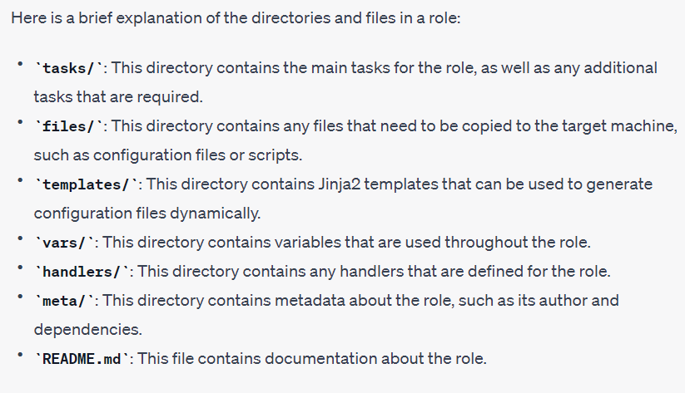
Ansible Session-05
Creating a basic role
Create an Ansible role by running the below command. You can set the location of the role based on your need. I have created the Ansible role with the name ‘roledemo’ located under the ‘etc/ansible/roles/‘ directory.
$ ansible-galaxy init etc/ansible/roles/roledemo --offline

Slide 5
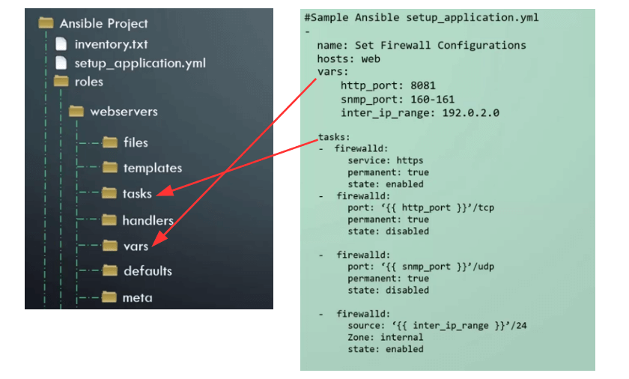
Ansible Session-05
Using role in Playbook
In the following example under my Ansible Project, I currently have an inventory file and a single large playbook to setup my webserver end to end. Now with roles, we are going to reorganize the playbook and variables, we create a new folder called role within which we create another folder with the name of the role, in this case, webservers. The webservers role contains additional folders named files, templates, tasks, handlers, vars, defaults, and meta. Each of these folders contains files associated with those purposes. For example, the tasks folder contains a YAML file containing a list of tasks and the vars folder contains var files defined with the variable declaration.

Slide 6
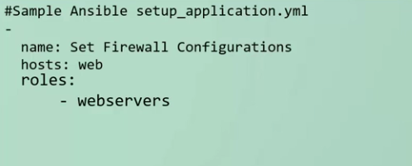
Ansible Session-05
Using role in Playbook
Now, we can move parts of the playbook to the different folders. We moved the variables into a file in the vars folder and we moved tasks into a file in the tasks folder. Now in our master playbook, we could simply say assign the following ansible roles to the server and the role is webserver which we have created under the roles folder.

Slide 7
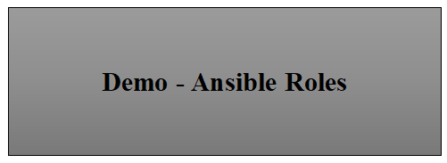
Ansible Session-05

