Slide 1

TRAINING CONTENT
Ansible
YOUR NEXT DESTINATION
OF SOFTWARE OUTSOURCING
Image Placeholder

Slide 2

Ansible Session-06
Introduction to Ansible Vaults
Used Ansible Vaults in Playbook
Demo

Slide 3

Ansible Session-06

Slide 4
Ansible Session-06
Ansible Vaults
Ansible Vault is a feature in Ansible that allows you to encrypt sensitive data such as passwords, private keys, and other confidential information. It uses symmetric encryption, which means that the same password is used to encrypt and decrypt the data.
The purpose of Ansible Vault is to provide a secure way of storing sensitive information in playbooks or inventory files that can be shared or version-controlled. It prevents the sensitive information from being visible in plain text, thereby reducing the risk of security breaches.

Slide 5


Ansible Session-06
Encrypting sensitive data using Ansible Vault
To encrypt sensitive data, you can use the ansible-vault command with the create option to create a new encrypted file or the encrypt option to encrypt an existing file:
To view the contents of an encrypted file, you can use the view option:
This will prompt you for the password to decrypt the file and display the contents in the terminal.
You can also use the edit option to modify an encrypted file or the decrypt option to remove the encryption:
When running an Ansible playbook that uses encrypted files, you can specify the password to decrypt them using the --ask-vault-pass option:
Alternatively, you can use a password file or environment variable to store the password using the --vault-password-file or --vault-password-env options, respectively.

Slide 6
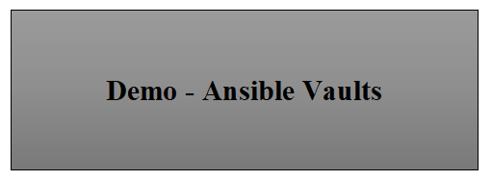
Ansible Session-06

