Slide 1

TRAINING CONTENT
Cloud Computing
YOUR NEXT DESTINATION
OF SOFTWARE OUTSOURCING
Image Placeholder

Slide 2
Lecture Outline
Docker
Container
Containers vs Virtual Machines
Docker Architecture Diagram
Docker Installation
Dockerfile
Push Image into Registry
Docker Networking
Docker Compose
Docker Compose Example
Kubernetes Overview

Slide 3
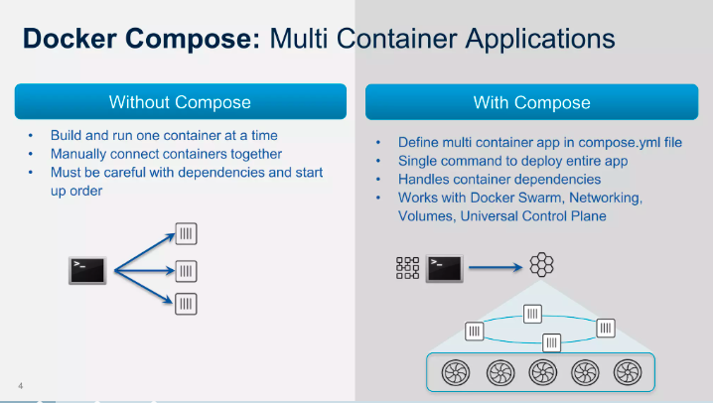
Docker Compose(1/2)
Compose is a tool for defining and running multi-container Docker applications. With Compose, you use a YAML file to configure your application’s services. Then, with a single command, you create and start all the services from your configuration

Slide 4
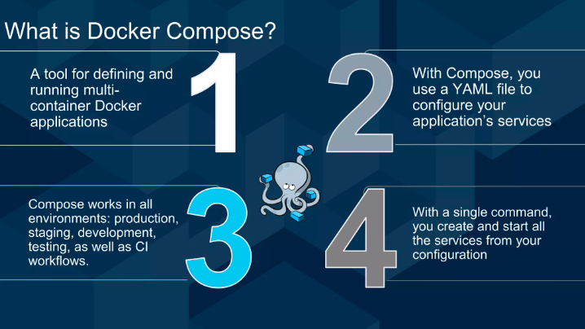
Docker Compose(2/2)

Slide 5
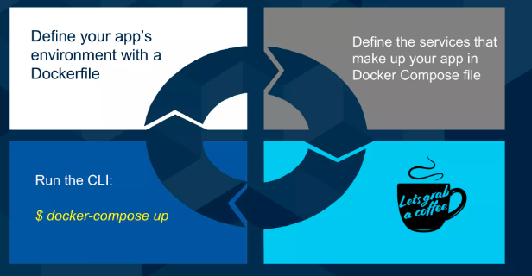
Docker Compose is a 3-step process

Slide 6
Install Docker Compose on Ubuntu
sudo apt install docker-compose-plugin
Check version:
sudo docker compose version
Second option for installation:
sudo curl -L "https://github.com/docker/compose/releases/download/1.29.2/docker-compose-$(uname -s)-$(uname -m)" -o /usr/local/bin/docker-compose
sudo chmod +x /usr/local/bin/docker-compose
docker-compose --version

Slide 7
Docker Compose vs. Docker Swarm vs. Kubernetes
What’s the difference between Docker Compose, Docker Swarm, and Kubernetes?.
Docker Compose is a tool for managing multiple containers on a single application host.
Docker Swarm is a tool for managing multiple containers across multiple hosts.
Kubernetes is a full-fledged container orchestration tool; it has features that make it easier to manage larger clusters of containers as your applications scale.
Deciding which tool is right for your needs is to consider the scale of your containerized application.
For smaller apps where you’ll be using a single host to manage all your containers, Docker Compose is sufficient.
For larger applications that require multiple hosts, the decision is between Docker Swarm (ease-of-use) and Kubernetes (scalability).

Slide 8
Multi-container example with Docker Compose-docker
#Create docker-compose.yaml file and copy and paste below code.
version: '3.7'
services:
db:
image: mysql:8.0.19
command: '--default-authentication-plugin=mysql_native_password'
restart: always
volumes:
- db_data:/var/lib/mysql
restart: always
environment:
- MYSQL_ROOT_PASSWORD=somewordpress
- MYSQL_DATABASE=wordpress
- MYSQL_USER=wordpress
- MYSQL_PASSWORD=wordpress
wordpress:
image: wordpress:latest
ports:
- 80:80
restart: always
environment:
- WORDPRESS_DB_HOST=db
- WORDPRESS_DB_USER=wordpress
- WORDPRESS_DB_PASSWORD=wordpress
- WORDPRESS_DB_NAME=wordpress
volumes:
db_data:

Slide 9
Run and check docker compose
docker-compose up –d
docker ps
Open your browser write
http://IP
It will show WordPress site
Verify MySQL Database:
sudo docker exec -it databaseconatinername/id bash
mysql –uroot -p

Slide 10
Container Management tool (Orchestration): Kubernetes
Kubernetes is an open-source container orchestration system for automating software deployment, scaling, and management. Originally designed by Google, the project is now maintained by the Cloud Native Computing Foundation.
Kubernetes automates operational tasks of container management and includes built-in commands for deploying applications, rolling out changes to your applications, scaling your applications up and down to fit changing needs, monitoring your applications, and more—making it easier to manage applications.

Slide 11
References
https://phoenixnap.com/kb/install-docker-on-ubuntu-20-04
https://phoenixnap.com/kb/how-to-install-python-3-ubuntu
https://docs.docker.com/language/python/run-containers/
https://docs.aws.amazon.com/AmazonECR/latest/userguide/docker-push-ecr-image.html

Slide 12
Thank You
Get in touch with us:
www.bjitgroup.com

