Slide 1


ATTENDANCE
TRACKING
SYSTEM
BY: ANURAG PUNDIR(16091072) , DIVYANSH DIXIT(16091095)
SUBMITTED TO : Ms. GUNJAN SHARMA

Slide 2
INTRODUCTION
Attendance Tracking System is a software developed for daily student attendance in college . It facilitates to access attendance information of the whole class date wise.
The purpose of developing the system is to computerize the traditional way of marking attendance.
The system is specially designed keeping in view the plunging strength of students in the college , thereby it will be a boon for teachers to track the attendance of the student.

Slide 3
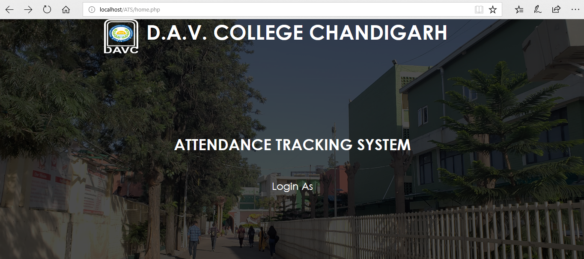
SNAPSHOT

Slide 4
MODULES
ADMIN
TEACHER
STUDENT
Admin and Teacher have login ids but Student can directly get a record of its own attendance so far.

Slide 5
COMPONENTS IN FRONT & BACK
FRONT END :
HTML
CSS
JAVASCRIPT
BACK END:
PHP
MYSQL
APACHE
SPECIAL REQUIREMENTS
Browser supporting HTML5.0 Eg. Microsoft Edge
Browser supporting javascript & Cookies.
XAMPP S/W

Slide 6
POINT TO BE KEPT IN MIND
Attendance of a particular day cannot be marked on any other day.
Attendance once submitted cannot be changed or altered.
Subjects and Students will automatically be updated time to time
from Admin’s side.
None of the student shall be left unattended in attendance marking
scheme.

Slide 7
DATABASE TABLES

Slide 8
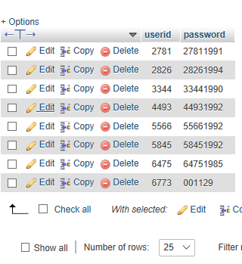
AUTHENTICATION
Whenever a new teacher is added its password is automatically generated as [id+DOB year]

Slide 9
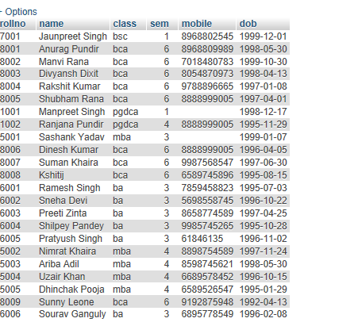
STUDENT DETAILS

Slide 10
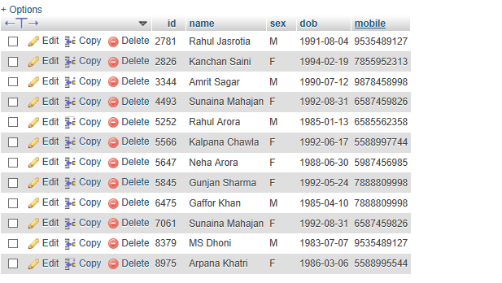
TEACHER DETAILS

Slide 11
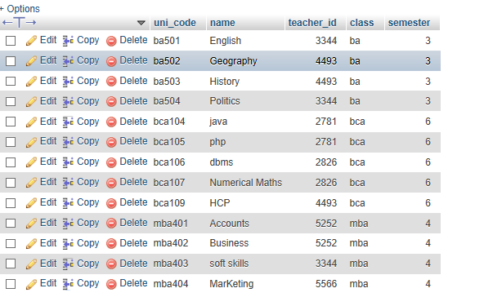
SUBJECT DETAILS

Slide 12
SCOPE OF PROJECT
With growing need of digitization it will be feasible to record attendance online.
It will extensibly help in maintaining stringent records so as to tighten the rules of attendance and shortages.
Helps in keeping the accurate and reliable data.
No interference can be done as data will be updated as and when submitted.
It will change the traditional way of attendance marking and brought a new positive change in the college environment pertaining to class attendance.

Slide 13
THANK YOU !

