Slide 1
Group 5 - Redmine
LAB 3

Slide 2
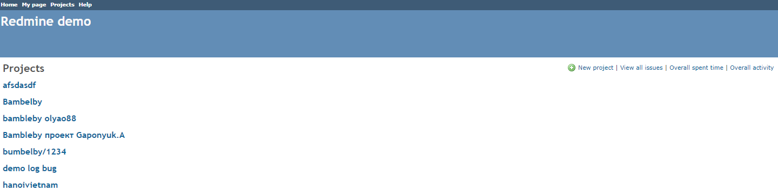
Step 1. Create project
1
2

Slide 3
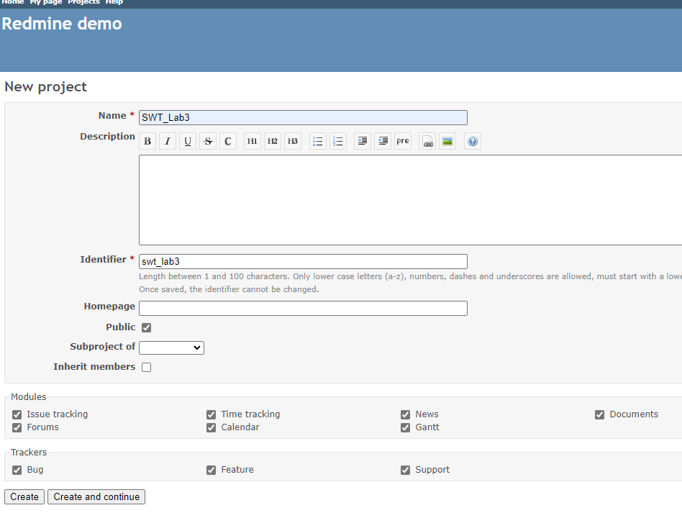
Step 2. Fill project infomation

Slide 4
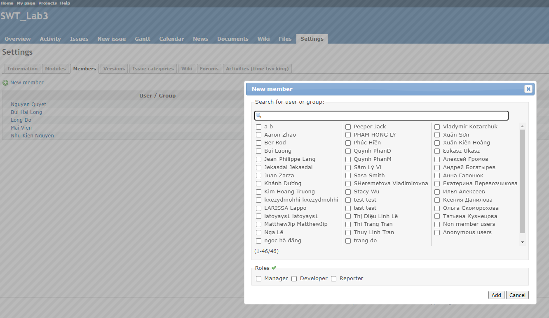
Step 4. Add member to your project
1
2
3

Slide 5
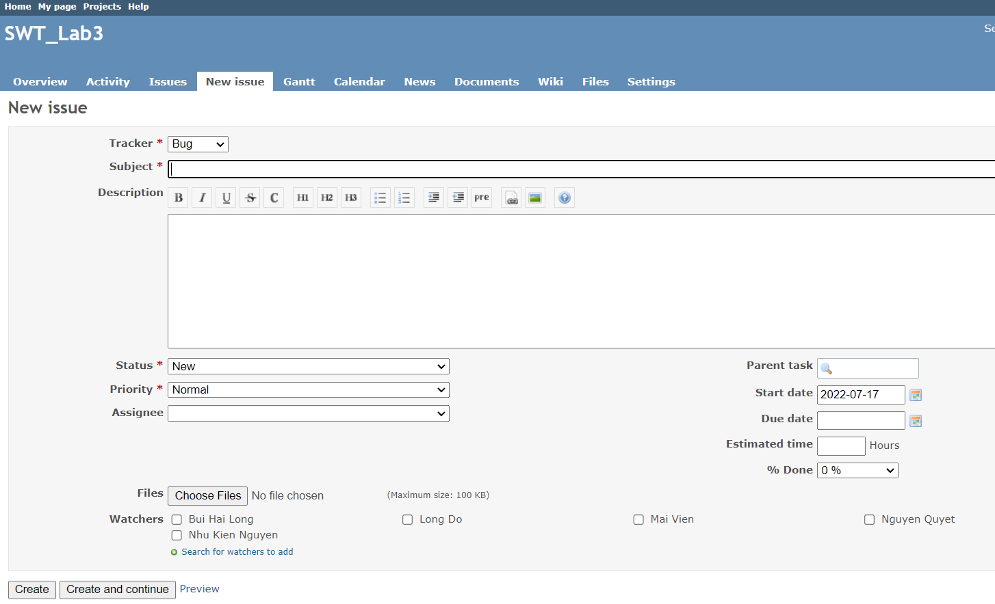
Step 4. Create issue
1

Slide 6
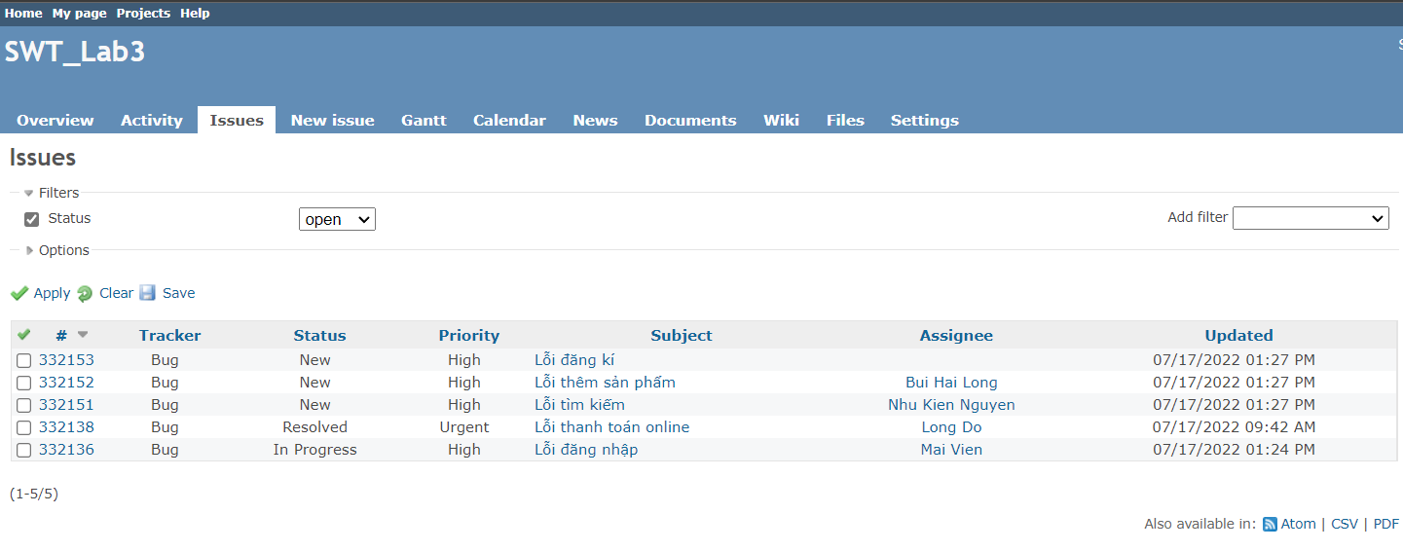
Step 5. Manage issue

