Slide 1

Project Title - Seasonal Agriculture Performance Analysis
Student Name – Arjun Srivastava
College Name – United University
AICTE STU ID : STU66145c622c94c1712610402

Slide 2

PROBLEM STATEMENT
Agricultural activities are influenced by seasonal variations in environmental conditions, farming practices, resource availability and market conditions. As a result, agricultural performance may differ from one season to another.
However, raw agricultural data does not clearly explain how agricultural performance changes across seasons or what patterns can be observed in different seasonal conditions.
The problem is to analyze the given agricultural dataset and investigate seasonal differences in agricultural performance by identifying meaningful patterns, trends, relationships and variations within the available data.

Slide 3
Project Description
Analyzed a dataset containing 4,000 agricultural records and 28 features.
Performed data cleaning and preprocessing.
Identified and handled missing values.
Checked duplicate records and investigated outliers.
Performed descriptive statistical analysis.
Conducted univariate, bivariate, and multivariate analysis.
Analyzed correlations between important agricultural variables.
Compared performance across Kharif, Rabi, and Zaid seasons.
Generated insights related to crop yield, profitability, irrigation, and agricultural performance.

Slide 4
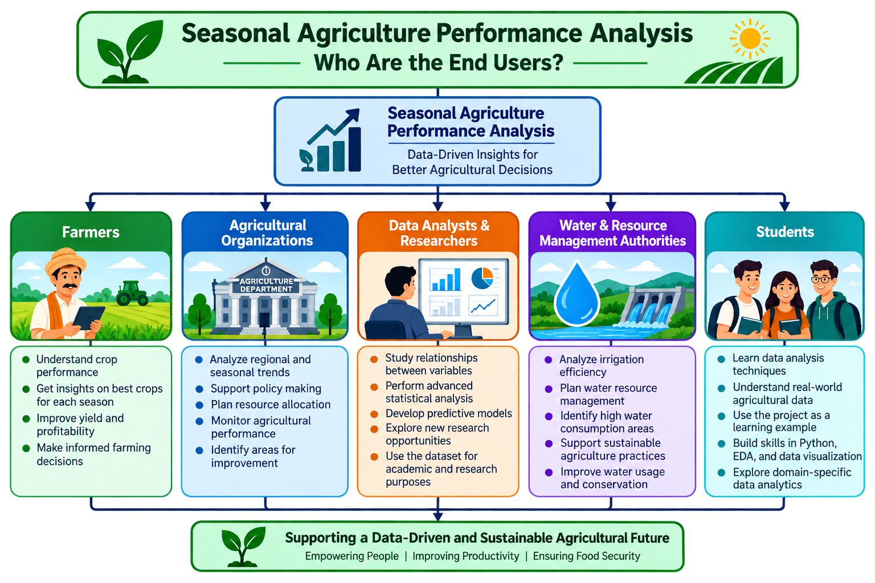

WHO ARE THE END USERS?

Slide 5
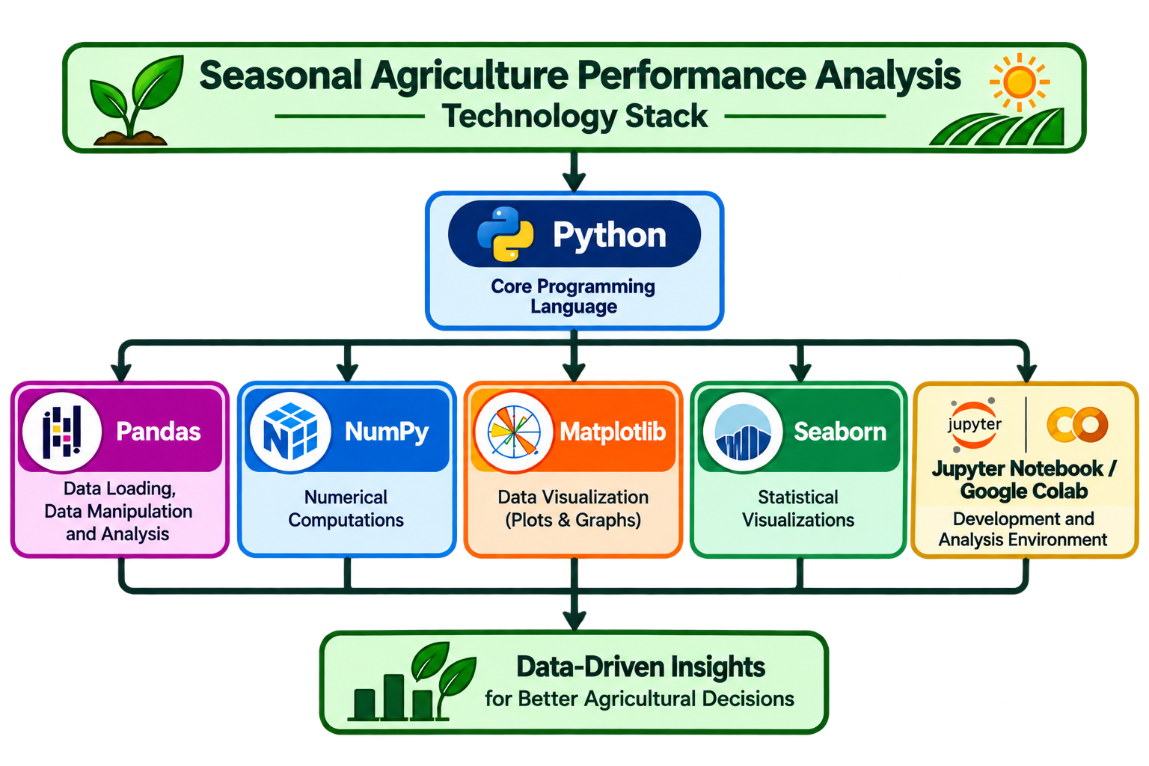

Technology Used

Slide 6
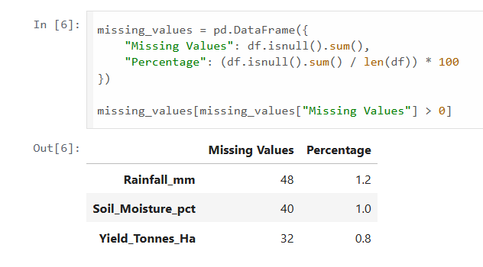
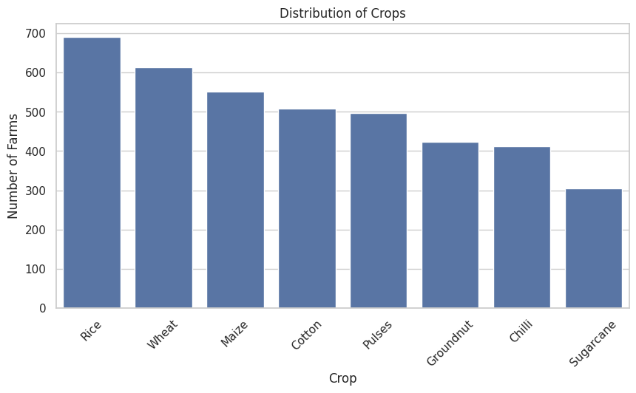
RESULTS
Missing Values Before Handling:
Crop Distribution:

Slide 7
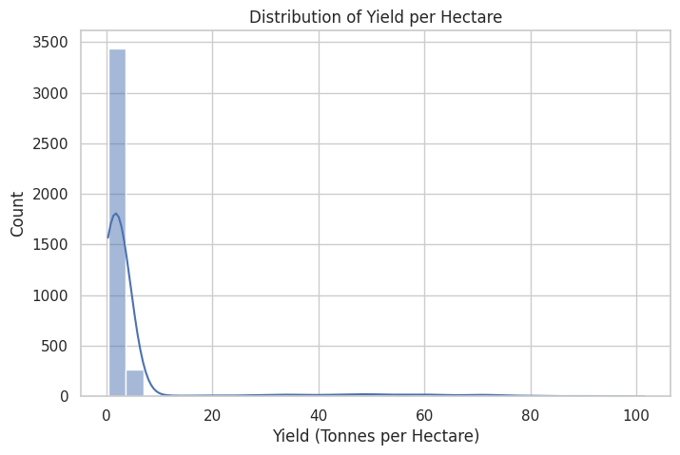
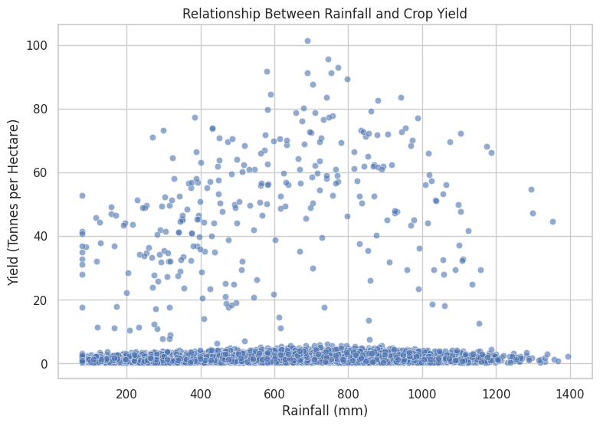
RESULTS
Agricultural Yield Analysis:
Rainfall vs Crop Yield:

Slide 8
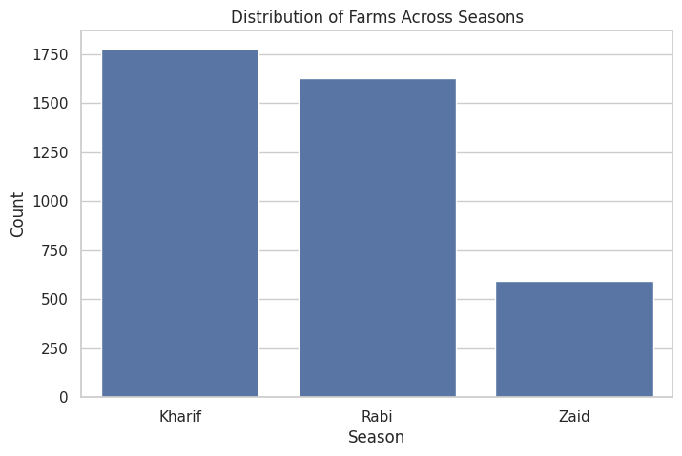
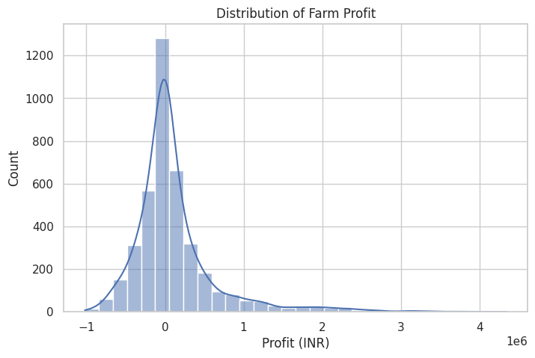
RESULTS
Average Yield by Season:
Average Profit:

Slide 9
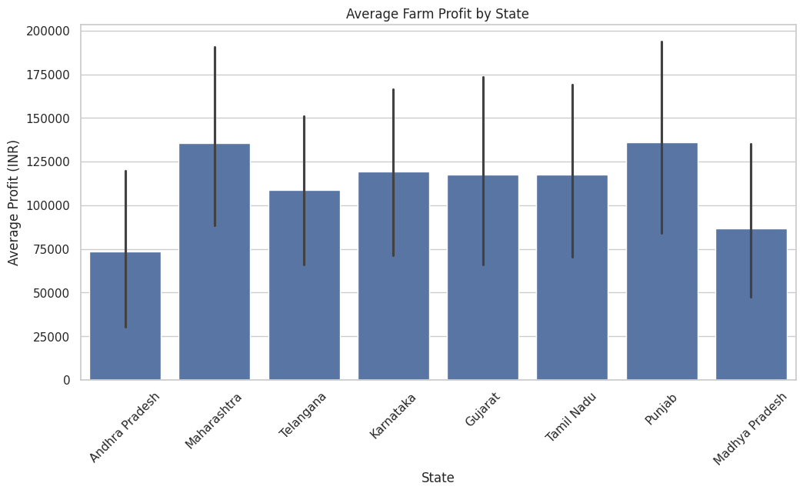
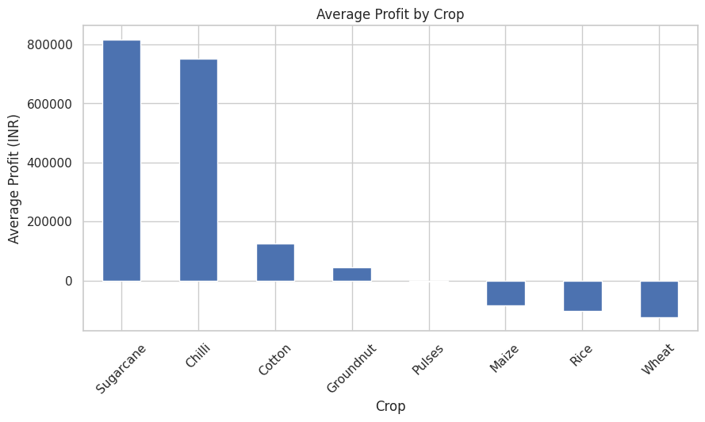
RESULTS
Average Profit by State:
Average Profit by Crop:

Slide 10
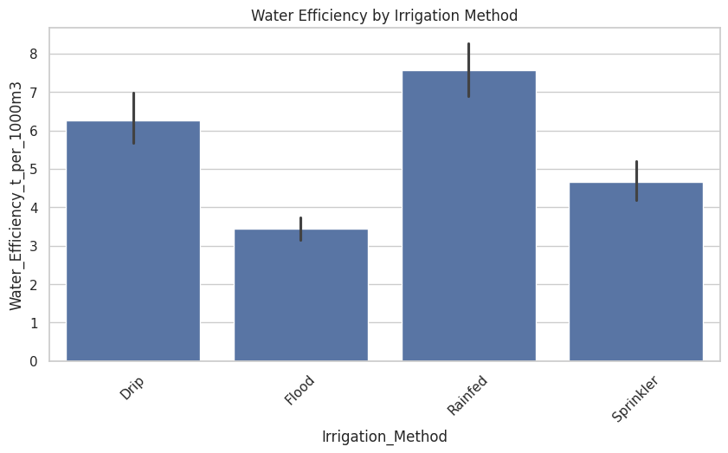
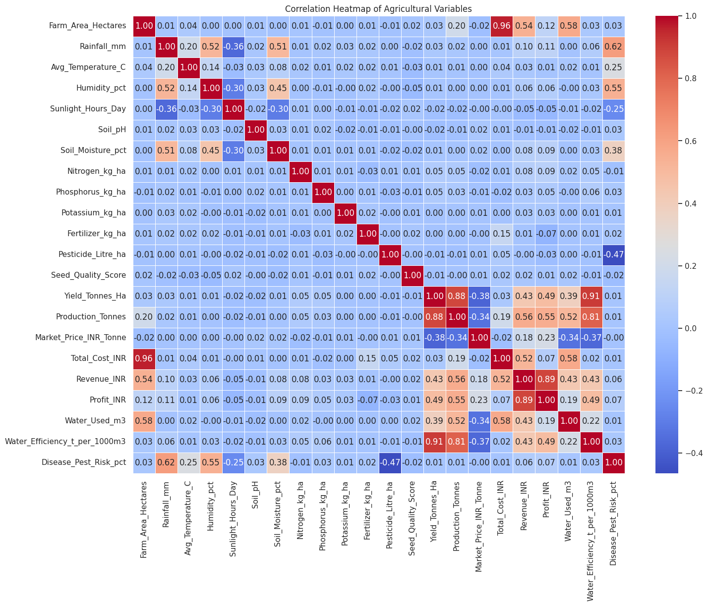
RESULTS
Water Efficiency by Irrigation Method:
Correlation Heatmap of Agricultural Variables:

Slide 11
Future scope
Develop a machine learning model to predict crop yield and profitability.
Use real-time weather data for more accurate agricultural analysis.
Build an interactive dashboard using Power BI or Streamlit.
Include satellite and geographical data for region-specific analysis.
Develop crop recommendation systems based on soil, climate, and seasonal conditions.
Perform time-series forecasting for future agricultural performance.
Extend the analysis using larger and real-world agricultural datasets.

Slide 12
GitHub Link
https://github.com/iamarjunsrivastava-collab/Seasonal-Agriculture-Performance-Analysis

Slide 13
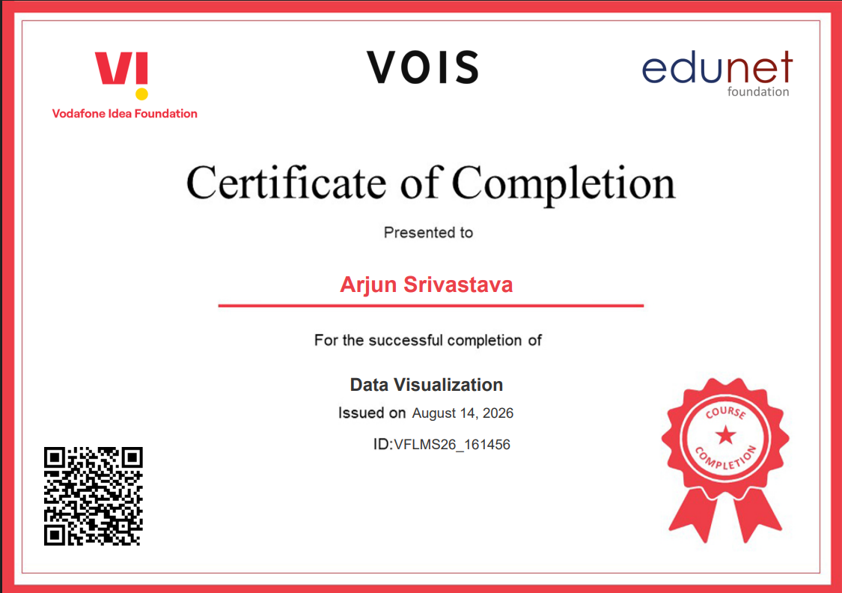
VOIS Course completion certificate - Course name- Data Visualization

Slide 14
Thank you
Seasonal Agriculture Performance Analysis
Presented By Arjun Srivastava AICTE Internship Student Registration ID : STU66145c622c94c1712610402 B.Tech CSE (Data Science & Analytics) — 7th Semester
.
.

