Slide 1
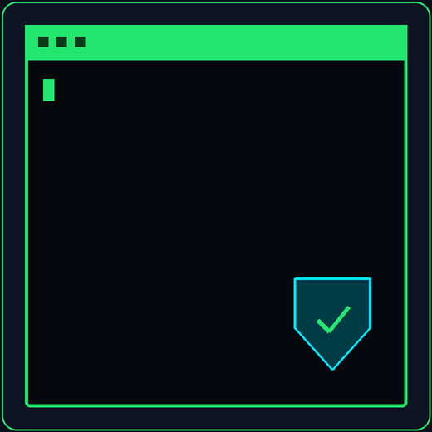
Cybersecurity Is NOT Just Hacking
// WEBINAR INTRO : CYBERSECURITY DOMAINS
14+ domains. One unified goal: Protecting the digital world.
[ ICEBREAKER QUESTION ]
"When you hear the word 'cybersecurity', what is the first career or image that pops into your mind?"
Target Audience: College Freshers & Tech Enthusiasts
Status: Live Interactive Session

Slide 2
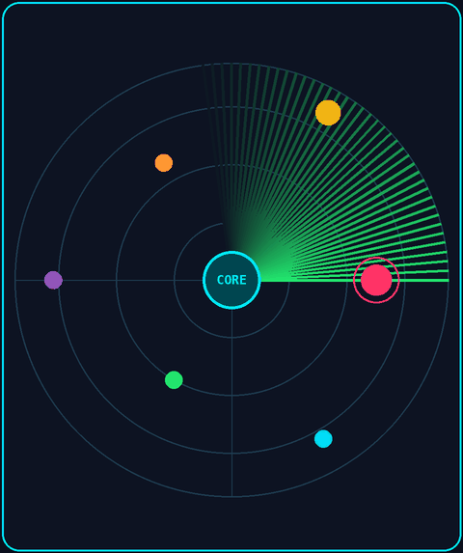






The Cybersecurity Map
01 / OVERVIEW
6 Key Functional Pillars
[ CYBERSECURITY CORE ]
Protecting Data • Defending Systems • Preventing Breaches
Offensive Sec
Defensive Operations
Pen Testing, OSINT, Red Teaming
SOC, Blue Team, Network Security
App & Web Security
Investigation
Web Sec, AppSec, Secure Coding
DFIR, Forensics, Malware Analysis
Cloud & DevOps
Identity & Governance
Cloud Sec, DevSecOps Automation
IAM, Cryptography, GRC, Architecture

Slide 3
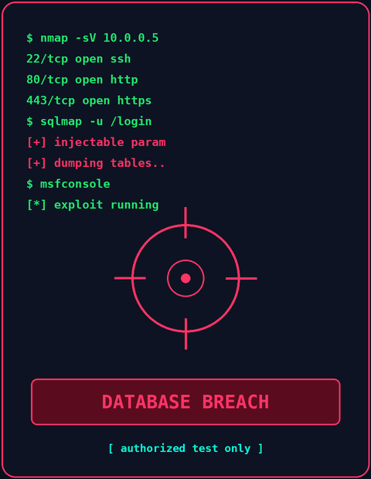


Offensive Security & Reconnaissance
02 / DOMAIN FOCUS
THE RED TEAM
DOMAIN 01
DOMAIN 02
Penetration Testing
OSINT (Open-Source Intel)
Ethically attacking systems to find security weaknesses before malicious hackers exploit them.
Gathering publicly available information to map target attack surfaces and digital footprints.
IN SIMPLE WORDS
IN SIMPLE WORDS
Like hiring a friendly burglar to try your locks, then telling you which ones are weak.
Using Google, social media and public records to learn about a target. No hacking needed.
WHAT PEOPLE ACTUALLY DO:
WHAT PEOPLE ACTUALLY DO:
Recon → Exploit → Report
Search → Correlate → Map

Slide 4
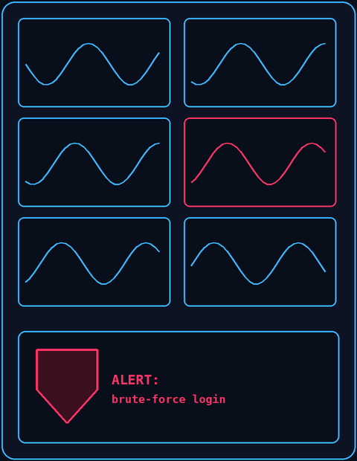


Defensive Operations & Network Security
03 / DOMAIN FOCUS
THE BLUE TEAM
DOMAIN 03
DOMAIN 04
SOC / Blue Team Operations
Network Security
Monitoring live enterprise traffic and responding immediately to suspicious alerts.
Securing internal data traffic, firewalls, and routers to stop unauthorized network access.
IN SIMPLE WORDS
IN SIMPLE WORDS
A control room where analysts watch screens all day and raise the alarm when something looks wrong.
Guards and gates for the roads that your data travels on.
WHAT PEOPLE ACTUALLY DO:
WHAT PEOPLE ACTUALLY DO:
Monitor → Detect → Contain
Filter → Inspect → Enforce

Slide 5
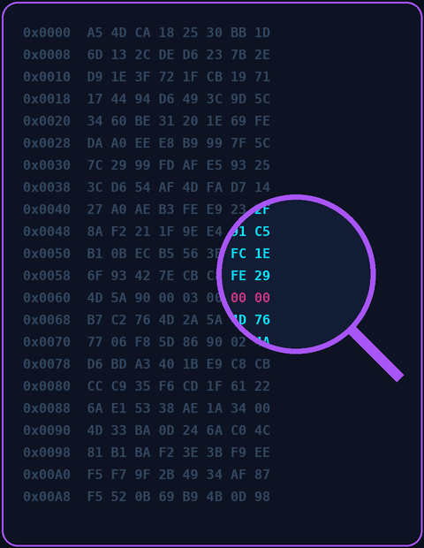


Incident Investigation & Forensics
04 / DOMAIN FOCUS
DIGITAL DETECTIVES
DOMAIN 05
DOMAIN 06
Digital Forensics (DFIR)
Malware Analysis
Investigating digital crime scenes to piece together how an attacker breached a system.
Reverse-engineering malicious software in safe sandboxes to understand its behavior.
IN SIMPLE WORDS
IN SIMPLE WORDS
Detective work after a break-in: find out what happened, how, and who did it.
Opening a computer virus inside a locked box to see what it does, without letting it cause harm.
WHAT PEOPLE ACTUALLY DO:
WHAT PEOPLE ACTUALLY DO:
Isolate → Analyze → Reconstruct
Decompile → Sandbox → Neutralize

Slide 6
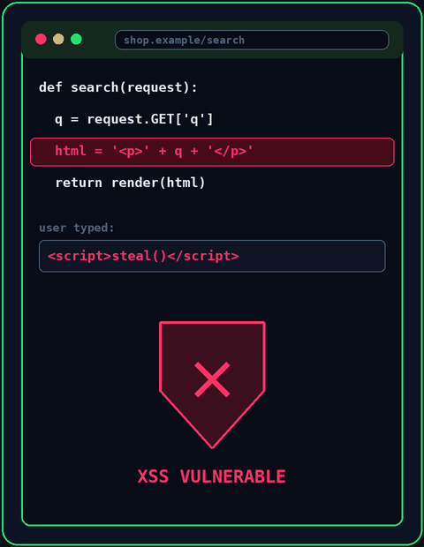


Web & Application Security
05 / DOMAIN FOCUS
BUILDING SECURE SOFTWARE
DOMAIN 07
DOMAIN 08
Web Security
Application Security (AppSec)
Protecting websites and web APIs against common flaws like SQL Injection and Cross-Site Scripting (XSS).
Embedding security reviews and code scanning early into developer codebases.
IN SIMPLE WORDS
IN SIMPLE WORDS
Making sure website forms can't be tricked into leaking data or running bad code.
Checking an app's code for mistakes while it is being built, not after it is released.
WHAT PEOPLE ACTUALLY DO:
WHAT PEOPLE ACTUALLY DO:
Audit → Sanitize → Shield
Review Code → Test → Patch

Slide 7
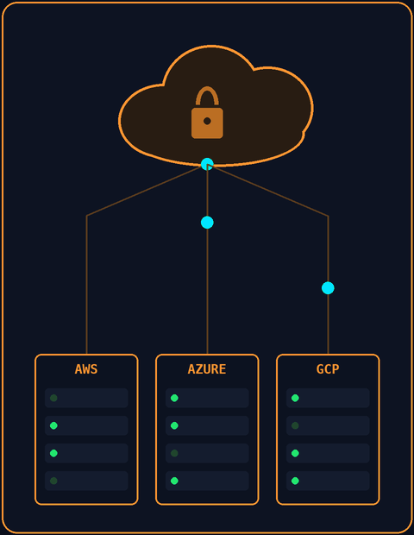

Cloud Security & DevSecOps
06 / DOMAIN FOCUS
MODERN INFRASTRUCTURE
DOMAIN 09
DOMAIN 10
Cloud Security
DevSecOps
Securing virtual servers, databases, and multi-cloud environments (AWS, Azure, GCP).
Automating security checks seamlessly into CI/CD deployment pipelines.
IN SIMPLE WORDS
IN SIMPLE WORDS
Locking down rented computers and storage on the internet, like those from Amazon or Google.
Building automatic security checks into the assembly line that ships software to users.
WHAT PEOPLE ACTUALLY DO:
WHAT PEOPLE ACTUALLY DO:
Configure → Harden → Monitor
Automate → Scan → Deploy

Slide 8
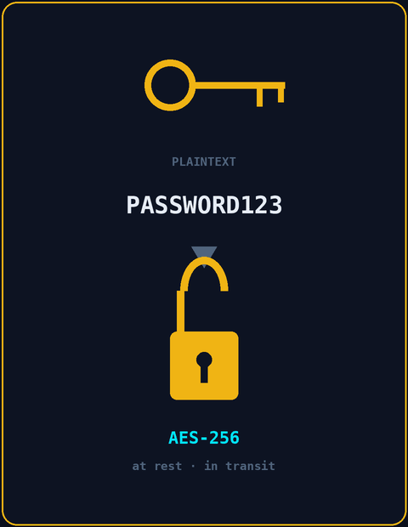


Identity & Cryptography
07 / DOMAIN FOCUS
THE ACCESS GUARDS
DOMAIN 11
DOMAIN 12
Identity & Access (IAM)
Cryptography & Data Sec
Ensuring the right users have access to the right resources (SSO, Multi-Factor Auth).
Scrambling sensitive information into unbreakable code mathematically at rest and in transit.
IN SIMPLE WORDS
IN SIMPLE WORDS
Making sure only the right people get in, and only into the rooms they actually need.
Turning readable data into scrambled code that only the right key can unscramble.
WHAT PEOPLE ACTUALLY DO:
WHAT PEOPLE ACTUALLY DO:
Authenticate → Authorize → Audit
Encrypt → Hash → Manage Keys

Slide 9
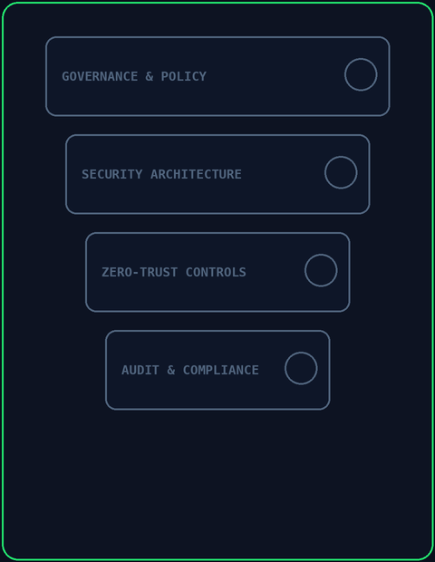


Architecture & Governance
08 / DOMAIN FOCUS
STRATEGY & COMPLIANCE
DOMAIN 13
DOMAIN 14
Security Architecture
Governance, Risk & Compliance (GRC)
Designing the high-level security blueprints and Zero-Trust frameworks for entire organizations.
Ensuring company security policies comply with government regulations (GDPR, ISO 27001).
IN SIMPLE WORDS
IN SIMPLE WORDS
The architect's blueprint: where the walls, doors and cameras go for a whole company.
Rulebooks and checklists that prove a company follows the law and protects people's data.
WHAT PEOPLE ACTUALLY DO:
WHAT PEOPLE ACTUALLY DO:
Model → Design → Validate
Assess Risk → Draft Policy → Audit

Slide 10




Which Cyber Domain Fits You?
09 / SUMMARY MATRIX
CAREER MATCHMAKING
The Puzzle Solver
The Defender
The Builder / Coder
Loves breaking things, finding loopholes & ethical hacking.
Enjoys real-time monitoring, hunting threats & blocking attacks.
Passionate about writing clean, secure code & developer tools.
→ Pen Testing, Red Team, OSINT
→ SOC Analyst, Blue Team, Network Sec
→ AppSec, Web Sec, DevSecOps
The Detective
The System Architect
The Policy Strategist
Fascinated by crime scene evidence, logs & malware dissecting.
Interested in big-picture infrastructure, clouds & key systems.
Combines business logic, tech risk management & compliance laws.
→ DFIR, Malware Analysis
→ Cloud Sec, IAM, Architecture
→ GRC, Cyber Risk Analyst

Slide 11
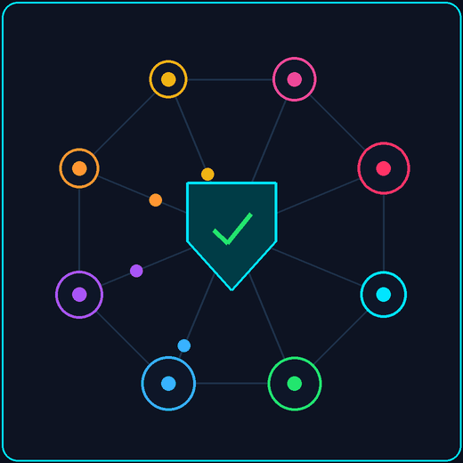
Your Cyber Journey Starts Here
// WEBINAR CLOSING & DISCUSSION
Cybersecurity is vast, dynamic, and needs all kinds of problem solvers.
[ AUDIENCE Q&A TIME ]
"Which cybersecurity domain sparked your curiosity today?"

