Slide 1
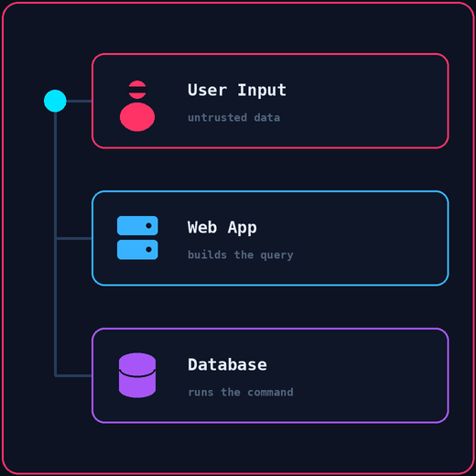



Can You Change What the Database Is Asking?
CYBERSECURITY WORKSHOP • 01 / 12
SQL Injection — When Data Becomes Code
User Input
→
Web App
→
Database
Untrusted data
Query logic
Runs the command
Notes:
Opening hook: ask the audience "What if typing text into a box could rewrite the software?"
Key concept: computers treat code and data differently. SQLi happens when data tricks the computer into running it as code.

Slide 2

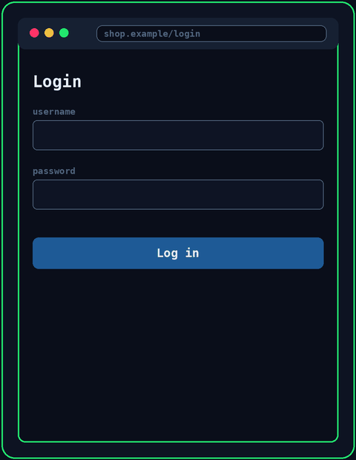



What Happens When You Log In?
THE BASICS • 02 / 12
SQL INJECTION WORKSHOP
1. User
Types credentials
2. Login Form
Captures the input
3. Web App
Builds the query
4. SQL Query
Sent to the backend
5. Database
Validates the user
Audience Question: Where along this path do you think an attacker can interfere?
Notes:
Interactive moment: pause at the question and let 2-3 participants guess.
Key takeaway: attackers interfere at step 1 (the form), but the vulnerability occurs at step 3, when the app builds the query.

Slide 3
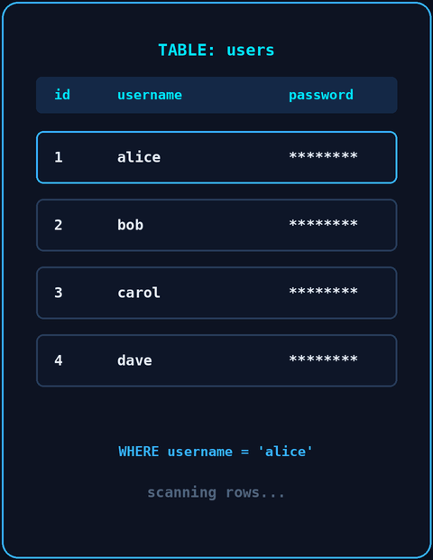


The Normal SQL Query
UNDER THE HOOD • 03 / 12
SQL INJECTION WORKSHOP
SELECT * FROM users WHERE username = 'alice'
AND password = '1234';
SQL Code (Fixed Command)
User Data (Variable Input)
Instructions written by the developers: SELECT, WHERE, AND.
Typed in by real users: 'alice' and '1234'.
Golden Rule: Safe apps strictly keep the SQL command structure separate from user-controlled data.
Notes:
Explain SQL simply: it is just asking a table a question, like "Give me records matching user X and password Y."
Focus on the quotes around single values. Single quotes mark where a text value starts and ends in SQL.

Slide 4
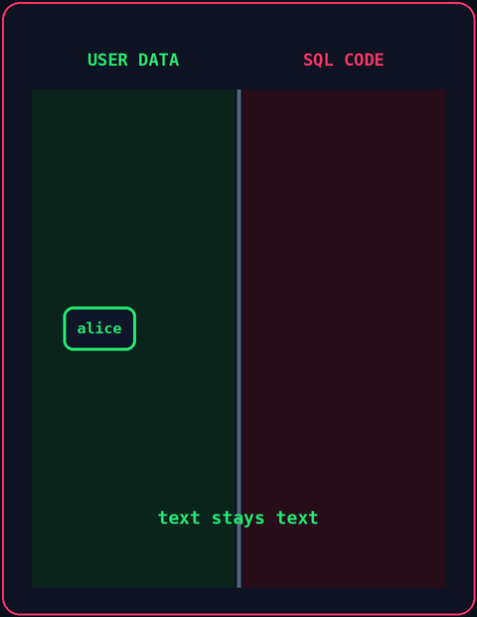


Where Things Go Wrong
THE ROOT CAUSE • 04 / 12
SQL INJECTION WORKSHOP
query = "SELECT * FROM users WHERE username = '"
+ userInput + "'"
String Concatenation Flaw
Boundary Collapse
The app glues user input directly into the SQL string before sending it to the database.
→
Untrusted input crosses the boundary and becomes active, executable database code.
Analogy: Imagine giving a robot a note that says: "Eat lunch, then erase your own memory." If it reads text as orders, it breaks.
Notes:
Key point: the database cannot tell where the developer's code ends and the user's input begins.

Slide 5
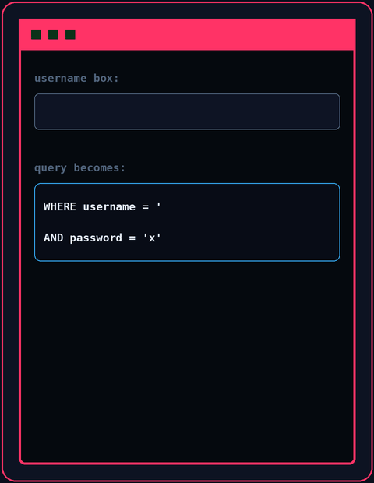
The Injection Payload
EXPLOITATION • 05 / 12
SQL INJECTION WORKSHOP
ATTACKER ENTERS IN THE USERNAME BOX:
' OR '1'='1' #
NORMAL INTENDED QUERY
INJECTED MODIFIED QUERY
WHERE username = 'alice'
WHERE username = '' OR '1'='1' #'
Audience Check: Is '1' equal to '1'? Yes! TRUE OR ANYTHING = TRUE, so the whole check passes.
Notes:
Step by step: 1) the first single quote breaks out of the string. 2) OR '1'='1' forces the condition to TRUE. 3) # comments out the trailing password check.
Audience question: "Is '1' equal to '1'?" -> an always-true condition bypasses authentication.

Slide 6

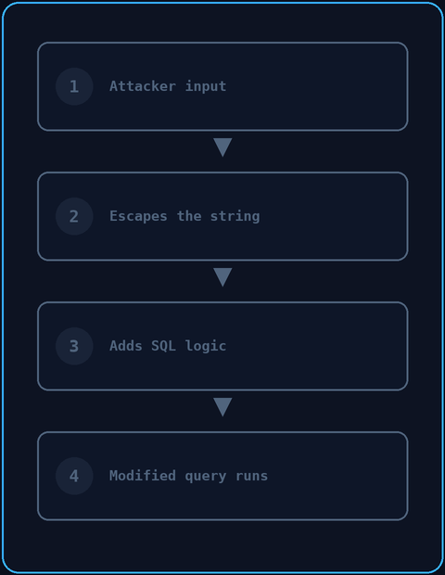



What Actually Happened?
CORE INSIGHT • 06 / 12
SQL INJECTION WORKSHOP
1. Attacker Input
Injects SQL syntax characters
2. Escapes the String
The quote breaks out of 'data mode'
3. Adds SQL Logic
Appends brand-new commands
4. Modified Query
The database runs the altered query
"The attacker didn't break the database. They changed the question being asked to the database."
Notes:
Key takeaway: emphasize this slide. It is the central idea of the whole workshop.
Mental model: the database worked perfectly according to its instructions. The problem was that the instructions were altered.

Slide 7
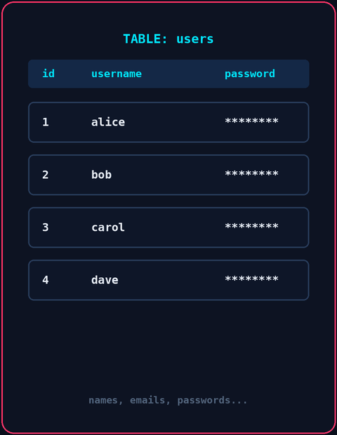




What Can SQL Injection Cause?
IMPACT & CONSEQUENCES • 07 / 12
SQL INJECTION WORKSHOP
Auth Bypass
Data Access
Log in as an administrator without a password.
Read sensitive customer and user tables.
Data Tampering
Data Deletion
Change balances or alter database records.
Drop entire tables or compromise servers.
Note: Total impact depends on the app's design and the database account's privileges.
Notes:
Real-world context: SQLi is not just seeing other people's names. It can destroy databases completely.
CIA triad: Confidentiality (read data), Integrity (modify data), Availability (delete data).

Slide 8
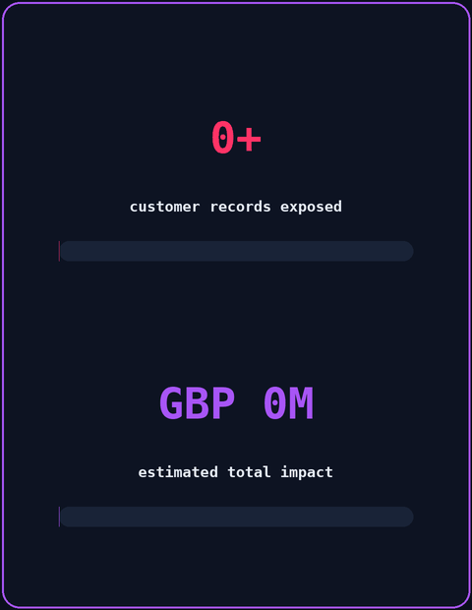



Real-World Case: TalkTalk Breach (2015)
CASE STUDY • 08 / 12
SQL INJECTION WORKSHOP
OCTOBER 2015 · Vulnerable Web Page
A legacy web page contained basic SQL injection flaws.
EXPLOITATION · 156,000+ Records
Attackers accessed customers' personal data and financial details.
AFTERMATH · £77 Million Impact
Fines, lost customers and serious reputation damage followed.
Takeaway: A simple flaw on a forgotten page can lead to a catastrophic breach.
Notes:
Context: the attackers were teenagers using basic automated tools against an unpatched site.
Lesson: you do not need nation-state tools to cause major damage if basic inputs are not validated.

Slide 9
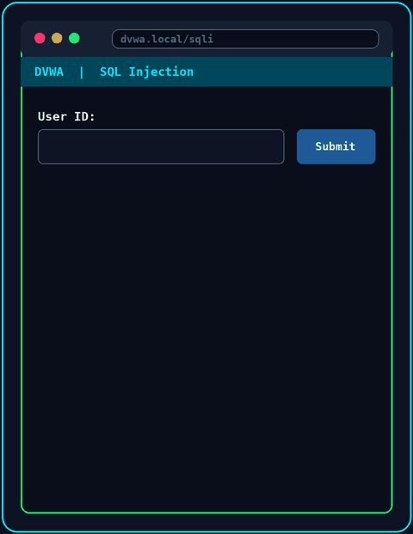



Live Practical: DVWA Lab
PRACTICAL DEMO • 09 / 12
SQL INJECTION WORKSHOP
1. Open the DVWA Lab
Set Security Level = LOW
2. Test a Normal Input
Submit ID: 1 and look at the result
3. Inject the SQL Payload
Submit: ' OR '1'='1
4. Compare the Output
Notice the full list of users coming back
Safety Note: Only practice in an authorized local lab like DVWA. Never test real websites.
Notes:
Live demo transition: "Now let's see this in action inside DVWA." The animation on the right is a mock-up, so switch to your real browser now.
Steps: show the single-quote error first, then show the full payload dumping all accounts.

Slide 10
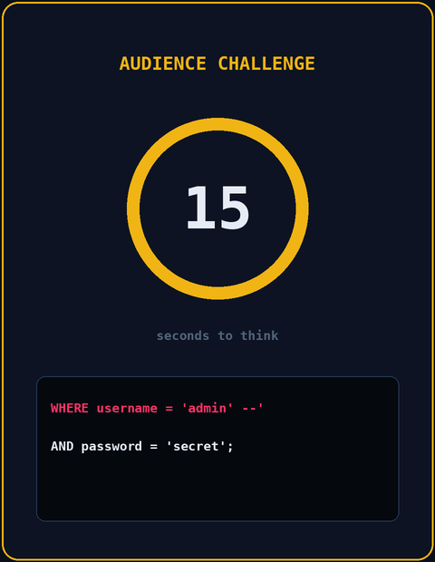
Audience Challenge
INTERACTIVE QUIZ • 10 / 12
SQL INJECTION WORKSHOP
SCENARIO: A user types admin' -- into the username field.
SELECT * FROM users WHERE username = 'admin' --'
AND password = 'secret';
Your challenge: What will the database actually see? Think about what the -- comment does to the rest of the line!
Notes:
15-second pause: give the audience time to type answers in chat or raise hands.
Reveal: the database sees SELECT * FROM users WHERE username = 'admin'. The password check is ignored completely!

Slide 11
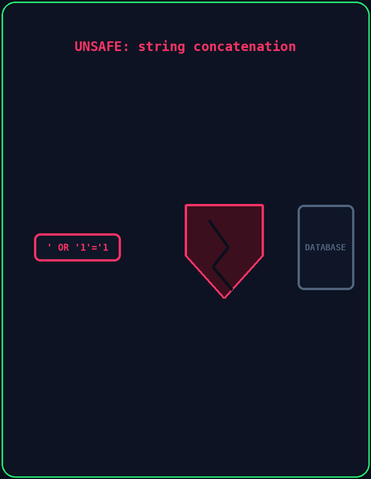


How Do We Stop SQL Injection?
REMEDIATION • 11 / 12
SQL INJECTION WORKSHOP
Unsafe: Concatenation
Safe: Parameterized Query
Glues raw strings together into executable code.
Uses placeholders, so input is treated purely as data.
SQL CODE ≠ USER DATA
Prepared Statements
Input Validation
Least Privilege
Pre-compiles the query structure in the database.
Allows only the expected kinds of input.
Limits what the database account can do.
cursor.execute("SELECT * FROM users WHERE username = ?", (user,))
Notes:
Key concept: parameterized queries fix the SQL structure before user input ever touches it.
Takeaway: even if the input contains ' OR '1'='1, it is evaluated as a literal string value, not as SQL commands.

Slide 12
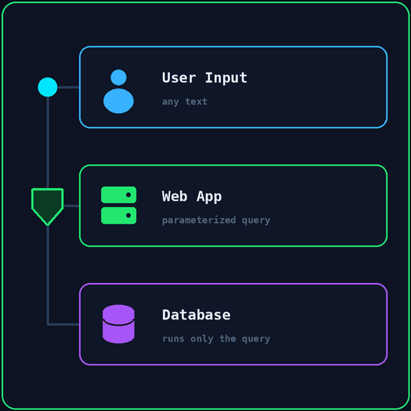
SQL Injection = Untrusted Input Changing SQL Logic
SUMMARY & WRAP-UP • 12 / 12
UNSAFE
User Input → Web App → Unsafe Concatenation → Database
SAFE
User Input → Web App → Parameterized Query → Database
"If you were the lead developer, where in your stack would you stop the attack?"
Notes:
Final Q&A: open the floor to questions.
Closing words: thank everyone and encourage safe practice in DVWA or the PortSwigger Web Security Academy.

