Slide 1
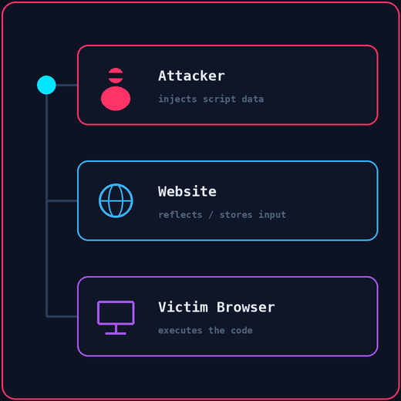



What If a Comment Could Run Code?
CYBERSECURITY WORKSHOP • 01 / 12
Cross-Site Scripting — When Data Becomes Code in the Browser
Attacker
→
Website
→
Victim Browser
Injects script data
Reflects / stores input
Executes the code
Notes:
Opening hook: "If I put JavaScript into a comment box, who do you think executes it?"
Core concept: unlike SQLi (which targets the server), XSS targets the victim's web browser.

Slide 2
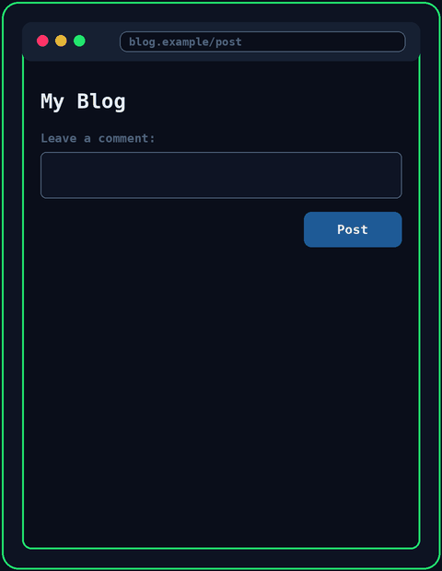




What Does a Website Normally Do?
THE BASICS • 02 / 12
XSS WORKSHOP
1. User
2. Web App
3. HTML
4. Browser
Submits text
Processes input
Generates the page
Renders the layout
COMMENT SUBMITTED
BROWSER OUTPUT
→
"Nice website!"
Nice website!
Takeaway: The browser receives content and decides how to interpret it.
Notes:
Explanation: browsers render text automatically. HTML structures text; JavaScript adds interactivity.
Key insight: browsers trust whatever HTML content the website sends back to them.

Slide 3
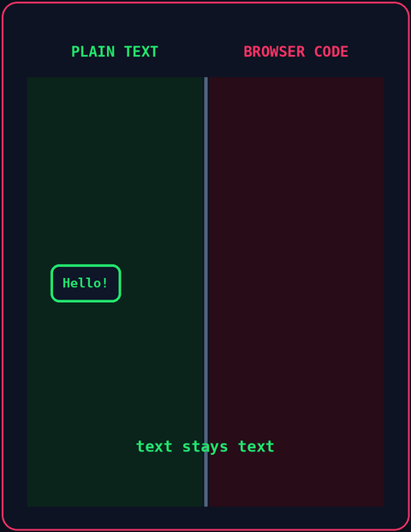


Where Does XSS Happen?
THE VULNERABILITY • 03 / 12
XSS WORKSHOP
User Input
Boundary Collapse
Untrusted text typed in by a person.
→
That text gets treated as executable script.
"XSS happens when attacker-controlled input is interpreted as executable content by a victim's browser."
Remember: Unlike SQLi, which targets the server, XSS targets the victim's browser.
Notes:
Simple definition: explain XSS without jargon. The web app fails to separate text data from web code.
Boundary question: ask "What happens if user input contains HTML tags like </div>?"

Slide 4
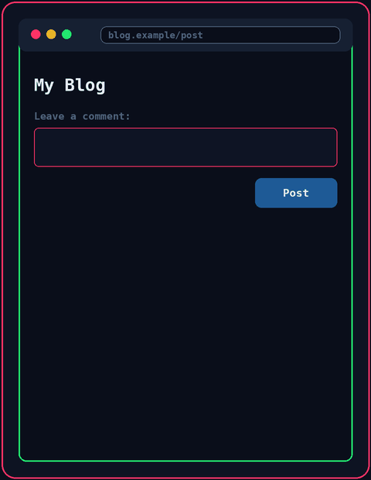
The Injection Payload
EXPLOITATION • 04 / 12
XSS WORKSHOP
ATTACKER ENTERS A PROOF-OF-CONCEPT:
<script>alert("XSS")</script>
1. Submit
2. Store / Reflect
Attacker enters the input
Website outputs the input
3. Load
4. Execute
Victim opens the page
JS runs in the browser
Audience Question: Did the attacker directly hack the victim's computer? (No! The victim's browser ran content delivered through the website.)
Notes:
Audience check: pause at the question. Highlight that the website acted as the unwitting carrier.
Safety note: alert() is just a harmless test to prove that JavaScript code runs.

Slide 5
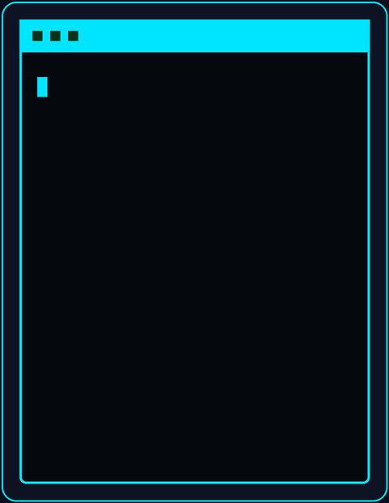
Why Does This Work?
CORE INSIGHT • 05 / 12
XSS WORKSHOP
SAFE DATA
UNSAFE INPUT
Hello everyone!
<script>alert("XSS")</script>
Browser displays plain text.
Browser runs it as JavaScript.
"The problem isn't JavaScript itself. The problem is untrusted input being treated as code."
Mental model: Browsers can't guess a programmer's intentions. They only parse HTML syntax.
Notes:
Mental model: browsers cannot guess programmer intentions; they only parse HTML syntax.
Concept check: reiterate that the alert box is purely a harmless proof-of-concept.

Slide 6
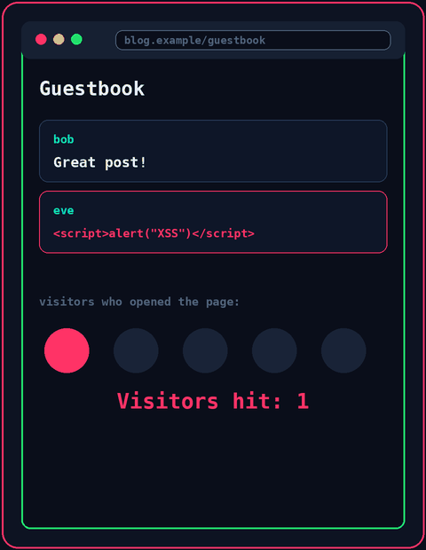



Three Flavors of XSS
TYPES OF XSS • 06 / 12
XSS WORKSHOP
Reflected XSS
The payload bounces off the server in a single response, for example through a crafted link.
Stored XSS
The payload is saved (like a comment) and hits everyone who views the page.
DOM-based XSS
The page's own JavaScript writes untrusted data into the page, inside the browser.
Remember: Stored XSS is often the most damaging, because every visitor becomes a victim without clicking a link.
Notes:
Walk through the three types. Tie stored XSS back to the guestbook demo coming up, and mention that the right fix is the same for all three: never let untrusted data be treated as code.

Slide 7
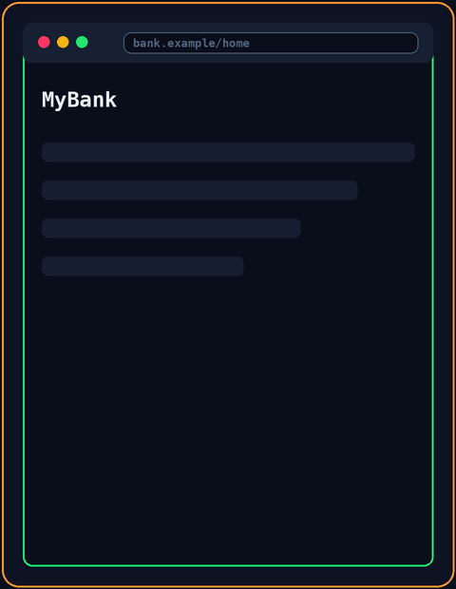




What Can XSS Cause?
IMPACT & CONSEQUENCES • 07 / 12
XSS WORKSHOP
Session Hijacking
Fake Login Pop-ups
Script can act as the victim on a site they are logged into.
Injected forms trick people into typing their passwords.
Page Defacement
Malicious Redirects
The page content is changed for every visitor.
Visitors are silently sent to a harmful website.
Note: Impact depends on the site and on what the victim can do there.
Notes:
Keep it conceptual for beginners: XSS lets an attacker's script run with the victim's privileges on that website. Tie the impact to what the victim can do on the site.

Slide 8
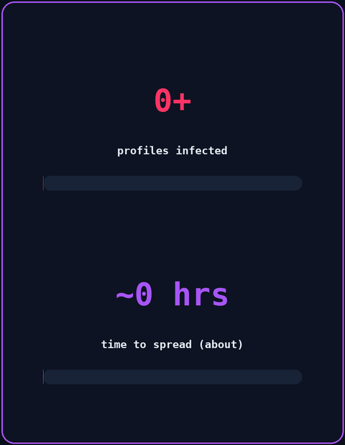


Real-World Case: The Samy Worm (2005)
CASE STUDY • 08 / 12
XSS WORKSHOP
OCTOBER 2005 · A Profile Page Flaw
A stored XSS bug let a script live inside social-network profiles.
EXPLOITATION · 1,000,000+ Profiles
The script copied itself to every profile that viewed an infected one, within about 20 hours.
AFTERMATH · Emergency Patching
The site had to scramble to fix the hole, and the author faced legal consequences.
Takeaway: A single stored script can spread by itself, with no one hacking anyone directly.
Notes:
Context: the Samy worm is the classic example of a self-spreading stored XSS attack. Worth double-checking the numbers against a source before presenting.

Slide 9
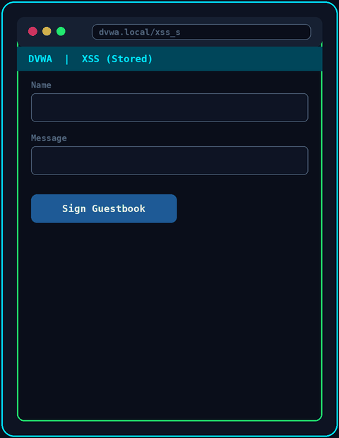




Live Practical: DVWA Lab
PRACTICAL DEMO • 09 / 12
XSS WORKSHOP
1. Open the DVWA Lab
Set Security Level = LOW
2. Open XSS (Stored)
Find the guestbook comment form
3. Inject the Payload
Message: <script>alert("XSS")</script>
4. Observe the Popup
It runs every time the page loads
Safety Note: Only practice in an authorized local lab like DVWA. Never test real websites.
Notes:
Live demo: submit the comment, refresh the page, and show how the popup triggers automatically every time. The animation on the right is a mock-up, so switch to your real browser now.
Concept check: reiterate that the alert box is purely a harmless proof-of-concept.

Slide 10
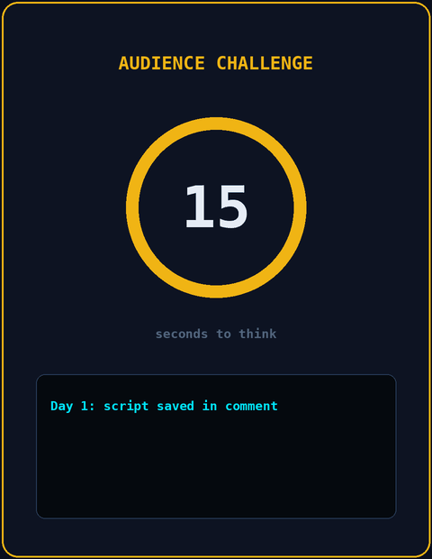
Audience Challenge
INTERACTIVE QUIZ • 10 / 12
XSS WORKSHOP
SCENARIO: STORED COMMENT An attacker posts a comment containing a script to a public guestbook, and the website saves it.
Then... Alice opens the page tomorrow. What happens?
Think about: What does the browser do when it reads that saved comment as part of the page?
Notes:
15-second pause for answers.
Reveal: the script runs in Alice's browser when she loads the page, even though the attacker is not online any more.

Slide 11
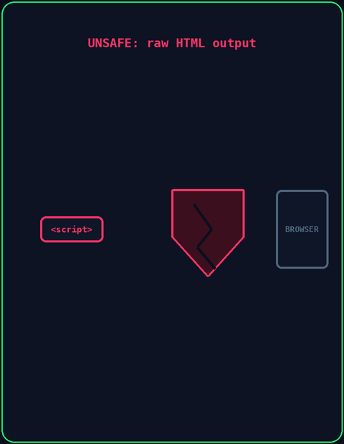


How Do We Stop XSS?
REMEDIATION • 11 / 12
XSS WORKSHOP
Unsafe: Raw HTML Output
Safe: Encode the Output
The browser treats the user's text as page code.
Special characters become harmless text.
USER DATA ≠ BROWSER CODE
Output Encoding
Input Validation
CSP
Turns < and > into harmless text.
Allows only the expected kinds of input.
Content Security Policy tells the browser which scripts it may run.
&lt;script&gt;alert("XSS")&lt;/script&gt; <- shown as text
Notes:
Key concept: output encoding turns the dangerous characters into harmless text before the browser sees them.
Takeaway: even if the input contains a script tag, the browser shows it as text instead of running it.

Slide 12
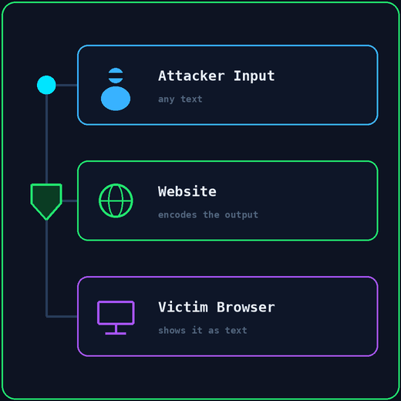
XSS = Untrusted Input Running as Code in the Browser
SUMMARY & WRAP-UP • 12 / 12
UNSAFE
Attacker Input → Website → Raw HTML Output → Victim
SAFE
Attacker Input → Website → Encoded Output → Victim
"If you were the lead developer, where in your stack would you stop the attack?"
Notes:
Final Q&A: open the floor to questions.
Closing words: thank everyone and encourage safe practice in DVWA or the PortSwigger Web Security Academy.

