Slide 1
Defect Inspection Digital Twin
Computer vision + ML for reuse / repair / recycle decisions in circular manufacturing
REUSE
REPAIR
RECYCLE
Ashkan Aghamoali · Project walkthrough · 2026
Notes:
Open with the problem. This is a simulation-only system that decides what to do with a recovered part: reuse, repair, or recycle.

Slide 2
THE PROBLEM
What do we do with a recovered part?
Circular manufacturing keeps parts and materials in service instead of scrapping them.
The bottleneck is triage: every returned part must be inspected and routed.
Done by hand it is slow, subjective and inconsistent.
Goal: automate the decision — reuse, repair, or recycle — end to end, in simulation.
3
recovery paths, one automated decision
REUSE
REPAIR
RECYCLE
2
Notes:
Land the three words early. A worn part comes in; the system decides what to do with it.

Slide 3
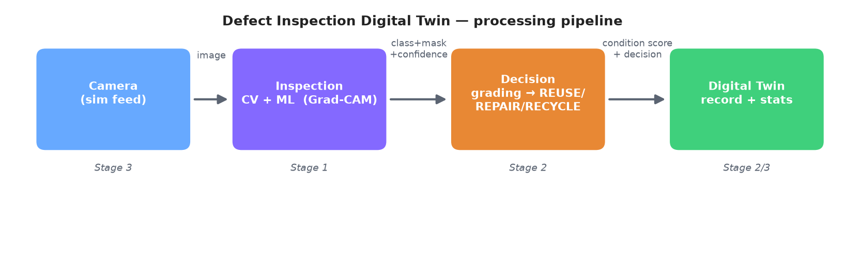
BIG PICTURE
One pipeline, four parts, three build stages
A part image flows left to right: the camera feeds an image, the CV model finds and localizes the defect, the grader turns that into a decision, and the digital twin records every part.
3
Notes:
Point at each box as you name it. Three layers = Stage 1 vision, Stage 2 decision, Stage 3 robotics.

Slide 4
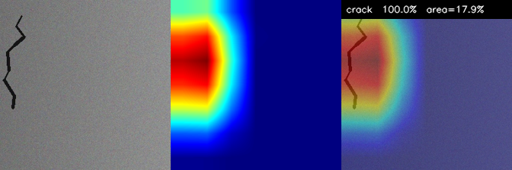
STAGE 1 · COMPUTER VISION
Seeing — and locating — the defect
Pretrained PyTorch ResNet, fine-tuned on surface-defect images.
Per part: defect type, a confidence, and a heatmap of where the defect is.
Grad-CAM gives the location from simple image labels — no pixel masks needed.
Outputs a defect-area %, used by the next stage.
original | Grad-CAM heatmap | overlay
4
Notes:
Why not exact outlines? Grad-CAM needs only simple labels, much cheaper, and enough to locate the defect. ~88% accuracy on the demo set, trained in a minute.

Slide 5
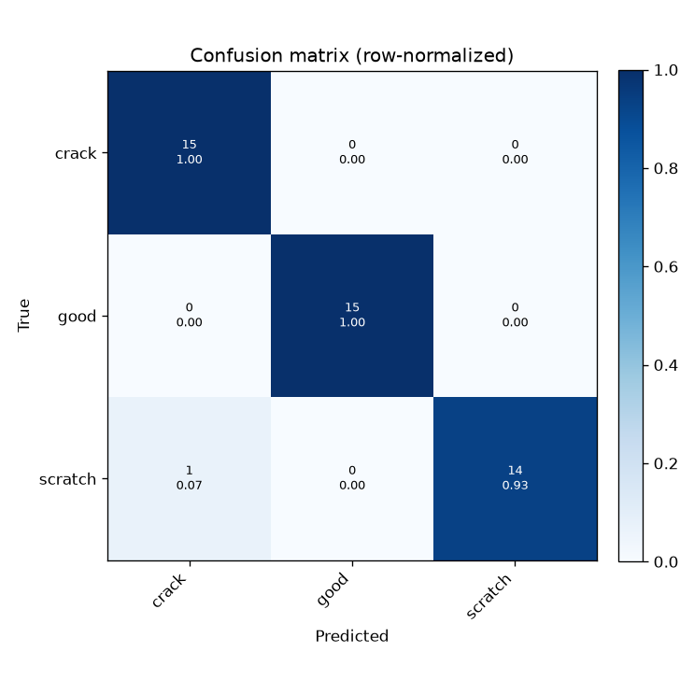
STAGE 1 · RESULTS
It separates the defect classes
~88% test accuracy (demo set)
~1 min to fine-tune on CPU
Strong diagonal = clean separation between good / scratch / crack.
Lightweight backbone + transfer learning → fast, reproducible runs.
Same code trains on real datasets (NEU-DET, casting) for real numbers.
5
Notes:
The 88% is on a synthetic demo set that proves the pipeline. For headline numbers, train on NEU-DET or casting.

Slide 6
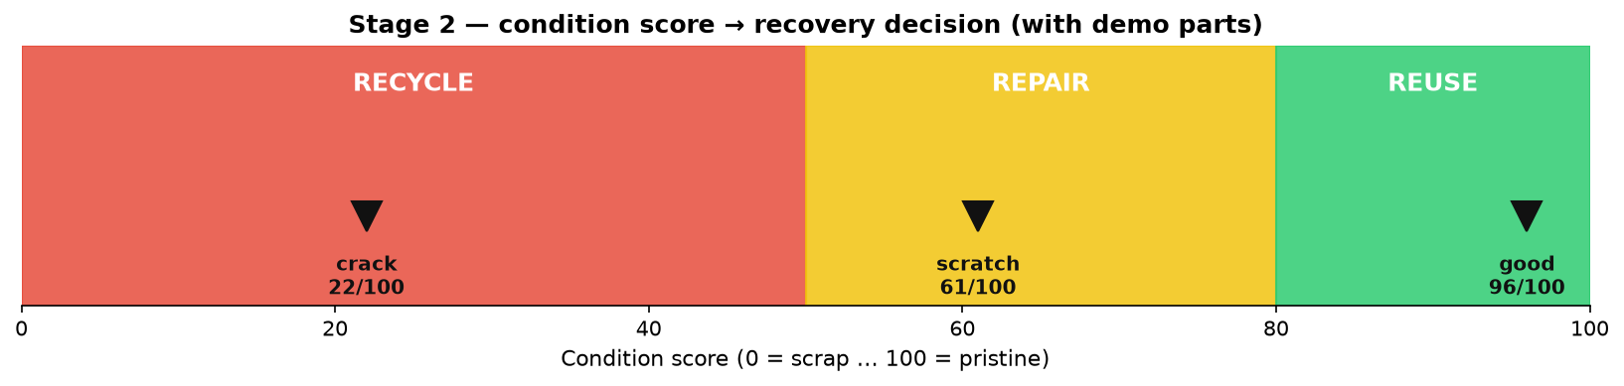
STAGE 2 · DECISION
From defect to recovery decision
A condition score (0–100) from defect type + how much surface it covers.
Crack → low → RECYCLE. Scratch → mid → REPAIR. Clean → high → REUSE.
A transparent rule, not a black box — so every decision can be explained and audited.
Confidence drops near a threshold, where the call is genuinely less certain.
6
Notes:
Stress the explainability: an unexplained RECYCLE is hard to trust. Thresholds are tunable.

Slide 7
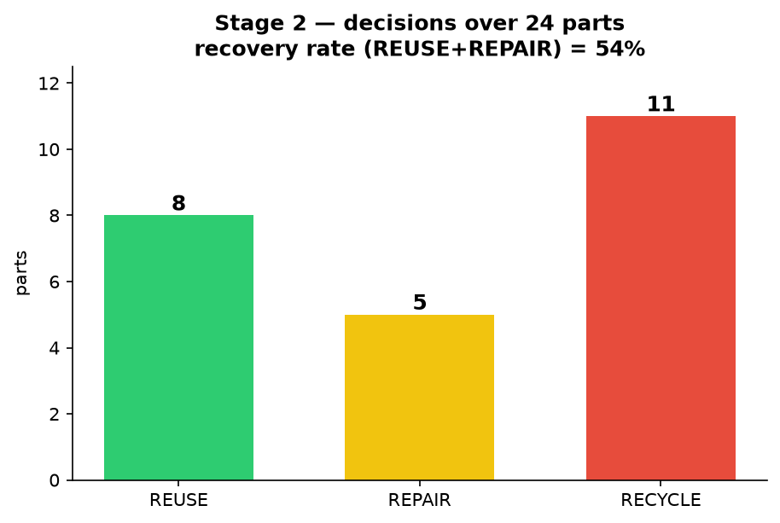
STAGE 2 · DIGITAL TWIN
A live record of every part
Every inspected part is appended to the digital twin: score, decision, timestamp.
A Streamlit dashboard shows the part, the overlay, the decision badge, and live stats.
Running ‘recovery rate’ = share of parts kept in service (reuse + repair).
54% recovery rate over 24 demo parts
7
Notes:
If live, open the dashboard and pick a sample to show the badge update.

Slide 8
STAGE 3 · ROBOTICS
Wrapped in a ROS 2 node graph
Camera
→
Inspection
CV + ML
→
Decision
grading
→
Digital Twin
record
Each job is its own node, passing typed messages down the line.
A minimal Gazebo scene (table + fixed camera) and RViz markers — green / amber / red.
Nodes reuse the exact Stage 1 model and Stage 2 grader — no duplicated logic.
Runs on Linux; shipped as a Docker image for a headless end-to-end demo.
8
Notes:
Be honest: ROS/Gazebo run on Linux, packaged in Docker. Verified structurally; runs end-to-end in the container.

Slide 9
CHOICES
Tools — and why
PyTorch + ResNet Pretrained → fast, lightweight fine-tuning
Grad-CAM Localizes defects without costly pixel labels
Rule-based grading Explainable, auditable, tunable
Streamlit Interactive dashboard from a Python script
ROS 2 + Gazebo Industry standard; swappable, isolated nodes
All free / open Reproducible, no paid services anywhere
9
Notes:
Every tool chosen to be lightweight, free, explainable, reproducible.

Slide 10
A complete, runnable demo
Vision + ML automating the reuse / repair / recycle decision for circular manufacturing — three independent layers, fully reproducible, all open source.
github.com/iamashkan/defect-inspection-digital-twin
REUSE
REPAIR
RECYCLE
Notes:
Close: complete, reproducible, open source. Offer to dive into any stage.

