Slide 1
05BC3301 - Database Management System – 2 (DBMS-2)

Slide 2
Course content
Brief introduction to SQL Fundamentals
Basics of PL/SQL
Advantages of PL/SQL
PL/SQL Block Structure
PL/SQL Fundamentals:
  PL/SQL Variables and PL/SQL Data Types
  Variable Attribute (%type, %rowtype)
PL/SQL Control Structure:
  Conditional Control
  Iterative Control and Sequential Control.
2

Slide 3
What is SQL?
SQL stands for structured query language.
It was developed by IBM in 1970.
It is a standard language used to interact with modern RDBMS.
SQL is a cross-platform and cross-product language.
It is known as database language which is used to interact with
database.
SQL is English language, it has simple command set.
It’s a statement & syntax oriented language
SQL is non-procedural language.
SQL is used to Creating / maintaining , Manipulating data & Controlling database.

Slide 4
What is SQL?
SQL is so much powerful in handling data and various database objects.
But, there is lack some of basic functionalities provided by other programming language.
For example, SQL does not provide basic procedural capabilities such as conditional checking, branching and looping.
Oracle provides PL/SQL (Procedural Language / Structured Query Language) to overcome disadvantages of SQL.
PL/SQL supports all the functionalities provided by SQL along with its own procedural capabilities.
Data definition statements are not allowed because PL/SQL code is
compile time. So, it cannot refer to objects that do not yet exist.
4

Slide 5
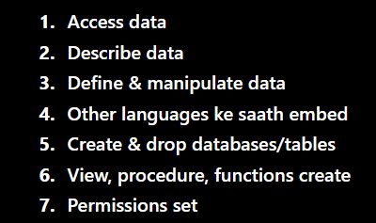
Advantages Of SQL
SQL is widely popular because it offers the following −
  Allows users to access data in the RDMS.
  Allows users to describe the data.
  Allows users to define the data in a database and manipulate that data.
  Allows to embed/integrate within other languages using SQL modules, libraries & pre- compilers.
  Allows users to create and drop databases and tables.
  Allows users to create view, stored procedure, functions in a database.
  Allows users to set permissions on tables, procedures and views.

Slide 6
SQL COMMANDS
CREATE TABLE
ALTER TABLE
DROP TABLE
TRUNCATE TABLE
RENAME
DATA
DIFINATION
LANGUAGE
INSERT
UPDATE
DELETE
SELECT
DATA MANIPULATION
LANGUAGE
DDL DML
TCL DCL
COMMIT
ROLLBACK
SAVE POINT
TRANSACTION
CONTROL LANGU.
GRANT
REVOKE
DATA CONTROL LANGUAGE

Slide 7
CREATE TABLE
Used to create a new table in current user.
syntax:
CREATE TABLE <table name> (
<field name> <Data type>(<Size>) [CONSTRAINT ],
<field name>
……
);
<Data Type> (<Size>) [CONSTRAINT ],
Example :
CREATE TABLE student
(
rollno number (2),
name char (8), birthdate date, stream char(5)
);
7

Slide 8
ALTER TABLE
By using alter table command we can modify the structure of the database.
Using ALTER TABLE statement to:
  Add a new column
  Modify an existing column
  Define a default value for the new column
  Drop a column
  Rename column name
8

Slide 9



Alter table
Add / modify column
Example
ALTER TABLE
<table name> ADD / MODIFY (
<column name> data type (size)
);
ALTER TABLE student ADD (Div char(1) );
ALTER TABLE student MODIFY ( Name char(12));
ALTER TABLE student DROP (Div);
Delete column
ALTER TABLE
<table name> DROP (<column name>);

Slide 10
Truncate Table :
This command used to remove all records stored in database.
It is similar to DROP TABLE command.
When you place truncate table command your table will be empty.
Only the difference between drop & truncate is truncate removes
all records from table but not remove table definition or structure.
Syntax: TRUNCATE TABLE <table name>;
Example : TRUNCATE TABLE student;

Slide 11
Drop Table :
This command used to remove table definition.
When you place drop table command it will remove all records first then remove table definition.
Syntax: DROP TABLE <table name>;
Example : DROP TABLE student;

Slide 12
RENAME
This command is used to rename table.
Syntax:
Rename <old table name> TO <new table name> ;
Example :
RENAME student TO stud;

Slide 13
DML COMMANDS
Sr.No. | Command & Description
1 | SELECT Retrieves certain records from one or more tables.
2 | INSERT Creates a record.
3 | UPDATE Modifies records.
4 | DELETE Deletes records.
13

Slide 14
SELECT
To retrieve data stored in our tables, we use the SELECT
statement.
Syntax:
SELECT */<fieldname> | FROM <table_name> /TAB [ WHERE <condition> ]
[GROUP BY <fieldname> [HAVING <Condition>]]
[ORDER BY <fieldname> [ORDER]];
Example
SELECT * FROM emp;
SELECT rlno, name, stream FROM stud WHERE stream =‘BSCIT’
ORDER BY rlno DESC;

Slide 15
SELECT
To retrieve data stored in our tables, we use the SELECT
statement.
Syntax:
SELECT */<fieldname> | FROM <table_name> | TAB [ WHERE <condition> ]
[GROUP BY <fieldname> [HAVING <Condition>]]
[ORDER BY <fieldname> [ORDER]];
Example
SELECT * FROM emp;
SELECT rlno, name, stream FROM stud WHERE stream =‘BSCIT’
ORDER BY rlno DESC;

Slide 16
Insert syntax & example:
It’s a DML command which is used to enter data inside a field of table.
Syntax:
INSERT INTO <table name> [(<field name>,…)] VALUES (
<value1>,<value2>…..
);
Example:
Insert into stud values( 1 ,’john’, ‘bscit’, ‘01-jan-03’ );

Slide 17
UPDATE
Update command used to update the records of a table.
We can modify existing data with the help of Update.
Syntax:
UPDATE TABLE SET <column_name> = value [, <column_name> = value….]
[ WHERE <condition>];
Example:
UPDATE stud set DIV=‘B’ where rlno=5;

Slide 18
DELETE
This command is used to remove one or all records from table
Syntax:
DELETE FROM <table_name> [WHERE <condition>];
Example
DELETE FROM stud where rlno=8;

Slide 19
DCL COMMANDS
Sr.No. | Command & Description
1 | GRANT //kisi user ko permition dene ke liye hota hai Used to assign privileges (insert or update ke liye)
2 | REVOKE //di hui permition wapas lene ke liye hota hai Remove previously assigned privileges.
19

Slide 20


DCL commands
Grant/privilege
syntax & example
With the help of grant command we can
  Assign role: connect, resource & DBA.
  Assign rights to perform Insert data , Update data , Display data or Delete data from a specific table.
Syntax:
GRANT <PRIVILEGE> | ROLE ON [<OBJECT NAME>] TO <USER NAME>;
Example:
  GRANT CONNECT TO MKB;
  GRANT INSERT, UPDATE ON STUD
TO MKB;

Slide 21
DCL commands
Revoke
syntax & example
With the help of revoke command we can
  Remove role: connect, resource & DBA.
  Remove all rights to perform Insert data , Update data , Display data or Delete data from a specific table.
Syntax:
REVOKE <PRIVILEGE> | ROLE ON [<OBJECT NAME>] FROM <USER NAME>;
Example:
  REVOKE CONNECT FROM MKB;
  REVOKE INSERT, UPDATE ON
STUD FROM MKB;

Slide 22
TCL COMMANDS
Sr.No. | Command & Description
1 | Commit Used to save transaction
2 | Rollback Remove the effect of last transaction
3 | SAVEPOINT It is essentially allows partial rollbacks within a transaction.
22

Slide 23
COMMIT COMMAND
A set of changes made to a table using DML (INSERT, UPDATE,
DELETE) commands are temporary.
To make be
the changes
permanent, commands.
Syntax: -
COMMIT command must
needed after DML
COMMIT;
Example: -
DELETE FROM EMP WHERE NO=500; COMMIT;

Slide 24
ROLLBACK COMMAND
The ROLLBACK statement allows you to change your mind about a
transaction.
It brings back the original state of the tables to the state as of the last COMMIT statement or the beginning of the current transaction.
Matlab ROLLBACK table ko us state mein wapas le jaata hai jo:
Syntax: -
ROLLBACK [TO SAVEPOINT <Savepoint_Name>];
Example: -
DELETE FROM EMP WHERE NO=500; ROLLBACK;
NOTE: - You cannot ROLLBACK the transaction after the COMMIT. So, After the COMMIT you cannot use ROLLBCAK command.

Slide 25
SAVE POINT
Additionally, you can use SAVEPOINT to further subdivide the DML statements within a transaction before the final COMMIT of all DML statements within the transaction.
SAVEPOINT essentially allows partial rollbacks within a transaction.
Syntax: -
SAVEPOINT <Savepoint_Name>;
ROLLBACK TO SAVEPOINT <Savepoint_Name>;
Example: -
DELETE FROM EMP WHERE NO=500; SAVEPOINT A1;
ROLLBACK TO SAVEPOINT A1;

Slide 26
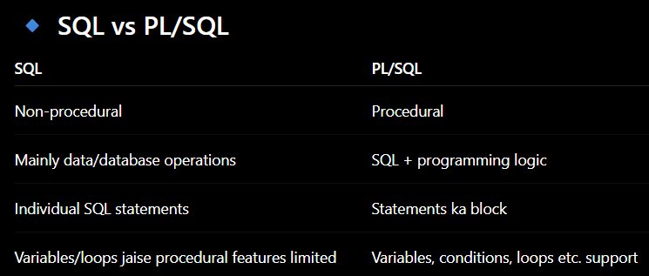
WHAT IS PL/SQL?
PL/SQL stands for Procedural Language extensions to the Structure
PL/SQL is a combination of SQL along with the procedural features of programming languages.
It was developed by Oracle Corporation in the early 90's to enhance the capabilities of SQL.
Oracle uses a PL/SQL engine to processes the PL/SQL statements.

Slide 27
Advantages of PL/SQL
Procedural Capabilities
Support to variables
Error Handling
User Defined Functions
Portability
Sharing of Code
Efficient Execution
27

Slide 28
Advantages of PL/SQL
Procedural Capabilities
  PL/SQL provides procedural capabilities such as condition checking, branching and looping.
  This enables programmer to control execution of a program based on some conditions and user inputs.
Support to variables
(Values temporarily store)
  PL/SQL supports declaration and use of variables.
  These variables can be used to store intermediate results of a query or
some expression.
Error Handling
  When an error occurs, user friendly message can be displayed.
  Execution of program can be controlled instead of abruptly terminating the program.

Slide 29
Advantages of PL/SQL
User Defined Functions
  SQL also supports user defined functions and procedures.
  khud ke functions aur procedures bana sakte hain.
Portability
  Programs written in PL/SQL are portable.PL/SQL mein likhe programs portable hote hain.
  (portable maines(comp/system se dosre system par transfer karke execute karna)
  It means, programs can be transferred and executed from any other computer hardware and operating system, where Oracle is operational.
Sharing of Code:
  Allows user to store compiled code in database.
  PL/SQL code can be accessed and shared by different applications.
  PL/SQL code can be executed by other programming language like JAVA.

Slide 30
Advantages of PL/SQL
7) Efficient Execution
PL/SQL sends an entire block of SQL statements to the Oracle engine, where these statements are executed in one go.
👉 PL/SQL mein SQL statements ka poora block ek saath Oracle engine ko send kiya jaata hai.
Reduces network traffic and improves efficiency of execution.
In SQL, all statements are transferred one by one.

Slide 31
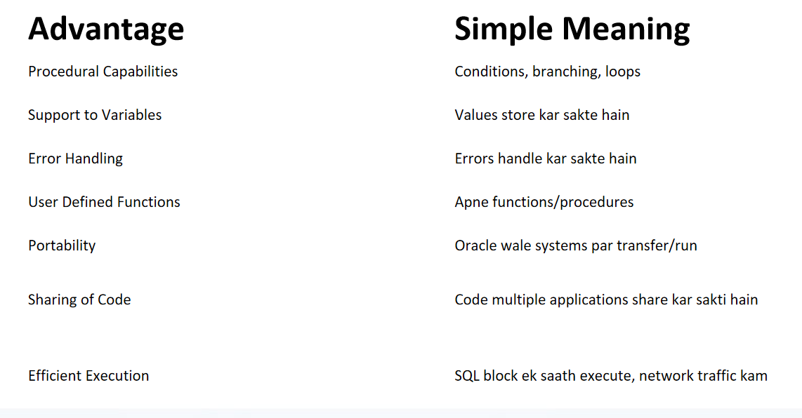
All 7 Advantage
b | Advantage | Simple Meaning
1 | Procedural Capabilities | Conditions, branching, loops
2 | Support to Variables | Values store kar sakte hain
3 | Error Handling | Errors handle kar sakte hain
4 | User Defined Functions | Apne functions/procedures
5 | Portability | Oracle wale systems par transfer/run
6 | Sharing of Code | Code multiple applications share kar sakti hain
7 | Efficient Execution | SQL block ek saath execute, network traffic kam

Slide 32
SQL VS PL/SQL
SQL | PL/SQL
SQL stands for structured query language | PL/SQL stands procedural language/ structure query language.
Can not use variables, constants | Use variables & constants
Allow you to use built in functions only | Allow you to use built in functions as well as create your own user define function
SQL commands can not be sharable | You can share PL/SQL code
In SQL we can not use conditional statement & looping statement | In PL/SQL we can use conditional statement & looping statement
We can use commands to solve queries | We can write a program/group of statements
SQL is syntax/statement oriented language | PL/SQL is structure oriented language

Slide 33
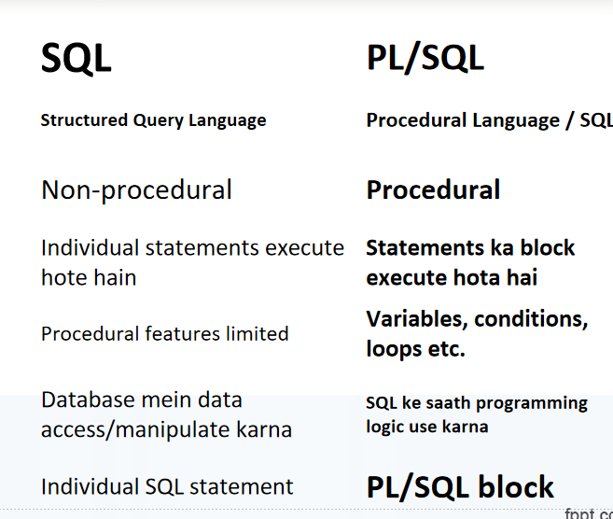
SQL vs PL/SQL
Point | SQL | PL/SQL
Full form | Structured Query Language | Procedural Language / SQL
Nature | Non-procedural | Procedural
Execution | Individual statements execute hote hain | Statements ka block execute hota hai
Programming features | Procedural features limited | Variables, conditions, loops etc.
Use | Database mein data access/manipulate karna | SQL ke saath programming logic use karna
Code unit | Individual SQL statement | PL/SQL block

Slide 34
SQL VS PL/SQL
SQL | PL/SQL
In SQL you can not create or use package | Create a package
There is no facility to handle exceptions | Allows you to write exception handling code
There is no facility of trigger. | You can create trigger.
SQL support DML & DDL compiler | PL/SQL is compiled with PL/SQL compiler

Slide 35
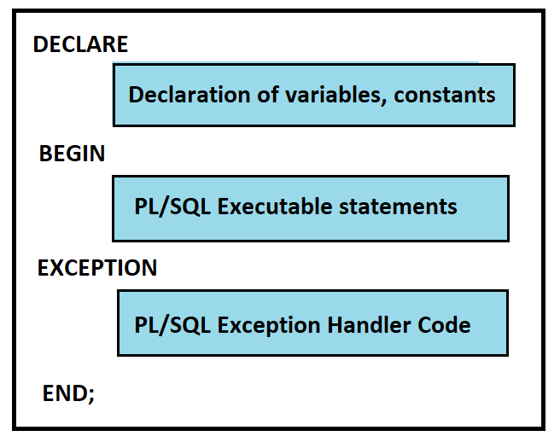
Generic PL/SQL Block

Slide 36
Generic PL/SQL Block
Declarations (Optional)
  This section starts with the keyword ‘DECLARE’.
  eg.DECLARE
  v_num NUMBER;
  It defines and initializes variables and cursors used in the block.
  eg.DECLARE
  v_num NUMBER := 10;
  (10 is this the initial value)
Executable Part\BEGIN (Mandatory)
  This section starts with the keyword ‘BEGIN’.
  It contains various SQL and PL/SQL statements providing functionalities like
data retrieval, manipulation, looping and branching.
maining (👉 BEGIN aur END ke beech hum actual SQL aur PL/SQL statements likhte hain.)

Slide 37
eg.BEGIN
DBMS_OUTPUT.PUT_LINE('Hello');
Exception Handling (Optional)
  This section starts with the keyword ‘EXCEPTION’.
  eg.EXCEPTION
  WHEN OTHERS THEN
  DBMS_OUTPUT.PUT_LINE('Error occurred');
  It handles errors that arise during the execution of data manipulation
statements in ‘executable commands’ section.
  This section specifies that end of PL / SQL block.

Slide 38
Complete struture
DECLARE
v_num NUMBER := 10;
BEGIN
DBMS_OUTPUT.PUT_LINE(v_num);
EXCEPTION
WHEN OTHERS THEN
DBMS_OUTPUT.PUT_LINE('Error occurred');
END;
/

Slide 39
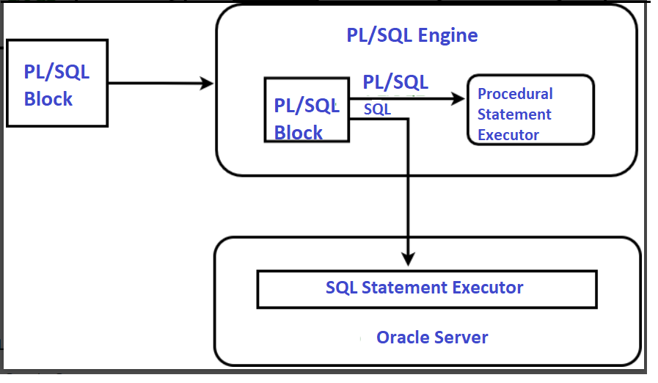
PL/SQL Environment role ofPL/SQL Engine & SQL Engine
PL/SQL Engine → procedural part handle karta hai.
SQL Engine → SQL part handle karta hai.

Slide 40
PL/SQL Environment
The PL/SQL engine accepts as input any valid PL/SQL unit.
The engine runs procedural statements, but sends SQL statements to the SQL engine in the database.
Typically, the database processes PL/SQL units.
When an application development tool processes PL/SQL units, it passes them to its local PL/SQL engine.
If a PL/SQL unit contains no SQL statements, the local engine processes the entire PL/SQL unit.
This is useful if the application development tool can benefit from
conditional and iterative control.
36

Slide 41
The PL/SQL Literals
A literal is an explicit numeric, character, string, or Boolean
value not represented by an identifier. (fixe val direct likhte h
For example, TRUE, 786, NULL, ‘marwadi university' are all literals of type Boolean, number, or string.
PL/SQL, literals are case-sensitive.
following kinds of literals −
  Numeric Literals
  Character Literals
  String Literals
  BOOLEAN Literals
PL/SQL supports the
Date and Time Literals
37

Slide 42
The PL/SQL Literals
Numeric Literals:
25 | 6.34 | 7g2 | .1 | +17 | -5
050 | 78 | -14 | 0 |  | +32767
6.6667 | 0.0 | -12.0 | 3.14159 |  | +7800.00
Character Literals
'%'
'A'
‘*’
'z'
'('
38

Slide 43
The PL/SQL Literals
String Literals
'Hello, world!'
‘Marwadi Univerisity'
'19-NOV-12'
BOOLEAN Literals
TRUE, FALSE, and NULL.
Date and Time Literals
DATE ‘25-DEC-78';
TIMESTAMP '2012-10-29 12:01:01';
39

Slide 44
Data Types
PL/SQL is super set of the SQL.
So, it supports all the data types provided by SQL.
In PL/SQL Oracle provides subtypes of the data types.
For example, the data type NUMBER has a subtype INTEGER.
called

Slide 45
Data Types
Category | Data Type | Sub types/values
Numerical | NUMBER | BINARY_INTEGER, DEC, DECIMAL, DOUBLE PRECISION, FLOAT, INTEGER, INT, NATURAL, POSITIVE, REAL, SMALLINT
Character | CHAR,LONG, VARCHAR2 | CHARACTER, VARCHAR, STRING, NCHAR, NVARCHAR2
Date | DATE | -
Binary | RAW, LONG RAW | -
Boolean | BOOLEAN | Can have value like TRUE, FALSE and NULL
RowID | ROWID | Stores values of address of each record

Slide 46
PL/SQL CONSTANT
A constant holds a value that once declared, does not change in the program.
A constant declaration specifies its name, data type, and value, and allocates storage for it.
The declaration can also impose the not null
constraint.
A constant is declared using the constant keyword.
Syntax:
<constant name> CONSTATNT <datatype>:=value;
E.G.
PI CONSTATNT number:=3.14;

Slide 47
Variables
Variables are used to store values that may be change during the execution of program.
In PL/SQL, variables contain values resulting from queries or expression.
mainig quaries ki value store karta hai
Variables are declared in Declaration section of the PL/SQL block.
maing DECLARE ke andar declare karte hai
eg.DECLARE
variable_name data_type;
It can assign valid data type and can also be initialized if necessary. maing any valid data tyle di ja sakti hai
43

Slide 48
Variables
Declare a Variable Syntax:
variableName
datatype [ NOT NULL] := initialValue;
datatype can be any valid data type supported by PL/SQL.
‘:= ‘ used as assignment operator.
eg. v_age := 19;
If variable need to be initialized then initialValue can be assigned at declaration time.
eg. v_age NUMBER := 19;
If NOT NULL is included in declaration, variable cannot have NULL value during program execution and such variable must be initialized.
44

Slide 49
Variables
Example:
no
NUMBER(3);
value city name
DECIMAL; CHAR(10);
VARCHAR(10);
counter NUMBER(2) NOTNULL := 0
45

Slide 50
Anchored/Attach Data Type Variable
A variable can be declared as anchored data type.
It means, datatype for variable is determined based on the data type of the other object.
This object can be other variable or a column of the table.
This provides ability to match the data types of the variables
with the data types of the columns defined in the database.
If data type of column is changed, then the data type of variable will also changed automatically.
Advantage: It reduces maintenance cost and allow a program to
adapt changes made in tables
Syntax.
.variable_name table_name.column_name%TYPE;
.v_salary EMP.SAL%TYPE;
%TYPE(refrence)
46

Slide 51
slaid 50 samary
Anchored Data Type Variable mein variable ka datatype kisi existing variable ya table ke column se liya jata hai. Isse variable aur database column ke datatype match rahte hain, aur column ka datatype change hone par variable bhi automatically us change ko follow karta hai. Isliye maintenance kam hoti hai.

Slide 52
Anchored Data Type Variables
Syntax:
variableName object%TYPE [ NOTNULL] := initialValue ;
object can be any variable declared previously or column of a database.
To refer of a column of particular table, column name must be
combined with table name.
Example
no Account.Acc_No%TYPE := 101;
bal Account.Balance%TYPE;
name Customer.name%TYPE;
.previously declared variable(variable jo pahle declere kiya ho)

Slide 53
Assign Value to Variable
By using Assignment Operator Syntax:
variableName := value ;
  A value can be a constant value or result of some expression or return value of some function.
By Reading from the Keyword: Syntax:
variableName := &variableName ;
  This is similar to scanf() function.
  Whenever ‘&’ is encountered, a value read from the keyboard and assign it to variable.
no := &no;
48

Slide 54
Assign Value to Variable
3) Selecting or Fetching table data values into Variables:
Syntax:
SELECT col1, col2, …, colN INTO var1, var2, …, varN FROM tableName WHERE condition ;
This statement retrieves values for specified column and stores them in given variable.
Data type and size of variables must be compatible with the relative columns.
A condition in WHERE clause must be such that it selects only single record.
This statement cannot work if multiple records are selected.
49

Slide 55
Assign Value to Variable
3) Selecting or Fetching table data values into Variables:
Example: Write PL/SQL block stores account number and balance for account ‘A01’ into variable ‘no’ and ‘bal’.
Input:
DECLARE
no Account.Acc_No%TYPE;(clo ke datatyepe se li jaegi )
bal Account.Balance%TYPE; ( same )
BEGIN
SELECT Acc_No, Balance INTO no, bal FROM WHERE Acc_No = ‘A01’ ;(table se Acc_No aur Balance lena hai.)
Account
END;
/
50

Slide 56
Display Messages
Syntax:
❑
dbms_output.put_line ( message );
A dbms_output is a package, which provides functions to accumulate information in a buffer.(temporay store area)
A put_line is a function, which display messages on the screen.
A message is a character string to be displayed.
To display data of other data type,jsaise NUMBER they must be concatenated with some character string.
The environment parameter, SERVEROUTPUT must be ON to
display messages on screen.
SET SERVEROUTPUT ON;
51

Slide 57
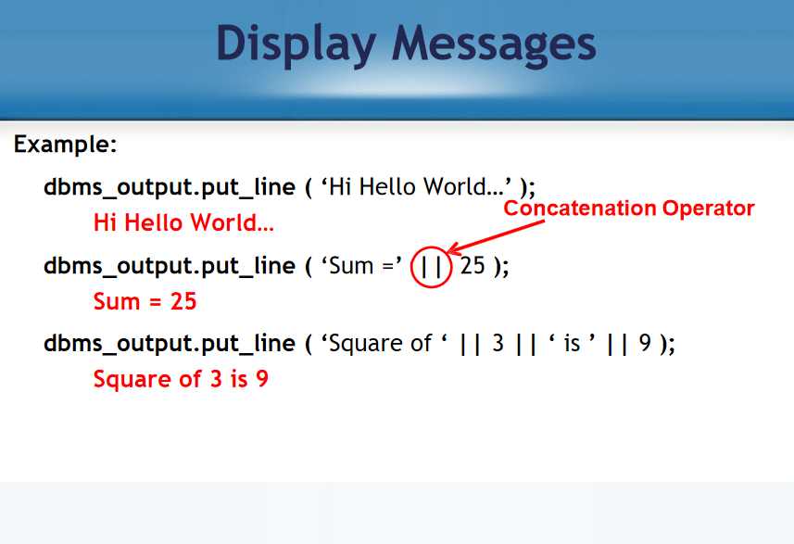

Slide 58
Comments
Comments are statement that will not get executed even though
they are present in the program code.
Comments are used to increase readability of a program.
There are two types of comments:
-- (Double hyphen or double dash) (Single Line Comment):
  Treats single line as a comment.
--
2) /* …. */
This single line is a comment
(Multiple Line Comment):
Treats multiple lines as comment.
/* This statement is spread over two line and both lines are treated as comments */
53

Slide 59
Control Structures
There are 3 types of Control Structures in PL/SQL:
  Conditional Control
  if marks >=40 ->pass else ->faile
  Iterative Control
  loop,while,for
  Sequential Control
  sequence/order mein execute karna
54

Slide 60
Control Structures - Conditional Control
To control the execution of block of code based on some
condition, PL/SQL provides the IF statement.
Three form of conditional controls
  Simple if
  Else if
  If ….then….elseif ….else
55

Slide 61
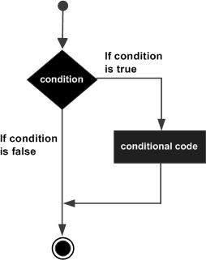
Conditional Control
Simple if
Syntax
If <condition> Then
<statements>
End if;

Slide 62
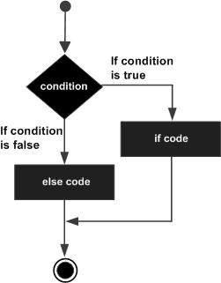
Conditional Control
If …else
Syntax
If <condition> Then
<statement 1>
Else
<Stement2> End if;

Slide 63
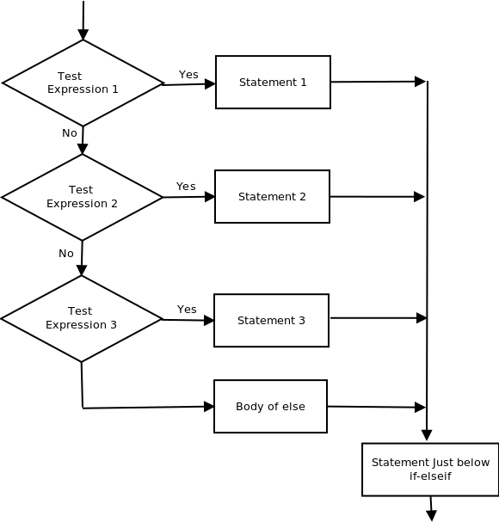
Conditional Control
If …then…elsif
If <Condition> then
<Statement1> Elsif <condition2> then
<statment2> Elsif <condition3> Then
<Stement3>
Else
…
End if;

Slide 64
Control Structures- Iterative Control
Iterative control allows a group of statements to execute
repeatedly in a program. It is called Looping.
PL/SQL provides three constructs to implement loops, as listed below:
  1. LOOP
  2. WHILE
  3. FOR
In PL/SQL, any loop starts with a LOOP keyword and it terminates with an END LOOP keyword.
Each loop requires a conditional statement to control the
number of times a loop is executed.

Slide 65

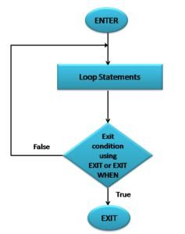
Iterative control- Loop
Syntax:
Loop
<Statements>;
[Exit When <Condition>]; End Loop;

Slide 66

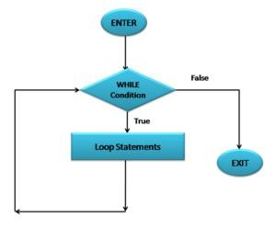
Iterative control- While
Syntax:
While <condition> Loop
<Statements>;
End Loop;

Slide 67

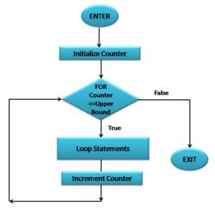
Iterative control- for
Syntax:
For Variable In [Reverse] Start..End
Loop
<Statement> End Loop;

Slide 68
Control Structures- sequential control
Normally, execution proceeds sequentially within the block of
code(ek ke baad ek executed hoti hai )
Sequence can be changed conditionally (any condition basis) as well as unconditionally.(without conditon basis)
To alter the sequence unconditionally, the GOTO statement can
be used.
Syntax:
GOTO jumpHere ;
:
:
<< jumpHere >>
The GOTO statement makes flow of execution to jump at << jumpHere >>.
63

Slide 69
Example
BEGIN
GOTO second_message;
<<first_message>>
DBMS_OUTPUT.PUT_LINE('Hello');
<<second_message>>
DBMS_OUTPUT.PUT_LINE('PL/SQL GOTO Demo');
END;
/

Slide 70

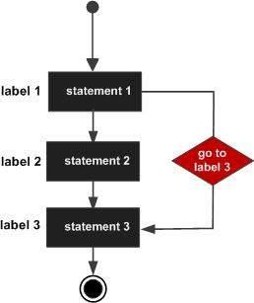
Control Structures- sequential
control
BEGIN
GOTO second_message; <<first_message>> DBMS_OU TPUT.PUT_LINE( 'Hello' );
GOTO the_end;
<<second_message>>
DBMS_OUTPUT.PUT_LINE( 'PL/SQL GOTO
Demo' );
GOTO first_message;
<<the_end>>
DBMS_OUTPUT.PUT_LINE( 'and good bye...'
);
END;

