Slide 2
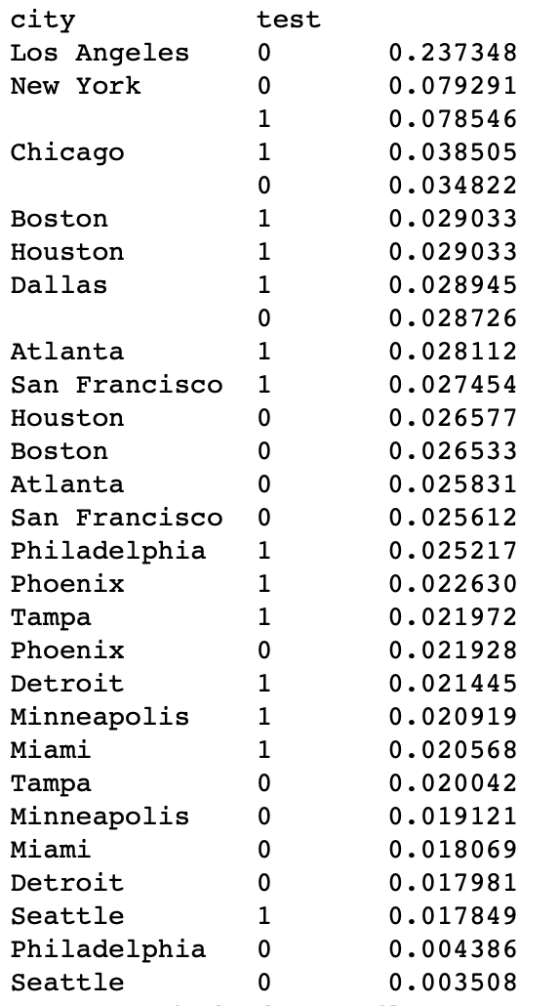
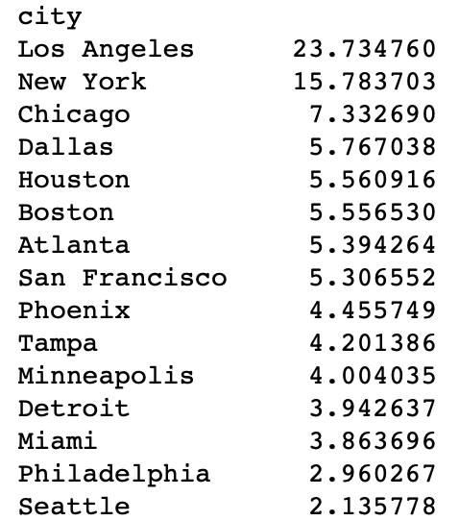
Reproducing the negative result
We see that LA has high proportion of viewers even after the introduction of commercial including local mayors
Figure A
Figure B

Slide 3
Further Investigation
I investigated different factors using visualization technique. I observed no other factors contributed viewers to watch the show.

Slide 4
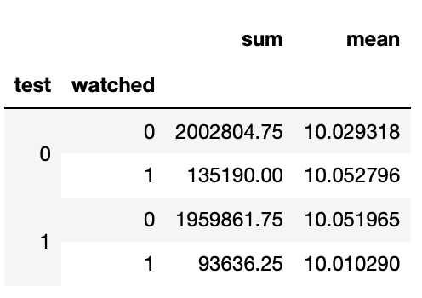
Comments on Experiment
I couldn’t find anything wrong with the experiment. Based on the following data which shows the average of total_watched_time, we observe that the mean time for watching the show in the test and the control condition is almost the same. The producer may stop showing the new commercials.

