Slide 1

ANTI-BACTERIAL PHYTOCHEMICAL DATABASE

Slide 2
INTRODUCTION
The antibacterial phytocompound database is a specialzed database using a collection of different plant database which cure the bacterial infection.
This database contain the information about the iupac name, smile,molecular
formula,molecular weight,hbond, hdonar,Inchi , Inchi key , lop p and and connected with
some other database too which include pubchem,kegg , chembl ... so on .
This database finds the utility to the scientific community for a quick review on the
number of phytocompound for anti bacterial research and also used as the platform for
the devlopment fo drugs.
This database provides an experimental related information to reseachers to discover
potent compounds with better activity.

Slide 3
MATERIAL REQUIED
Operating system
Linux – kali
Tools and software
Html , Boostrap
Python
Django
Postgres sql database
System requirements
128 MB RAM
2.26 GHZ processor
20 gb hard disk
Internet Connection

Slide 4
METHODOLGY
DATA COLLECTION
Antibacterial phytocompound were collected from the different literatures , other plant database , natural compound database ,pubmed ,Dr.Druck database and Google keyword search.
The collected informations are stored in MS-Excel sheets in ordered form.Generally databases uses table or lists to keep data and these data are made up of fields and records.

Slide 5
Data mining
Data mining is the process of analyzing data from the different perspectives tool for analyzing data.it analyze ,catogorize and summarize the relationships.
The fundamental goal of data mining techniques are prediction adn description.

Slide 6
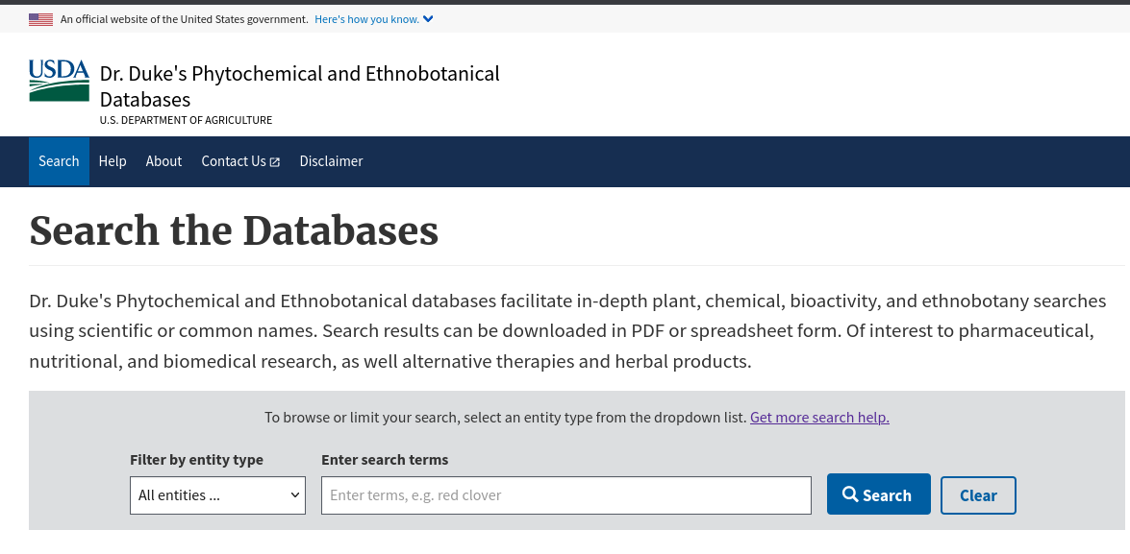
Dr.Duke database

Slide 7
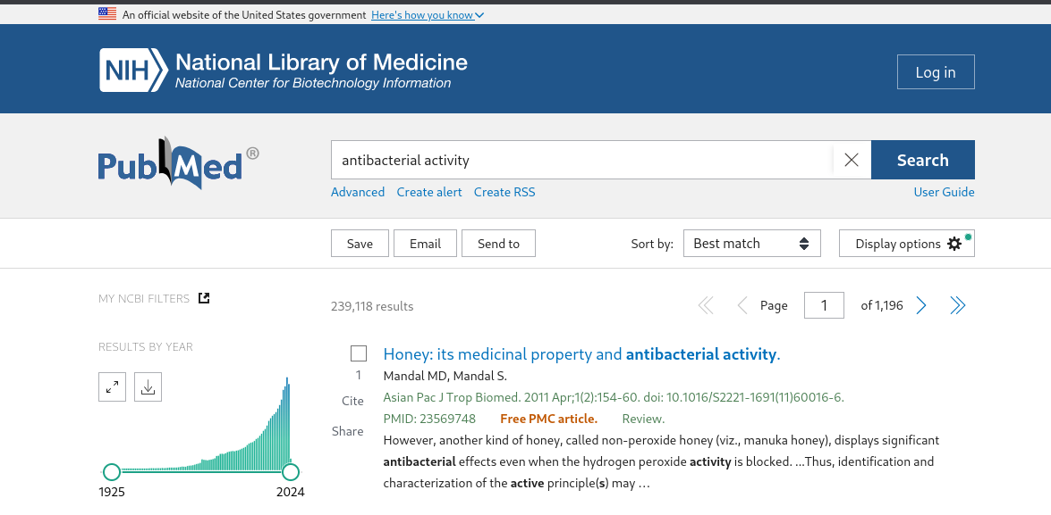
Pubmed database

Slide 8
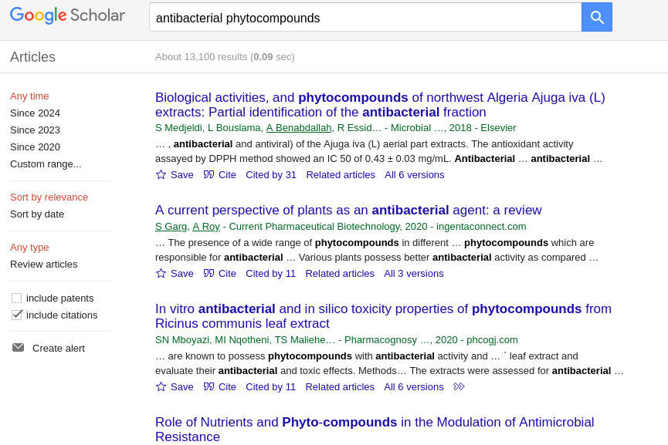
Google scholar

Slide 9
Provided information
Number of Lipinski’s rule of 5 violations
Lipinski’s rule of 5
Number of Ghose rule violations
Ghose rule
Veber rule
Egan rule
GSK 4/400 rule
Pfizer 3/75 rule
Bioavailability score
Solubility class [ESOL]
Solubility class [Silicos-IT]
Blood Brain Barrier permeation
Gastrointestinal absorption
Log Kp (Skin permeation, cm/s)
Number of PAINS structural alerts
Number of Brenk structural alerts
P-glycoprotein substrate
Molecular weight (g/mol)
Log P
Topological polar surface area (Å2)
Number of hydrogen bond acceptors
Number of hydrogen bond donors
Number of carbon atoms
Number of heavy atoms
Number of heteroatoms
Number of nitrogen atoms
Number of sulfur atoms
Phytochemical name:
Synonymous chemical names:
chemical identifiers:
SMILES:
InChI:
InChIKey:
DeepSMILES:

Slide 10
How user acquire the data?
Viewing compound
Article page
Compound propeties
Detail about the chemical andit’s images
Aritcle’s and their reference
Detail about compound properties and it’s adme and drug likines

Slide 11
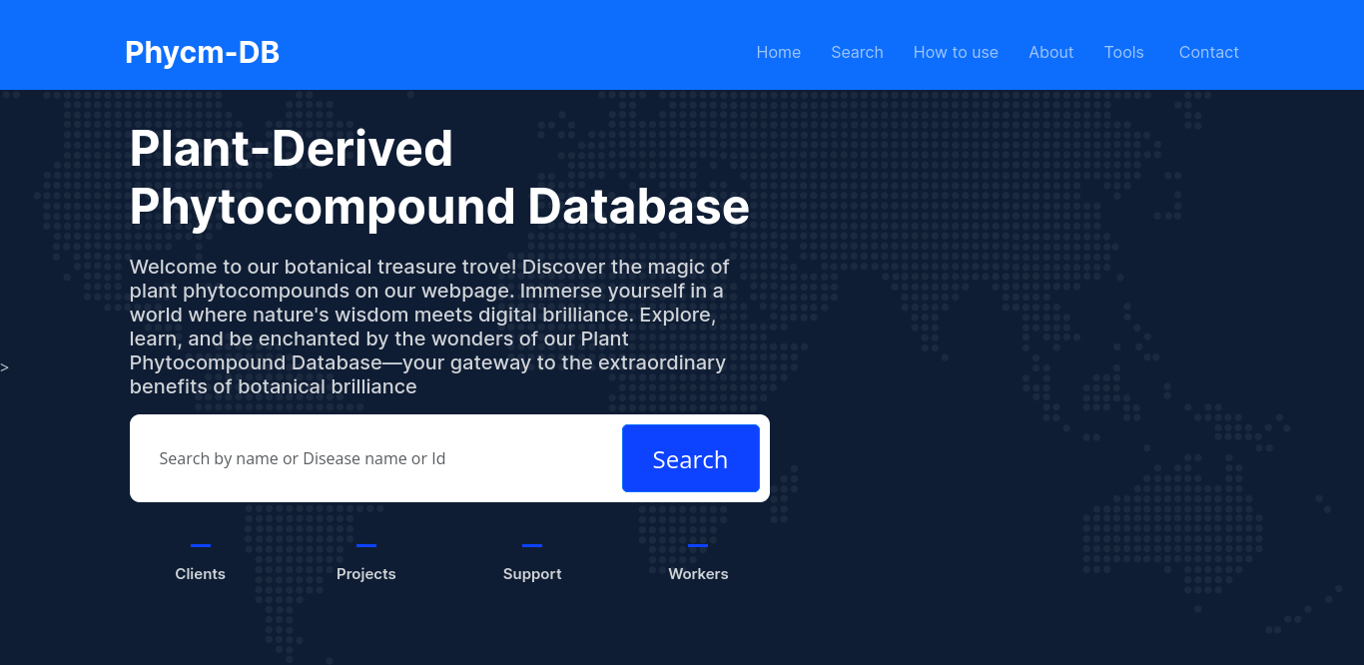
WORK STATUS
Home page

Slide 12
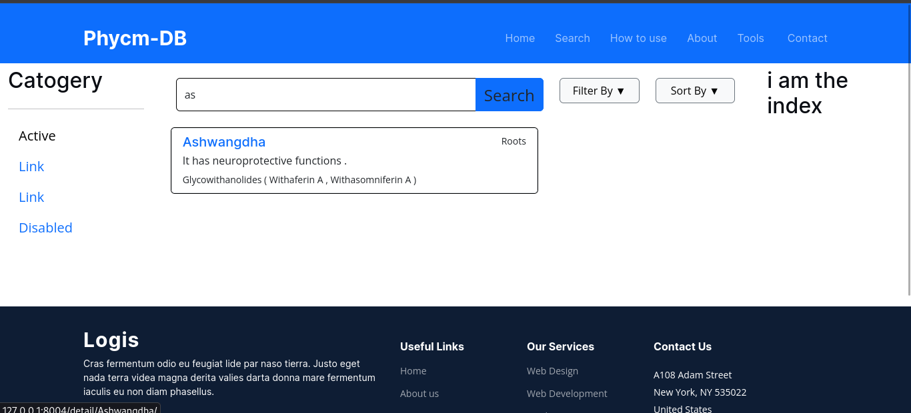
Search page

Slide 13
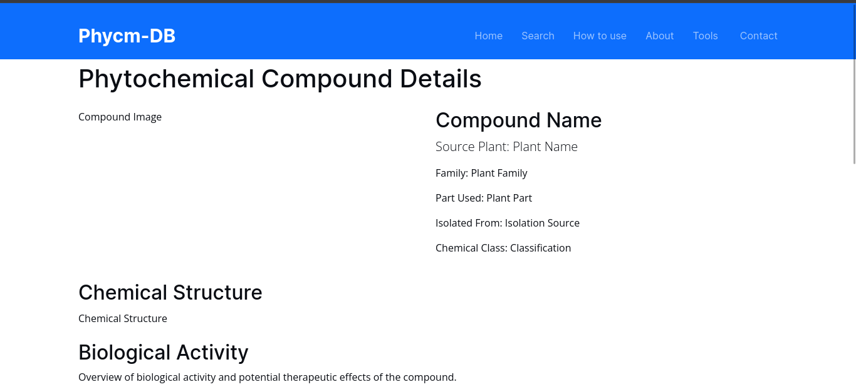
Compound detail_page

Slide 14
TECHONOLOGY USED
Html
Html is the standard markup language for creating and designing web pages.
Bootstrap
Bootstrap is a popular front-end framework that simplifies the process of designing responsive and mobile-friendly web pages.
Python
Python is a high-level, interpreted programming language known for its simplicity and readability. It’s also used with django and flask to develope a robust website real quick.
PostgreSQL – PostgreSQL is a powerful, open-source relational database management system (RDBMS). It is commonly used as a backend database for web applications built with frameworks like django.

Slide 15
CONCLUSION
The are global trend for revival of interest in the traditional system of medicine in recent year.
Screening of medicinal herbs become a potential source of biodynamiccopounds of therapeutic value in phytocomounds reserch.
The advantage of the databasewould help in the process of drug discovery by providing resarcher starting points for in silico screening of natural compoundsas well as design of novel drugs.

