Slide 1

An Internship Presentation On “Generative AI Chatbot” At Amnil Technologies Pvt. Ltd. Submitted By Basanta Rai (23473/076) An Internship Presentation Submitted in partial fulfillment of the requirement of Bachelor of Science in Computer Science & Information Technology (BSc.CSIT) 8th Semester of Tribhuvan University, Nepal Ashadh, 2081

Slide 2
Table of Content
Introduction to Organization​
Introduction to Project​
Objective of the Project​
Introduction to the field of internship​
Diagrams
Modules
Lesson Learned
Conclusion​
References​
Demo

Slide 3
Introduction to Organization
AMNIL Technologies Pvt. Ltd., established in 2009 A.D
ISO certified, leading company in the tech industry, offering a variety of IT solutions
Serves a diverse range of clients from various industries such as banking, pharmaceuticals, telecommunication
Specializes in web/app development, API development, UI/UX design, Chatbot development, integrating services for SMS, Viber, and WhatsApp messaging etc.

Slide 4
Introduction to project
Generative AI Chatbot
It leverages advanced technologies such as LangChain, OpenAI (GPT-3.5) and ChromaDB to facilitate seamless communication and knowledge extraction using Retrieval Augmented Generation (RAG) capabilities
Specifically focuses on enabling users to create tenant profiles, ingest data from various sources (PDFs, web pages), and leverage advanced LLM capabilities for interactive communication

Slide 5
Objective of the Project
To enhance user interaction to provide intelligent, context-aware responses for improved user engagement
To implement efficient data ingestion to create a robust system for seamless data integration from PDFs, web pages, and other sources
To optimize information retrieval to enable rapid and accurate data retrieval to enhance performance and usability

Slide 6
Introduction to the field of Internship
Worked as a Node.js intern
Major tasks and responsibilities:
API development with Express.js and LoobBack
Database management with PostgreSQL and MongoDB
Implementing unit and integration testing
Working with TypeScript for enhanced type safety
Developing and managing RESTful API services

Slide 7
Diagrams
Use case diagram
System architecture diagram
Sequence diagram
Activity diagram
Refinement diagram
Deployment diagram

Slide 8
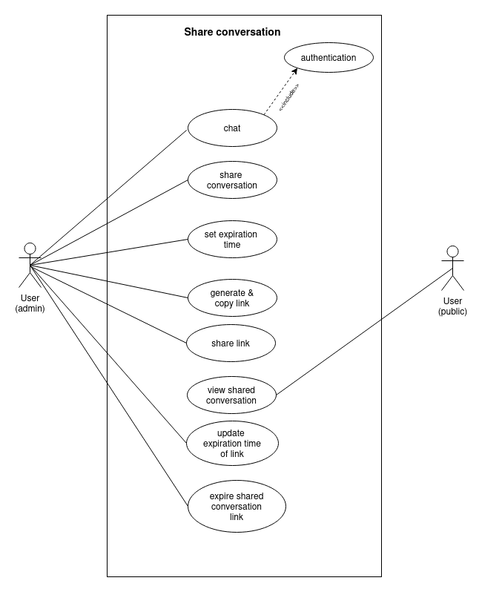
Use case Diagram
Use case Diagram for share conversation

Slide 9
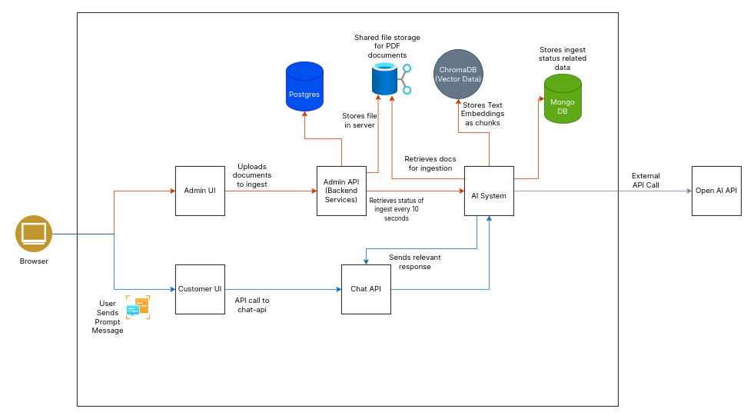
System Architecture
System architecture of Generative AI Chatbot

Slide 10
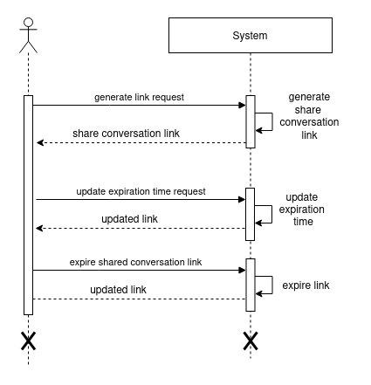
Sequence Diagram
Sequence diagram for sharing conversation

Slide 11
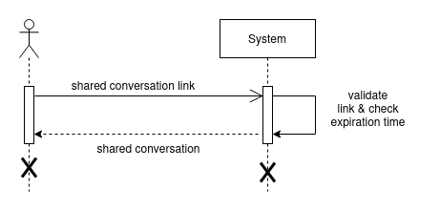
Sequence Diagram
Use case Diagram for viewing shared conversation

Slide 12
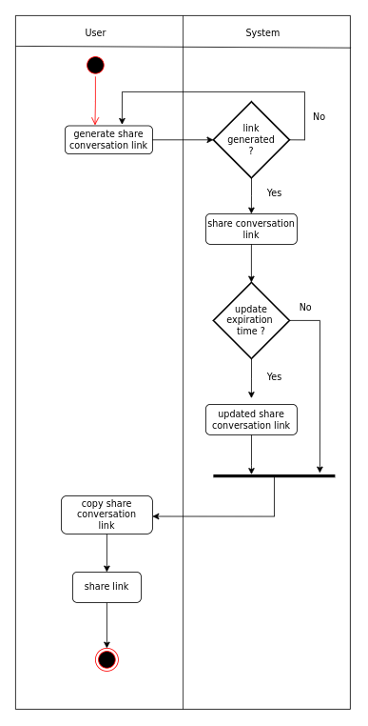
Activity Diagram
Activity diagram for sharing conversation

Slide 13
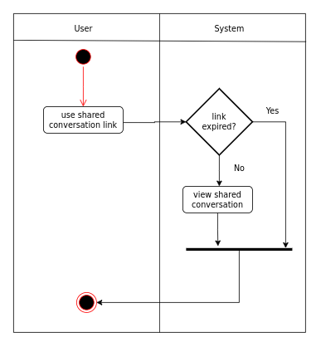
Activity Diagram
Activity diagram for viewing shared conversation

Slide 14
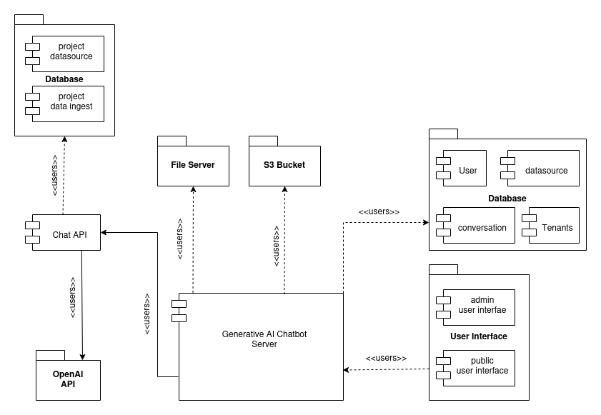
Refinement Diagram
Refinement diagram of Generative AI Chatbot

Slide 15
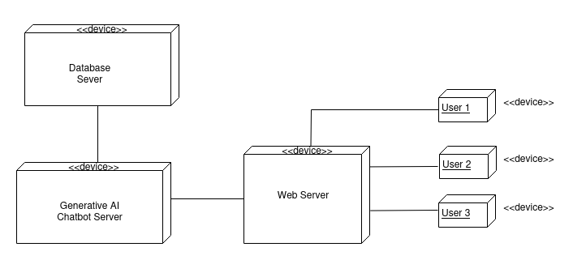
Deployment Diagram
Deployment diagram of Generative AI Chatbot

Slide 16
Modules
Share conversation

Slide 17
Share conversation
Users engage in conversation with the Chatbot and generate a share conversation link
The link can then be shared with recipients, allowing them to access the shared conversation
The generator retains the ability to update or expire the shared link as needed

Slide 18
Lesson Learnt
General Lesson Learnt
Learned best practices for structuring, organizing, and maintaining backend or API
Effectively managed time to balance multiple tasks and meet project deadlines
Developed effective communication and collaboration skills with mentors and peers, fostering a productive team environment
Adapted to the company's development methodologies and workflows, gaining insights into professional software development practices

Slide 19
Lesson Learnt
Specific Lesson learnt
Developed a deep understanding of JavaScript fundamentals and advanced concepts
Built RESTful APIs using Express.js, LoopBack and integrated them with MongoDB and PostgreSQL for robust data management
Implemented robust unit testing, ensuring code reliability and minimizing bugs
Created comprehensive API and database design documents prior to implementation, ensuring clarity and reducing errors

Slide 20
Conclusion
Developed a solid foundation in JavaScript
Mastered Express.js, including its core features, middleware, routing, and best practices for error handling etc.
Integrated Express.js with both relational (PostgreSQL) and non-relational (MongoDB) databases for developing RESTful services
Learned to create detailed API and database design documents
Improved understanding of professional software development practices and methodologies
Gained valuable hands-on experience in software development and collaboration, as well as the ability to quickly adapt to new technologies and challenges

Slide 21
References
Brown, T. B., Mann, B., Ryder, N., Subbiah, M., Kaplan, J., Dhariwal, P., Neelakantan, A., Shyam, P., Sastry, G., Askell, A., Agarwal, S., Herbert-Voss, A., Krueger, G., Henighan, T., ChiComment: 40+32 pagesld, R., Ramesh, A., Ziegler, D. M., Wu, J., Winter, C., ... Amodei, D. (2020). Language Models are Few-Shot Learners (arXiv:2005.14165). arXiv. http://arxiv.org/abs/2005.14165
Lewis, P., Perez, E., Piktus, A., Petroni, F., Karpukhin, V., Goyal, N., Küttler, H., Lewis, M., Yih, W., Rocktäschel, T., Riedel, S., & Kiela, D. (2021). Retrieval-Augmented Generation for Knowledge-Intensive NLP Tasks (arXiv:2005.11401). arXiv.http://arxiv.org/abs/2005.11401

Slide 22
References
Vaswani, A., Shazeer, N., Parmar, N., Uszkoreit, J., Jones, L., Gomez, A. N., Kaiser, L., & Polosukhin, I. (2023). Attention Is All You Need (arXiv:1706.03762). arXiv.http://arxiv.org/abs/1706.03762

Slide 23
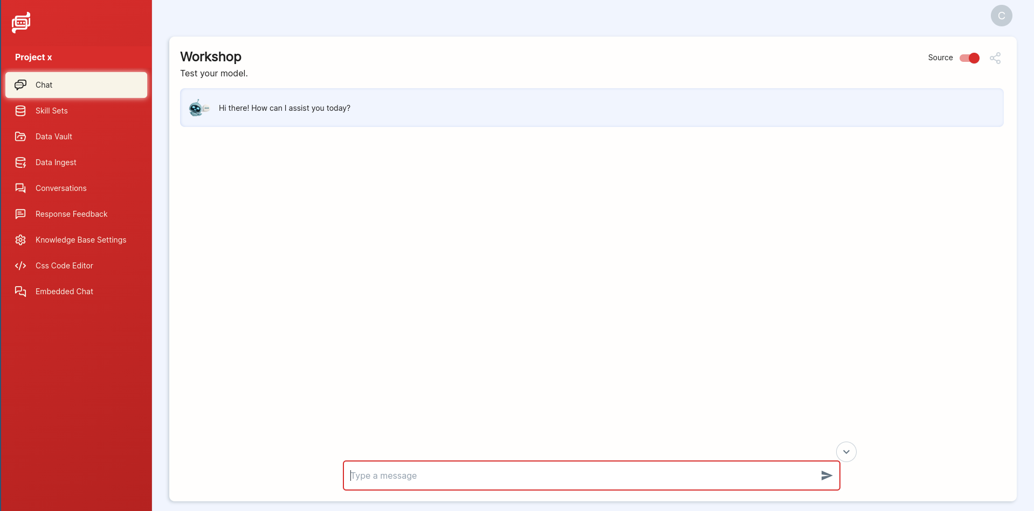
DEMO
chat interface

Slide 24
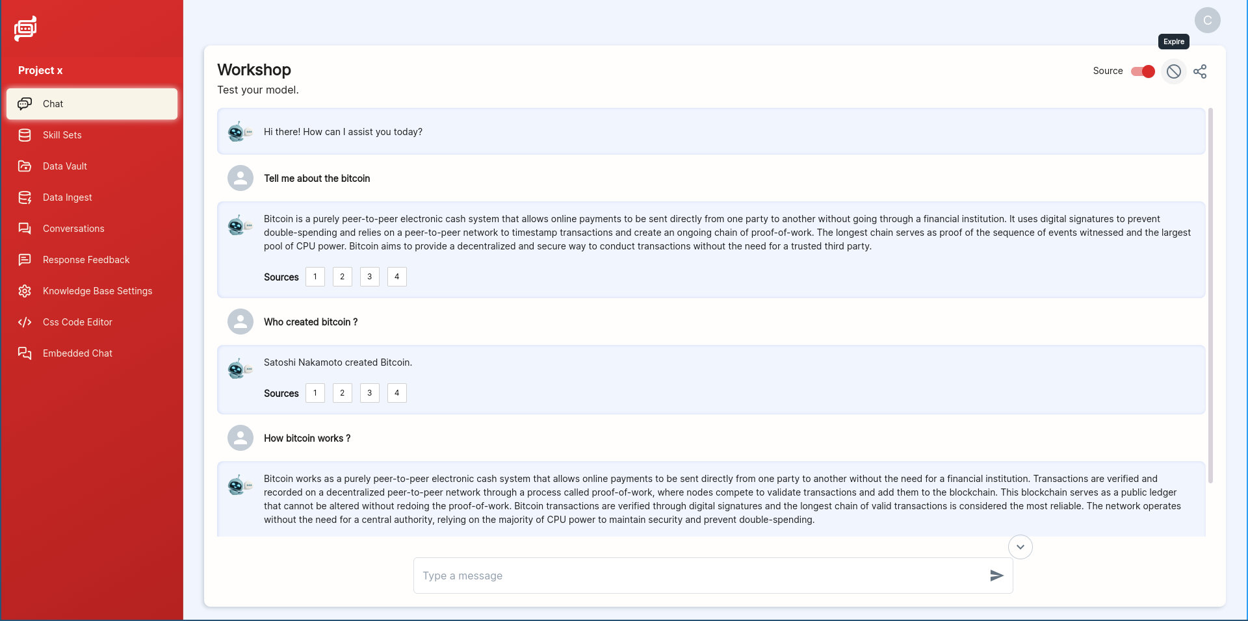
DEMO
chat responses

Slide 25
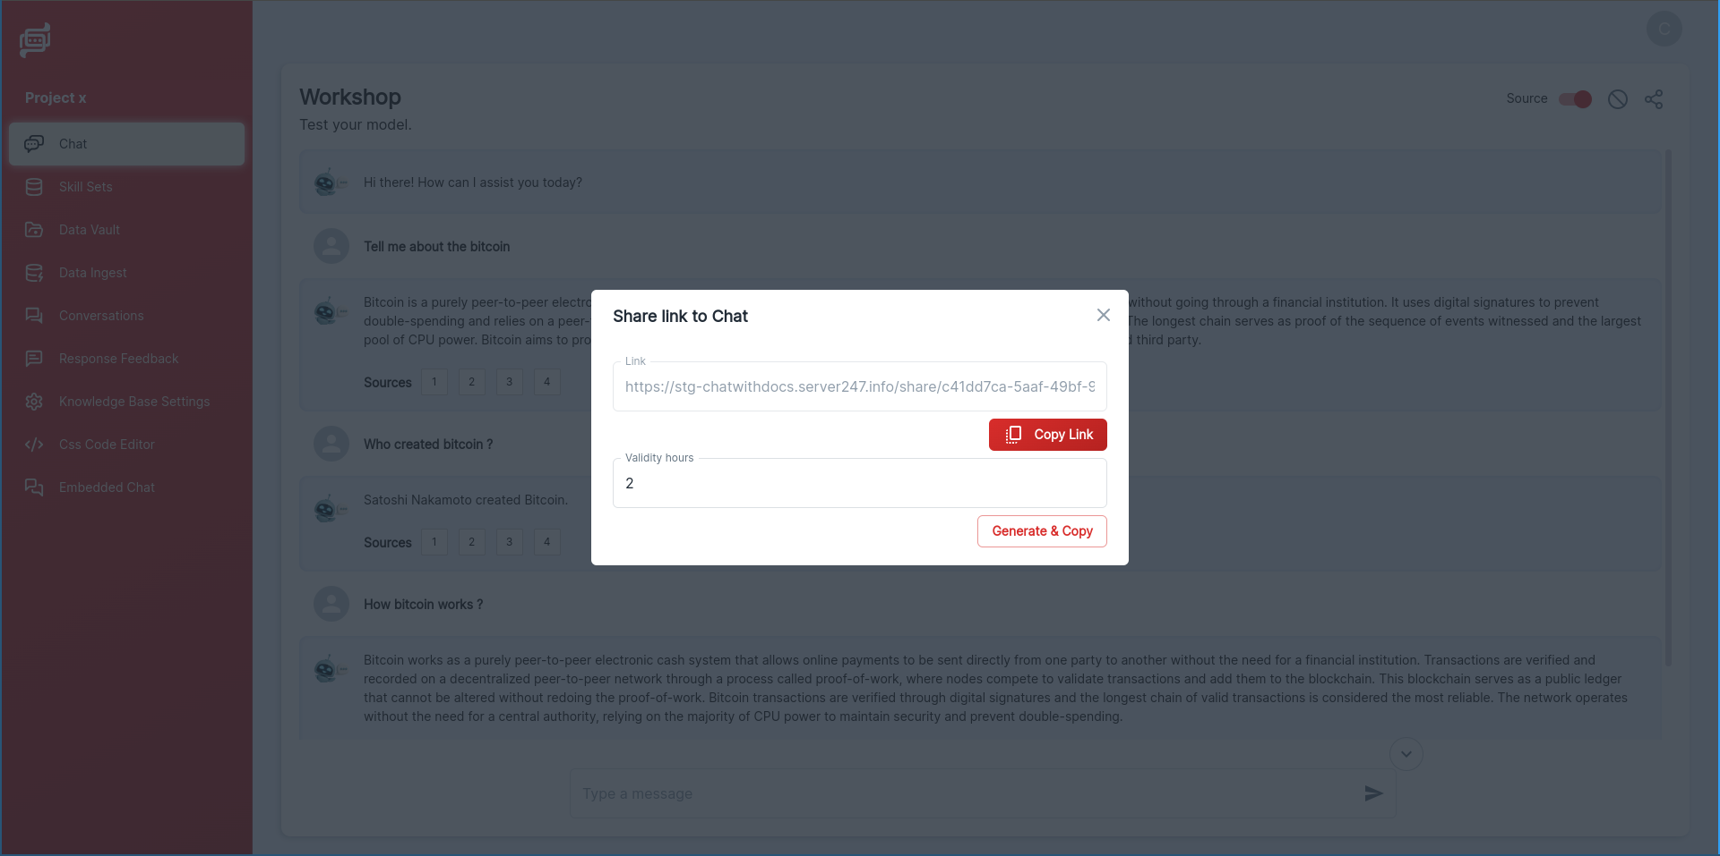
DEMO
share conversation pop up

Slide 26
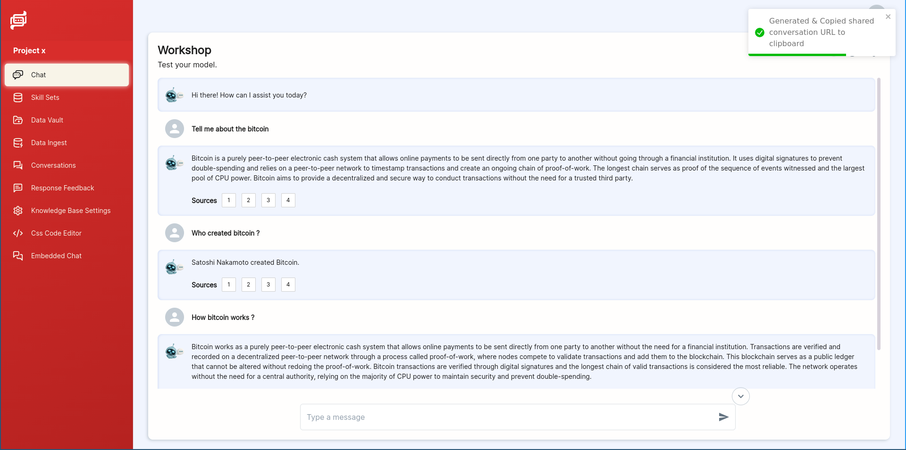
DEMO
copy generated share conversation link

Slide 27
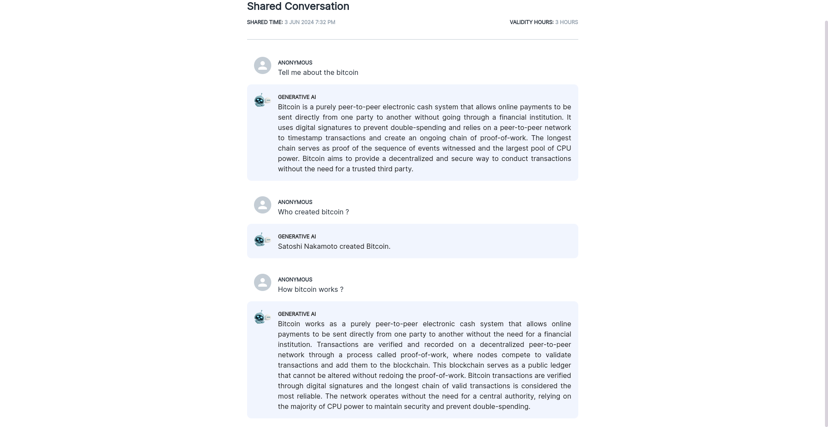
DEMO
view shared conversation

Slide 28
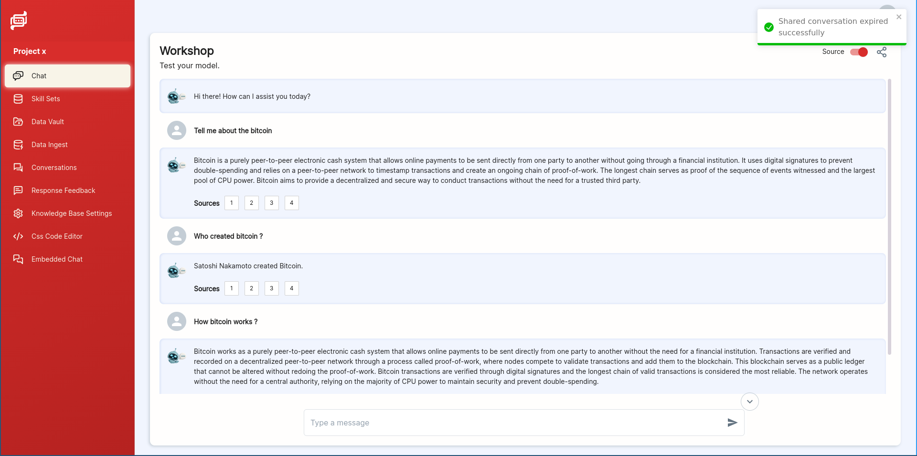
DEMO
expire shared conversation link

Slide 29

DEMO
view shared conversation with expired link

Slide 30
Thank You!

