Slide 1
UNDERSTANDING OF USE CASE
Fresh Grocery Company has excessive spend in printing, but lacks visibility into where, why, and how costs are being incurred across the organization.
The objective is not only to identify cost issues, but to uncover actionable opportunities
The analysis must translate data into a clear spend narrative, understand drivers, root causes, and discover cost saving opportunities.
The end goal is to create a mechanism to reduce printing costs over the next 12 months while maintaining business continuity and operational needs.

Slide 2
BACKGROUD & DATA ASSUMPTIONS
Background
Fresh Grocery Company has multiple store banners, distribution centers, and a head office.
Discount stores are focused on cost efficiency and upscale stores more flexible on spend.
Printing happens across many departments and printing costs are charged on a Cost-Per-Page model, with color pages are about 4 times more expensive than black & white, and pricing includes devices and services.
Data Assumptions
Annual page volume has been calculated from previous and current year readings.
Records with negative invoice amount have lower current year readings vs previous year and it is assumed those printers have been reset or reinstalled.
Printer models with prefix “MPC”, “SPC” and “PROC” are multi function printers and rest are black & white.
Only HST has been considered in Total Invoice amount, rest of the taxes (GST, PST and QST) are not.

Slide 3
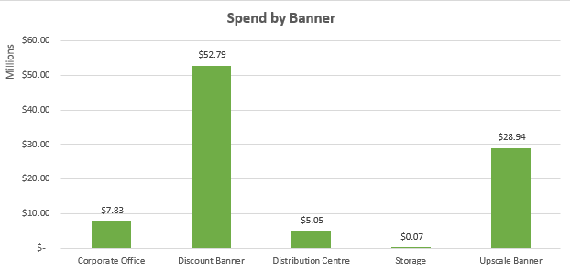
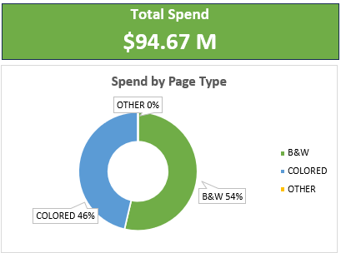

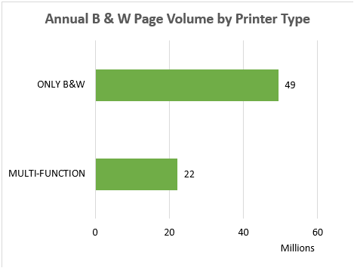



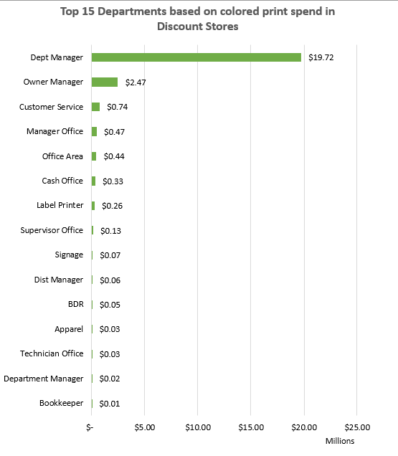
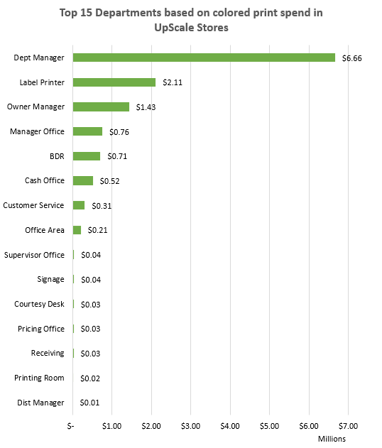
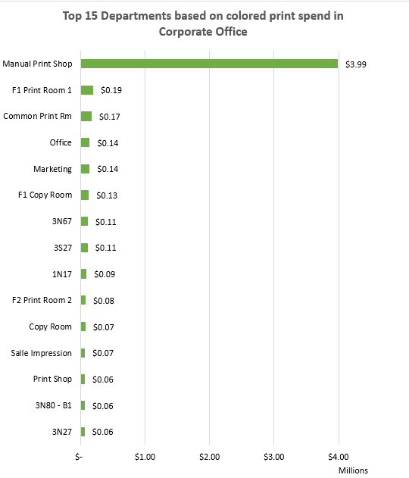
PRINT SPEND ANALYSIS & SAVING OPPORTUNITIES
Colored prints contribute to 46% of total spend
Discount stores are contributing to over 55% of total spend on printing
Out of 71M B&W pages printed this year, 22M are being printed from Multi-Function printers
47% of print spend in discount stores is on colored prints and out of which 79% is coming from Dept Manager office.
45% of print spend in upscale stores is on colored prints and out of which 52% is coming from Dept Manager office.
77% of print spend in corporate office is on colored prints and out of which 66% is coming from Manual Print Shop.

Slide 4
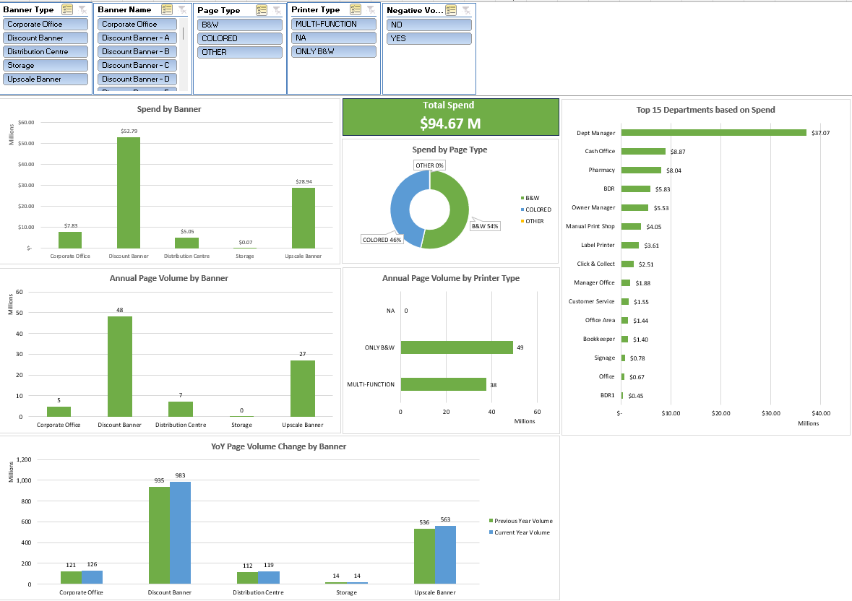
RECOMMENDED APPROACH TO REDUCE SPEND
Focus on high-cost colored printing
Prioritize reducing color printing, which drives nearly half of total spend, with targeted controls in Discount Stores, Upscale Stores, and Corporate Office.
Target high-impact departments
Address disproportionate color usage from administrative offices like Dept Manager, Manual Print Shop, Owner Manager etc.
Optimize device and print channel mix
Review usage of Multi-Function Printers for B&W printing to ensure the right devices are used for high-volume, low-cost print jobs.
Implement data-driven governance using dashboards
Deploy dashboards like this to track key KPIs and enable ongoing visibility, accountability, and course correction.
Renegotiate the Cost-Per-Page (CPP) contract
Use insights from color vs B&W volumes, banner-level usage, and device mix to negotiate lower color CPP rates

