Slide 1
▲
Traffic Sign Recognition
From Raw Data to a Real-Time Driving Assistant
Bekzod Boboev · AI/ML Fundamentals Capstone Project
Notes:
Welcome / title. 10-second intro: what the project is and what you'll cover -- demand, method, future plan.

Slide 2
●
Why This Matters
!
Roads Are Getting Busier
Tashkent traffic and complex intersections are the new normal. Faded paint, dust, poor lighting, and driver fatigue all make signs harder to read reliably.
↑
The Industry Is Already Moving This Way
Driver-assistance features increasingly rely on exactly this kind of on-road visual perception — this project applies the same idea locally.
★
Built For Local Roads
Uzbekistan's smart-city and digitalization push needs systems trained on local signage and driving conditions, not just models built elsewhere.
Notes:
The demand section. Keep this to ~45 seconds: road safety, industry trend, local relevance.

Slide 3
●
The Task, and the Data Behind It
Input: a photograph of a traffic sign.
Output: which of 200 known sign types it is.
200
116,642
14.9 GB
SIGN CLASSES
IMAGES
RAW DATASET
Source: a public Kaggle dataset of traffic signs from post-Soviet states — chosen because it matches the signage actually used on local roads.
The whole project, from raw files to a working demo, was built stage by stage: audit the data, prepare it carefully, train a baseline, improve it with evidence, then deploy it.
Notes:
Define the task precisely, then land on the dataset stats. Quick slide, ~30 seconds.

Slide 4
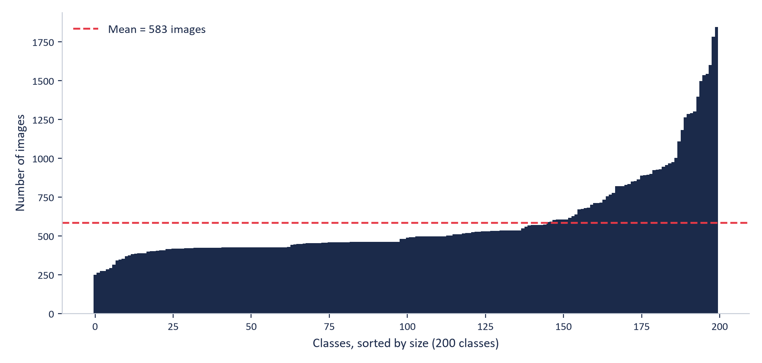
●
Step 1 — Audit the Data Before Touching the Model
248 – 1,845
images per class — mean 583
Real, but moderate imbalance — no class had only a handful of images.
Decision: a weighted sampler plus light augmentation would be enough. No need for drastic measures.
Notes:
Class imbalance found, but moderate -- explain the WeightedRandomSampler decision. ~35 seconds.

Slide 5
●
A Critical Catch: Data Leakage Risk
FINDING
RISK
DECISION
Filenames suggested many images are near-duplicate photos of the same physical sign — confirmed for ~10% of files; the rest use other naming patterns.
Near-identical photos could end up split across train / validation / test, quietly inflating accuracy without real generalization.
Use perceptual image hashing across the whole dataset, then split by duplicate group — never by individual image.
→
→
Notes:
This is the leakage-prevention story: finding, risk, decision. Emphasize this shaped stage 4 entirely. ~40 seconds.

Slide 6
●
Preprocessing: Every Choice Traces to a Finding
✓
64×64 Letterbox Resize
Padded to a square, not stretched — the audit found a real aspect-ratio tail (thin plates up to 5.9:1).
✓
RGBA → RGB
The audit found the dataset was majority RGBA — every image needed flattening before training.
✓
ImageNet Normalization
Chosen early, deliberately — kept the door open for a pretrained backbone later (this paid off directly).
✓
Weighted Sampling + Light Augmentation
A modest, targeted response to the moderate class imbalance found in the audit.
Notes:
Quick pipeline slide -- each bullet's justification is the point, not the pipeline itself. ~35 seconds.

Slide 7
●
The Baseline Model: A Surprising Finding
87.84%
−0.124
baseline validation accuracy
(3-block CNN, from scratch)
correlation: class size vs. accuracy
→ imbalance was NOT the problem
So what was? The confusion matrix showed a clear pattern: specific, systematic confusion between visually similar sign pairs — not scattered random error.
The single biggest error: “Method of parking” confused with “Dangerous roadside”, 122 times — more than any other mistake in the model.
Notes:
This is the pivotal slide -- the stat that redirected the whole project. Give it real time, ~60 seconds.

Slide 8
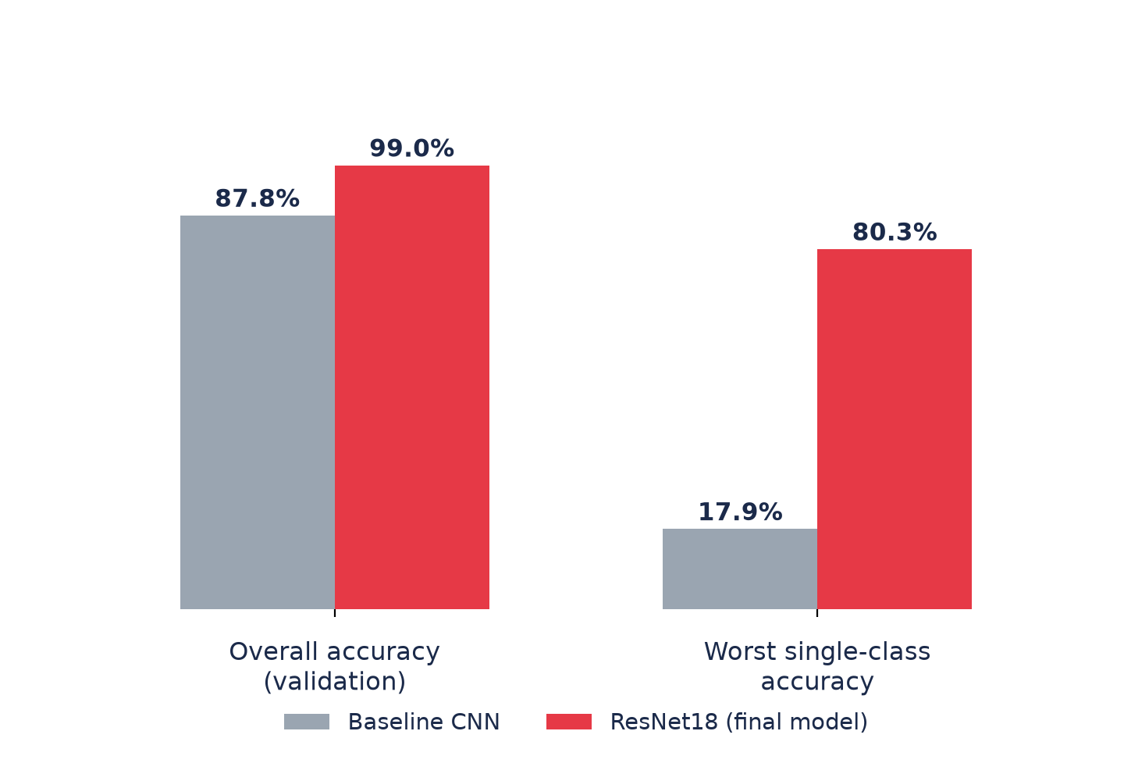
●
The Fix: A Pretrained Backbone, Not a Bigger CNN
The baseline's weakness was fine-grained visual discrimination — not raw model size.
A ResNet18 pretrained on ~1.4 million photos brings far richer visual features than a small CNN trained only on this one dataset.
Everything else — pipeline, split, batch size, 15 epochs — was kept identical to the baseline, so this is a clean, single-variable comparison.
Notes:
Explain WHY ResNet18 over a deeper from-scratch CNN, then reveal the accuracy jump. ~45 seconds.

Slide 9
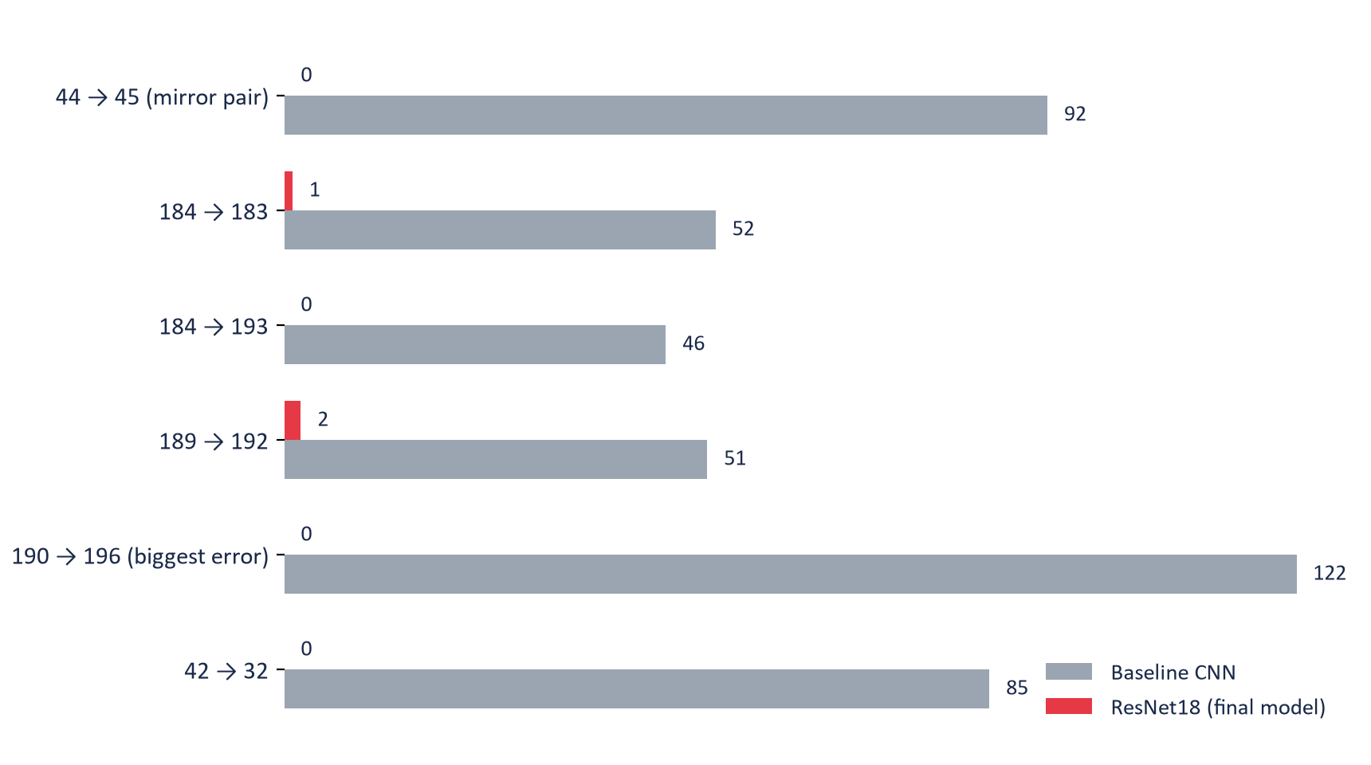
●
Did It Fix the Exact Problems We Found?
Every confusion flagged earlier collapsed to near zero — including the single biggest baseline error.
This is targeted evidence, not a generic accuracy bump.
Notes:
The payoff slide. Let the chart do the talking -- pause here. ~40 seconds.

Slide 10
●
Final, Held-Out Test Results
99.37%
99.4%
88.5%
TEST ACCURACY
MACRO F1-SCORE
WORST-CLASS ACC.
(was 17.9%)
Test accuracy came in slightly above validation accuracy — a good sign that comparing experiments never overfit the model to the validation set. Evaluated exactly once, only after the model was already chosen.
Notes:
Final numbers, and the honest 'why the high number is trustworthy' point. ~35 seconds.

Slide 11


●
From Model to Product: A Telegram Bot
1
User sends a photo of a sign to the bot
2
Model predicts the sign, entirely on CPU — no GPU needed
3
Bot replies with: sign name, category (mandatory / warning / info / …), confidence, and a clean reference picture
Priority
road
Category: Priority
Confidence: 99.8%
Notes:
Show the bot mockup, mention it's verified live on Telegram with real photos. ~35 seconds.

Slide 12
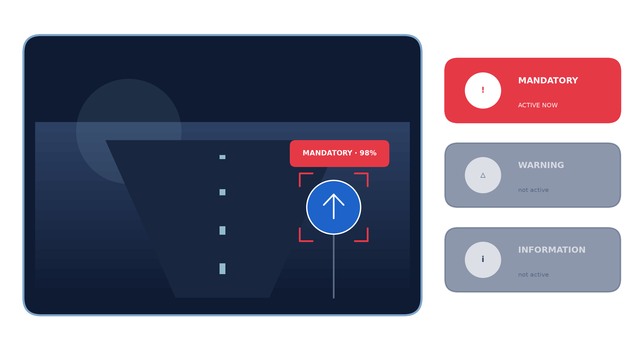
●
What's Next: Photos → Real-Time Video
A dash-cam-style device, watching the road continuously, telling the driver which rule is active right now.
Notes:
The vision slide -- let the picture carry it. Explain: continuous video, not single photos; categorized by rule type in real time. ~50 seconds.

Slide 13
?
Thank You
Questions?
Notes:
Close and open for questions.

