Slide 1

Servlets & JSP Express: Fast-Track to Web Development
Bharath Ashok

Slide 2
Day 20 to 23: Agenda
Multi-tier Architecture
Web Server
HTTP
J2EE Container
Servlets
Servlet Life Cycle
Servlets API
JSP
JSP Life Cycle
JSP Scripting Elements
Hands-on
Assignments
Interview Questions

Slide 3
Server Side Development

Slide 4
Multi-tier Architecture
It divides an application into distinct layers or tiers, each responsible for specific tasks and functions.
The main purpose of tiered architecture is to enhance maintainability, scalability, and flexibility by separating concerns and promoting reusability
Presentation Tier (or User Interface Tier)
It includes components such as web pages, mobile app interfaces, and user interfaces (UIs).
Its primary function is to display information to users and gather user inputs.
It communicates with the application logic tier to request and display data.
Application Logic Tier (or Middle Tier)
The application logic tier is where the core business logic and processing occur.
It acts as an intermediary between the presentation tier and the data storage tier.
In web applications, this tier often contains components like servlets, controllers, or API endpoints.
Data Storage Tier (or Data Tier)
This layer manages data storage and retrieval.
It can include various data storage solutions such as relational databases, NoSQL databases, and file systems.
The data tier is responsible for storing, retrieving, and managing data in a way that ensures data integrity and persistence.

Slide 5
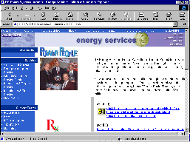
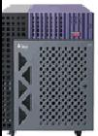
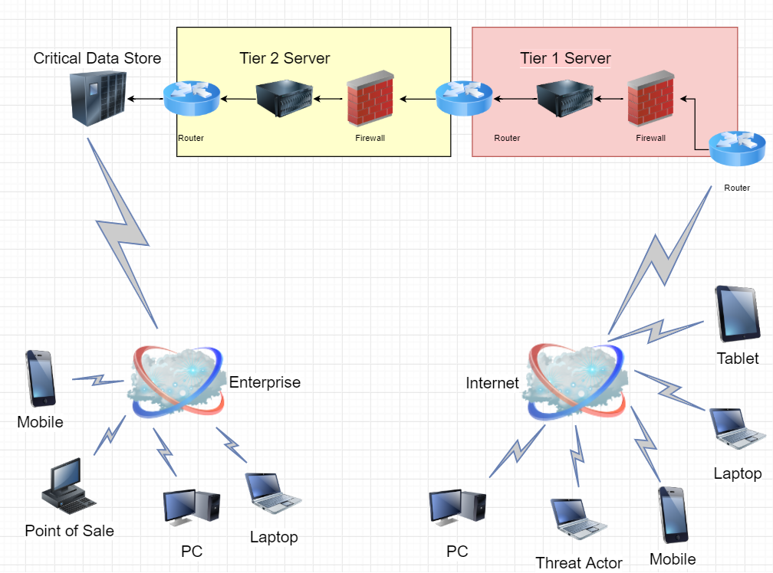
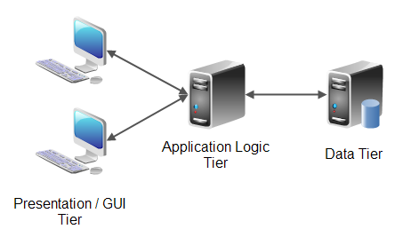
Multi-tier Architecture
Application/Browser
(User Interface)
Web Server
(Application Logic)
Database/ FileSystem
(Persistent Storage)

Slide 6
Web Server

Slide 7
Web Server
A web server is a program running on the server that listens for incoming requests and services those requests as they come in.
Once the web server receives a request, depending on the type of request the web server might look for a web page, or it might execute a program on the server.
It will always return some kind of results to the web browser, even if its simply an error message saying that it couldn’t process the request.
By default the role of a web server is to serve static pages using the http protocol
Web servers can be made dynamic by adding additional processing capability to the server

Slide 8
HTTP

Slide 9
HyperText Transfer Protocol
Lightweight protocol for the web involving a single request & response for communication
Different applications use different protocols
Web Servers/Browsers use HTTP
File Transfer Utilities use FTP
Electronic Mail applications use SMTP
Naming Servers use DNS
HTTP Request:
An HTTP request is made by a client (e.g., a web browser) to a server to request a resource (e.g., a web page or an image).
It consists of a request method (e.g., GET, POST, PUT, DELETE), a URL (Uniform Resource Locator), and HTTP headers.
HTTP Response:
The server responds to an HTTP request with an HTTP response.
It includes an HTTP status code indicating the outcome of the request (e.g., 200 OK, 404 Not Found, 500 Internal Server Error) and the requested resource's content.

Slide 10
HTTP Methods
HTTP supports various methods, including:
GET: Retrieve data from the server.
POST: Submit data to the server, often used for form submissions.
PUT: Update an existing resource on the server.
DELETE: Remove a resource from the server.
HEAD: Retrieve only the headers of a resource (useful for checking resource existence or metadata).
OPTIONS: Retrieve information about the communication options for the server.

Slide 11
J2EE – Container Architecture

Slide 12
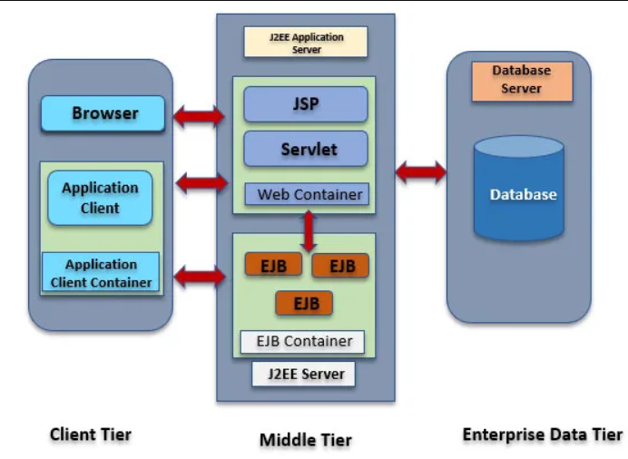
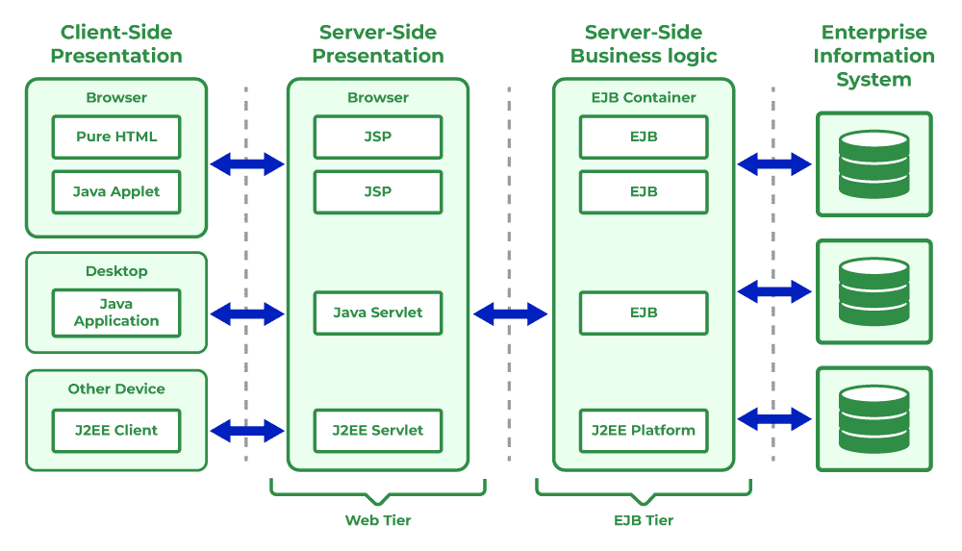
J2EE Architecture

Slide 13
Middle Tier Container
Web Container
Manages execution of servlets and JSPs
Part of web or application server
Supports HTTP
EJB Container
Business Components that contain business logic or rules
Two types of EJBs
Session Beans – Logic Oriented and deal with handling client requests and data processing
Entity Beand – Strongly coupled with data and deal with data access and persistence

Slide 14
Container Architecture
WEB Container
J2EE Server
WEB Container
Shopping Cart Application
WEB Container
Catalog Servlet
WEB Container
Application Container
OrderManager Application
Supplier Server
Cart Servlet
StockOrder
(XML/JSON)
Order
ClientApp
Process Servlet
Order Manager
Servlet
Static
Pages
EJB Container
WEB Container
Order Manager EJBApplication
Database
Order EJB

Slide 15
Servlets

Slide 16
Servlets Introduction
Servlets are classes that dynamically process requests and construct responses
Dynamically generate html pages in response to requests
Run in a servlet container and have access to services that the container provides
In an application processing of each request will normally be done by a different servlet.
e.g. search catalog, check out, confirm order etc.
Client of the servlet can be any of the following
Browser
Java Application
Another Service

Slide 17
Servlets Hands-On

Slide 18
Servlet Lifecycle

Slide 19
Servlet Lifecycle
Instantiation:
The constructor of the servlet class is called during this stage.
Initialization (init() method)
The init() method is called by the servlet container to allow the servlet to perform any one-time setup tasks, such as loading configuration data or establishing database connections.
Request Handling (service() method)
The service() method is called whenever a client (e.g., a web browser) sends a request to the servlet.
The servlet container invokes the appropriate service() method (e.g., doGet(), doPost()) based on the HTTP request method (GET, POST, etc.) to handle the request.
Destruction (destroy() method)
When the servlet container decides to remove a servlet instance (e.g., when the web application is stopped or undeployed), it calls the destroy() method.
The destroy() method allows the servlet to perform cleanup tasks, such as closing open resources (e.g., database connections) before the servlet is removed from memory.

Slide 20
Servlet Lifecycle
Servlet Container
Create Thread Pool
Thread
Thread
Instantiate servlet
Servlet
Call init ( ) method
Perform Initialization
HTTP Request 1
Allocate request to thread
Call service ( ) method
HTTP Request 2
Allocate request to thread
Call service ( ) method
Perform Service
Shutdown Initiated
HTTP Response 1
Block all further requests Wait for active threads to end
Perform Service
Terminate thread pool
HTTP Response 2
call destroy ( ) method
Perform cleanup
terminate servlet
Servlet destroyed & garbage collected
Container shutdown

Slide 21
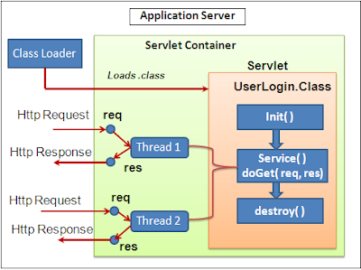
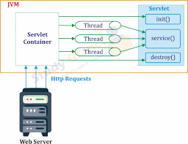
Servlet Lifecycle

Slide 22
Servlets API

Slide 23
Servlets API
Contained in two packages
javax.servlet
javax.servlet.Http
Contains around 20 interfaces and 16 classes
Javax.servlet package can be extended for use with any application layer protocol
HTTP is the most popularly used protocol
Javax.servlet.http package is extension of the javax.servlet package for http protocol
The Servlet specification allows to implement separate Java methods implementing each HTTP method in your subclass of HttpServlet.
Override the doGet() and/or doPost() method to provide normal servlet functionality.
Override doPut() or doDelete() if you want to implement these methods.

Slide 24
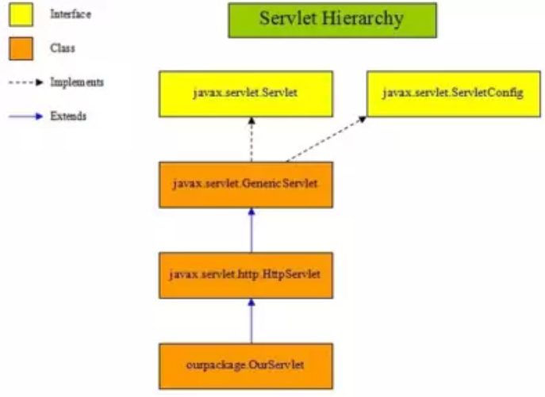
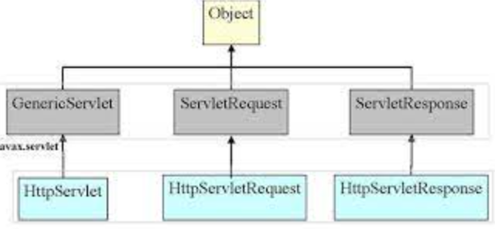
Servlet Hierarchy

Slide 25
HttpServlet Class
HttpServlet extends the Generic Servlet
Inherits the init() and destroy() methods
Overrides the service() method
Service() method
Signature: Protected void service(HttpServletRequest req, HttpServletResponse res)
Forwards the request to the appropriate method
Developer should not normally override this method
The developer needs to implement the methods corresponding to the request
doGet(), doPost(), doHead(), doPut()

Slide 26
HttpServletRequest Interface
Extends ServletRequest
Inherited methods from ServletRequest
getParameterNames()
getParameter(String name)
getParameterValues(String name)
getServerName()
getServerPort()
getRequestDispatcher
New methods defined
getCookies()
getHeader()
getPathInfo()
getContextPath()
getQueryString()

Slide 27
HttpServletResponse Interface
Extends ServletResponse
Inherited methods from ServletResponse
getoutputStream()
getWriter(String name)
flushBuffer()
setContentType()
New methods
encodeURL(String url)
encodeRedirectURL(String url)
setDateHeader()
setStatus()

Slide 28
Writing a Servlet
Create a servletclass
extend HttpServlet
Implement the doGet() or doPost() method
Both methods accept two parameters
HttpServletRequest
HttpServletResponse
Obtain parameters from HttpServletRequest Interface using
getParameter(String name)
Obtain the writer from the response object
Process input data and generate output (in html form) and write to the writer
Close the writer

Slide 29
Example Login Servlet
package training.servlets;
import javax.servlet.http.*;
import java.io.*;
public class Login extends HttpServlet {
public void doPost(HttpServletRequest request, HttpServletResponse response) {
// Get the parameter from the request
String username = request.getParameter("username");
// Send the response back to the user
try {
response.setContentType("text/html");
PrintWriter writer = response.getWriter();
writer.println("<html><body>");
writer.println("Thank you, " + username + ". You are now logged into the system.");
writer.println("</body></html>");
writer.close();
} catch (Exception e) {
e.printStackTrace();
}
}
}

Slide 30
Servlets Hands-On

Slide 31
JSP

Slide 32
Introduction to JSP
JSP, or JavaServer Pages, is a widely-used technology for building dynamic web applications in the Java ecosystem.
It is a fundamental part of the Java EE (Enterprise Edition) platform, which is now known as Jakarta EE.
JSP allows developers to embed Java code directly into HTML pages, enabling the creation of dynamic and interactive web content.

Slide 33
JavaServer Pages
Dynamic Web Pages: JSP is used to create dynamic web pages, which means the content displayed on a web page can change based on various factors such as user input, database queries, or application logic.
Java Integration: JSP allows you to embed Java code within HTML pages using special tags. These tags are processed on the server-side before the HTML page is sent to the client's web browser. This integration of Java and HTML makes it easy to create web applications that can interact with databases, handle user input, and perform other server-side operations.
Servlet-Based: Under the hood, JSP is built on top of Java Servlets. When a JSP page is accessed, it is compiled into a servlet by the web container (e.g., Apache Tomcat), which then executes the Java code and generates the dynamic content.
Separation of Concerns: JSP encourages a separation of concerns between the presentation layer (HTML) and the application logic (Java code). This separation makes it easier for developers to work on different aspects of a web application and promotes code reusability.
Tag Libraries: JSP provides a variety of built-in tag libraries that simplify common tasks, such as accessing databases (JSTL - JavaServer Pages Standard Tag Library).
MVC Architecture: JSP is often used with the Model-View-Controller (MVC) design pattern. In this pattern, JSP pages serve as the "View" component, responsible for rendering the user interface. Java Servlets handle the "Controller" part, managing application logic, and interacting with the database, while the "Model" represents the data.
Deployment: JSP web applications are typically packaged as WAR (Web Application Archive) files and deployed to a web container. Popular web containers include Apache Tomcat, Jetty, and WildFly.

Slide 34
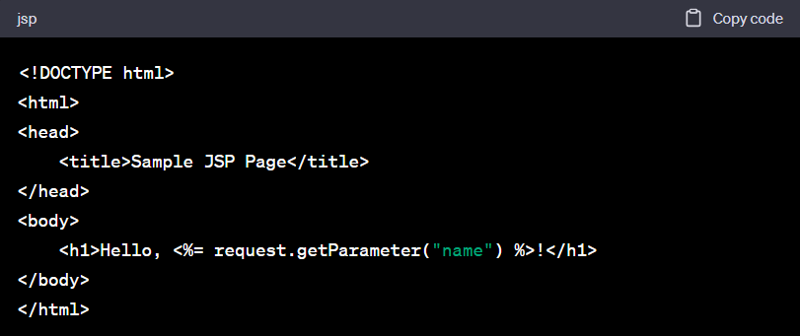
Simple JSP Example

Slide 35
Why use JSP?
JSP (JavaServer Pages) can be for building dynamic web applications in Java because it allows to seamlessly integrate Java code with HTML.
Enabling the creation of interactive and data-driven web content.

Slide 36
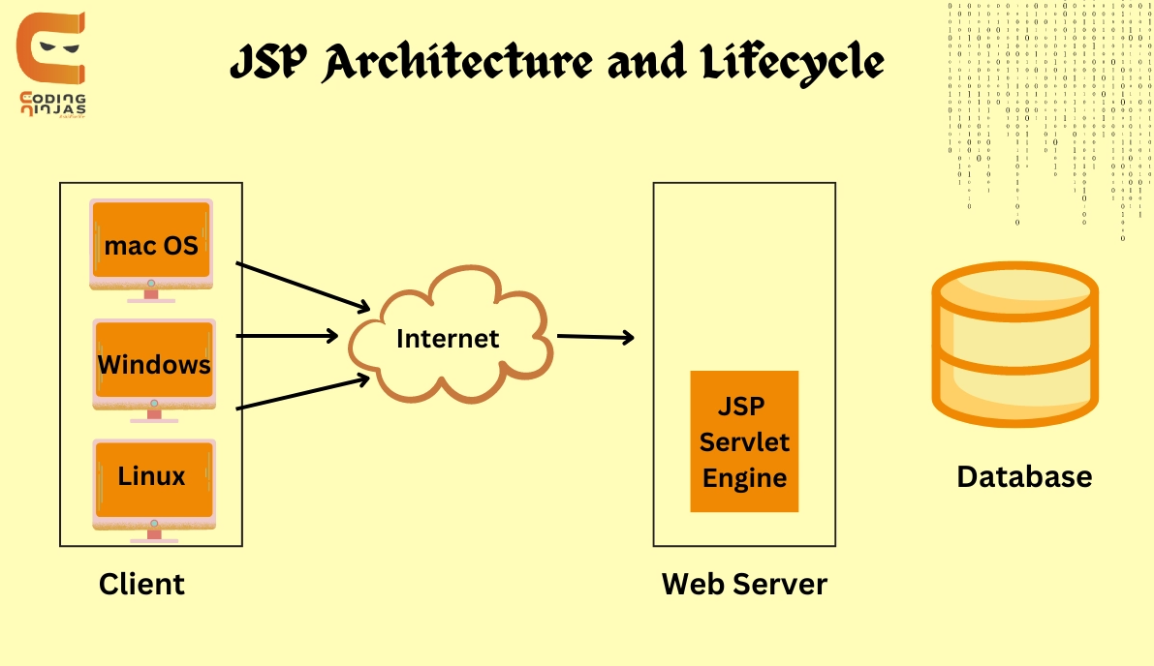
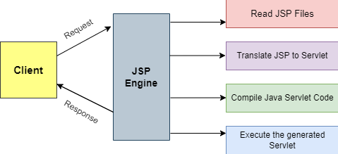
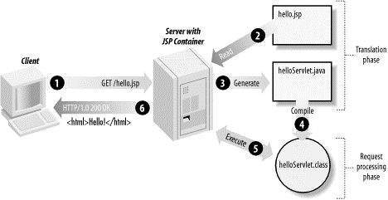
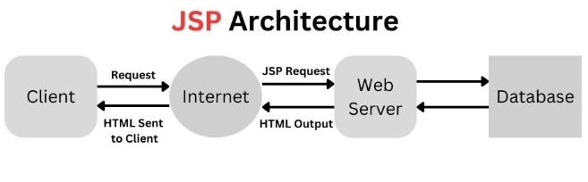
JSP Architecture

Slide 37
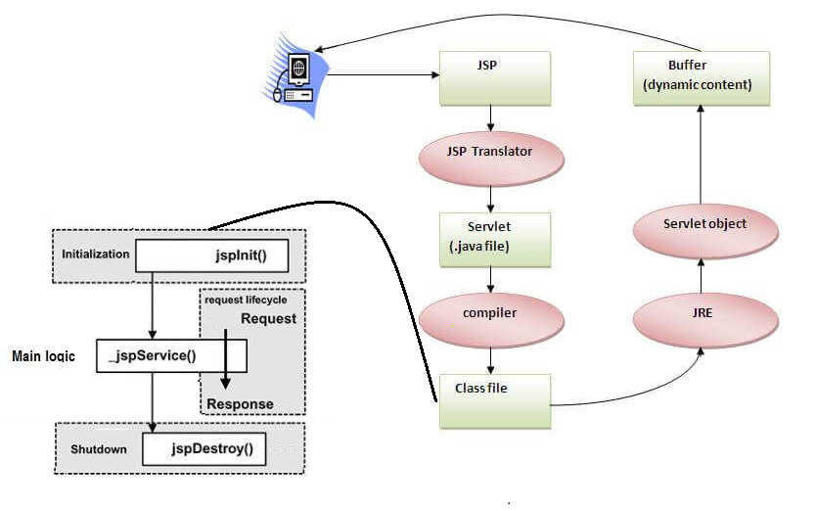
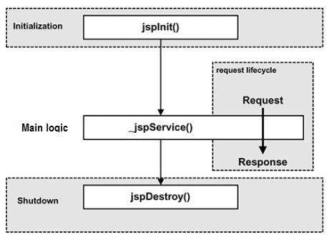
JSP Life Cycle

Slide 38
JSP Project Structure

Slide 39
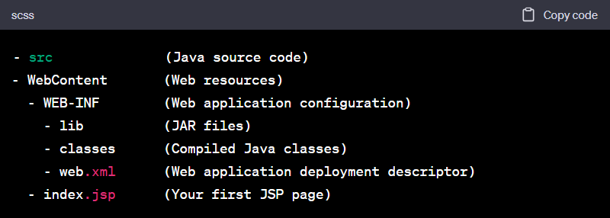
Servlet and JSP Project Structure

Slide 40
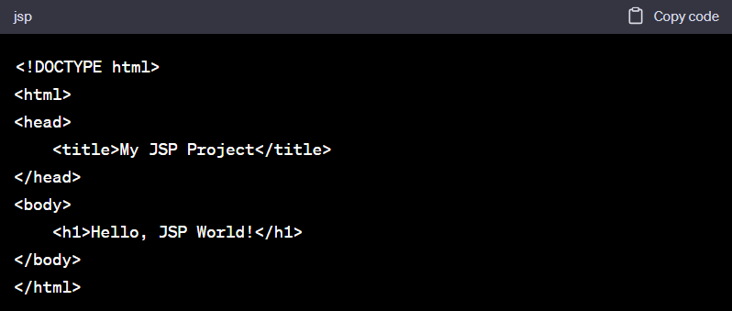
Sample JSP Page

Slide 41
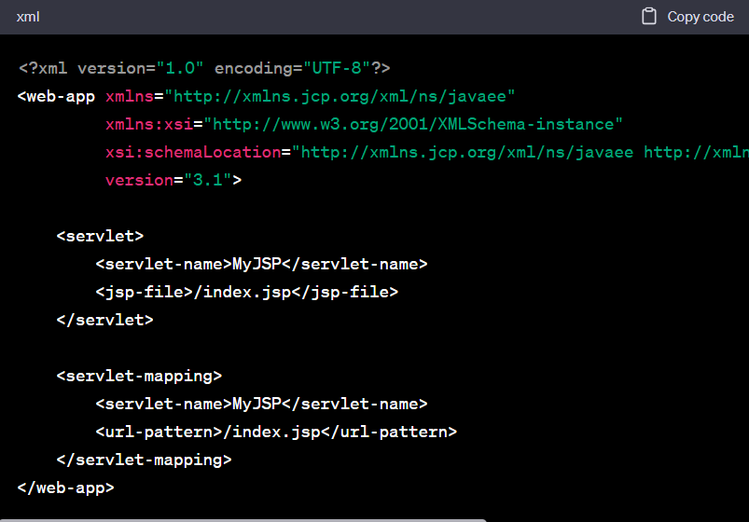
Configure Deployment Descriptor (web.xml)

Slide 42
JSP Scripting Elements

Slide 43
Scripting Elements
JSP (JavaServer Pages) uses a mix of HTML and Java code to create dynamic web pages.
It provides several scripting elements to embed Java code within the HTML content of a JSP page.
Declaration Tags (<%! ... %>)
Scriptlet Tags (<% ... %>)
Expression Tags (<%= ... %>)
Directive Tags (<%@ ... %>)
Action Tags (<jsp: ... >)
Comment Tags (<%-- ... --%>)

Slide 44
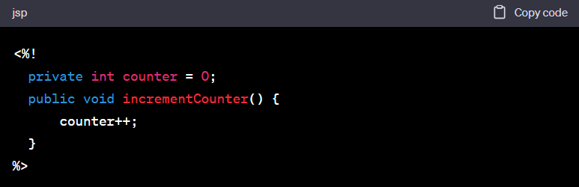
Declaration Tags (<%! ... %>)
Declaration tags are used to declare fields, methods, or variables in JSP.
They are typically placed outside the main HTML content and are used to define reusable Java code.

Slide 45
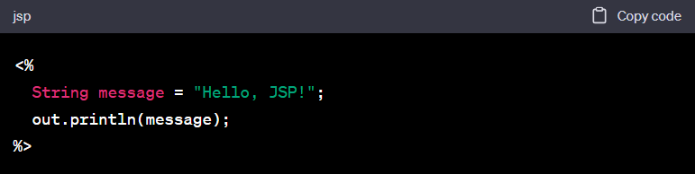
Scriptlet Tags (<% ... %>)
Scriptlet tags are used to embed Java code directly within the HTML content of a JSP page.
They can contain any valid Java code and are executed when the JSP page is processed on the server.

Slide 46
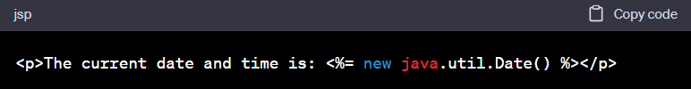
Expression Tags (<%= ... %>)
Expression tags are used to evaluate and display the result of a Java expression within the HTML content.
They automatically convert the result to a string and output it to the response.

Slide 47
JSP Hands-On

Slide 48
Ecommerce Application Demo

Slide 49

Q&A

