Slide 1

Netflix Data: Cleaning Analysis and Visualization
Presenter: Samandar Singh

Slide 2

Project Overview & Dataset information
Objectives: An in-depth exploration of Netflix’s catalog, analysing key factors such as release years, ratings, countries, and genres to uncover trends and insights that drive content distribution and viewer preferences.
Approach: Data cleaning, Visualization and Statistical analysis.
Source : Kaggle Netflix Dataset
Dataset : Netflix movies and TV shows
Entries : 8790 rows & 9 columns
Key Columns : Title, Type ( Movies/TV Shows ), Director, Country, Rating, Release Year and Duration

Slide 3

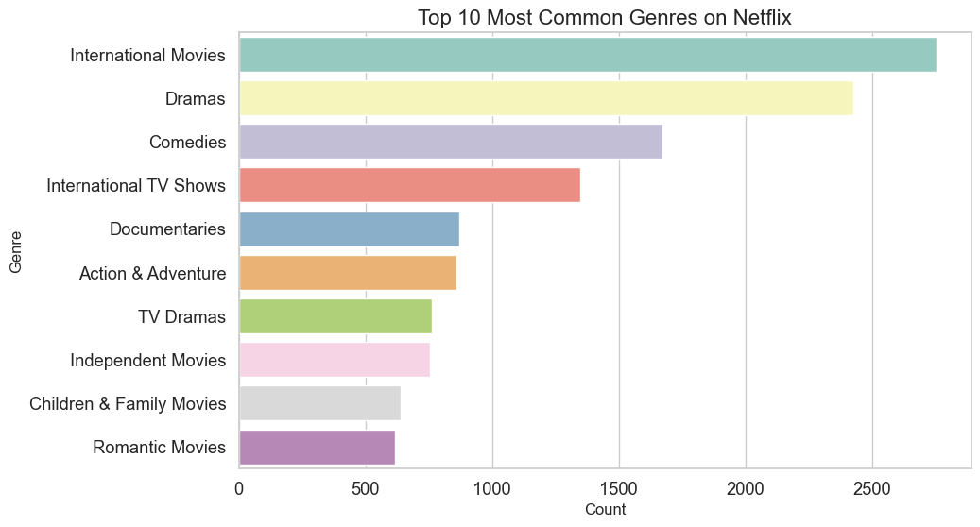
Top 10 Most Common Genres
Visualization: Bar chart showing top 10 Genres on Netflix.
Insights: The most common Genres includes International Movies, Drama and Comedies.

Slide 4
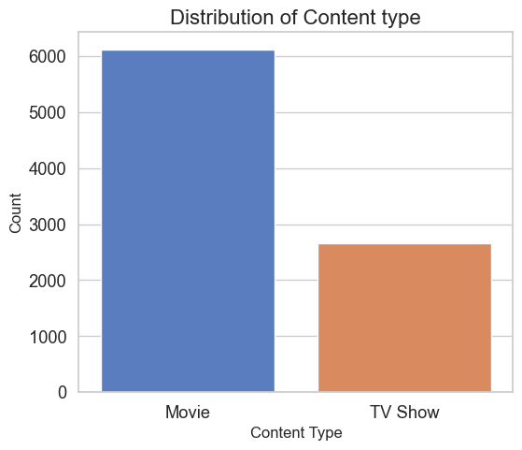
Content Type Distribution (Movies vs TV Shows)
Visualization: Bar chart showing Distribution of Movies and TV Shows on Netflix.
Insights: Movies make up a larger portion of Netflix Catalog while comparing with TV shows.

Slide 5
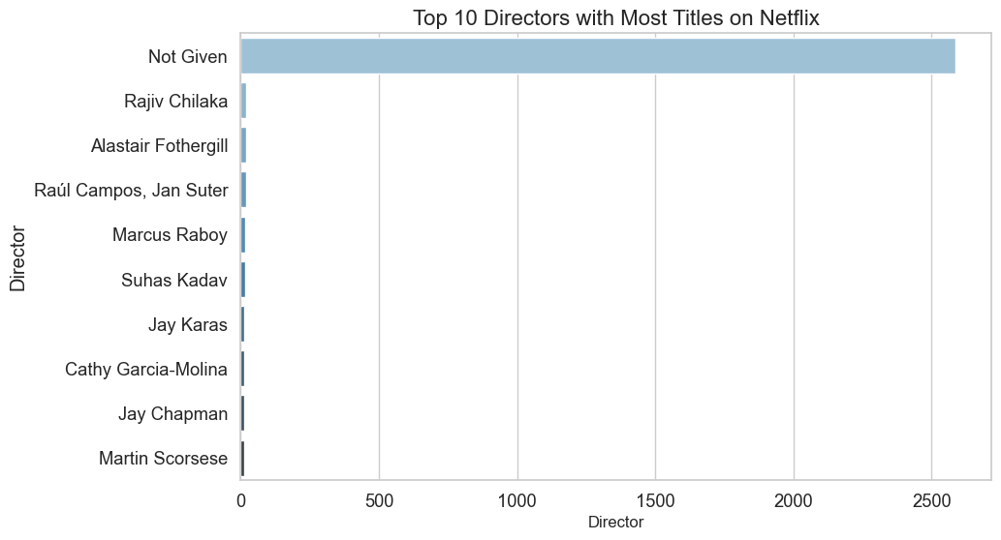
Top 10 Directors with most titles on Netflix
Visualization: Bar chart showing top 10 Directors working with Netflix.
Insights: Almost 90% of Movies and TV show’s Directors Name is unavailable in provided Dataset.

Slide 6
Top 10 Directors with most titles on Netflix
Visualization: Bar chart showing top 10 Directors working with Netflix.
Insights: Almost 90% of Movies and TV show’s Directors Name is unavailable in provided Dataset.

Slide 7
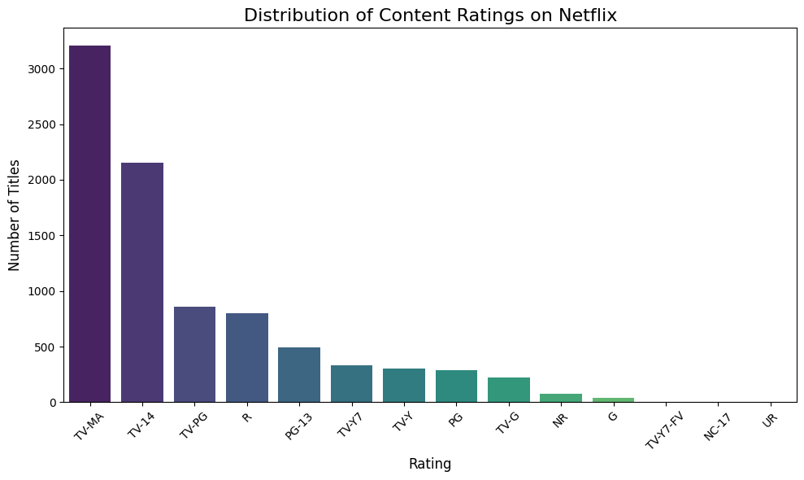
Distribution of Content ratings on Netflix
Visualization: Bar chart showing content rating Distribution of Netflix.
Insights: Netflix create most of the Movies in TV-MA or TV-14 ratings.

Slide 8
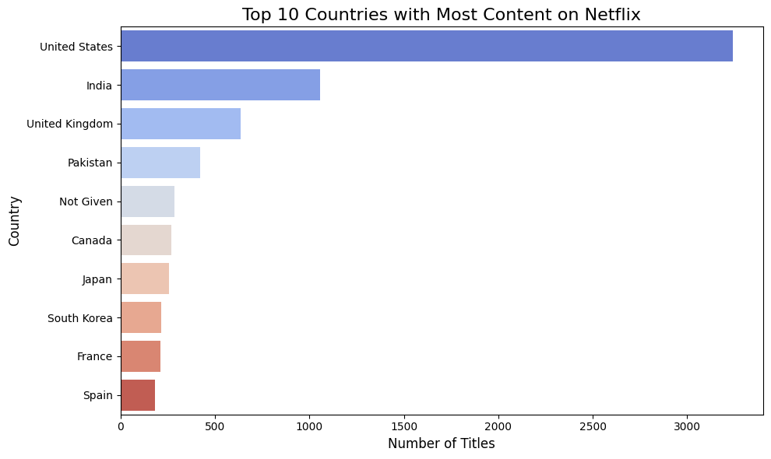
Top 10 Countries with Most content on Netflix
Visualization: Bar chart showing Netflix content Distribution for Top 10 Countries.
Insights: After United States India is the biggest Movies & TV Show Market for Netflix.

Slide 9
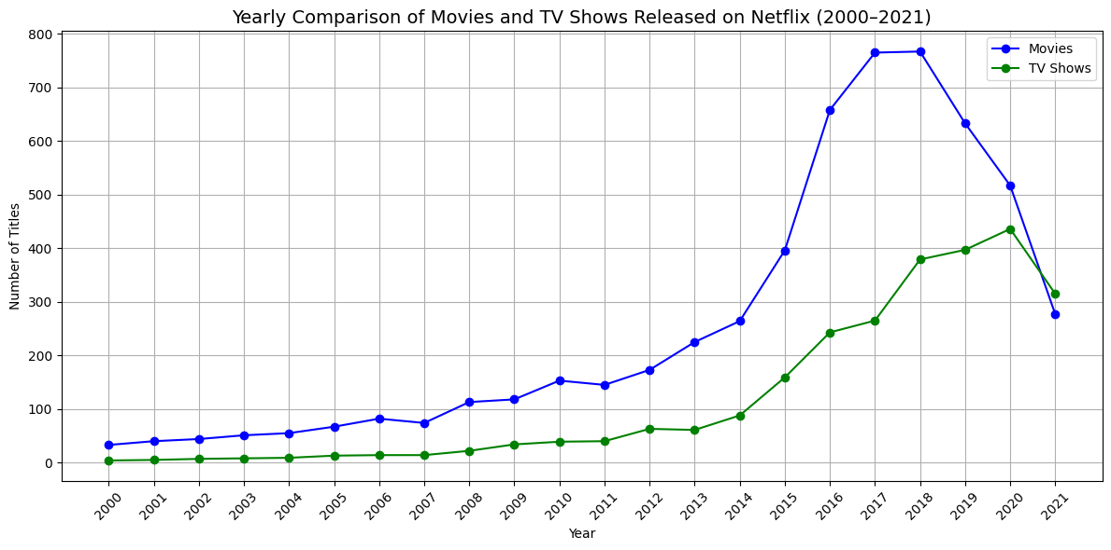
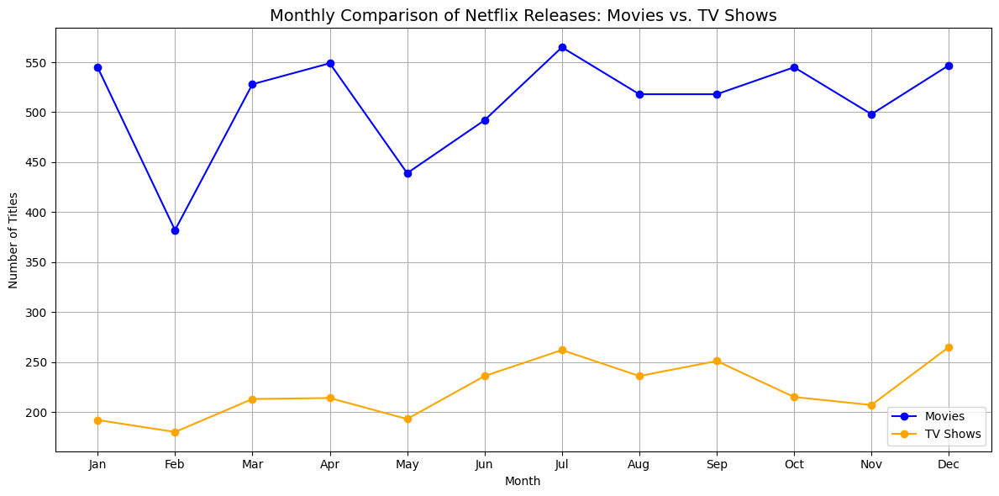
Yearly and Monthly Comparison
Visualization: Line Chart showing yearly and Monthly comparison of Movies vs TV show on Netflix.
Insights: After United States India is the biggest Movies & TV Show Market for Netflix.

Slide 10
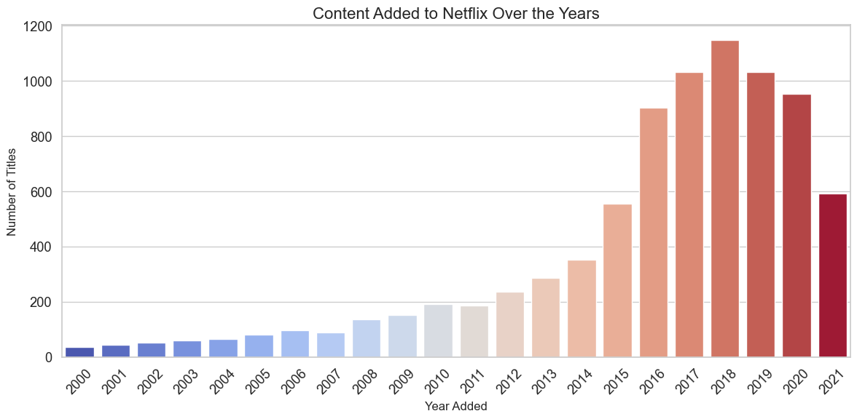
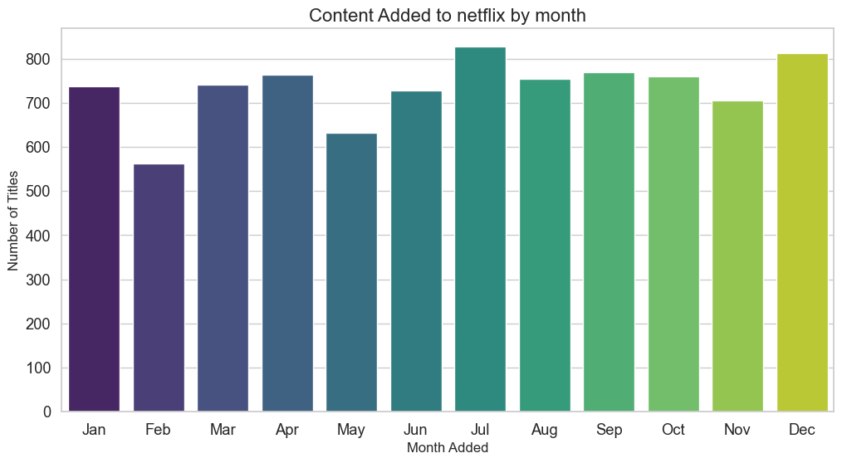
Content Type Distribution (Movies vs TV Shows)
Visualization: Bar chart showing the number of releases by year.
Insights: Majority of content was released after 2010, with the peak around 2017-2019

