Slide 1

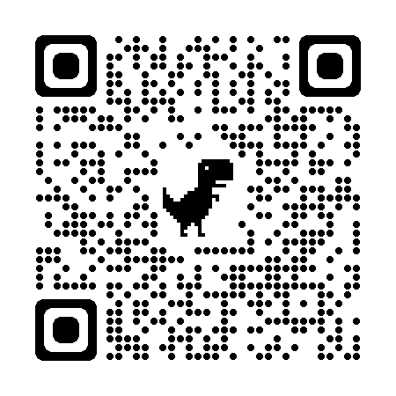








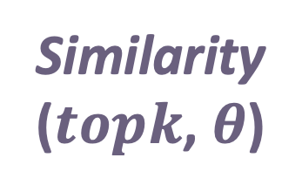
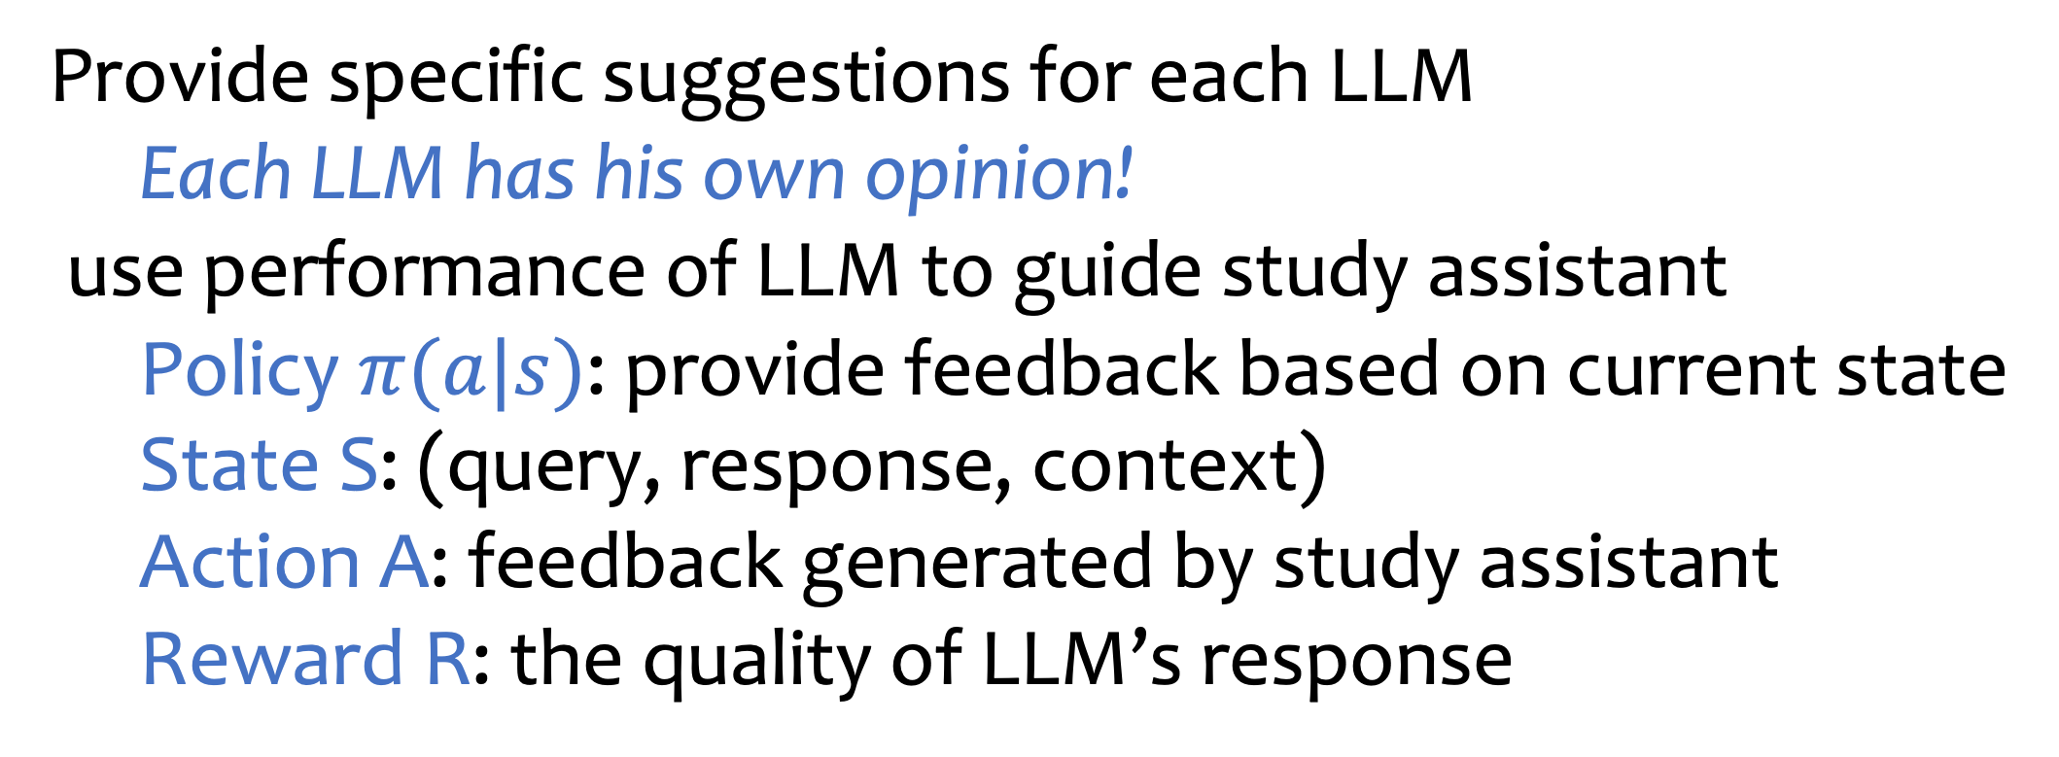
Learning from Mistakes via Cooperative Study Assistant for Large Language Models
Scan Here!
Danqing Wang danqingwang@ucsb.edu
Lei Li leili@cs.cmu.edu
LLMs can self-improve, but...
SALAM: finetune a study assistant for LLM
Cooperation makes LLMs better
Unreliable feedback may mislead LLMs
Jane thought today is 3/11/2002, but today is in fact Mar 12, which is 1 day later. What is the date a month ago?
Yesterday, Jan 21, 2011, Jane ate 2 pizzas and 5 wings. What is the date today?
Accuracy under the multi-choice setting
Query
02/12/2002
02/11/2002
Label
LLM
Study Assistant
Study Assistant
LLM
False
Analysis: The model might mistake ...
Analysis: The model might have misunderstood '1 day later'
ChatGPT on CommonSenseQA
Guideline: identify the correct date from which calculations should be made.
Guideline: For dates, remember to ...
Cite from: Large Language Models Cannot Self-Correct Reasoning Yet
Un-reusable experience makes LLMs forgetful
SALAM further enhances GPT-4
Retrieve
A 78-year-old man was talking to his 24-year-old friend about how much politics has changed in just the last few decades. Who embraces change?
Mistake Gathering
Mistake Memory
GPT-4 as LLM
GPT-4 as Study Assistant
Examination
Mistake Retrieval
The 24-year-old friend
Avoid making assumptions based on stereotypes
Key
Query
New query
Cannot answer
Value
Response
Response
Case 1
Ground Truth
Analysis
Analysis
Guideline
I watched an elderly man talking to a much more youthful man the other day in the park. Who has trouble remembering things?
Guideline
Similarity
($topk$, $θ$)
Retrieve
Case Study
The elderly man
Mistake Gathering
Examination
The feedback gives detailed guideline; SALAM w/ IL is more specific
Case 2
Mistake Memory
Jane visits the bookstore on the 16th of each month starting from the October of 2009. It is her 5th visit to the bookstore today. What is the date one year ago from today?
Previous answer: 08/16/2009
Correct answer: 02/16/2009
Model-specific Study Assistant by Imitation Learning
Which sentence has the correct adjective order:
red little silly cloth eating rectangular sock
silly little rectangular red cloth eating sock
Learning to correct mistakes by introducing a Cooperative Agent
Main LLM: solve problem
big (difficult to finetune)
Study assistant: provide feedback (small, easy to train)
Query: Which sentence has the correct adjective order:
(A) American triangular computer
(B) triangular American computer
Incorrect Answer: (A)
Provide specific suggestions for each LLM
Each LLM has his own opinion!
use performance of LLM to guide study assistant
Policy $π(a|s)$: provide feedback based on current state
State S: (query, response, context)
Action A: feedback generated by study assistant
Reward R: the quality of LLM’s response
Guideline: ...considering the correct day of the month and subtracting the specified number of months from the given date.
Retrieve
Guideline: the general rules of adjective order in English, such as opinion, size, age, shape, color, origin, material, and purpose.
SALAM
Guideline: ...the frequency of visits and the current visit number, to accurately calculate the elapsed time.
(B)
Mistake Collections
LLM
SALAM w/ IL

