Slide 1
Project 2: Fifteen Puzzle
Brian Walker

Slide 2
Benefits of Scrum
Sprints are probably the best use of this methodology. They are short spans in which a certain version of the project was worked on and it allows me to group all of that work in a sort of version control to go back to if I mess up a newer version of the game. It also gave me milestones and focus on particular features, making it easier to focus on specific parts of the project.

Slide 3

Problem Statement
Users need an interactive web-based application (sliding puzzle game) for entertainment and engagement.
Intuitive and responsive UI
Customizable features
Game logic with feedback

Slide 4

General Requirements
Inputs:
- User clicks (tile movements)
- Settings/preferences
- Timer/cheat button triggers
Outputs:
- Visual tile movements
- Game status (win/loss)
- Timers, scores, feedback

Slide 5
Design Overview
Solution Overview:
- Web-based UI using HTML/CSS/JS
- DOM manipulation for interaction
- Data persistence via PHP & MySQL
Key Features:
- Puzzle logic, timer, save/load
- Custom avatars & backgrounds

Slide 6
JavaScript Concepts Used
- Event listeners for interaction
- `setInterval()` for timer
- DOM manipulation
- JSON handling

Slide 7
UI Design
Features:
Responsive tile grid
Avatar/background selector
Timer and control buttons
Win message

Slide 8
UML Class Diagram
**Classes:**
- Game: puzzle logic
- Tile: value, position, click event
- Timer: start/stop/reset
- UserSettings: preferences
(Insert UML diagram here)

Slide 9
Pseudocode
**Tile Movement with Animation:**
```
function onTileClick(tile):
if tile is adjacent to empty:
animate tile with transition
swap positions
check for win
```
- Use `transform: translate()`
- `transition: all 0.3s ease-in-out`

Slide 10
Testing
Test 1: Figuring out how to implement MySQL on live web server
Getting tables together
Test 2: Figuring out how to get code to change pictures on game board
Test 3: Cleaning up code and trying to debug login/make admin account
Test 4: Realizing PHP might work better with most of this and switching over on main file to implement server-side logic for game
Test 5: Attempting auto-solve algorithm
Test 6: Realizing I’m running out of time and turning this in

Slide 11
functions.php
Purpose: Central utility for authentication, preferences, stats
Key Functions:
sanitize(): Prevents XSS by cleaning input
is_logged_in(), require_login(): Session Authentication
get_current_username(): Retrieved logged-in user
save_game(): Records puzzle results
save_user_preferences(): Inserts/Updates preferences
Upload_image, delete_image(): Manage game background images as admin
Deactivate_user(): Deletes accounts

Slide 12
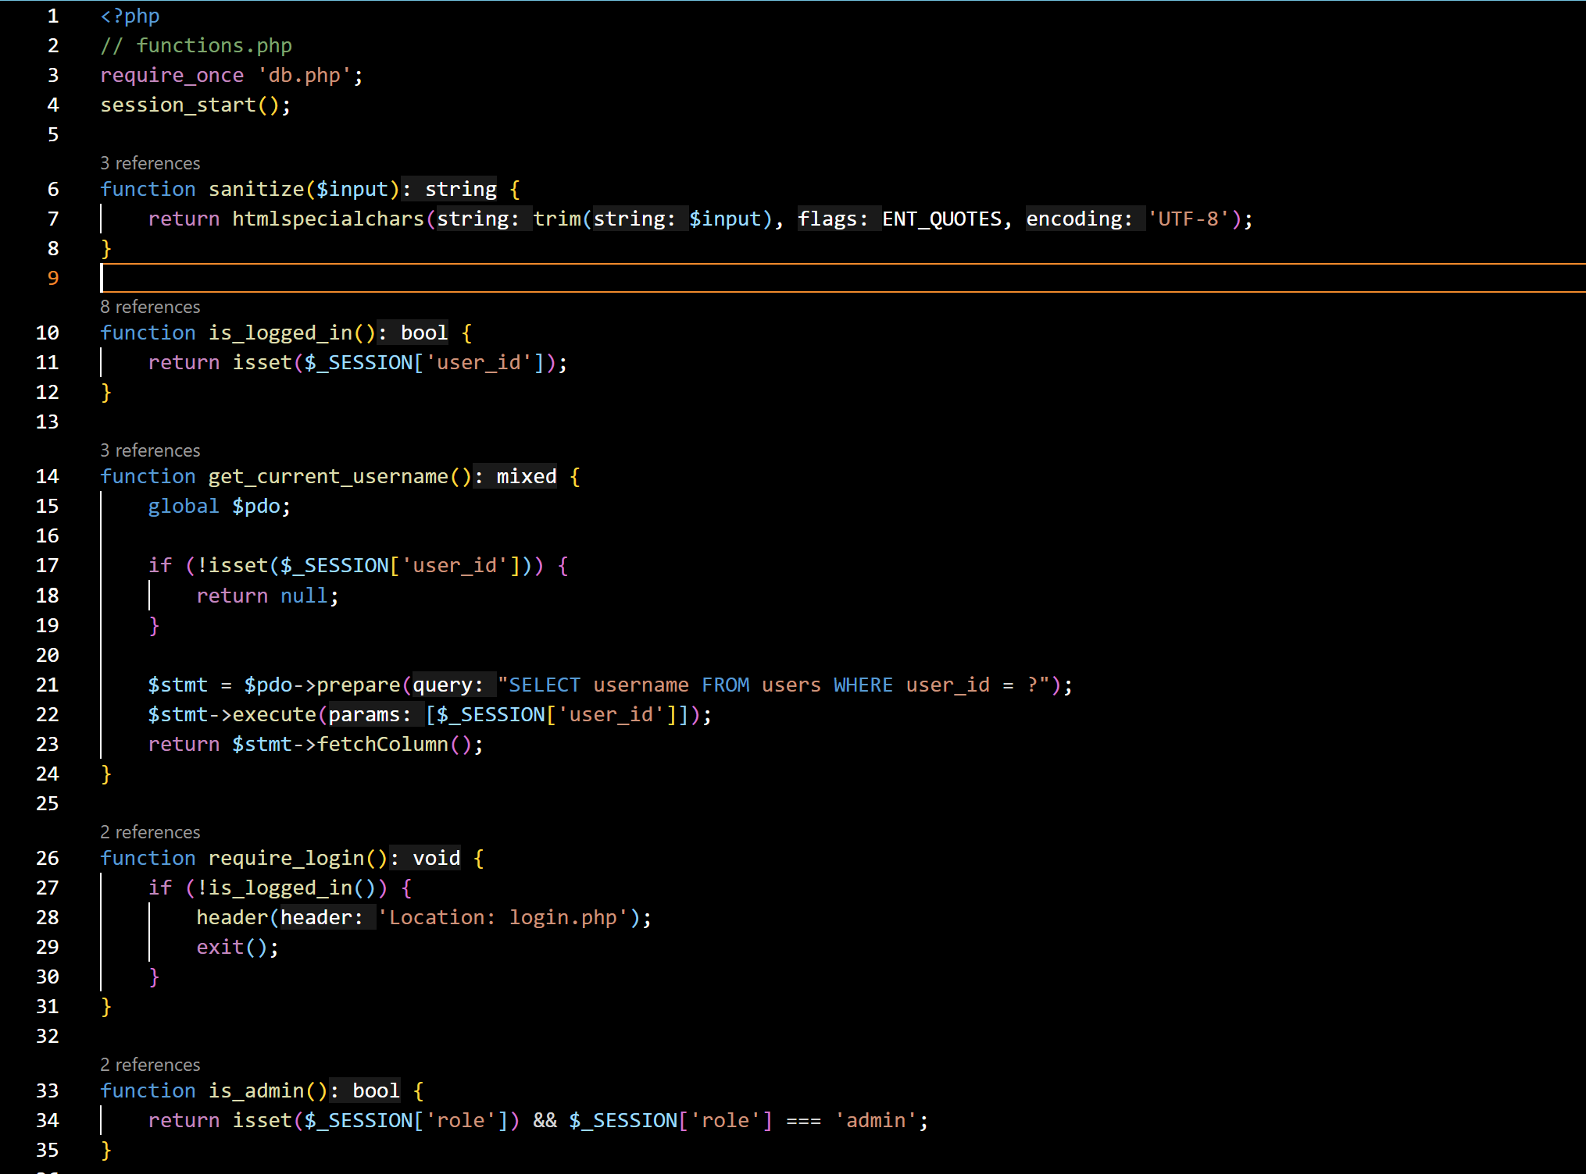
Functions.php

Slide 13
Fifteen.js
Purpose: Implements a dynamic, interactive Fifteen Puzzle game with:
Dynamic Puzzle Size
Tile Movement
Shuffling
Timer and Move Counter
Autosolve Feature
Save Function
User Preferences

Slide 14
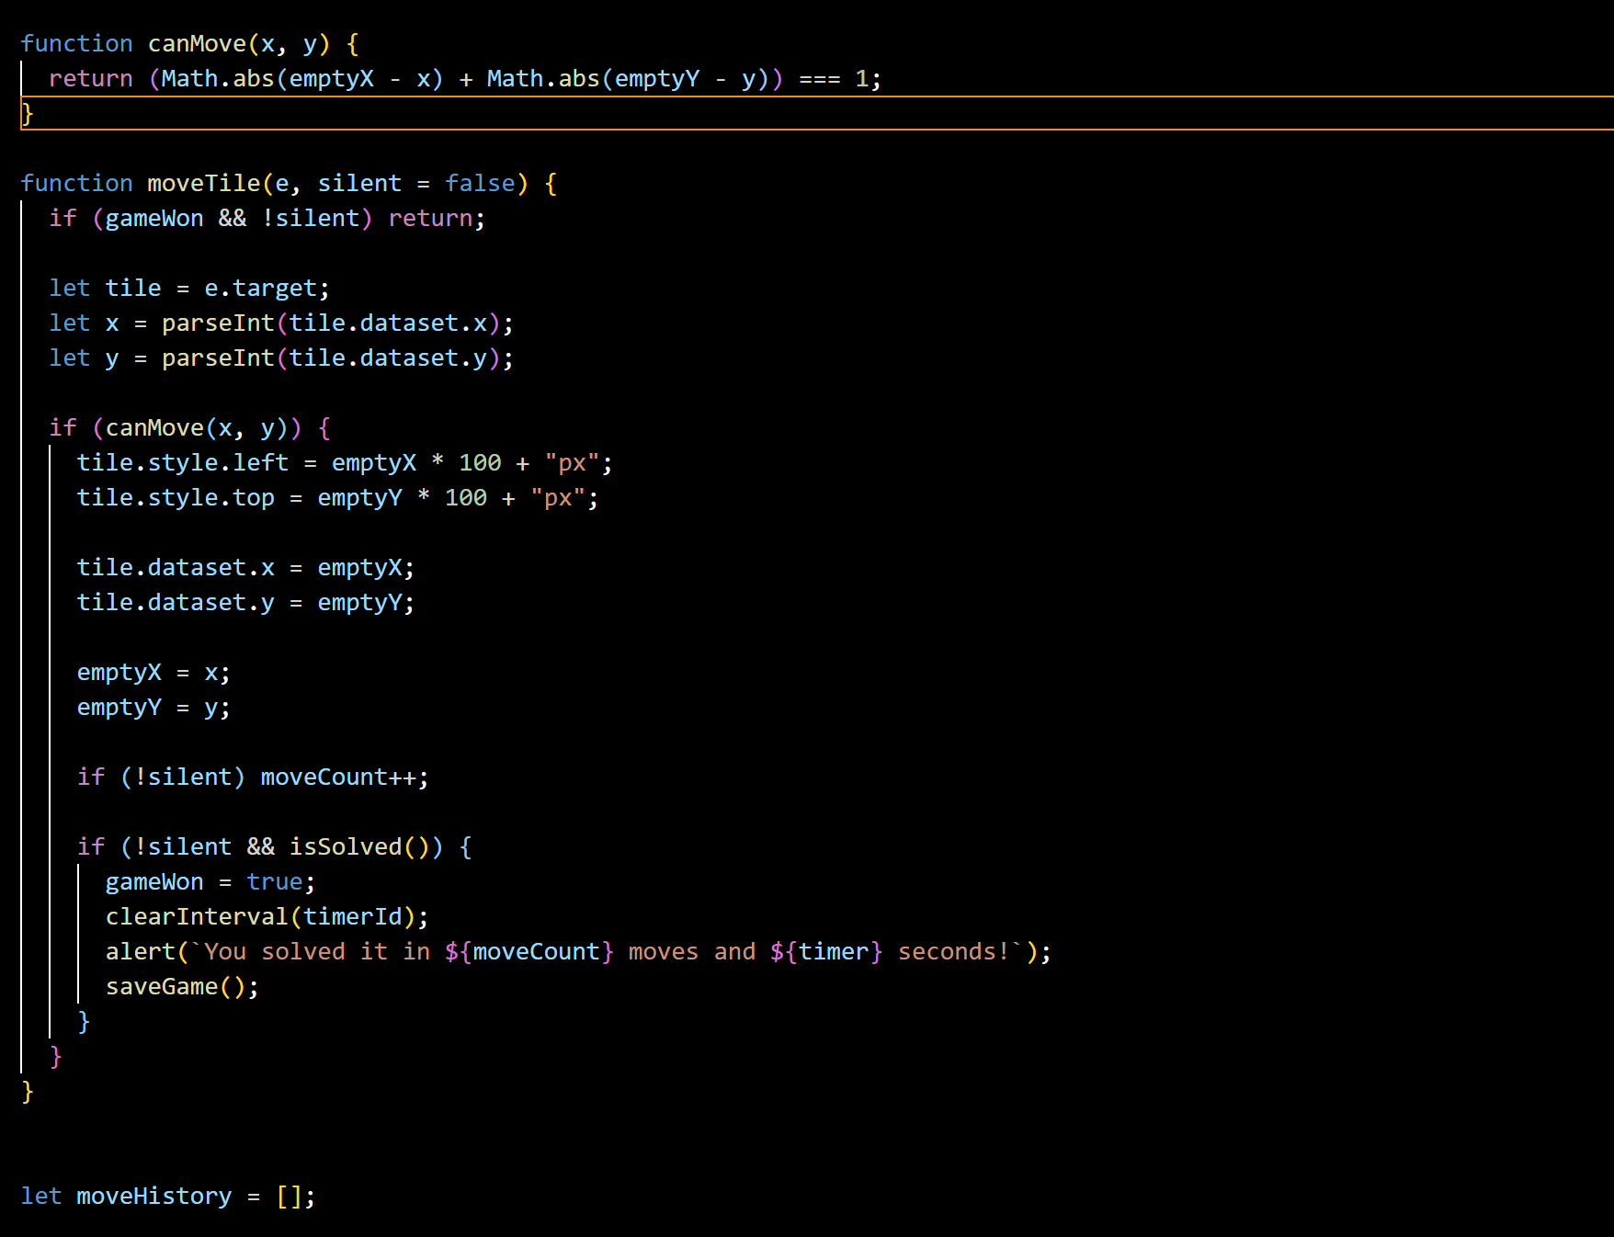
Fifteen.js

Slide 15
admin.php
Purpose: Provides admin-only access to manage users, background images, and global game statistics.
Uses require_login() and is_admin() to restrict access
Non-admin users are shown an “Access Denied” message
Displays users
Can deactivate users
Lists uploaded background images
Can delete images
Universal game statistics
Total Games
Average time
Average movements

Slide 16
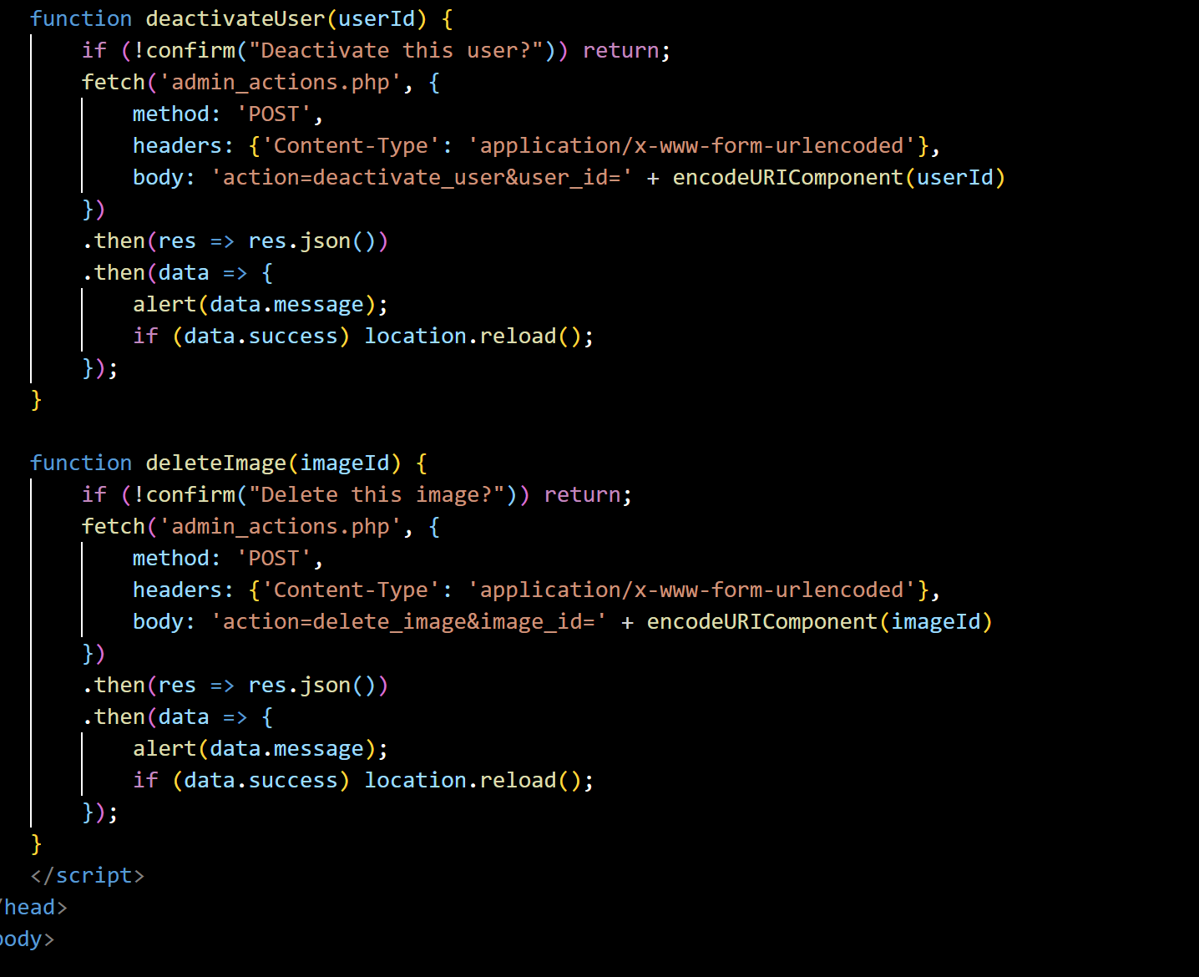
Admin.php

Slide 17
Conclusion
- Fully functional interactive puzzle
- JavaScript logic, UI design, animation
- Tested key features
- Ready for user feedback or deployment

