Slide 1

Debt Collection
Team C

Slide 2




Team Breakdown
Ayush Sharma (Team Rep)
MS – Artificial Intelligence
Aru Pandey
MS – Computer Science
Shiven Sharma
MS – Artificial Intelligence
Raktim Verma
MS – Computer Science

Slide 3
Project Overview
The primary objective of this analysis is to conduct a comprehensive examination of the debt collection practices within the Massachusetts court system.
Our project involves a comprehensive data analysis of the debt collections court system data supplied by WGBH. We aim to address the critical questions posed by WGBH through this in-depth examination.

Slide 4
Project Deliverables
What are the biggest organizations in debt collection?
Some specific insights about these companies?
How many cases end up with wage garnishes?
How many cases lead to Capias Warrants?
How many cases have been filed each year over the last ten years in each court?

Slide 5
How many cases have been filed each year over the last ten years in each court?
Year | Cases filed
2015 | 249336
2016 | 212631
2017 | 204275
2018 | 203849
2019 | 204445
2020 | 124730
2021 | 170731
2022 | 170498
2023 | 208288
2024 | 30787

Slide 6
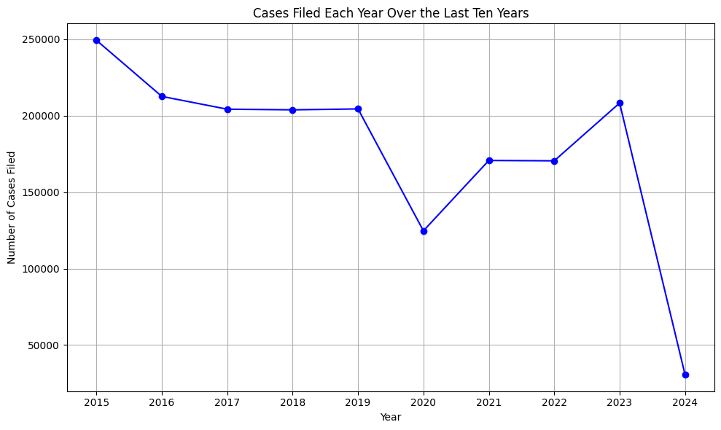

Slide 7
Points to note from previous graph and table:
1. General Trend (2015-2019): There was a gradual decline in the number of cases filed from 2015 to 2018, starting at 249,336 cases in 2015 and decreasing each year until it reached 203,849 in 2018. In 2019, there was a slight uptick to 204,445.
2. Significant Drop in 2020: There is a noticeable drop in the number of cases filed in 2020, where the figures plummeted to 124,730. This drop is likely due to the impact of the COVID-19 pandemic, which caused disruptions in many legal systems worldwide—courts were closed, cases were delayed, and there were limitations on legal proceedings due to lockdowns and social distancing measures.
3. Recovery Post-2020: The numbers start to recover in 2021 with 170,731 cases filed and remain relatively stable in 2022 with 170,498 cases. This could indicate the legal system's adaptation to the new normal, possibly incorporating more virtual proceedings and catching up on the backlog created in 2020.
4. Increase in 2023: There's a significant increase in cases filed in 2023 to 208,288. This could signify a return to pre-pandemic levels, suggesting that the backlog has been addressed, or it could reflect an increase in litigation possibly due to ongoing disputes arising as a result of the pandemic's long-term effects.
5. Partial Data for 2024: The figure for 2024 is notably lower at 30,787 cases. However, since 2024 is the current year and we do not have complete data, this number represents only part of the year. If this is data from the first quarter, for example, it might project an increase once the year is complete. If the current rate continues, 2024 could see a significantly higher total than previous years.

Slide 8
Findings
The top 10 companies in terms of the dollar amount of residential mortgage loans they serviced in 2022 in the Commonwealth of Massachusetts are as follows:
Nationstar Mortgage LLC: $21,415,050,000
Rocket Mortgage, LLC: $14,101,560,000
LoanCare, LLC: $13,003,850,000
ServiceMac, LLC: $11,695,070,000
NewRez LLC: $11,126,100,000
Freedom Mortgage Corporation: $9,943,681,000
PennyMac Loan Services, LLC: $8,563,333,000
PHH Mortgage Corporation: $7,906,210,000
Select Portfolio Servicing, Inc.: $4,009,109,000
RoundPoint Mortgage Servicing Corporation: $3,618,304,000

Slide 9
Findings
The bar chart in the next slide visualizes the top 10 companies in Massachusetts by the dollar amount of residential mortgage loans they serviced in 2022.

Slide 10
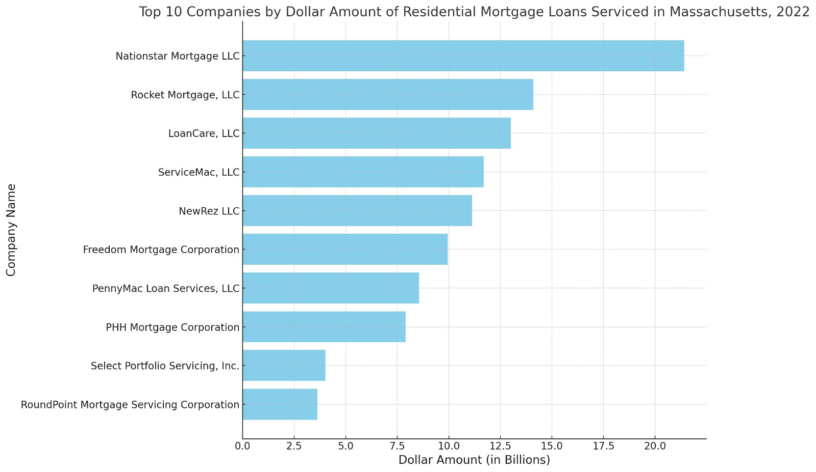
Findings

Slide 11
Findings
Things to note from the previous slide:
Nationstar Mortgage LLC tops the list with over $21 billion in serviced loans, followed by Rocket Mortgage, LLC.

Slide 12
Findings
Some Important Insights About These Companies
Number of Residential Mortgage Loans Serviced in 2022:
Nationstar Mortgage LLC serviced 87,541 residential mortgage loans.
Rocket Mortgage, LLC serviced 52,879 residential mortgage loans.
Dollar Amount of HUD Reverse Mortgage Loans Serviced in 2022
PHH Mortgage Corporation serviced HUD reverse mortgage loans with a total dollar amount of approximately $927.04 million.
Nationstar Mortgage LLC serviced HUD reverse mortgage loans with a total dollar amount of approximately $467.65 million.
Number of HUD Reverse Mortgage Loans Serviced in 2022
PHH Mortgage Corporation serviced 3,510 HUD reverse mortgage loans.
Nationstar Mortgage LLC serviced 1,913 HUD reverse mortgage loans.

Slide 13
Findings
Things to note from the previous slide:
HUD reverse mortgage loans serviced by dollar amount and by the number of loans: PHH Mortgage Corporation and Nationstar Mortgage LLC are highlighted in both instances, while Nationstar is highlighted in all the three instances

Slide 14
Findings
Non-mortgage debt collection, ranking companies by the number of debtor accounts they purchased in MA:
We ranked these companies by the number of debtor accounts they purchased in Massachusetts in 2022, providing a quantitative measure of their activity level in non-mortgage loan issuance and debt collection within the state, like credit cards, Student loans etc.
Midland Credit Management, Inc.: 55,102 accounts
Jefferson Capital Systems, LLC: 27,590 accounts
Portfolio Recovery Associates, LLC: 17,382 accounts
Spring Oaks Capital, LLC: 11,243 accounts
Credit Corp Solutions Inc.: 5,818 accounts
Velocity Investments, L.L.C.: 3,258 accounts
Andrew C Metcalf: 752 accounts
Unifund Corporation: 330 accounts
NCB Management Services, Inc.: 278 accounts
Webcollex, LLC: 60 accounts

Slide 15
Findings
Things to note from the previous slide:
In terms of non-mortgage debts, the top 4 companies have the majority of the debt collection accounts.
Midland Credit Management, Inc. holds the top position with over 55,000 accounts
Another thing to note here is that Andrew Metcalf in this instance has more debt collection accounts in his name (752) than even some corporations like Unifund corporation (330), NCB management Services Inc (278), and Webcollex LLC (60) {based on data provided for 2022}.

Slide 16
Findings
Next slide has the graph representing the percentage of cases filed in small claims and district courts by debt collectors.
Total number of debt collector cases filed in small claims and district courts = 177,248.

Slide 17
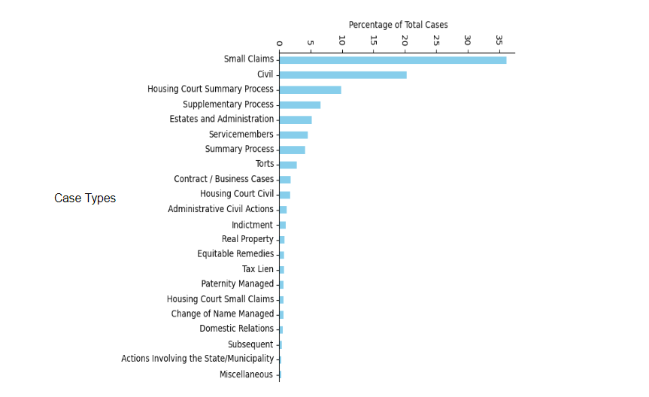
Case Types by Percentage of Total Cases
More detailed graph in the next slide

Slide 18
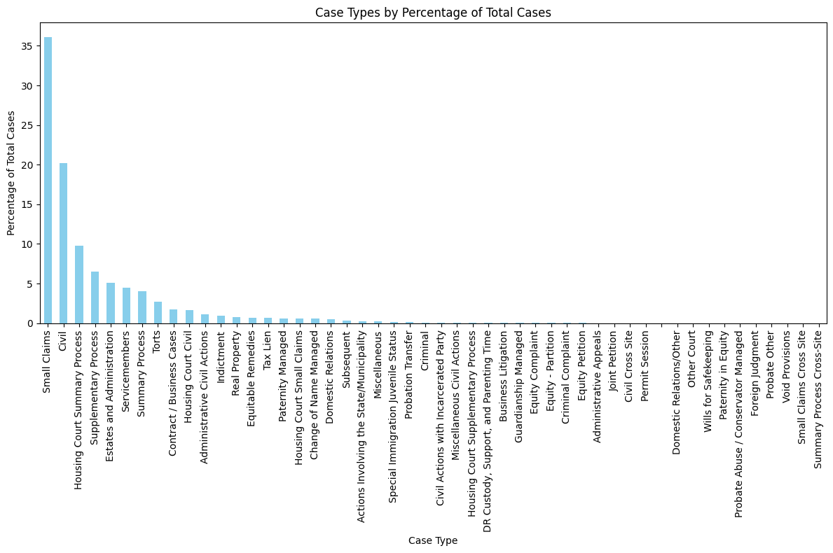

Slide 19
Points to note from previous graph:
The most common type of case, taking up a substantial margin compared to others, is 'Small Claims', indicating that this jurisdiction sees a lot of minor civil disputes involving small amounts of money. Following 'Small Claims' are 'Civil', 'Housing Court Summary Process', etc., all of which also make up a notable percentage of cases, but significantly less than small claims.
As the chart progresses to the right, the percentage of total cases for each case type diminishes, showing less frequent case types in this particular system.

Slide 20
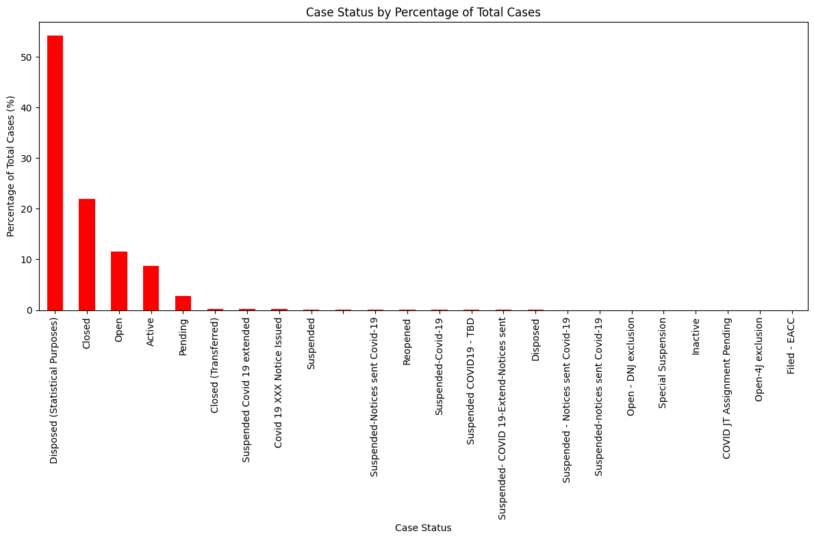

Slide 21
Points to note from previous graph:
The case status with the highest percentage is "Disposed," suggesting that the majority of cases have been resolved in some manner. This is followed by "Closed (Inactive)", "Open", "Active", "Pending" which together indicate that a significant proportion of cases are either currently active, in some form of alternative dispute resolution, awaiting action, or inactive.
A notable feature of this chart is the inclusion of several statuses related to COVID-19, such as "Suspended COVID-19", "COVID-19 XXX Notice Issued", etc. These categories are less in number meaning that Covid doesn’t have a significant impact on legal proceedings, i.e., a less number of cases being suspended due to COVID-19. This implies adjustments had to be made in the legal process to accommodate the challenges posed by the pandemic, and the adjustments were well made.

Slide 22
Findings
Some Important Insights:
Dominance in Mortgage Servicing: Nationstar Mortgage LLC appears to be a leading entity in the mortgage servicing space within Massachusetts, topping multiple categories. This suggests strong operational capacity and market penetration in residential mortgage loan servicing.
Non-Mortgage Debt Collection: Midland Credit Management, Inc. has a significant presence in the non-mortgage debt collection market with the highest number of accounts. This indicates that a few companies manage a large portion of debt collection activities, which could mean these companies have specialized strategies or capabilities for debt collection in non-mortgage sectors.
Individual vs. Corporate Debt Collection: It’s unusual to see an individual, Andrew Metcalf, holding more debt collection accounts than some corporations. This might indicate that Mr. Metcalf operates a substantial private business in debt collection, or it could be an anomaly worth investigating for possible errors or specific reasons behind such a high number of accounts.

Slide 23
Findings
Some Important Insights:
Legal Actions: The large number of cases in small claims and district courts, along with the cases that lead to wage garnishments and Capias warrants, underscores the legal intensity of debt collection efforts. It also raises questions about the socio-economic impact of such legal measures on individuals.
Overall Debt Collection Landscape: The provided data demonstrates a robust debt collection ecosystem with specific companies leading in various niches, whether it's servicing mortgage loans or handling non-mortgage related debts. The market seems concentrated with key players handling large volumes of accounts, which could have implications for competition and consumer experiences.

Slide 24
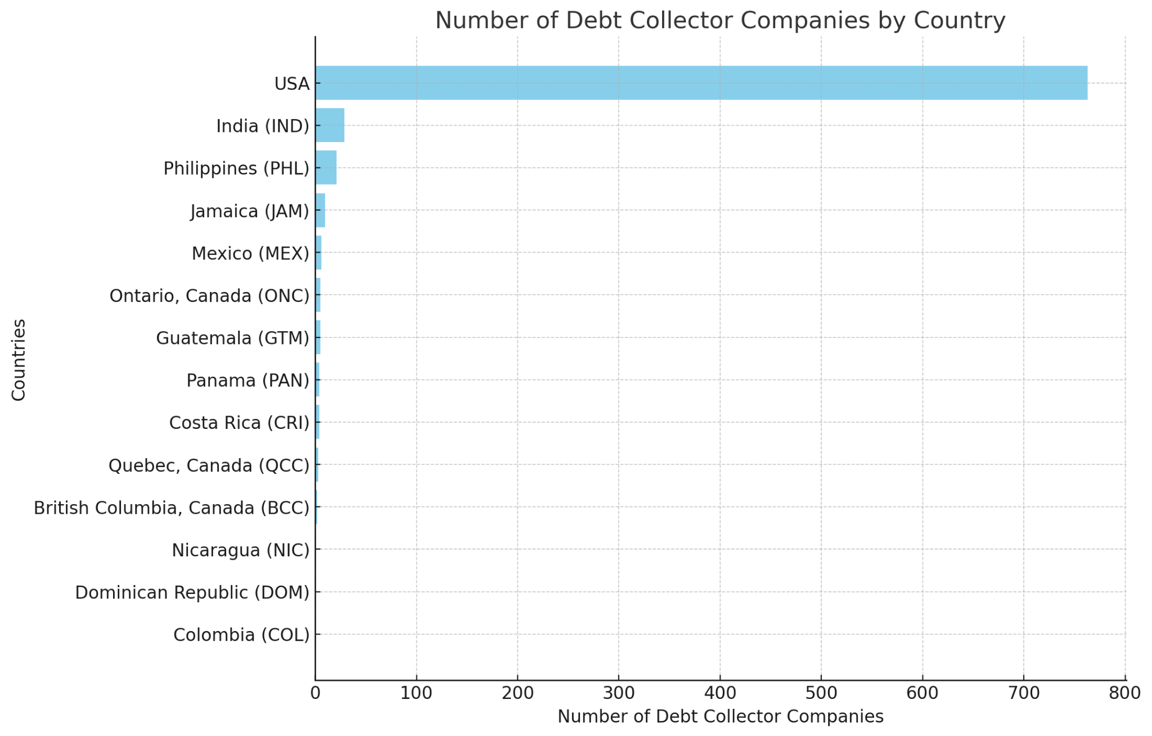
Findings

Slide 25
Findings
Data from the previous slide:
There are 763 unique debt collector companies based in the USA.
For debt collectors based elsewhere, the distribution across different countries is as follows:
India (IND): 29
Philippines (PHL): 21
Jamaica (JAM): 10
Mexico (MEX): 6
Ontario, Canada (ONC), Guatemala (GTM): Each 5
Panama (PAN), Costa Rica (CRI): Each 4
Quebec, Canada (QCC): 3
British Columbia, Canada (BCC): 2
Nicaragua (NIC), Dominican Republic (DOM), Colombia (COL): Each 1

Slide 26
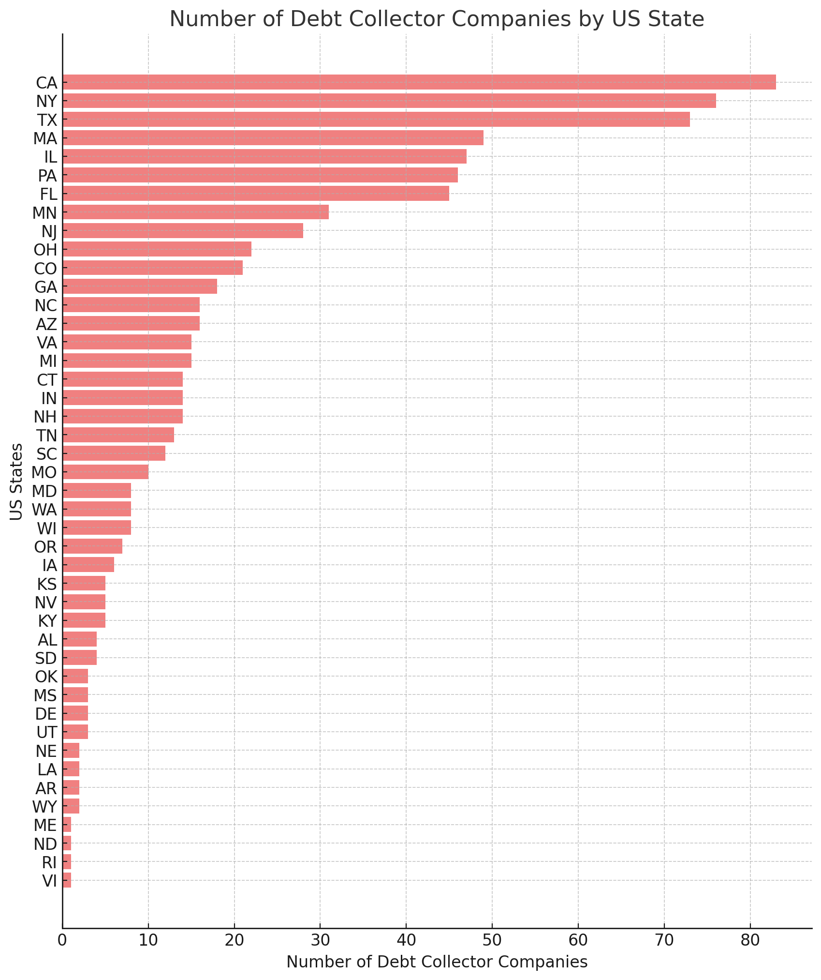

Slide 27
Findings
Data from previous slide:
State-wise in the US, we have noted the no. of debt collection entities in these cases upto 2023:
CA: 83
NY: 76
TX: 73
MA: 49
IL: 47
PA: 46
FL: 45
MN: 31
NJ: 28
OH: 22
CO: 21
GA: 18
ME, ND, RI, VI: 1
NC, AZ: 16
VA, MI: 15
CT, IN, NH: 14
TN: 13
SC: 12
MO: 10
MD, WA, WI: 8
OR: 7
IA: 6
KS, NV, KY: 5
AL, SD: 4
OK, MS, DE, UT: 3
NE, LA, AR, WY: 2

Slide 28
Findings
Points to note from the previous two graphs:
From the countries’ data, we can see that there is not a big concern as most of the debt collection entities are US-based, with India and Philippines being notable contributors to this list of debt collectors.
However, noting from the state data, we have noted that within the state of Massachusetts, the major debt collectors are not even from the state MA, instead they belong to California, New York, and Texas respectively. Also, a significant amount of debt collectors are based out of Illinois, Philadelphia, Florida and other states.

Slide 29
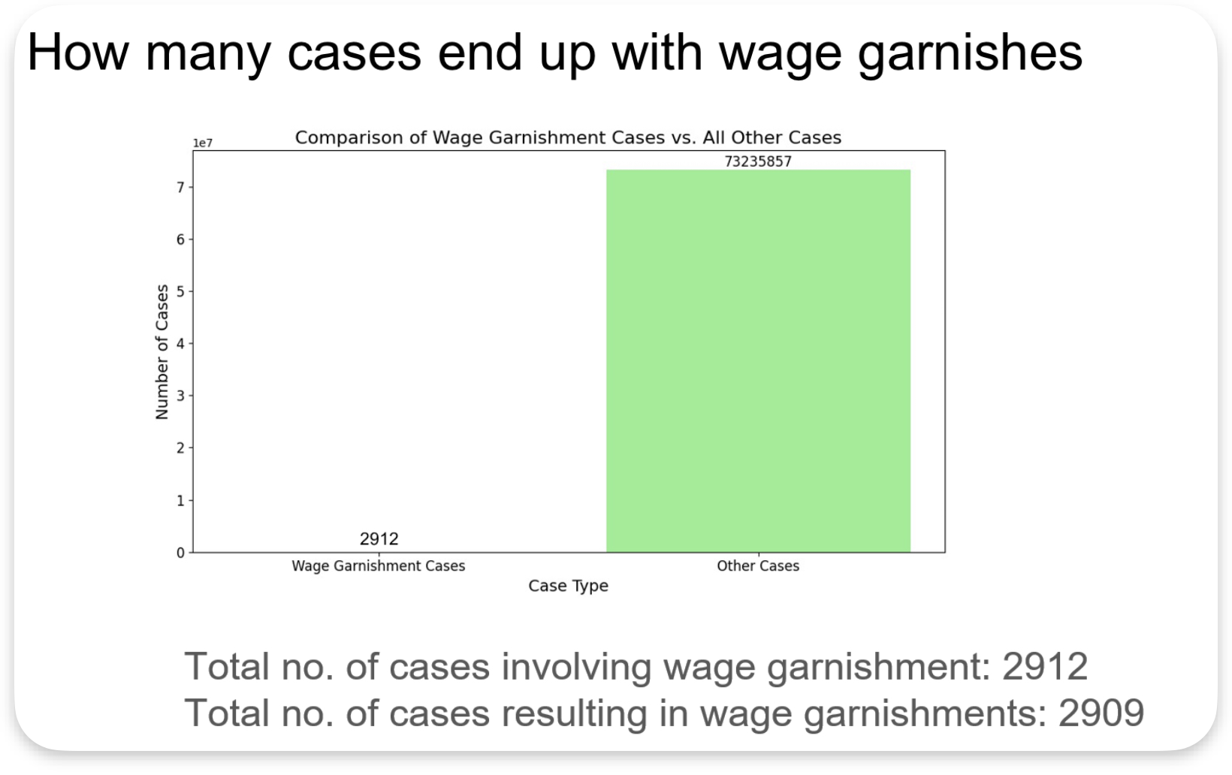

Slide 30
Findings
Things to note from the previous slide:
It reports a total of 2,912 cases involving wage garnishment, with almost all resulting in actual garnishments.

Slide 31
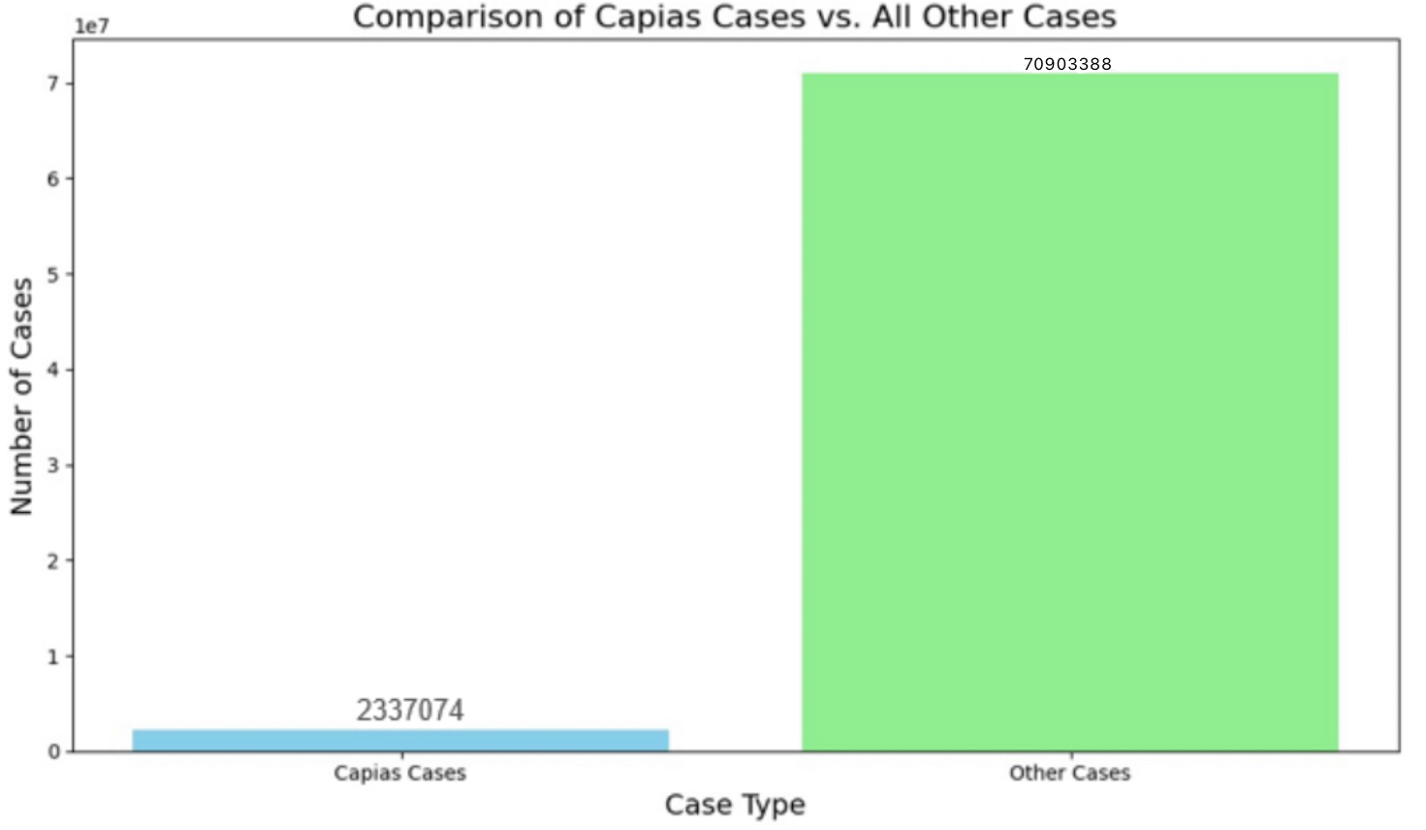
Findings

Slide 32
Findings
Things to note from the previous slide:
It notes that there were 233,074 cases involving Capias warrants, with only a small fraction resulting in the lifting or expiring of the warrants.

Slide 33
Future steps
Tracking the companies' home bases
Calculating the ranges of different amounts of debt cases
Biggest companies in terms of dollars.

Slide 34

Thank you!

