Slide 1
16S

Slide 2
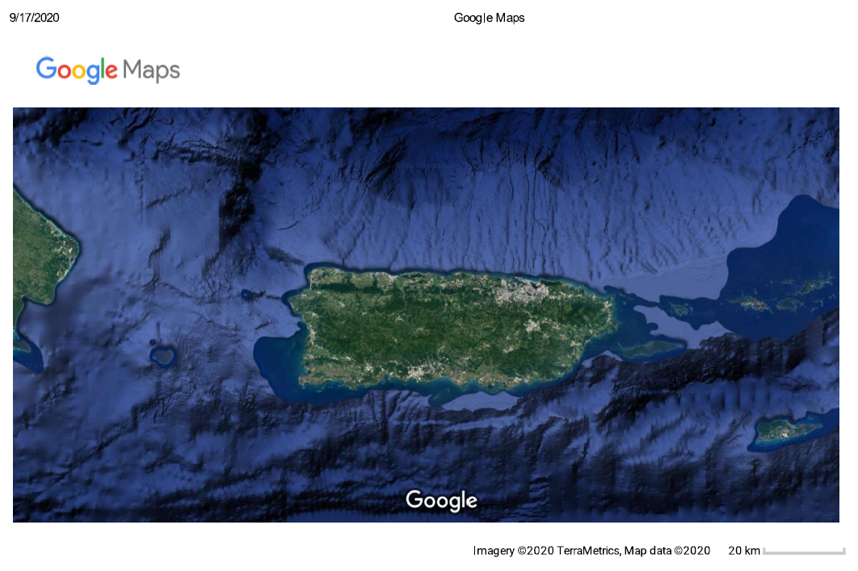


Slide 3
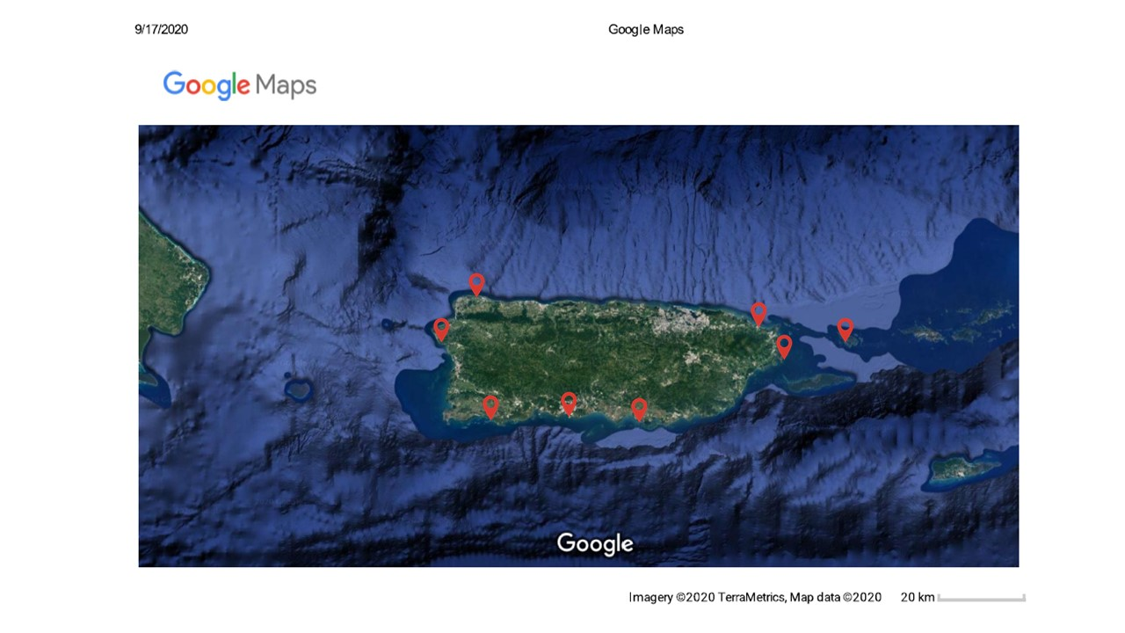

Slide 4
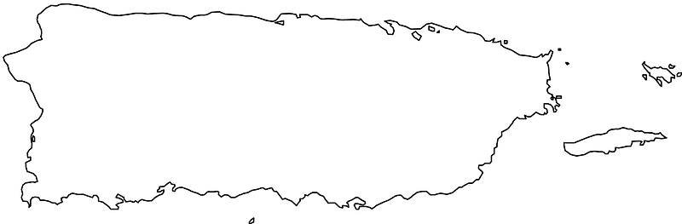

Slide 5
Notes:
Taxonomy by location level 4

Slide 6
Notes:
Taxonomy by location level 5

Slide 7
Notes:
Taxonomy by location level 6

Slide 8
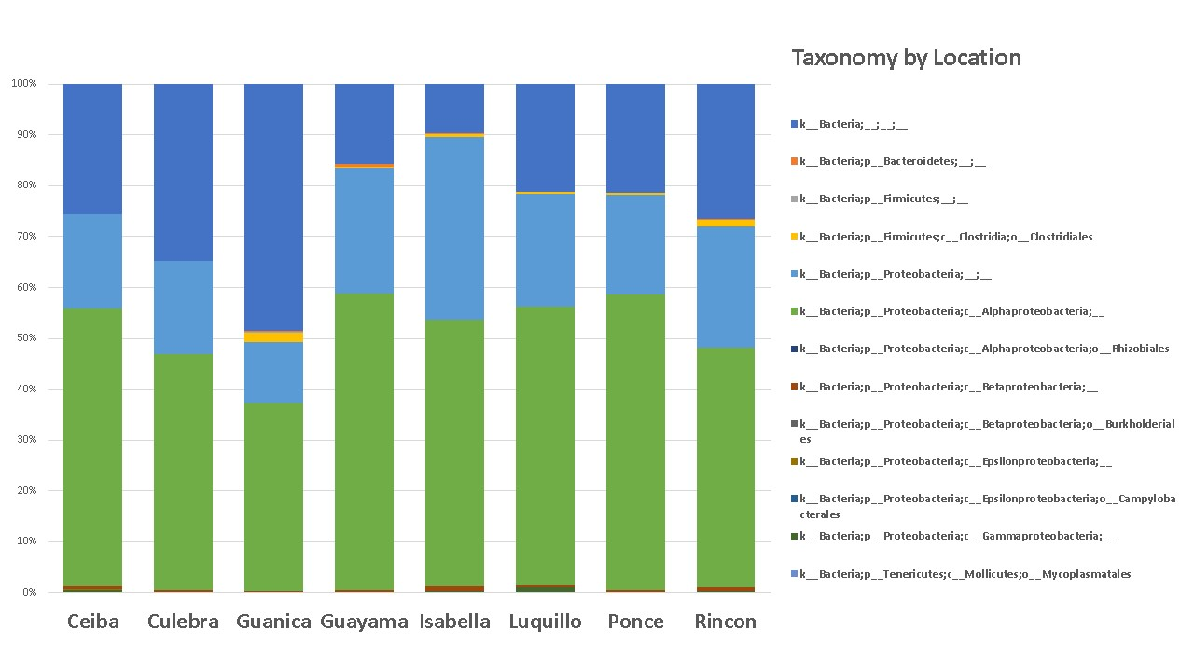

Slide 9
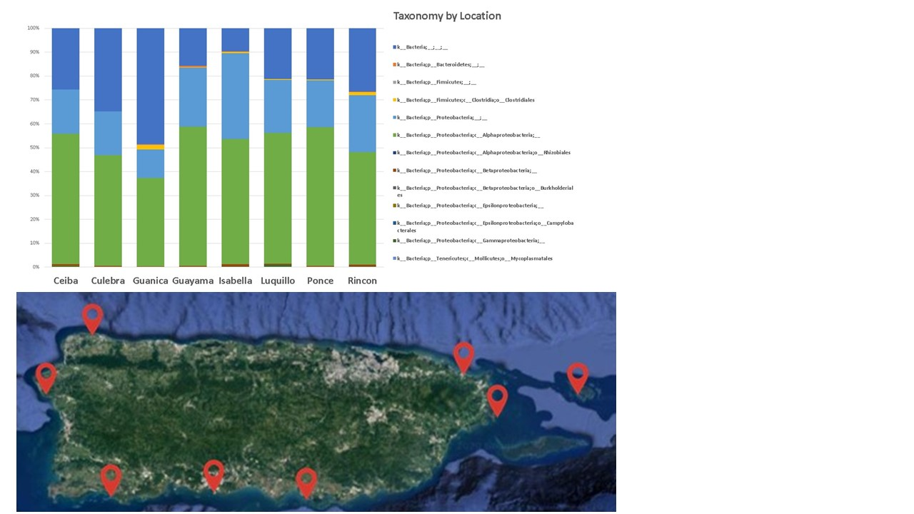

Slide 10










Slide 11
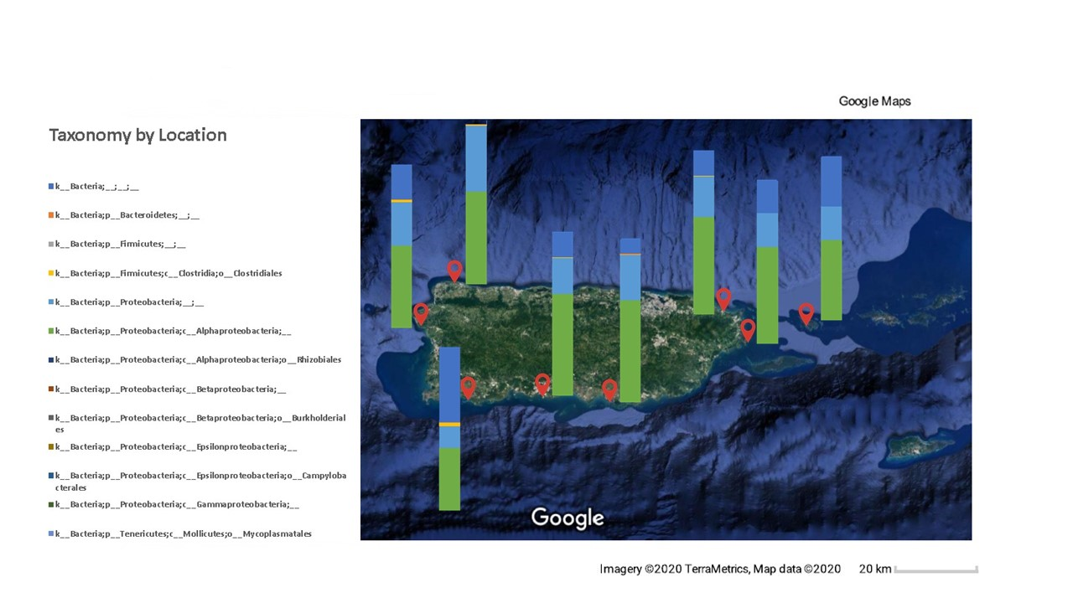

Slide 12
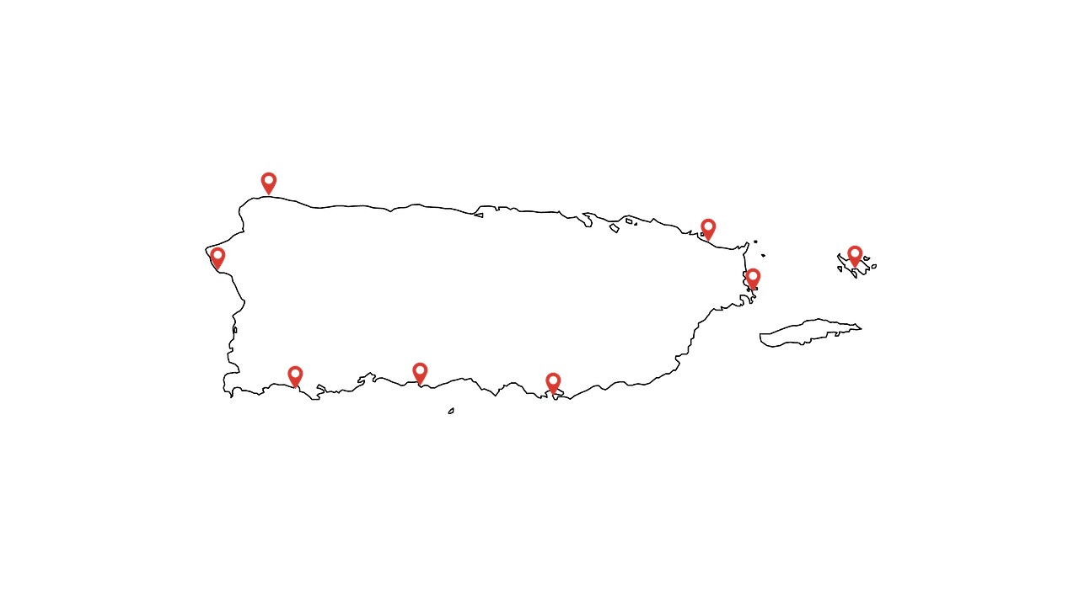

Slide 13
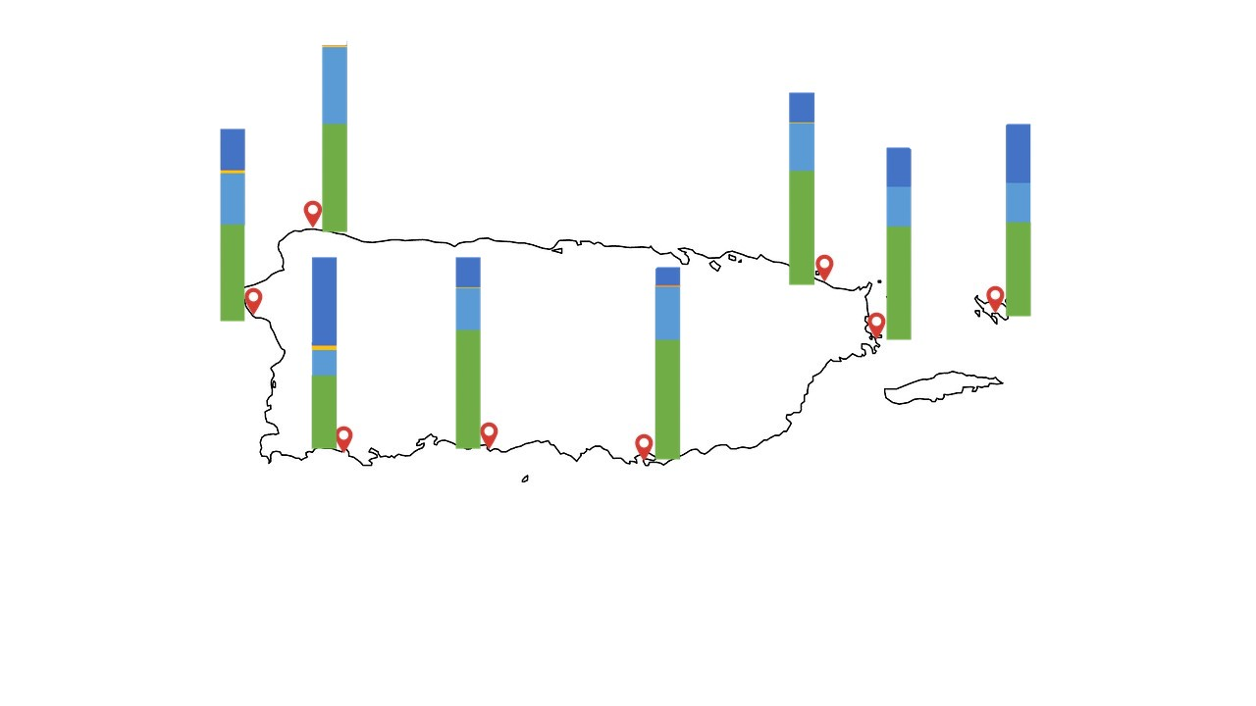

Slide 14
Notes:
Taxonomy by habitat level 4

Slide 15
Notes:
Taxonomy by habitat level 5

Slide 16
Notes:
Taxonomy by habitat level 6

Slide 17
Notes:
Taxonomy by size level 4

Slide 18
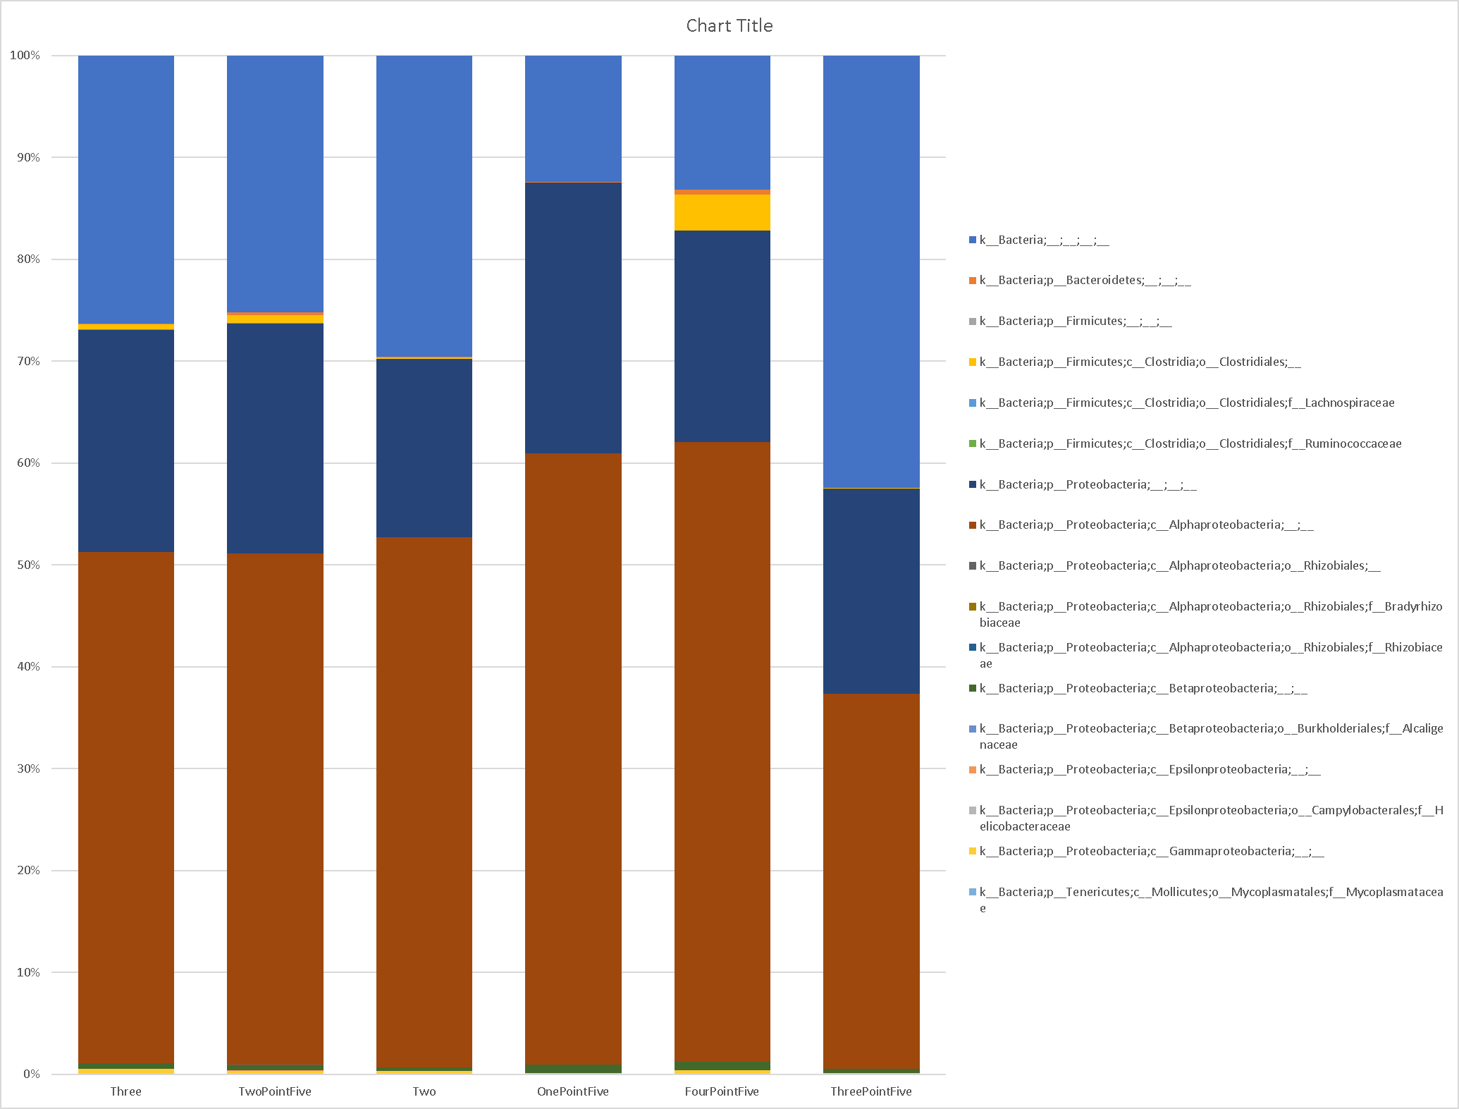
Notes:
Taxonomy by size level 5

Slide 19
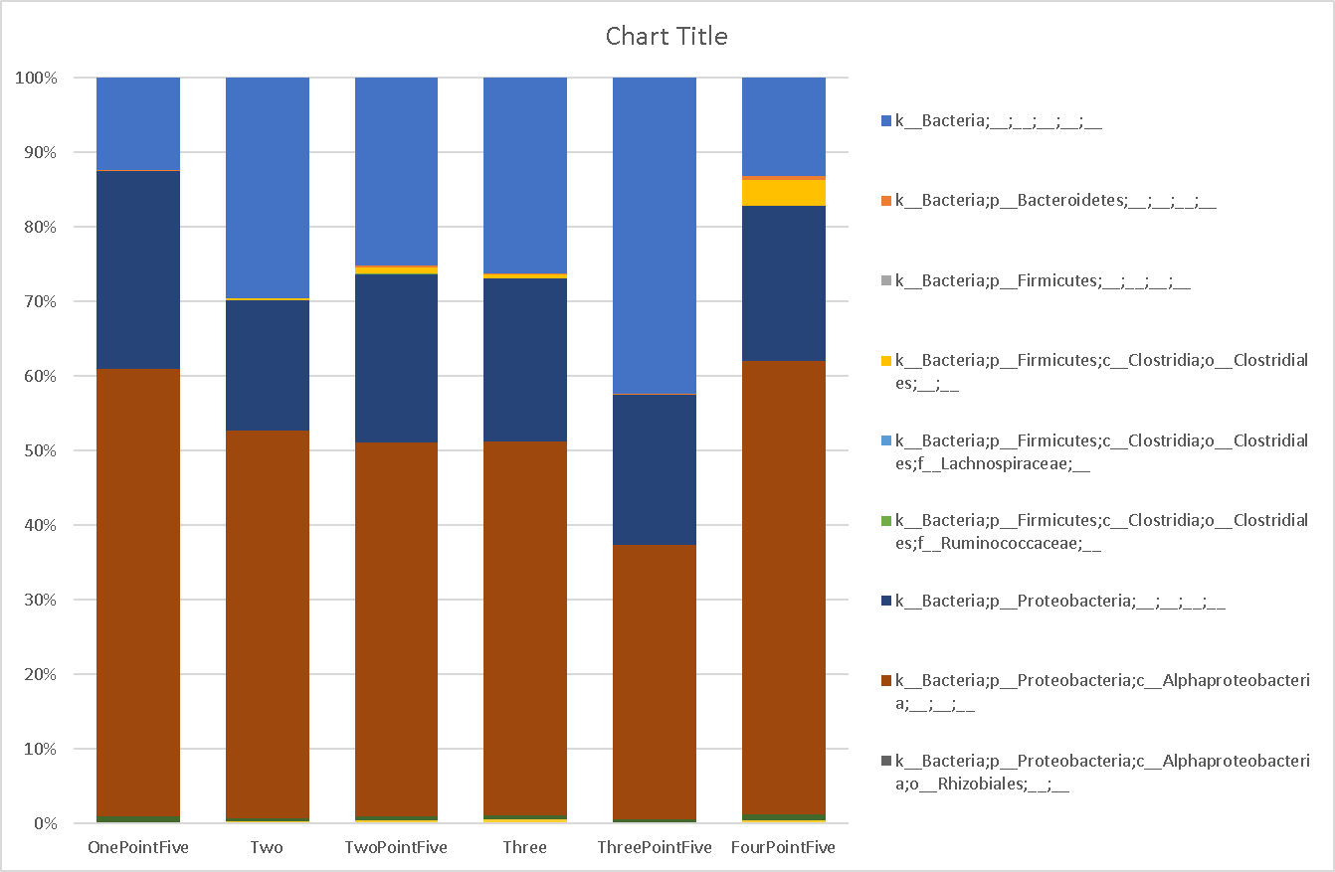
Notes:
Taxonomy by size level 6

Slide 21
Notes:
Taxonomy all samples level 5

Slide 22
Notes:
Taxonomy all samples level 6

Slide 23
Notes:
Taxonomy all samples level 7

Slide 24
CytoB

Slide 25
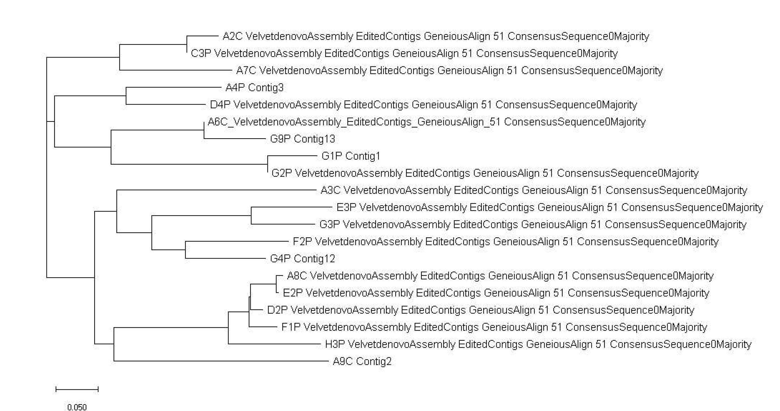

Slide 26
