Slide 1
Database Management Systems and SQL
Session 1

Slide 2
What is a DBMS?
Collection of interrelated data – manual or computerized or online
Set of programs to access the data
DBMS provides an environment that is both convenient and efficient to use.

Slide 3
Applications Areas of DBMS?
Banking: all transactions
Airlines: reservations, schedules
Universities: registration, grades
Sales: customers, products, purchases
Manufacturing: production, inventory, orders, supply chain
Human resources: employee records, salaries, tax deductions
Databases touch all aspects of our lives

Slide 4
Why do we use DBMS
To avoid data redundancy and inconsistency
Multiple file formats, duplication of information in different files
To avoid difficulty in accessing data
Need to write a new program to carry out each new task
To deal with data isolation — multiple files and formats
To deal with integrity problems
Integrity constraints (e.g. account balance > 0) become part of program code
Easy to add new constraints or change existing ones

Slide 5
Why do we use DBMS (contd..)
Atomicity of updates
Failures may leave database in an inconsistent state with partial updates carried out
E.g. transfer of funds from one account to another should either complete or not happen at all
Concurrent access by multiple users
Concurrent accessed needed for performance
Uncontrolled concurrent accesses can lead to inconsistencies
E.g. two people reading a balance and updating it at the same time
Security problems

Slide 6
Relational Model
Attributes
Example of tabular data in the relational model
customer-
name
customer-
street
customer-
city
account-
number
customer-id
192-83-7465
019-28-3746
192-83-7465
321-12-3123
019-28-3746
Johnson
Smith
Johnson
Jones
Smith
Alma
North
Alma
Main
North
Palo Alto
Rye
Palo Alto
Harrison
Rye
A-101
A-215
A-201
A-217
A-201

Slide 7
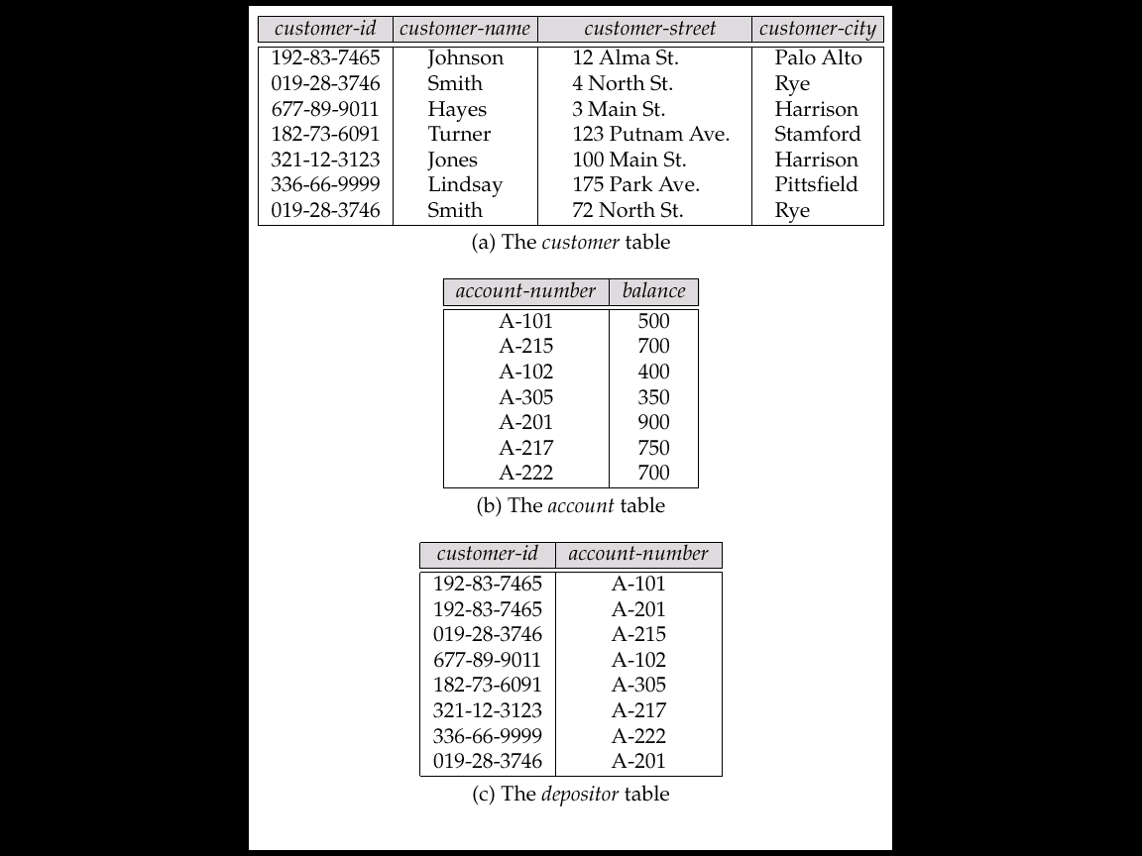
A Logically Related Database

Slide 8
Database Users
Users are differentiated by the way they expect to interact with the system
Application programmers – interact with system through DML calls
Sophisticated users – form requests in a database query language
Specialized users – write specialized database applications that do not fit into the traditional data processing framework
Naïve users – invoke one of the permanent application programs that have been written previously
E.g. people accessing database over the web, bank tellers, clerical staff

Slide 9
Database Administrator
Coordinates all the activities of the database system
Has a good understanding of the enterprise’s information resources and needs.
Database administrator’s responsibilities include:
Schema definition
Storage structure and access method definition
Schema and physical organization modification
Granting user authority to access the database
Specifying integrity constraints
Acting as liaison with users
Monitoring performance and responding to changes in requirements

Slide 10
Transaction Management
A transaction is a collection of operations that performs a single logical function in a database application
Transaction-management component ensures that the database remains in a consistent (correct) state despite system failures (e.g., power failures and operating system crashes) and transaction failures.
Concurrency-control manager controls the interaction among the concurrent transactions, to ensure the consistency of the database.

Slide 11
Storage Management
Storage manager is a program module that provides the interface between the low-level data stored in the database and the application programs and queries submitted to the system.
The storage manager is responsible to the following tasks:
interaction with the file manager
efficient storing, retrieving and updating of data

Slide 12
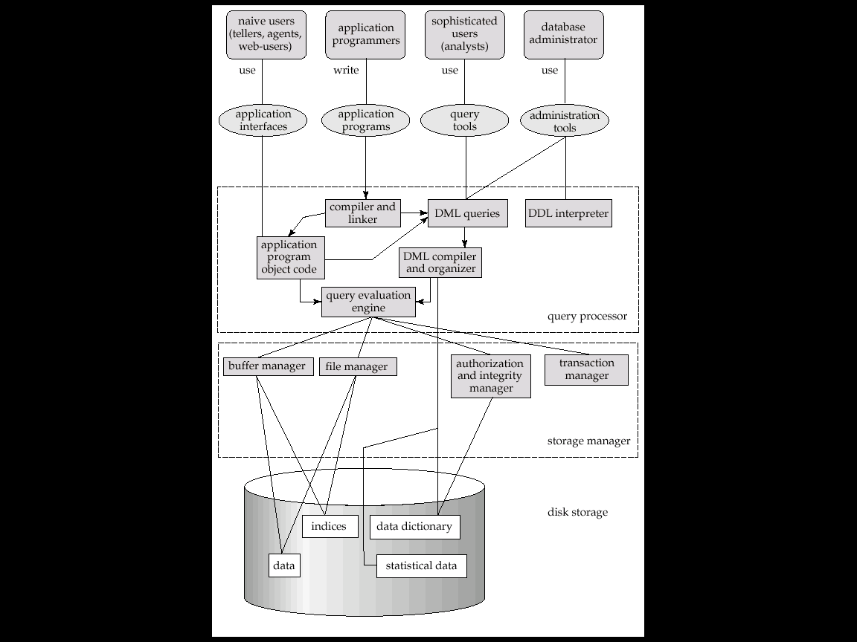
Overall System Structure

Slide 13
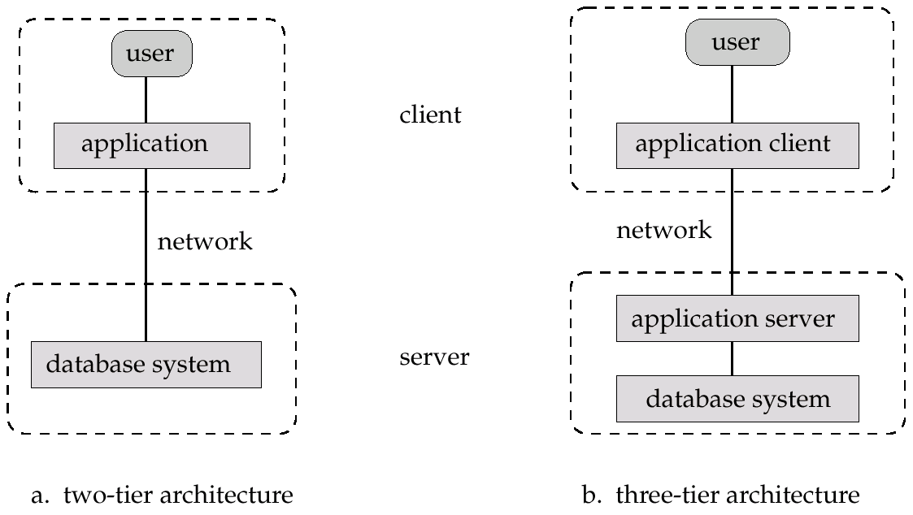
Application Architectures
Two-tier architecture: E.g. client programs using ODBC/JDBC to communicate with a database
Three-tier architecture: E.g. web-based applications, and applications built using “middleware”

Slide 14
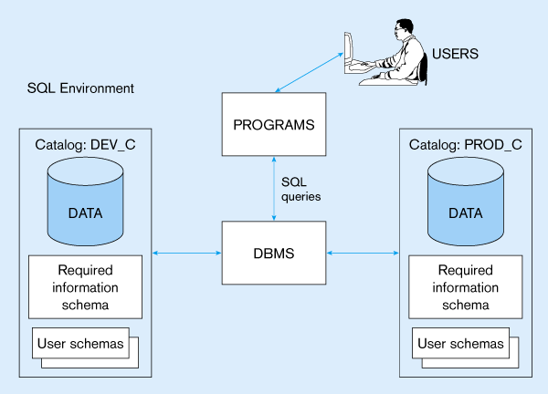
DBMS: Allows to Create, Manipulate & Access the Data

Slide 15
SQL Structured Query Language
The Language of DBMS
Standard language for querying and manipulating data. Very widely used.
Data Definition Language (DDL)
Create/alter/delete tables and their attributes
Data Manipulation Language (DML)
Insert/delete/modify tuples in tables

Slide 16
SQL
SQL: widely used non-procedural language
E.g. find the name of the customer with customer-id 192-83-7465 select customer.customer-name from customer where customer.customer-id = ‘192-83-7465’
E.g. find the balances of all accounts held by the customer with customer-id 192-83-7465 select account.balance from depositor, account where depositor.customer-id = ‘192-83-7465’ and depositor.account-number = account.account-number
Application programs generally access databases through one of
Language extensions to allow embedded SQL
Application program interface (e.g. ODBC/JDBC) which allow SQL queries to be sent to a database

Slide 17
Tables in RDBMS
Table name
Attribute names
Product
PName | Price | Category | Manufacturer
Gizmo | 19.99 | Gadgets | GizmoWorks
Powergizmo | 29.99 | Gadgets | GizmoWorks
SingleTouch | 149.99 | Photography | Canon
MultiTouch | 203.99 | Household | Hitachi
Tuples or rows

Slide 18
Steps to Define the Schema
Step 1: Define table name and its attributes
Product(PName, Price, Category, Manufacturer)
Product
PName | Price | Category | Manufacturer
Gizmo | 19.99 | Gadgets | GizmoWorks
Powergizmo | 29.99 | Gadgets | GizmoWorks
SingleTouch | 149.99 | Photography | Canon
MultiTouch | 203.99 | Household | Hitachi

Slide 19
Data Types and Domain of Attributes
Product(PName, Price, Category, Manfacturer)
Basic data types
Numeric
Integer numbers: INTEGER, INT, and SMALLINT
Floating-point (real) numbers: FLOAT or REAL, and DOUBLE PRECISION
Character-string
Fixed length: CHAR(n), CHARACTER(n)
Varying length: VARCHAR(n), CHAR VARYING(n), CHARACTER VARYING(n)

Slide 20
Data Types and Domain of Attributes
Boolean
Values of TRUE or FALSE or NULL
DATE
Ten positions
Components are YEAR, MONTH, and DAY in the form YYYY-MM-DD
Timestamp
Includes the DATE and TIME fields
Plus a minimum of six positions for decimal fractions of seconds
Optional WITH TIME ZONE qualifier

Slide 21
Steps to Define the Schema
Step 2: Define Data Types and Domain of Attributes.
Product(PName, Price, Category, Manfacturer)
Pname : Varchar,
Price: Float,
Category: Varchar
Manfacturer: Varchar

Slide 22
Step 3: Specifying Constraints.
Product(PName, Price, Category, Manfacturer)
Constraints: Restrictions on values of
Attribute.
Specifying Attribute and Domain Constraints
Specifying Key Constraints
Specifying Key and Referential Integrity Constraints

Slide 23
Specifying Attribute and Domain Constraints
NOT NULL
NULL is not permitted for a particular attribute
Default value
DEFAULT <value>
CHECK clause
Dnumber > 0 AND Dnumber < 21;
UNIQUE clause
Specifies attributes that have unique values

Slide 24
Specifying Key Constraints
PRIMARY KEY clause
Specifies one or more attributes that make up the primary key of a relation
It is an attribute or a combination of attributes that that uniquely identifies the records./tuples
e.g. roll_no, account_no, Id etc.
PRIMARY KEY = NOT NULL+ UNIQUE

Slide 25
Schema of Table Product
Product(Pname varchar Primary Key,
Price float Not Null,
Category varchar, check(Gadget, Photoraphy,
Household
Manufacturer varchar )
Attribute | Data Type | Constraints
Pname | Varchar | Primary Key
Price | Float | Not Null
Category | Varchar | Gadget, Photography, Household
Manufacturer | Varchar

Slide 26
LET’S CODE TOGETHER!!

Slide 27
Creating a Database
Step 1. Create a Database Company
CREATE DATABASE <DATABSE NAME>;
Create database company;
Step 2. USE Database
USE <DATABSE NAME>;
use company;
Step 2. SHOW TABLES
show tables;

Slide 28
Creating a Table
Step 1. Create a TABLE
CREATE TABLE <TABLE NAME> (
<ATTRIBUTE LIST> <DATA TYPE> <CONSTRAINT>,
<ATTR2> <DATA TYPE>,<CONSTRAINT>);
Attribute | Data Type | Constraints
Pname | Varchar | Primary Key
Price | Float | Not Null
Category | Varchar | Gadget, Photography, Household
Manufacturer | Varchar

Slide 29
Creating a Table
create table product(Pname varchar(20) primary key, price float NOT NULL,category varchar(20) CHECK(category in("Gadget","Photography","Household")), manufacturer varchar(20));
Attribute | Data Type | Constraints
Pname | Varchar | Primary Key
Price | Float | Not Null
Category | Varchar | Gadget, Photography, Household
Manufacturer | Varchar

Slide 30
Show Existing Tables
Show tables;
Describe structure of a Existing Table
Desc <tablename>;
Desc product;

Slide 31
Insert records in Table
INSERT INTO R(A1,…., An) VALUES (v1,…., vn)
insert into product(Pname,price,category,manufacturer) values("Gizmo",19.99, "Gadgets", "GizmoWorks");
or
insert into product values("Gizmo",19.99, "Gadgets", "GizmoWorks");
insert into product values("Powergizmo",29.99, "Gadgets", "GizmoWorks");
insert into product values("SingleTouch",149.99, "Photography", "Canon");
insert into product values("MultiTouch",203.99, "Household", "Hitachi");
PName | Price | Category | Manufacturer
Gizmo | 19.99 | Gadgets | GizmoWorks
Powergizmo | 29.99 | Gadgets | GizmoWorks
SingleTouch | 149.99 | Photography | Canon
MultiTouch | 203.99 | Household | Hitachi

Slide 32
Select Query
SELECT <attributes>
FROM <one or more relations>
WHERE <conditions>
Product
SELECT * FROM product;
“selection”
PName | Price | Category | Manufacturer
Gizmo | 19.99 | Gadgets | GizmoWorks
Powergizmo | 29.99 | Gadgets | GizmoWorks
SingleTouch | 149.99 | Photography | Canon
MultiTouch | 203.99 | Household | Hitachi

Slide 33
Select Query using WHERE
PName | Price | Category | Manufacturer
Gizmo | 19.99 | Gadgets | GizmoWorks
Powergizmo | 29.99 | Gadgets | GizmoWorks
SingleTouch | 149.99 | Photography | Canon
MultiTouch | 203.99 | Household | Hitachi
Product
SELECT Pname, Price FROM Product
PName | Price
Gizmo | 19.99
Powergizmo | 29.99
SingleTouch | 149.99
MultiTouch | 203.99
“projection”

Slide 34
Select Query using WHERE
Product
PName | Price | Category | Manufacturer
Gizmo | 19.99 | Gadgets | GizmoWorks
Powergizmo | 29.99 | Gadgets | GizmoWorks
SingleTouch | 149.99 | Photography | Canon
MultiTouch | 203.99 | Household | Hitachi
SELECT * FROM Product WHERE category=‘Gadgets’;
“selection” with
where
PName | Price | Category | Manufacturer
Gizmo | 19.99 | Gadgets | GizmoWorks
Powergizmo | 29.99 | Gadgets | GizmoWorks

Slide 35
Select Query using WHERE
Product
PName | Price | Category | Manufacturer
Gizmo | 19.99 | Gadgets | GizmoWorks
Powergizmo | 29.99 | Gadgets | GizmoWorks
SingleTouch | 149.99 | Photography | Canon
MultiTouch | 203.99 | Household | Hitachi
SELECT PName, Price, Manufacturer FROM Product WHERE Price > 100;
“selection” and
“projection” with
where
PName | Price | Manufacturer
SingleTouch | 149.99 | Canon
MultiTouch | 203.99 | Hitachi

Slide 36
Select Query using WHERE
Product
PName | Price | Category | Manufacturer
Gizmo | 19.99 | Gadgets | GizmoWorks
Powergizmo | 29.99 | Gadgets | GizmoWorks
SingleTouch | 149.99 | Photography | Canon
MultiTouch | 203.99 | Household | Hitachi
SELECT PName, Price, Manufacturer FROM Product WHERE Price > 100 and manufacturer =“Canon”;
Combine two or more
conditions Using
and
PName | Price | Manufacturer
SingleTouch | 149.99 | Canon

Slide 37
Select Query using WHERE
Product
PName | Price | Category | Manufacturer
Gizmo | 19.99 | Gadgets | GizmoWorks
Powergizmo | 29.99 | Gadgets | GizmoWorks
SingleTouch | 149.99 | Photography | Canon
MultiTouch | 203.99 | Household | Hitachi
SELECT PName, Price, Manufacturer FROM Product WHERE manufacturer =“Hitachi” or manufacturer = “Canon”;
Combine two or more
conditions Using
or
PName | Price | Manufacturer
SingleTouch | 149.99 | Canon
MultiTouch | 203.99 | Hitachi

Slide 38
Select Query using WHERE
Product
PName | Price | Category | Manufacturer
Gizmo | 19.99 | Gadgets | GizmoWorks
Powergizmo | 29.99 | Gadgets | GizmoWorks
SingleTouch | 149.99 | Photography | Canon
MultiTouch | 203.99 | Household | Hitachi
SELECT PName, Price, Manufacturer FROM Product WHERE manufacturer IN(“Hitachi”,“Canon”);
Replace OR with In
conditions Using
IN
PName | Price | Manufacturer
SingleTouch | 149.99 | Canon
MultiTouch | 203.99 | Hitachi

Slide 39
Note That
Case insensitive:
Same: SELECT Select select
Same: Product product
Different: ‘Seattle’ ‘seattle’
Constants:
‘abc’ - yes
“abc” - no

Slide 40
The LIKE operator
SELECT * FROM Products WHERE PName LIKE <pattern>
Pattern : pattern matching on strings. It contains two special symbols:
% = any sequence of characters
_ = any single character

Slide 41
Like Operator with %
Product name that starts with P
Product
PName | Price | Category | Manufacturer
Gizmo | 19.99 | Gadgets | GizmoWorks
Powergizmo | 29.99 | Gadgets | GizmoWorks
SingleTouch | 149.99 | Photography | Canon
MultiTouch | 203.99 | Household | Hitachi
SELECT * FROM Product WHERE Pname like ‘p%’;
PName | Price | Category | Manufacturer
Powergizmo | 29.99 | Gadgets | GizmoWorks

Slide 42
Like Operator with %
Product name that ends with Touch
Product
PName | Price | Category | Manufacturer
Gizmo | 19.99 | Gadgets | GizmoWorks
Powergizmo | 29.99 | Gadgets | GizmoWorks
SingleTouch | 149.99 | Photography | Canon
MultiTouch | 203.99 | Household | Hitachi
SELECT * FROM Product WHERE Pname like ‘%Touch’;
PName | Price | Category | Manufacturer
SingleTouch | 149.99 | Photography | Canon
MultiTouch | 203.99 | Household | Hitachi

Slide 43
Like Operator with %
Product name that contains e anywhere in the name
Product
PName | Price | Category | Manufacturer
Gizmo | 19.99 | Gadgets | GizmoWorks
Powergizmo | 29.99 | Gadgets | GizmoWorks
SingleTouch | 149.99 | Photography | Canon
MultiTouch | 203.99 | Household | Hitachi
SELECT * FROM Product WHERE Pname like ‘%e%’;
PName | Price | Category | Manufacturer
Powergizmo | 29.99 | Gadgets | GizmoWorks
SingleTouch | 149.99 | Photography | Canon

Slide 44
Like Operator with _ &%
Product name with second letter ‘o’
Product
PName | Price | Category | Manufacturer
Gizmo | 19.99 | Gadgets | GizmoWorks
Powergizmo | 29.99 | Gadgets | GizmoWorks
SingleTouch | 149.99 | Photography | Canon
MultiTouch | 203.99 | Household | Hitachi
SELECT * FROM Product WHERE Pname like ‘_o%’;
PName | Price | Category | Manufacturer
Powergizmo | 29.99 | Gadgets | GizmoWorks

Slide 45
Like Operator with %
Product name with second last character ‘c’
Product
PName | Price | Category | Manufacturer
Gizmo | 19.99 | Gadgets | GizmoWorks
Powergizmo | 29.99 | Gadgets | GizmoWorks
SingleTouch | 149.99 | Photography | Canon
MultiTouch | 203.99 | Household | Hitachi
SELECT * FROM Product WHERE Pname like ‘%c_’;
PName | Price | Category | Manufacturer
SingleTouch | 149.99 | Photography | Canon
MultiTouch | 203.99 | Household | Hitachi

Slide 46
Eliminating Duplicates
Category
Gadgets
Photography
Household
SELECT DISTINCT category
FROM Product;
Compare to:
Category
Gadgets
Gadgets
Photography
Household
SELECT category
FROM Product;

Slide 47
Aggregate Functions
SQL supports several aggregation operations:
Sum
Max
Min
Avg
Count
Except count, all aggregations apply to a single attribute

Slide 48
Aggregate Functions – SUM
Sum of Price of all Products
Product
PName | Price | Category | Manufacturer
Gizmo | 19.99 | Gadgets | GizmoWorks
Powergizmo | 29.99 | Gadgets | GizmoWorks
SingleTouch | 149.99 | Photography | Canon
MultiTouch | 203.99 | Household | Hitachi
SELECT sum(price) FROM Product;
403.96

Slide 49
Aggregate Functions – MAX
Max of Price of all Products
Product
PName | Price | Category | Manufacturer
Gizmo | 19.99 | Gadgets | GizmoWorks
Powergizmo | 29.99 | Gadgets | GizmoWorks
SingleTouch | 149.99 | Photography | Canon
MultiTouch | 203.99 | Household | Hitachi
SELECT max(price) FROM Product;
203.96

Slide 50
Aggregate Functions – MIN
Min of Price of all Products
Product
PName | Price | Category | Manufacturer
Gizmo | 19.99 | Gadgets | GizmoWorks
Powergizmo | 29.99 | Gadgets | GizmoWorks
SingleTouch | 149.99 | Photography | Canon
MultiTouch | 203.99 | Household | Hitachi
SELECT min(price) FROM Product;
19.99

Slide 51
Aggregate Functions – AVG
Avg of Price of all Products
Product
PName | Price | Category | Manufacturer
Gizmo | 19.99 | Gadgets | GizmoWorks
Powergizmo | 29.99 | Gadgets | GizmoWorks
SingleTouch | 149.99 | Photography | Canon
MultiTouch | 203.99 | Household | Hitachi
SELECT avg(price) FROM Product;
100.99

Slide 52
Aggregate Functions – COUNT
Total number of Products
Product
PName | Price | Category | Manufacturer
Gizmo | 19.99 | Gadgets | GizmoWorks
Powergizmo | 29.99 | Gadgets | GizmoWorks
SingleTouch | 149.99 | Photography | Canon
MultiTouch | 203.99 | Household | Hitachi
SELECT count(price) FROM Product;
4
SELECT count(*) FROM Product;

Slide 53
More Examples
Query | Sql
Max price of Gadgets category Products | Select Max(price) from product where category=“Gadgets”
Total no of products in Household category | Select count(*) from product where Category=“Household”
Count total no. of categories | Select Count(Distinct(category) ) from product

Slide 54
WRITE THE QUERY
PName | Price | Category | Manufacturer
Gizmo | 19.99 | Gadgets | GizmoWorks
Powergizmo | 29.99 | Gadgets | GizmoWorks
SingleTouch | 149.99 | Photography | Canon
MultiTouch | 203.99 | Household | Hitachi
Problem Statement | SQL Query
Average Price of Gizmo Works manufacturer | ?
Total price of Gizmo Works manufacturer | ?
Count total number of manufacturers | ?
Count number of products that contains ‘o’ in their name | ?

Slide 55
Ordering the Results
SELECT pname, price, manufacturer
FROM Product
WHERE manufacturer=‘GizmoWorks’ AND price > 50
ORDER BY price, pname;
Ties are broken by the second attribute on the ORDER BY list, etc.
Also works without Where
Ordering is ascending, unless you specify the DESC keyword.
SELECT pname, price, manufacturer
FROM Product
ORDER BY price DESC;

Slide 56
FIND THE RESULT
PName | Price | Category | Manufacturer
Gizmo | 19.99 | Gadgets | GizmoWorks
Powergizmo | 29.99 | Gadgets | GizmoWorks
SingleTouch | 149.99 | Photography | Canon
MultiTouch | 203.99 | Household | Hitachi
SELECT DISTINCT category
FROM Product
ORDER BY category
?
SELECT Category
FROM Product
ORDER BY PName
?
SELECT DISTINCT category
FROM Product
ORDER BY PName
?

Slide 57
Practice Exercise

Slide 58
Create a new table in your current database ‘COMPANY’ with the following schema
Attribute | Data Type | Constraints
Cname | Varchar | Primary Key
Reg_Date | Date | Not Null
Stock_Price | Float
Country | Varchar

Slide 59
Create a new table named ‘COMPDTLS’ in your current database with the following schema
Attribute | Data Type | Constraints
CompName | Varchar | Primary Key
RegDate | Date | Not Null
StockPrice | Float
Country | Varchar
COMPDTLS( CompName varchar Primary Key,
RegDate Date Not Null,
StockPrice Float
Country varchar )

Slide 60
Insert the following Records in COMPDTLS
CompName | RegDate | StockPrice | Country
GizmoWorks | 2019/10/21 | 25 | USA
Canon | 2019/10/3 | 65 | Japan
Hitachi | 2019/10/10 | 15 | India

Slide 61
Write SQL Queries for:
List the details of all companies
List the registration date of all companies
Show the details of all companies of Japan
List the company name whose stock price is 65
List the companies of Japan or India
Show the maximum stock price.
Show the average stock price.
Show the distinct countries
Show the total no of countries
Show the company name whose country name ends with ‘a’.

