Slide 1
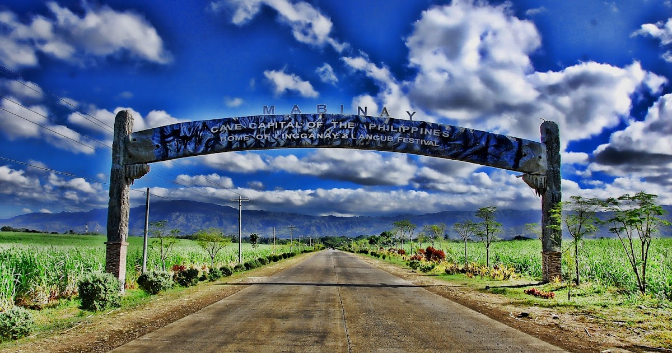
WELCOME

Slide 2

- officially the Municipality of Mabinay, is a 1st class municipality in the province of Negros Oriental, Philippines. According to the 2020 census, it has a population of 82,953 people [3], making it the most-populous municipality in Negros Oriental.

Slide 3

HISTORY
Folklore has it that a woman named Binay fell in love with the son of her father's rival chieftain. Her father ended the affair by having her lover killed. Binay grieved. Mother Nature took the weeping maiden into her bosom. Where Binay was laid to rest, a spring broke forth. According to the legend, she weeps to this day, feeding Mabinay Spring, one of the town's many alluring attractions.

Slide 4

It had over 100 known caves, including the popular Pandalihan, Panligawan and Gasidlak, each one with its own distinctive features ranging from fascinating to awesome. A team of Belgian and Dutch cavers determined Odloman Cave to be the second longest in the Philippines.

Slide 5
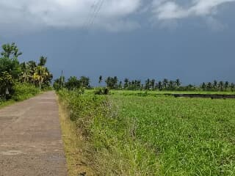
- Mabinay was carved from barrios of Bais and created a municipality in 1960. In 1966 more barrios of Bais and Manjuyod were annexed to enlarge it. Mabinay produces rice and corn, copra, soybeans and peanuts. Its principal crop, sugar cane, makes it an important member of the north's sugar district. It is a border town: the Provincial Highway runs through it and links Negros Oriental with its sister province.
Travel from Dumaguete City is about two hours.

Slide 6
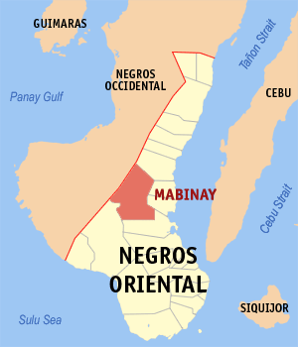
Geography
Mabinay is situated roughly in the central part of the island of Negros abutting the western side of the provincial boundary. The municipality of Ayungon bounds it in the north, the City of Bais in the south, the municipalities of Bindoy and Manjuyod and a portion of Bais in the east, and the province of Negros Occidental in the west. It is 87 kilometres (54 mi) north-west of the provincial capital, Dumaguete and can be reached via the circumferential but well-paved national road that cuts across the middle of the province from Bais to Negros Occidental.

Slide 7
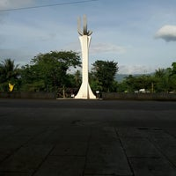
Barangays
Mabinay is politically subdivided into 32 barangays.
Abis
Arebasore
Bagtic
Banban
Barras
Bato
Bugnay
Bulibulihan
Bulwang
Campanun-an
Canggohob
Cansal-ing
Dagbasan
Dahile
Himocdongon
Hagtu
Inapoy
Lamdas
Lumbangan
Luyang
Manlingay
Mayaposi
Napasu-an
New Namangka
Old Namangka
Pandanon
Paniabonan
Pantao
Poblacion
Samac
Tadlong
Tarâ

Slide 8
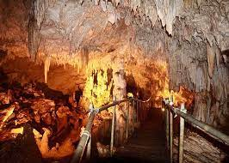
Tourism
Mabinay is known for its caves. The Odloman Cave is one of the largest cave in the Philippines with 8,870 metres (29,100 ft) long and Cayaso Cave, the ninth longest cave in the country measuring 2,222 metres (7,290 ft) long.

Slide 9
THANK YOU

Slide 10

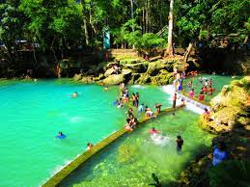
Aside from the caves, Mabinay also has rivers and natural springs. One of its known natural spring is located at the heart of the municipality, the Mabinay spring. Ideal for family outing, swimming, kayaking, it also serves as the main water resource of the main town. It is about a 3 to 5 minute ride with tricycle, jeepney or a bus from the town center.

