Slide 1
Intro. to Network Programming HW3
TA 廷翰

Slide 2
Due date
Sunday, May 24, 2020 by 11:55pm

Slide 3
Outline
Introduction
Amazon S3
Details of this homework

Slide 4
Introduction
What you have to do in this homework.
Write a client program to connect to your server.
Store the content of the post on the client-side (Amazon S3) instead of the server-side.
Implement a simple mail service.

Slide 5
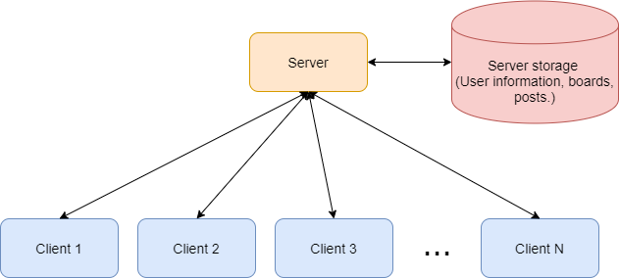
Introduction (cont.)
System architecture in the previous part. Client program only sends command to the server and gets the corresponding result from the server.

Slide 6
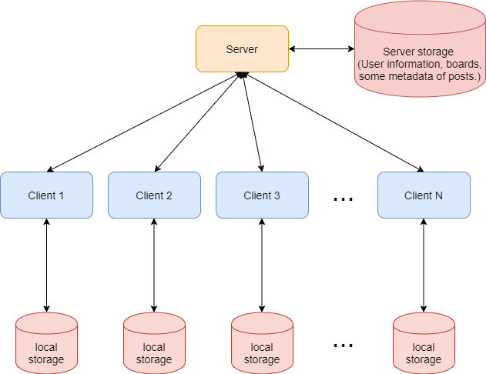
Introduction (cont.)
Change to the new system architecture.

Slide 7
Introduction (cont.)
Problem: What if client1 wants to read client2’s post but client2 is offline?

Slide 8
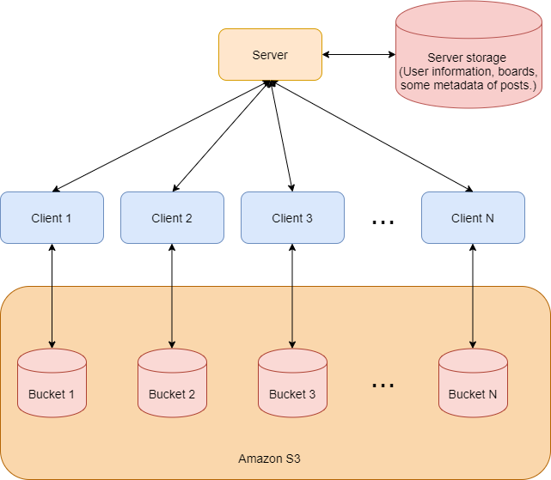
Introduction (cont.)
System architecture we will use in this homework

Slide 9
Amazon S3
Amazon Simple Storage Service (S3) is storage for the Internet.
You can use Amazon S3 to store and retrieve any amount of data, at any time, from anywhere on the web.
The Amazon S3 data model is a flat structure. There is no hierarchy of subbuckets or subfolders.

Slide 10
Amazon S3 - Overview
Amazon S3
Bucket 1
Bucket 2
…
Bucket N
…
…
…
object 1
object 2
object N
object 1
object 2
object N
object 1
object 2
object N

Slide 11
Amazon S3 - Bucket
A bucket is a container for objects stored in Amazon S3.
By default, you can create up to 100 buckets in each of your AWS accounts
If you want to store data in Amazon S3, you have to create a bucket with a unique name first.
Bucket names must be unique across all existing bucket names in Amazon S3.
Bucket names must be at least 3 and no more than 63 characters long.
Bucket names must not contain uppercase characters or underscores.
Bucket names must start with a lowercase letter or number.

Slide 12
Amazon S3 - Object
Objects are the fundamental entities stored in Amazon S3.
Objects consist of object data and metadata.
Each object within a bucket has its unique key (name of the object).
Size of each object: 0 Byte – 5 TB

Slide 13
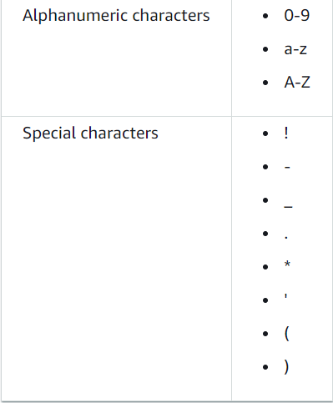
Amazon S3 – Object Key
Unique identifier within a bucket. If you upload the same key name object without versioning-enabled, it will overwrite the original one.
The following character sets are generally safe for use in key names.

Slide 14
Amazon S3 – Bucket Policy
Bucket policy is used to manage access permissions of all resources within a bucket to other AWS accounts or AWS Identity and Access Management (IAM) users.

Slide 15
Amazon S3 – Bucket Policy
Bucket Policy example – json format
{
"Version":"2012-10-17",
"Statement":[
{
"Sid":"PublicRead",
“Effect”:“Allow",
"Principal": "*",
"Action":["s3:GetObject"],
"Resource":["arn:aws:s3:::examplebucket/*"]
}
]
}

Slide 16
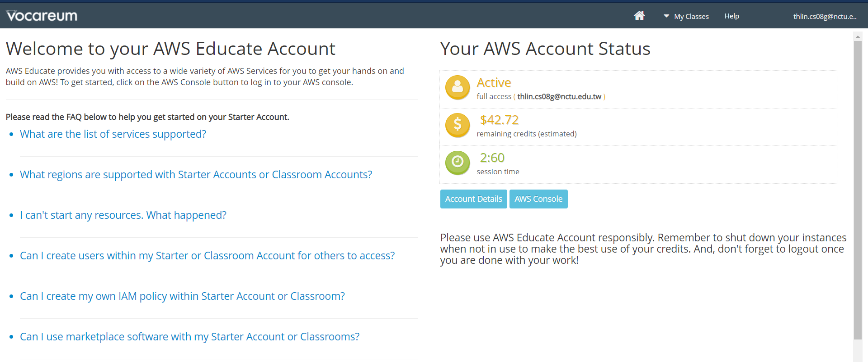
Amazon S3 – Amazon S3 Console
Login your AWS Educate -> Go to Intro. to Network Programming classroom, then you will see the page below.
Click AWS Console

Slide 17
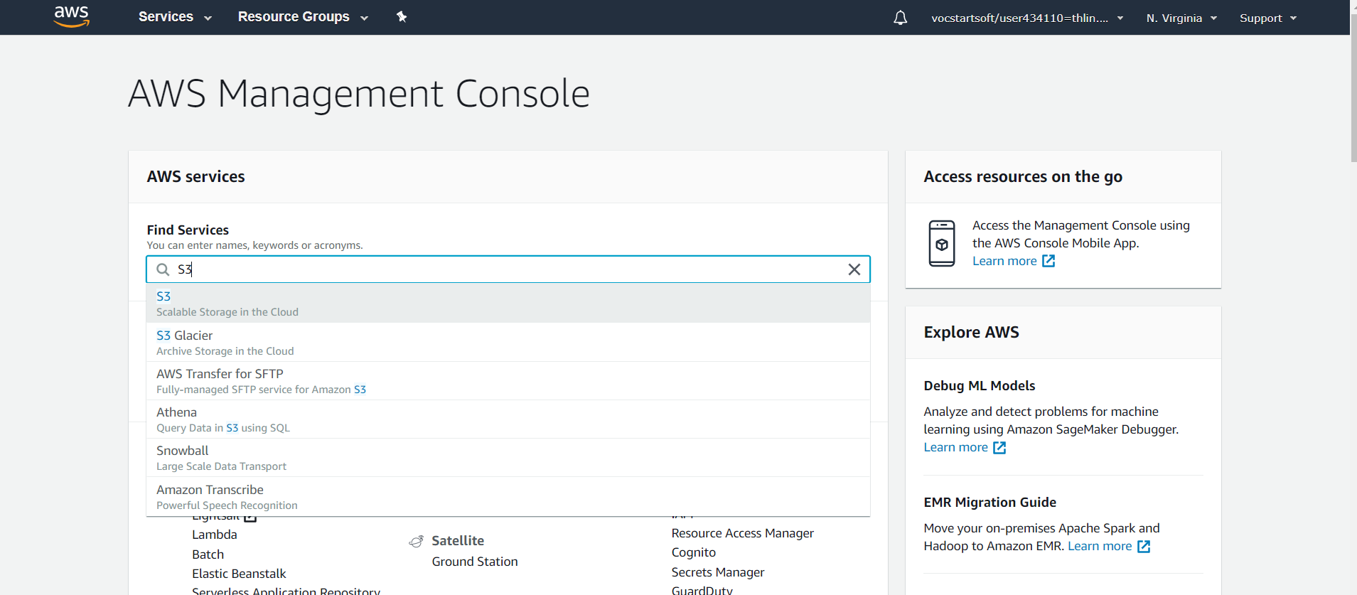
Amazon S3 – Amazon S3 Console
Select S3 Service

Slide 18
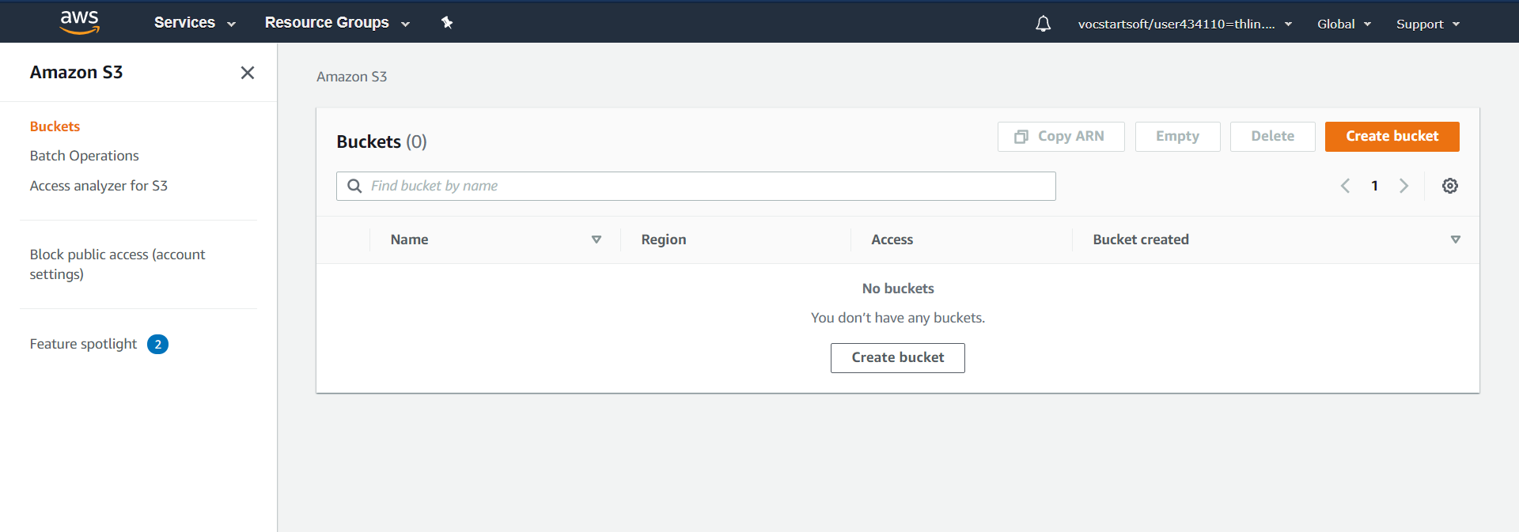
Amazon S3 – Amazon S3 Console
You can manipulate your Amazon S3 and see its state here.

Slide 19
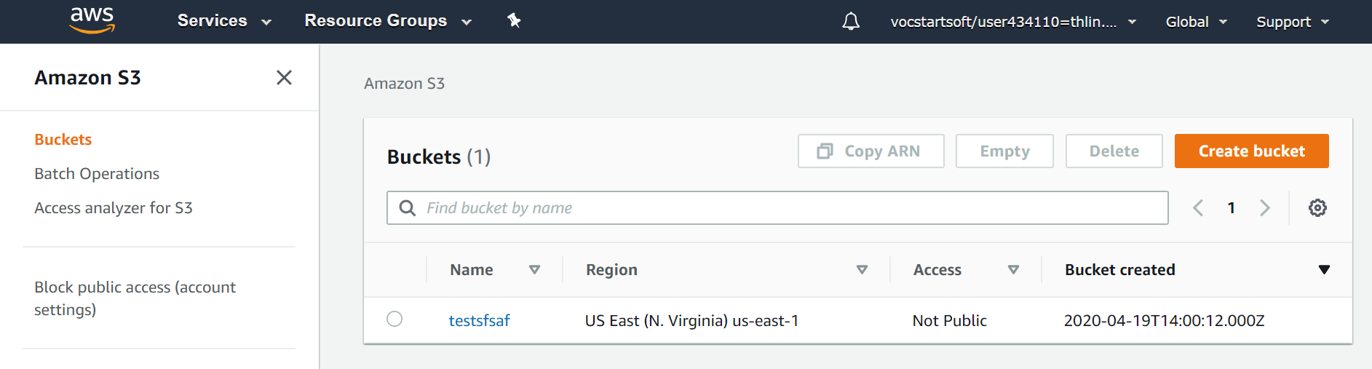
Amazon S3 – Amazon S3 Console
Example: create a bucket (testsfsaf)

Slide 20
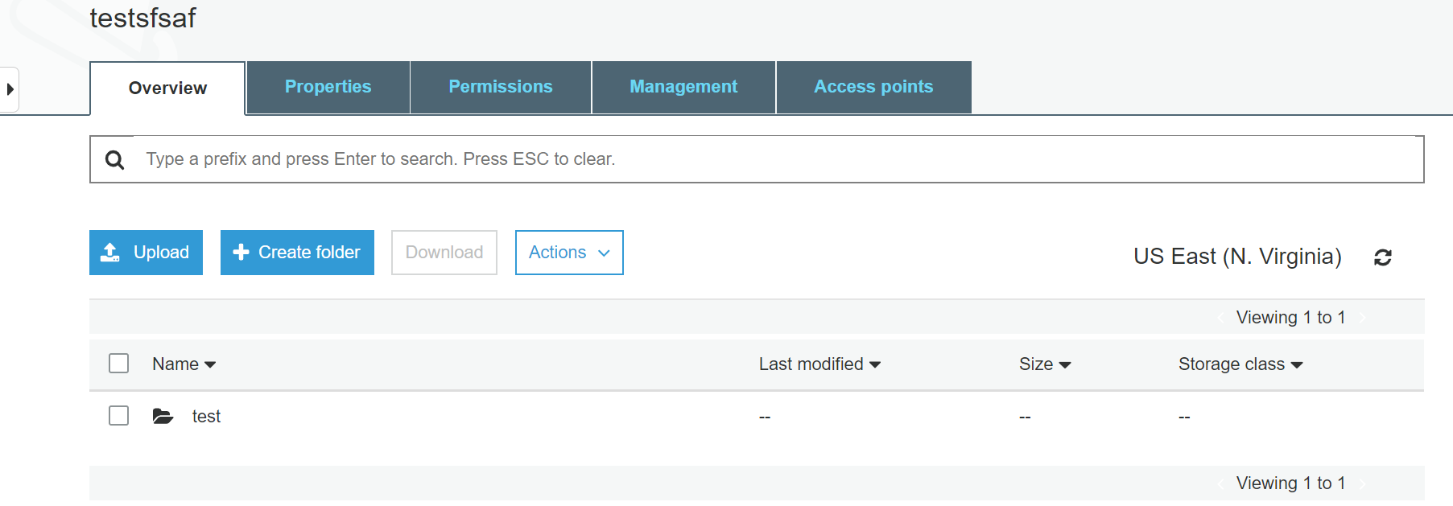
Amazon S3 – Amazon S3 Console
Example: create folder
Note: This is not a real folder. It’s just an object with key “test/”. Amazon S3 console infer logical hierarchy using key name prefixes and delimiters.

Slide 21
Amazon S3 – Amazon S3 API
However, in this homework, we will manipulate Amazon S3 using AWS CLI or AWS SDK in the client program.
If you want to use AWS SDK to make Amazon S3 API calls, you have to provide your AWS credential first.
How to set up authentication credential:
Create a credential file at ~/.aws/credentials. The content of this file is described as follows:
[default]
aws_access_key_id=<your access key>
aws_secret_access_key=<your secret access key>
aws_session_token=<your session token>

Slide 22
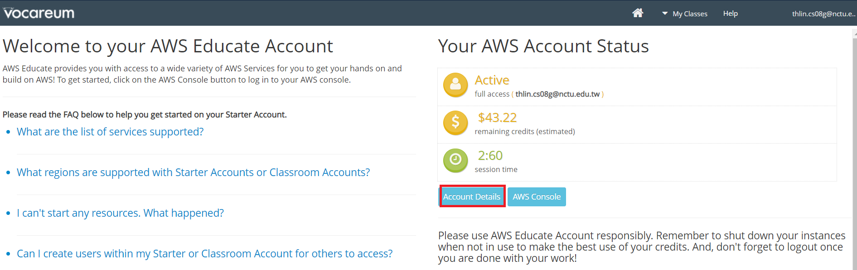
Amazon S3 – Amazon S3 API
You can get these key from your AWS Educate account. Log in your account and go to Intro. to Network Programming classroom. Then, you will see the following page.

Slide 23
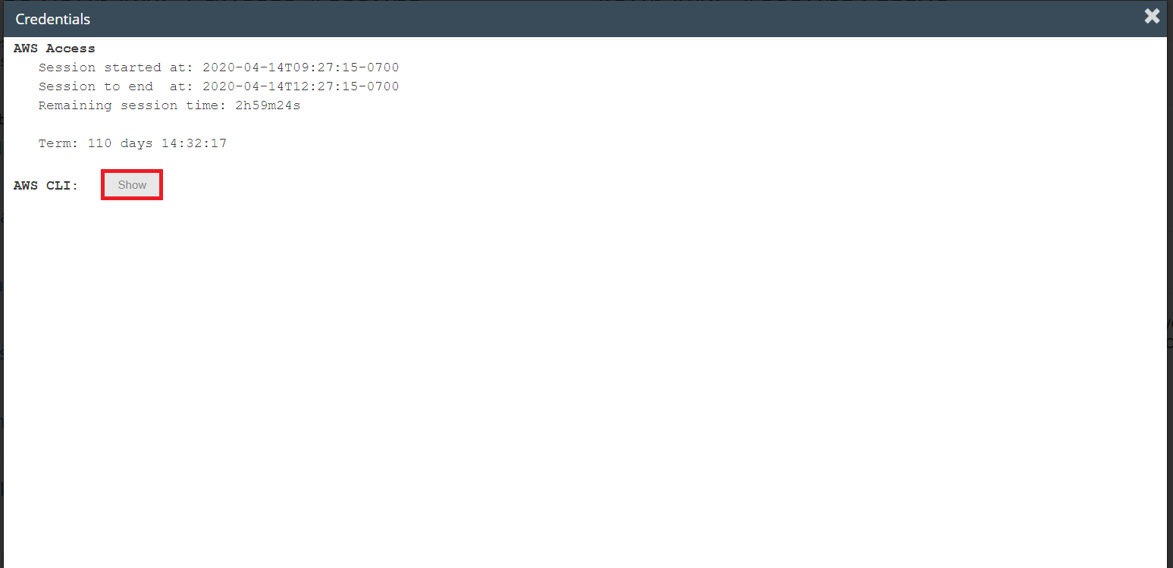
Amazon S3 – Amazon S3 API
Click Show and copy those keys into ~/.aws/credentials
The credential we use here is temporary, so you have to copy and paste again when the credential expiration.

Slide 24
Amazon S3 – Amazon S3 API
Actions you might use:
Create bucket
Delete bucket
Upload object
Get object
Delete object

Slide 25
Amazon S3 – Amazon S3 API
Create bucket
import boto3
s3 = boto3.resource(‘s3’)
s3.create_bucket(Bucket=‘testsfsaf’)
Amazon S3 Console

Slide 26
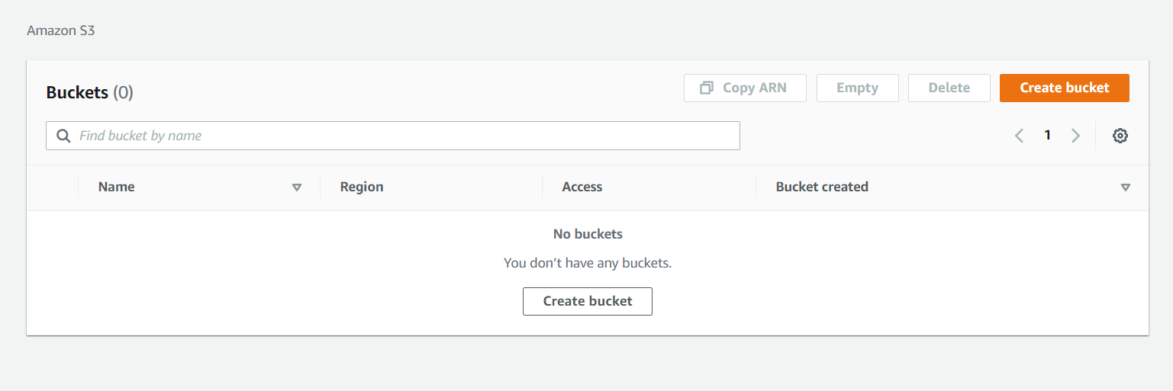
Amazon S3 – Amazon S3 API
Delete bucket
Note: The bucket must be empty when deleting.
import boto3
s3 = boto3.resource(‘s3’)
target_bucket = s3.Bucket(‘testsfsaf’)
target_bucket.delete()
Amazon S3 Console

Slide 27
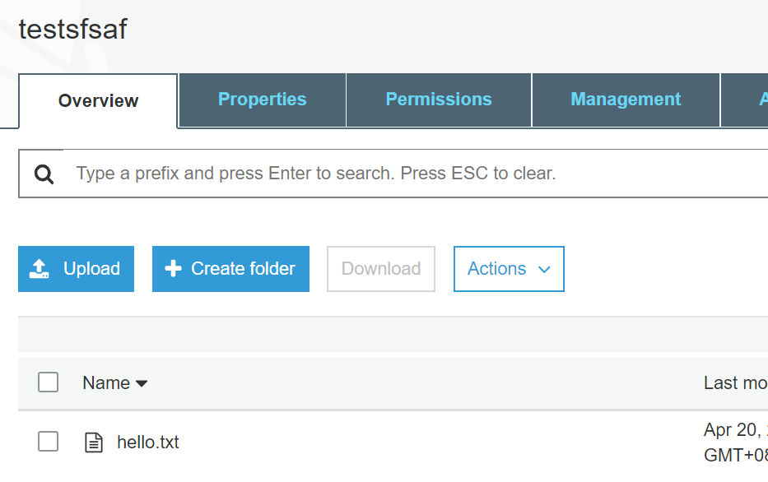
Amazon S3 – Amazon S3 API
Upload object
First argument of upload_file is the file you want to upload.
Second argument is object key.
Amazon S3 Console
import boto3
s3 = boto3.resource(‘s3’)
target_bucket = s3.Bucket(‘testsfsaf’)
target_bucket.upload_file(‘./tmp/hello.txt’, ‘hello.txt’)

Slide 28
Amazon S3 – Amazon S3 API
Get object
import boto3
s3 = boto3.resource(‘s3’)
target_bucket = s3.Bucket(‘testsfsaf’)
target_object = target_bucket.Object(‘hello.txt’)
object_content = target_object.get()[‘Body’].read().decode() #get the content of hello.txt

Slide 29
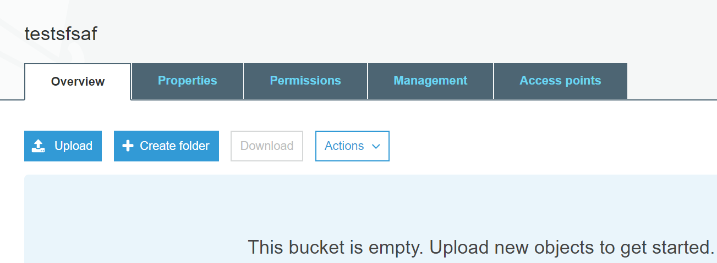
Amazon S3 – Amazon S3 API
Delete object
Amazon S3 Console
import boto3
s3 = boto3.resource(‘s3’)
target_bucket = s3.Bucket(‘testsfsaf’)
target_object = target_bucket.Object(‘hello.txt’)
target_object.delete()

Slide 30
Details of this homework
Your server and client program must be able to handle all commands in the previous part.
For some commands such as whoami, exit, logout, create-board, list-board ##<key> and list-post <board-name> ##<key>, your client program only sends the command to the server and gets the corresponding result from the server.
However, there are some commands that your client program will interact with Amazon S3.
Also, there are some new commands you have to implement for simple mail service.
We will discuss the details of 3. and 4. by reading the requirements and scenario parts of the spec.

