Slide 1

Gene Expression Cancer RNA-Sequence
Presented by:
Group 4 & Team 34
Niraj Chetry
Vikas Deep Shukla

Slide 2
Objective
Monitoring Gene Expression and Transcriptome changes with Cancer RNA Sequencing (RNA-Seq) can aid in understanding tumor classification and progression. Cancers accumulate numerous genetic changes, but typically only a few drive tumor progression. Cancer RNA-Seq can help to determine which variants are expressed in cancer samples.
Multiple Unsupervised Machine Learning techniques are applied to analyze the Cancer Genomic Data in order to retrieve insights related to various tumor types.

Slide 3
Overview of Dataset
The data set has five different labels. There are 801 rows and 20531 columns. The original data set is maintained by the Cancer Genome Atlas Pan-Cancer Analysis Project. The dataset is provided by UCI Machine Learning Repository (http://archive.ics.uci.edu/ml/datasets/gene+expression+cancer+RNA-Seq) and its parameters are different gene sequence.
We are planning to use Exploratory Data Analysis by using NumPy, Pandas and Matplotlib. We would like to use clustering approach to predict different type of tumors based on gene sequence. The outcome is expected to be more actionable and result in operational changes followed by a better use in medical for diagnosing tumor. With an intention to give an estimation of type of tumor from clustering algorithm, the project proposes a method to show tumor types. Samples (instances) are stored row-wise. Variables (attributes) of each sample are RNA-Seq gene expression levels measured by illumina HiSeq platform. A dummy name (gene XX) is given to each attribute.

Slide 4
Scope of Project
Class-wise distribution of sample size
Plot standard deviation for top 10% genes
Average value distribution for top 10% genes are obtained for each of tumor type
For Dimension reduction, we have applied PCA and captured more than 95% of the total variance
Applied K-Means Clustering and Hierarchical Clustering and calculate Adjusted Rand Index

Slide 5
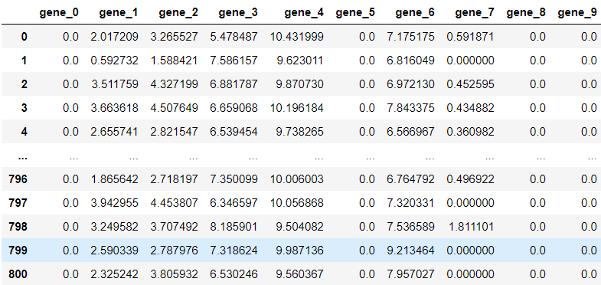
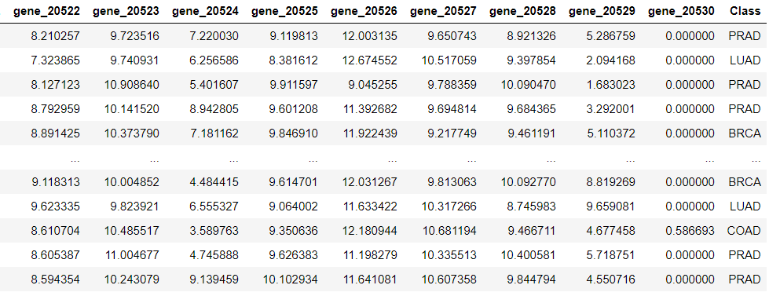
Dataset

Slide 6

Overview of Problem * Reduce the dimension from more than 20,000 features to 500 features (99.7 % reduction) *Apply multiple clustering multiple algorithm in the principles components in order to cluster the patients. * Validate the predicted clusters with the original labels present

Slide 7

Insights and Modelling

Slide 8
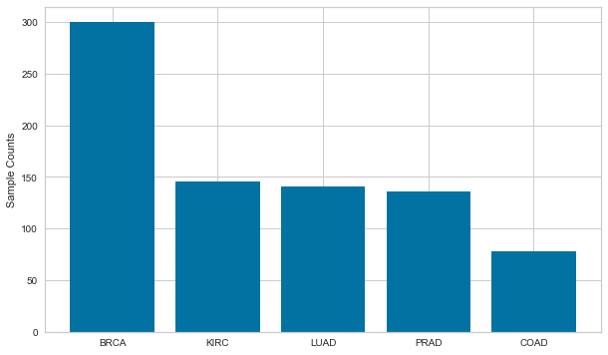
Classwise distribution of sample size
The Sample count of BRCA is highest i.e 300 and the lowest observation is shown by COAD cancer.

Slide 9
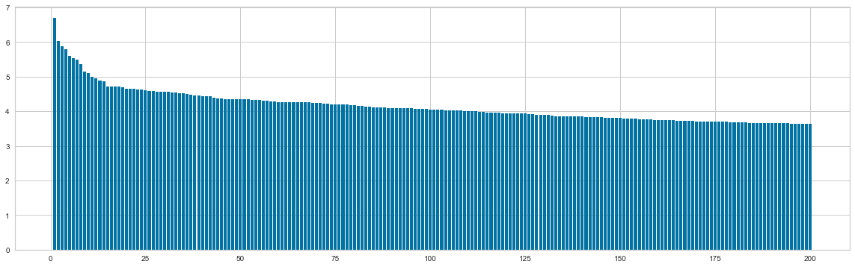
Plot of Standard Deviation for top 200 Genes
Top 10% gene based on highest value of variance are selected and plotted

Slide 10
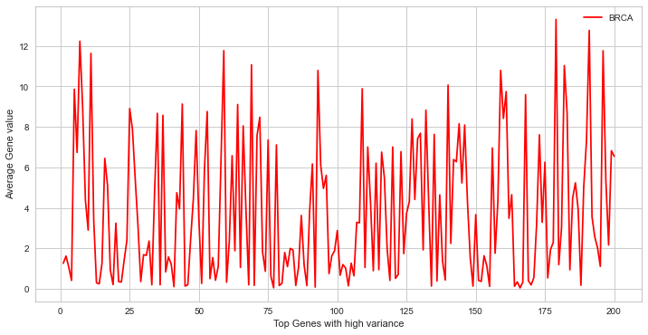
Average value for Top Genes for BRCA

Slide 11
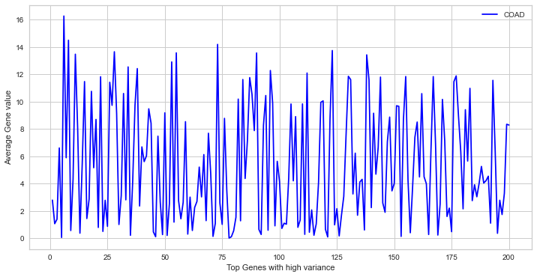
Average value for Top Genes of COAD

Slide 12
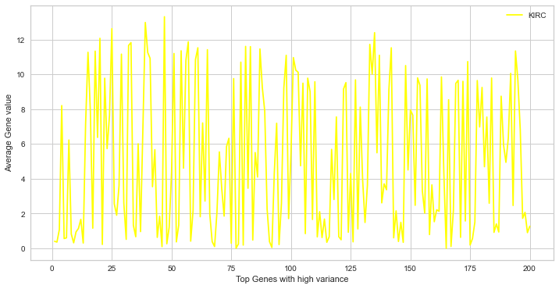
Average value for Top Genes of KIRK

Slide 13
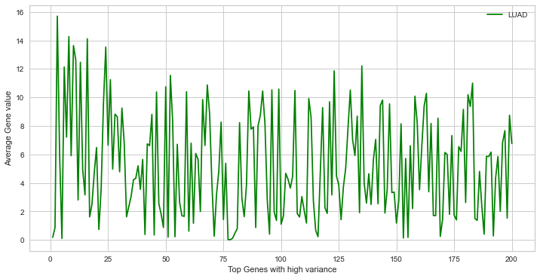
Average value for Top Genes of LUAD

Slide 14
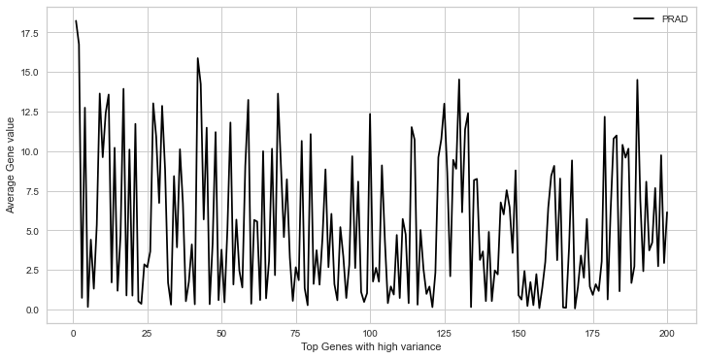
Average value for Top Genes of PRAD

Slide 15
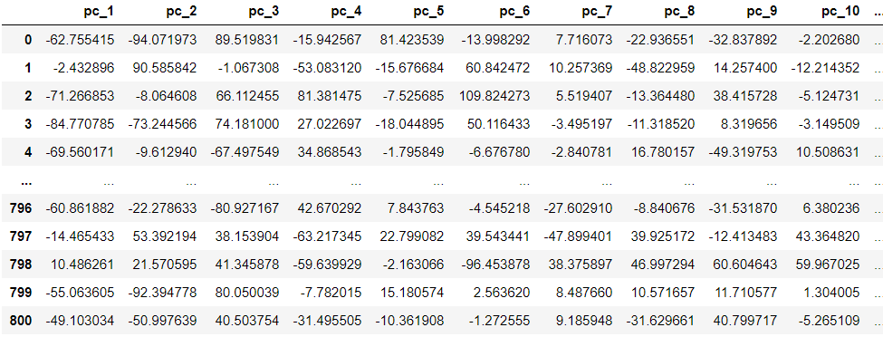
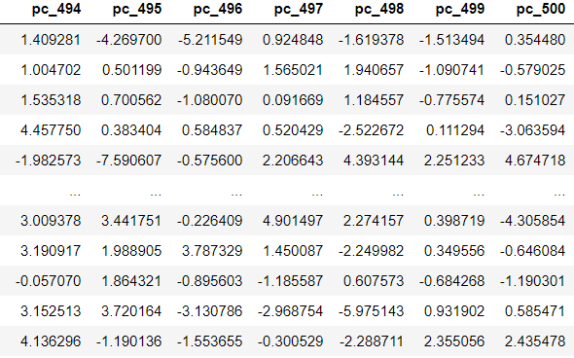
Input data to clustering
Input data to clustering

Slide 16
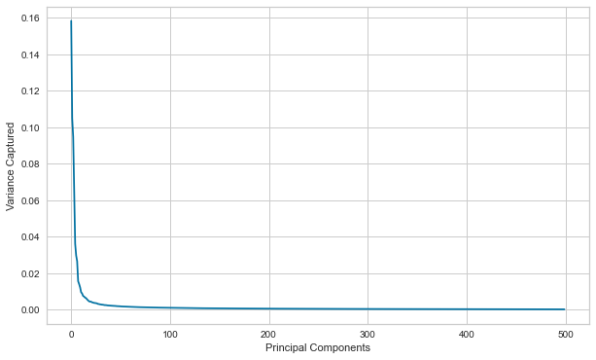
Variance capture by principal components

Slide 17
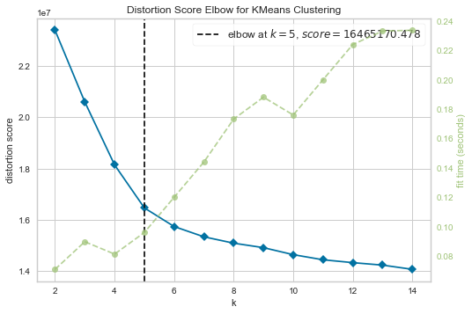
KMeans Clustering by applying Elbow method The Elbow method runs k-means clustering on the dataset for a range of values for k and then for each value of k computes an average score for all clusters. The distortion score is computed by the sum of square distances from each point to its assigned center. Cluster count: 2 to 15
Optimum number of Cluster is 5

Slide 18
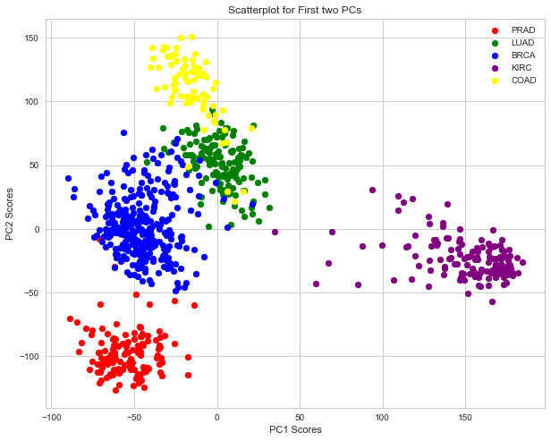




Distribution of clusters based on PC1 & PC2 scores

Slide 19


Rand Index TP – True Positive TN – True Negative FP – False Positive FN – False Negative
The Rand Index computes a similarity measure between two clusterings by considering all pairs of samples and counting pairs that are assigned in the same or different clusters in the predicted and true clusterings.
Rand Index of K-Means clustering– 0.9814
Rand Index of Hierarchical clustering – 0.9888

Slide 20
Applications
Unsupervised Machine Learning techniques are very powerful and efficient tools in predicting different morbidities like Cancer or Tumor for very large number of patients’ data collected from various Health Care institutes and Hospitals.
This project can be more advanced in nature if tumor images are directly considered as inputs; followed by applying image based Supervised Classification algorithms to determine the type of the tumor.

Slide 21


