Slide 1
Biodiversity Project
Biodiversity for the national parks

Slide 2
Title and Content Layout with List
Data description
A section describing the significance calculations that you did for endangered status between different categories of species
A recommendation for conservationists concerned about endangered species, based on your significance calculations
A section describing the sample size determination that you did for the foot and mouth disease study
Foot and mouth disease study
Sample size determination
recommendation
All of the graphs that you created in the notebook

Slide 3
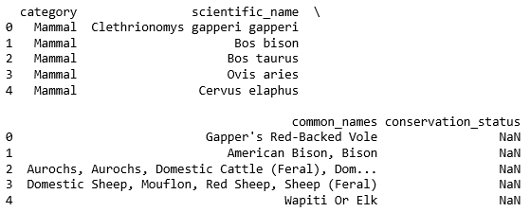
Data description
The scientific name of each species
The common names of each species
The species conservation status

Slide 4
Title and Content Layout with Chart

Slide 5
Two Content Layout with Table
First bullet point here
Second bullet point here
Third bullet point here
Class | Group A | Group B
Class 1 | 82 | 95
Class 2 | 76 | 88
Class 3 | 84 | 90

Slide 6
Two Content Layout with SmartArt
First bullet point here
Second bullet point here
Third bullet point here
Step 1 Title
Step 3 Title
Step 4 Title
Step 5 Title
Step 2 Title

Slide 7
Add a Slide Title - 1

Slide 8
Add a Slide Title - 2

Slide 9
Add a Slide Title - 3

Slide 11
Add a Slide Title - 4

Slide 12
Add a Slide Title - 5

Slide 13
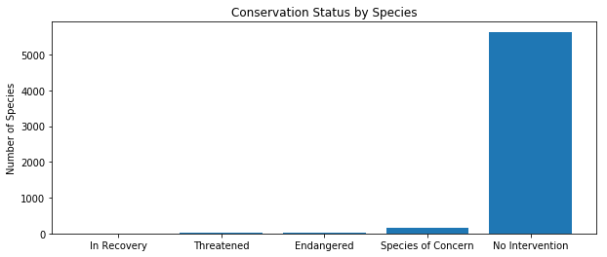
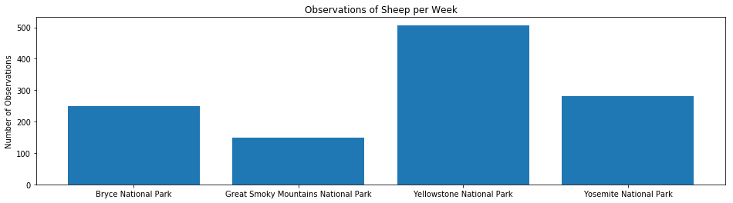

Slide 14
Observation of per week

