Slide 1
Biodiversity for the national parks
Sooyun (Christine) Lee
sooyun.career@gmail.com

Slide 2
Agenda
Data description
Species in national park
7 day observation from four national parks
Data analysis summary
Endangered species
The significance calculations for endangered status between different categories of species
A recommendation for conservationists concerned about endangered species
Foot and mouth disease study
Sample size determination
A recommendation for conservationists

Slide 3
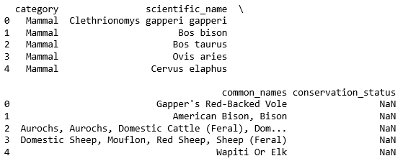
Data description
The given data shows;
total 5824 species (raw data) in the national parks
5504 unique species with their common name
5541 unique scientific name of species
7 species categories – Amphibian, Bird, Mammal, Reptile, Nonvascular Plant, Vascular Plant
Current conversation status of species in the national parks as
Species of Concern - declining population or appears to be in need of conservation.
Endangered - seriously at risk of extinction.
Threatened - vulnerable to endangerment in the near future.
In Recovery - formerly Endangered, but currently not in danger of extinction throughout all
No intervention – not categorized, no data

Slide 4
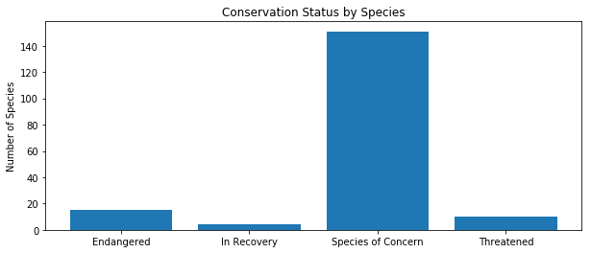
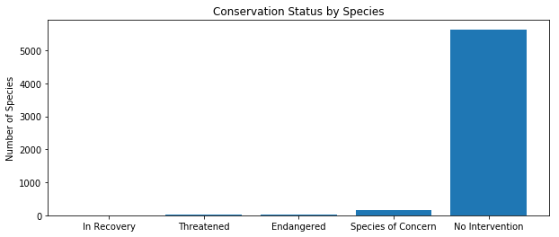
Data analysis I – current conversation status
Current conversation status of approximately 200 (3.5% ) of species in national parks show in the given data (graph on the right).
Categorised species
It indicates the rest of species (5633) aren’t categorised and marked as “no intervention”. It means those species aren’t being threatened and not require a protection

Slide 5
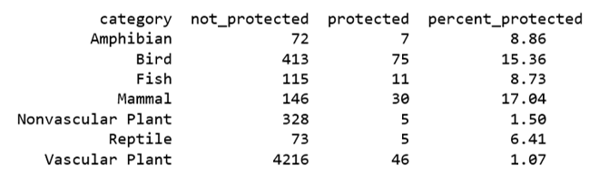
Data analysis II - Investigating Endangered Species
The table below shows the proportion of ‘not protected’ and ‘protected’ species by its category. By looking at the protected percentage (%) column, Mammal has the highest percentage of protected species.
Is mammal more likely to be endangered?
Category | Not protected | Protected | Protected(%)
Amphibian | 72 | 7 | 8.86%
Bird | 413 | 75 | 15.36%
Fish | 115 | 11 | 8.73%
Mammal | 146 | 30 | 17.03%
Nonvascular plant | 328 | 5 | 1.5%
Reptile | 73 | 5 | 6.41%
Vascular plant | 4216 | 46 | 1.07%

Slide 6
Data analysis III – Investigating Endangered Species using Chi-Squared Test for Significance
The data shows Mammals are more likely to be endangered than Birds, but is it true? We can do a significance test to validate this statement. In this test, our null hypothesis is that this difference is due to chance
Mammal vs. Bird
Mammal vs. Reptile
 | Protected | Not protected
Mammal | 30 | 146
Bird | 75 | 413
 | Protected | Not protected
Mammal | 30 | 146
Reptile | 5 | 73
p-value = 0.688
Mammals are not more endangered species then Birds.
p-value = 0.038 SIGNIFACANT!
Mammals are more endangered than reptiles

Slide 7
Recommendation - Investigating Endangered Species
The given data suggests, Mammals may be the most endangered species in the national parks
However, national parks should proceed further testings using the method we used to identify the most endangered species. This way, national parks can prioritise which species need an immediate attention.
We also recommend, national parks should have a close look at species categorised in no intervention if any of them is on the line between ‘no intervention’ and ‘species of concerns’. Prevention is always better!

Slide 8
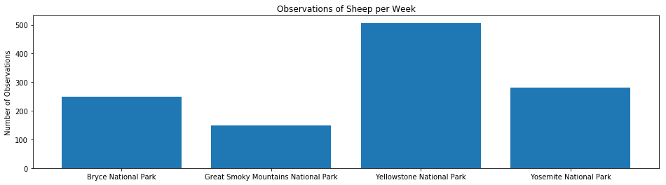
Data description - Foot and mouth disease study
The bar chart below shows number of sheep in each national parks. The chart has produced from two data sets – original species data and 7 day park observation data from each national park.

Slide 9
Data analysis - Foot and mouth disease study
The only information the scientists currently have about the foot and mouth disease is that last year it was recorded that 15% of sheep at Bryce National Park have foot and mouth disease.
Park Rangers at Yellowstone National Park have been running a program to reduce the rate of foot and mouth disease at that park. The scientist wants to validate if the reduction program works.
We will determine the sample size and make a recommendation on how many weeks for selected parks need to observe enough sheep. Bryce National Park and Yellowstone National Park are selected to make a recommendation.

Slide 10
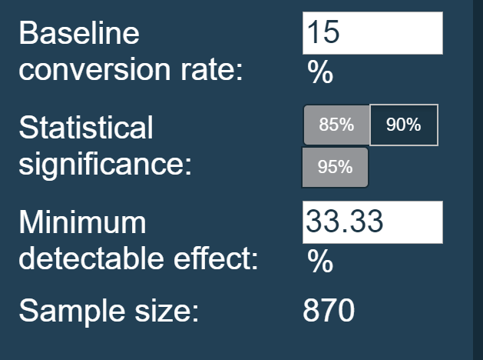
Foot and mouth disease study – sample size determination
15% of sheep at Yellowstone national park has foot and mouth diseases
Scientists want to know when the disease has reduced by 5% confidently
The recommended sample size is *510
*The sample size is being calculated as 870 when you do this exercise is completed from the web version

Slide 11
Recommendation - Foot and mouth disease study
Two selected national parks for recommendation to be observed for duration as stated in the table below;
All other national parks should use this method to determine how long each of them will take to ensure enough sheep have been observed.
Sample size (The number of sheep must observed from each park) | 510
Yellowstone national park observation duration | 1 week
Bryce national park observation duration | 2 weeks

