Slide 1
Biodiversity Project
Biodiversity for the national parks

Slide 2
Title and Content Layout with List
Data description
A section describing the significance calculations that you did for endangered status between different categories of species
A recommendation for conservationists concerned about endangered species, based on your significance calculations
A section describing the sample size determination that you did for the foot and mouth disease study
Foot and mouth disease study
Sample size determination
recommendation
All of the graphs that you created in the notebook

Slide 3
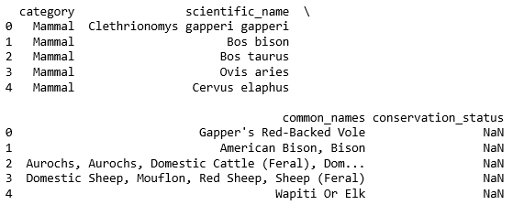
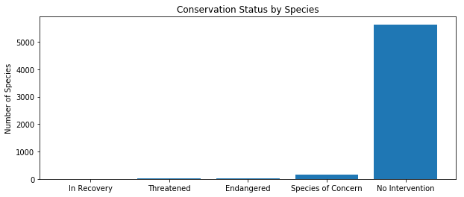
Data description
The given data shows;
Total 5824 species (raw data)
5504 unique species with their common name
5541 unique scientific name of species
7 species categories
Amphibian
Bird
Mammal
Reptile
Nonvascular Plant
Vascular Plant
Current conversation status of species as
Species of Concern
Endangered
Threatened
In Recovery
No intervention (No status, no data)

Slide 4
Title and Content Layout with Chart

Slide 5
Two Content Layout with Table
First bullet point here
Second bullet point here
Third bullet point here
Class | Group A | Group B
Class 1 | 82 | 95
Class 2 | 76 | 88
Class 3 | 84 | 90
Category | Scientific name example | Common name example | Conservation status
Amphibian
Bird
Fish
Mammal | Bos bison Coyote
Reptile
Nonvascular Plant
Vascular Plant | Saxifraga californica

Slide 6
Two Content Layout with SmartArt
First bullet point here
Second bullet point here
Third bullet point here
Step 1 Title
Step 3 Title
Step 4 Title
Step 5 Title
Step 2 Title

Slide 7
Add a Slide Title - 1

Slide 8
Add a Slide Title - 2

Slide 9
Add a Slide Title - 3

Slide 11
Add a Slide Title - 4

Slide 12
Add a Slide Title - 5

Slide 13
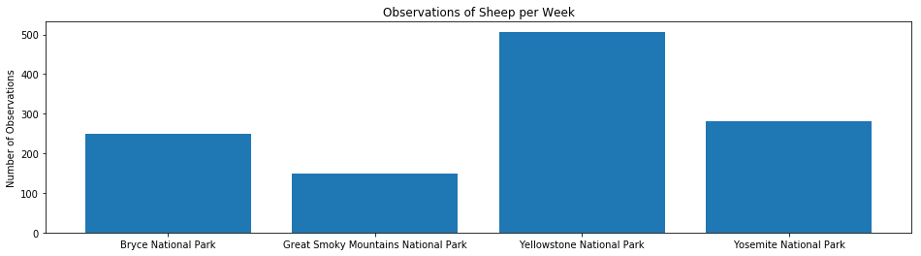

Slide 14
Observation of per week

