Slide 1

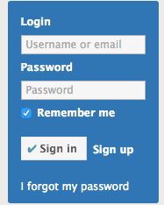
Next page
Start Request
Parse Postcard
Google SpreadSheet
Parse Gallery
Login Check
Packages:
Scrapy
Selenium
GoogleAPI

