Slide 1

Personal dATa bReach awareness In Cybersecurity Incident hAndling
2nd edition, 5 June 2025
PATRICIA II
Systems Oversight and Technology Audits Sector, Technology and Privacy Unit

Slide 2


Exercise Instructions
Do not record the session.
Avoid taking pictures or videos during the exercise.
Do not post the exercise content on internet or social media.

Slide 3
Agenda
09:30 - 10:00 – Welcome & Scope Objectives
10:00 - 10:30 - Incident 1 (30 min)
10:30- 10:50 - Coffee Break
10:50 - 12:00 - Incident 2 (70 min)
12:00 - 13:00 - Incident 3 (60 min)
13:00 - 14:00 - Light Lunch
14:00 - 14:15 - Family Picture
14:15 - 15:45 - Debrief - Open Discussion (90 min)
15:45 – 16:00 – EDPS Closing

Slide 4
Scope - Objectives

Slide 5
PATRICIA - Objectives
Main Goal:
Raise awareness in personal data breach management to EUIBAs staff, especially IT personnel who are involved in cybersecurity incidents and would need to collaborate with other roles in the EUIBA, to effectively manage a personal data breach.
Objectives:
Identify the need to assess risks to data subjects, as a result of a cybersecurity incident.
Identify expected actions or allocation of responsibilities in case of a personal data breach.
Identify communication needs between different actors such IT teams, LISO/Local cybersecurity officer, DPO.
Evaluate if your internal processes on personal data breach management support you on main steps and notification outlines.

Slide 6
How are we going to play?
Each EUIBA team will play as a team and will discuss actions on how to handle each incident, based on their internal processes.
For each question, several options are available. Each team picks the more relevant in the questionnaire.
At the end of each incident a discussion among all the participants will take place.
At the end of the preparation time for each scenario, each team will provide the filled questionnaire to the organizers.
Each player will also be asked to fill an anonymous feedback questionnaire, evaluating the experience and the exercise.

Slide 7
How to make the most out of PATRICIA?
Dialogue and collaboration between the players is highly encouraged.
There is no right or wrong answer!
The goal is to see if you have sufficient guidance by your internal processes, to handle a personal data breach.
You work as a team!
There should be one answer per team!
Note: Each incident is taking place at a different day!

Slide 8
Scenario

Slide 9
Scenario presentation
Your EUIBA operates an IT platform to support exchange of information, including documents, with MS, as part of experts groups and/or specific processes spanning across EU and MS level.
In case of any problem or enquiry, your EUIBA has deployed a ticketing system to provide technical support to platform users.
The platform counts around 500 users, both internal and external (MS experts involved in different processes and procedures).

Slide 10
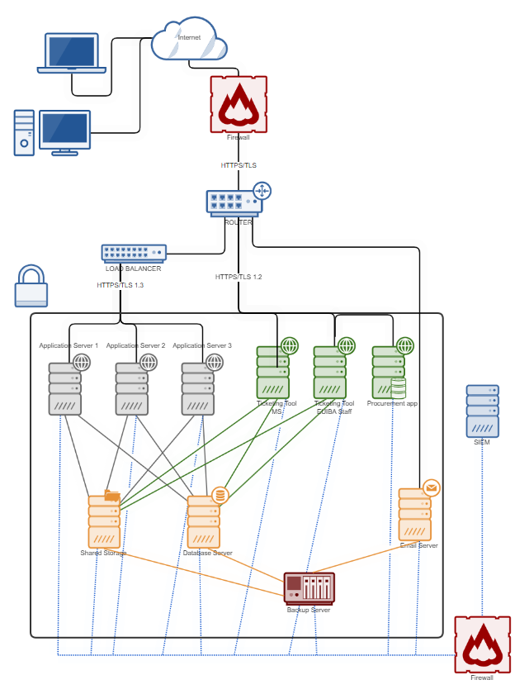
Network diagram

Slide 11
Incident 1
IT security team receives alerts from the SIEM

Slide 12
Incident 1
Timeline: Day 1, 12:30 UTC
Your EUIBA IT security team has received an alert from the Security Information and Event Management (SIEM) system indicating that the antivirus (AV) protection on the IT platform has been disabled.
The IT security team immediately begins a detailed investigation to determine the cause and scope of the issue.
During the investigation, the team identifies multiple attempts of privilege escalation, suggesting that the threat actor has been targeting your EUIBA systems.

Slide 13


12:58
Fill in questionnaire
10’

Slide 14
Incident 1
Timeline: Day 1, 12:30 UTC
Your EUIBA IT security team has received an alert from the Security Information and Event Management (SIEM) system indicating that the antivirus (AV) protection on the IT platform has been disabled.
The IT security team immediately begins a detailed investigation to determine the cause and scope of the issue.
During the investigation, the team identifies multiple attempts of privilege escalation, suggesting that the threat actor has been targeting your EUIBA systems.

Slide 15
Question 1
Is there a procedure that should be initiated?
A
Yes
B
Not yet, further analysis needs to be performed
C
No

Slide 16
Question 2
Multiple Answers
Who needs to be informed of the incident
(and by whom)?
A
Business Owner – Delegated Controller
B
System Manager
C
Platform Users
CISO – LISO - LCO
D
E
DPO
F
Senior Management
G
Other

Slide 17
Question 3
What is the process that should be initiated?
Who should initiate it?
A
Security incident response process,
initiated by ……..
Personal data breach management process,
initiated by ……..
B
C
Other,
initiated by .....

Slide 18
Open Discussion
10’

Slide 19
Coffee Break

Slide 20
Incident 2
Database compromise and user information exposure

Slide 21
Incident 2
Timeline: Day 4, 09:00 UTC
Four days following the initial detection of the antivirus being disabled and privilege escalation attempts, the investigation team concludes that the platform was compromised.
The platform utilizes a dedicated user authentication service, that stores in the database usernames, hashed passwords and other information for all users, internal and external to the EUIBA.
The database logs analysis reveals that the user information stored in the authentication table has been accessed multiple times by the threat actor.

Slide 22
Fill in questionnaire
20’

Slide 23
Incident 2
Timeline: Day 4, 09:00 UTC
Four days following the initial detection of the antivirus being disabled and privilege escalation attempts, the investigation team concludes that the platform was compromised.
The platform utilizes a dedicated user authentication service, that stores in the database usernames, hashed passwords and other information for all users, internal and external to the EUIBA.
The database logs analysis reveals that the user information stored in the authentication table has been accessed multiple times by the threat actor.

Slide 24
Question 4
Is there a procedure that should be initiated?
A
Yes
B
Not yet, further analysis needs to be performed
C
No

Slide 25
Question 5
Multiple Answers
Who needs to be informed of the incident
(and by whom)?
A
Business Owner – Delegated Controller
B
System Manager
C
Platform Users
CISO – LISO - LCO
D
E
DPO
F
Senior Management
G
Other

Slide 26
Question 6
What is the process that should be initiated?
Who should initiate it?
A
Security incident response process,
initiated by ……..
Personal data breach management process,
initiated by ……..
B
C
Other,
initiated by .....

Slide 27
Question 7
Multiple Answers
Which are the initial - immediate actions to contain the incident and mitigate, if possible, the risks to the data subjects?
A
Isolate the compromised server
B
Force change of passwords for all users
C
Rebuild the server, including updating and patching
Monitor network traffic
D
E
Review firewall settings
F
Inform users that their credentials have been leaked
G
Other

Slide 28
Question 8
How would you assess the risk to the data subjects?
A
Unlikely risk
B
Risk
C
High Risk

Slide 29
Question 9
Do you believe the assessment of the risk to the data subjects would be different if LCO was not consulted?
A
Yes
B
No

Slide 30
Question 10
How does the LCO and DPO reflect on the fact that leaked passwords were hashed with MD5?
A
There is still some level of protection
B
They should be considered as revealed
C
There is a probability that they are revealed

Slide 31
Question 11
Multiple Answers
Which external stakeholders would you notify?
A
EDPS
B
cert-EU
C
Users of the platform
Public
D
E
National CSIRT of hosting MS
F
Law enforcement Authorities of hosting MS
G
Other

Slide 32
Open Discussion
10’

Slide 33
Incident 3
Compromise of the ticketing system

Slide 34
Incident 3
Timeline: Day 5, 10:00 UTC
Your EUIBA platform, includes a ticketing system used by the platform users to report various technical issues.
The ongoing investigation reveals that the ticketing system used by your EUIBA’s staff and external experts has also been compromised and tickets have been exfiltrated.

Slide 35
Fill in questionnaire
20’

Slide 36
Incident 3
Timeline: Day 5, 10:00 UTC
Your EUIBA platform, includes a ticketing system used by the platform users to report various technical issues.
The ongoing investigation reveals that the ticketing system used by your EUIBA’s staff and external experts has also been compromised and tickets have been exfiltrated.

Slide 37
Question 12
Multiple Answers
Who needs to be informed of the incident
(and by whom)?
A
Business Owner – Delegated Controller
B
System Manager
C
Platform Users
CISO – LISO - LCO
D
E
DPO
F
Senior Management
G
Other

Slide 38
Question 13
How would you assess the risk to the data subjects?
A
Unlikely risk
B
Risk
C
High Risk

Slide 39
Question 14
Multiple Answers
Which information should the LCO share with the DPO and the delegated controller?
A
Which parts of the system were accessed by the unauthorized users
B
Which files were accessed by the unauthorized users
C
Which files were exfiltrated by the unauthorized users
Which files were modified by the unauthorized users
D
E
For how long the unauthorized users had access
F
If a backup, prior to the unauthorized access, is available
G
Other

Slide 40
Question 15
Multiple Answers
Which information should the DPO and the delegated controller share with the LCO?
A
Special characteristics of the data subjects
B
Ease of identification of individuals
C
Categories of personal data included in the tickets
D
Other

Slide 41
Question 16
Multiple Answers
Which are the initial - immediate actions to contain the incident and mitigate, if possible, the risks to the data subjects?
A
Isolate the compromised server
B
Force change of passwords for all users
C
Rebuild the server, including updating and patching
Monitor network traffic
D
E
Review firewall settings
F
Inform users that their data have been leaked
H
Other
Analyse data included in the tickets
G

Slide 42
Open Discussion
10’

Slide 43
Lunch

Slide 44
Debrief
Lessons learned

Slide 45
Open Discussion
Allocation of responsibilities
What was your experience from Patricia?
What did you like?
What you did not like?
Which findings will you apply in real life scenarios?
Were the goals and objectives met?
What could be added in future editions?
Internal Communication
Assessing risks to data subjects’ rights
Internal processes

Slide 46
Anonymous survey

Slide 47

Next steps
After action report in Q4 2025
Shared with participants
For any comment, feedback or recommendation, please contact konstantina.vemou@edps.europa.eu

Slide 48


