Slide 1
C&I LAB
LEARNING DYNAMICS OF LLM FINETUNING
ICLR 2025
Yi Ren, Danica J. Sutherland
2025.9.11
YunSung Byun

Slide 2
Contents
1.
Introduction
2.
Learning Dynamics
3.
Hallucination/Squeezing Effect
4.
Solution
5.
Conclusion
C&I LAB
2

Slide 3
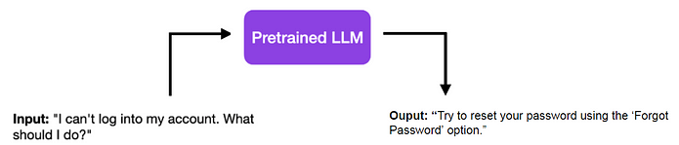
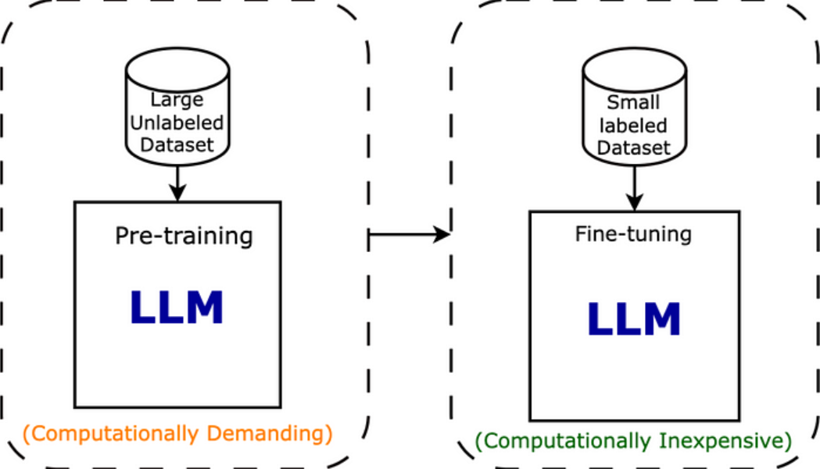
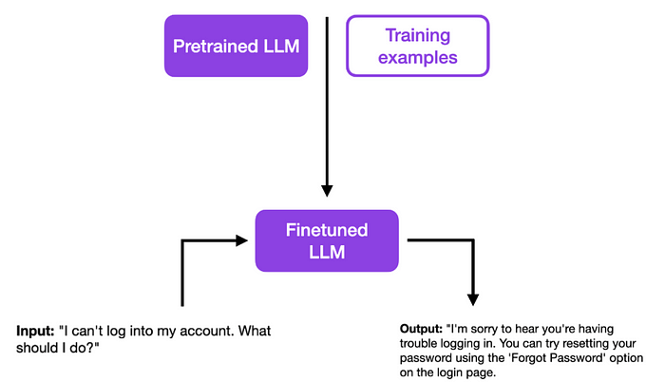
SFT?
Introduction
Pre-training -> Supervised Fine-tuning
C&I LAB
3

Slide 4
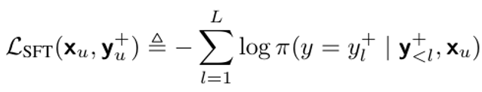
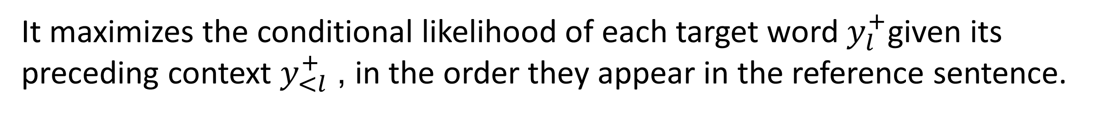
SFT?
Introduction
It maximizes the conditional likelihood of each target word $y_{l}^{+}$given its preceding context $y_{<l}^{+}$, in the order they appear in the reference sentence.
C&I LAB
4

Slide 5
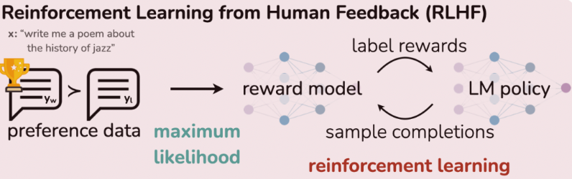
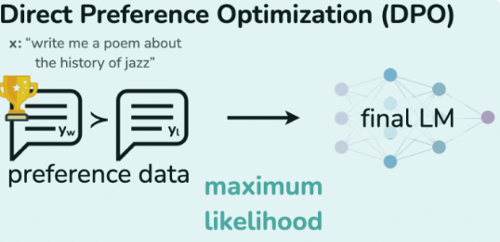
DPO?
Introduction
C&I LAB
5

Slide 6

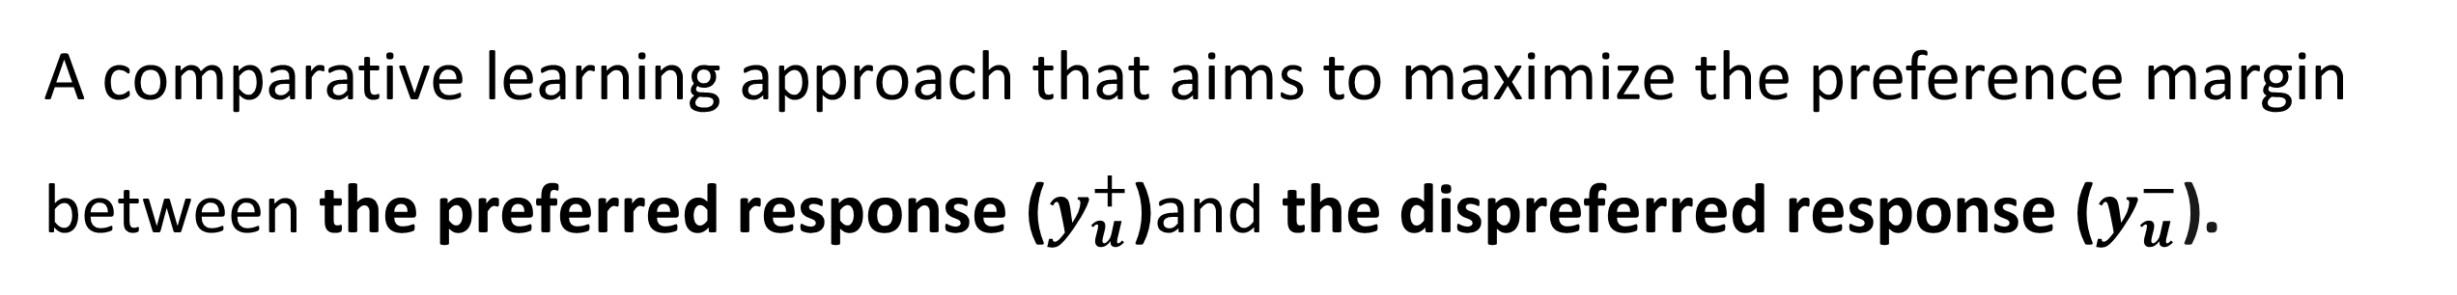
DPO?
Introduction
A comparative learning approach that aims to maximize the preference margin between the preferred response ($y_{u}^{+}$)and the dispreferred response ($y_{u}^{−}$).
C&I LAB
6

Slide 7
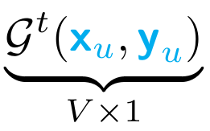
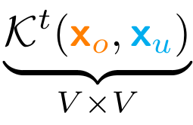
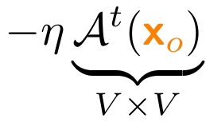
What is Learning Dynamics
Learning Dynamics
Update Command or Gradient Vector
Influence Channel or Similarity Kernel
Scaled Adaptation or Receiver's State
C&I LAB
7

Slide 8
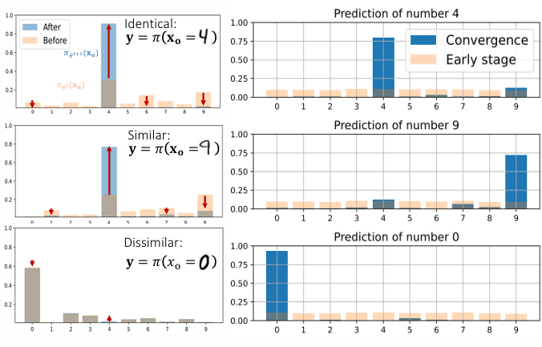
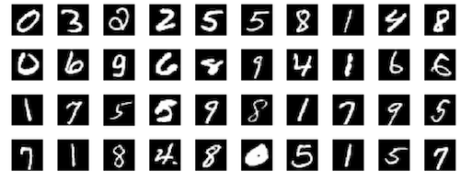
What is Learning Dynamics
Learning Dynamics
Learning Dynamics: An analysis framework that identifies the relationship between a gradient update from training data (x_u​) and how it causes a change in the prediction on other data (x_o​).
C&I LAB
8

Slide 9
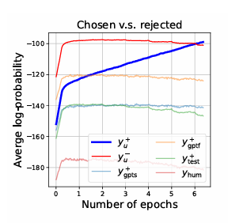
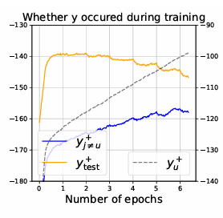
SFT cause hallucinations?
Hallucination/Squeezing Effect
This is because SFT encourages the model to depend on surface-level similarity rather than capturing the semantic meaning of knowledge.
C&I LAB
9

Slide 10
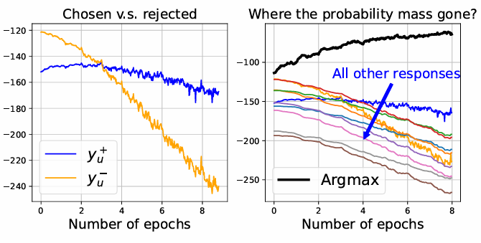
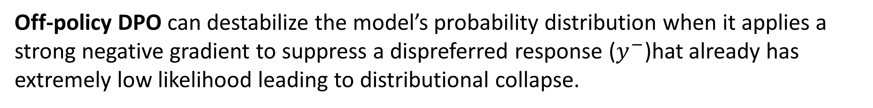
Squeezing Effect
Hallucination/Squeezing Effect
Argmax: Argument of the Maximum
Off-policy DPO can destabilize the model’s probability distribution when it applies a strong negative gradient to suppress a dispreferred response ($y^{−}$)hat already has extremely low likelihood leading to distributional collapse.
C&I LAB
10

Slide 11
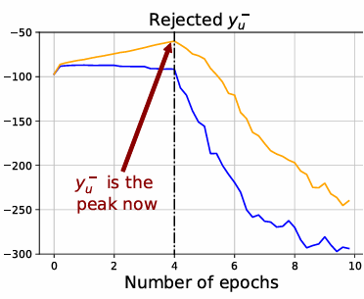
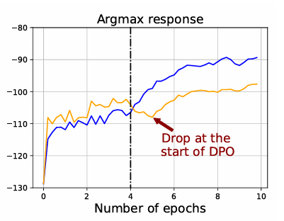

How to solve?
Solution
Argmax: Argument of the Maximum
C&I LAB
11

Slide 12
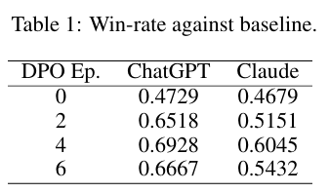
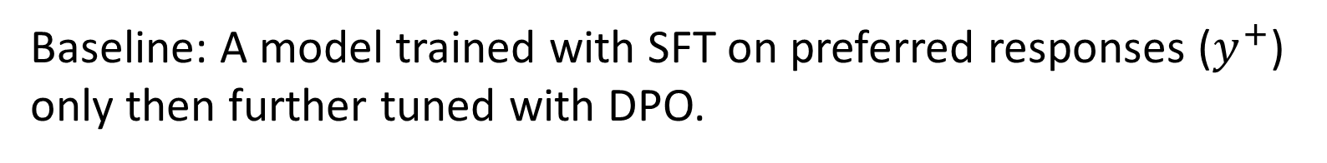
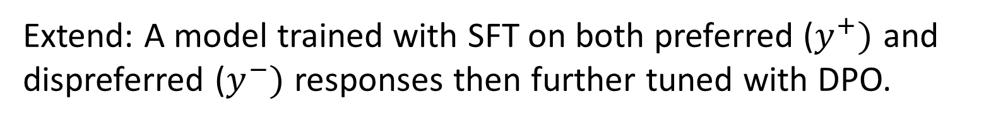
Result
Conclusion
Why?
Qwen1.5-1.8B
Baseline: A model trained with SFT on preferred responses ($y^{+}$) only then further tuned with DPO.
Extend: A model trained with SFT on both preferred ($y^{+})$ and dispreferred ($y^{−})$ responses then further tuned with DPO.
Baseline(win rate(%)) + Extend(win rate(%)) = 1
C&I LAB
12

