Slide 1
C&I LAB
HealthGPT: A Medical Large Vision-Language Model for Unifying Comprehension and Generation via Heterogeneous Knowledge Adaptation
ICML 2025
Tianwei Lin, Wenqiao Zhang, Sijing Li, Yuqian Yuan
2025.9.25
YunSung Byun

Slide 2
Contents
1.
Introduction
2.
HealthGPT
3.
Experiments
4.
Conclusion
C&I LAB
2

Slide 3
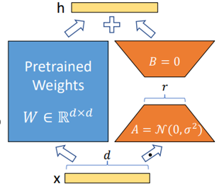


LoRA ?
Introduction
Low-Rank Adaptation : A technique for efficiently fine-tuning large-scale models with billions of parameters.
C&I LAB
3

Slide 4
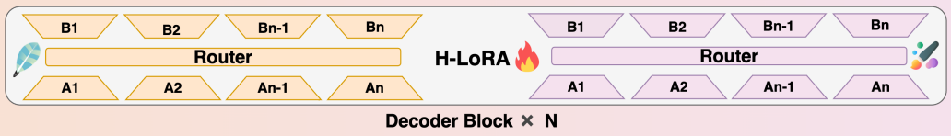
H-LoRA ?
Introduction
Heterogeneous-LORA : A multi-expert extension of LoRA that separates comprehension and generation knowledge into task-specific adapters
C&I LAB
4

Slide 5
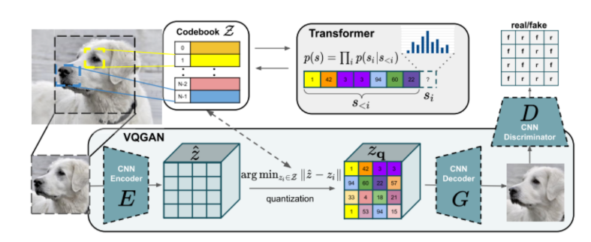
VQGAN?
Introduction
Encoder: Compresses an input image into a very small sequence of discrete numerical codes (index sequences).
Decoder: Takes these numerical codes as input and reconstructs them into a high-quality image similar to the original.
C&I LAB
5

Slide 6
Introduction
Contribution
The First Unified Medical Vision-Language Model
- first model to integrate both image comprehension and generation within a single framework
Effective Learning Paradigm (H-LORA)
- optimized learning architecture called H-LORA was proposed
3. Comprehensive Training Dataset (VL-Health)
- To effectively train the unified model a comprehensive dataset called VL-Health
4. Proven Superior Performance
- HealthGPT achieved state-of-the-art (SOTA) performance
C&I LAB
6

Slide 7
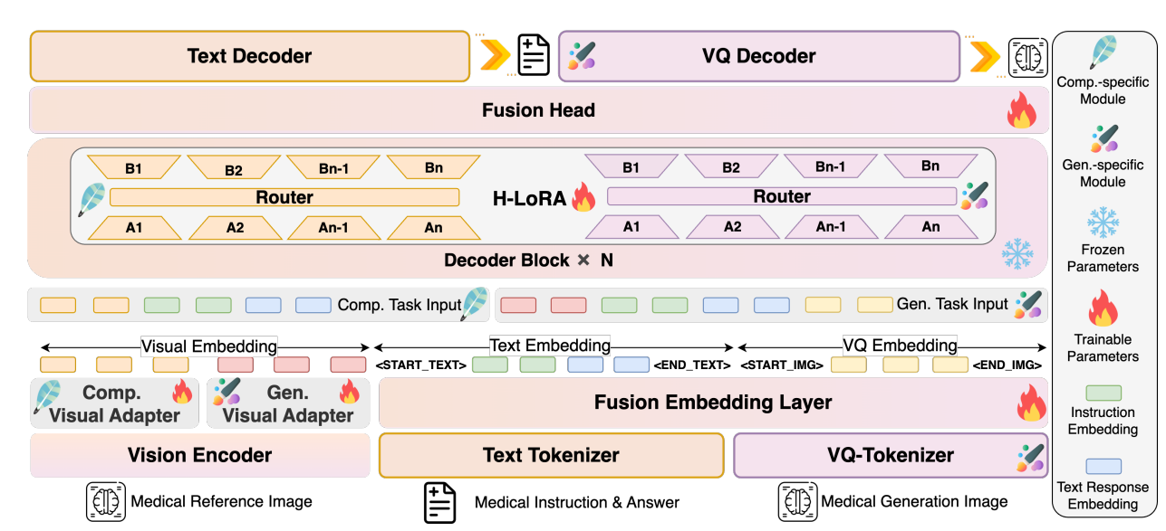
HealthGPT
HealthGPT
Basic Structure: Uses a Vision Transformer (ViT)–based encoder such as CLIP-L/14
Output Format: The image is divided into small patches, which are converted into token-level continuous vector sequences (Visual Embeddings)
C&I LAB
7

Slide 8
HealthGPT
HealthGPT
Basic Structure: Multiple Transformer decoder blocks with H-LoRA adapters (task-specific experts + router)
Output Format: Generates either text tokens (for comprehension) or VQ indices (for image generation)
C&I LAB
8

Slide 9
HealthGPT
HealthGPT
Comp. Visual Adapter (for Comprehension) Emphasizes abstracted features of the image to support tasks such as summarization, analysis, and visual question answering.
Gen. Visual Adapter (for Generation) Preserves fine-grained details necessary for reconstructing the image as-is or transforming it into another form.
C&I LAB
9

Slide 10
HealthGPT
HealthGPT
Input : Medical Instruction & Answer (Question/Instruction/Explanation)
Tokenization → Embedding : Subword Token → Text Embedding.
C&I LAB
10

Slide 11
HealthGPT
HealthGPT
Input : Medical Generation Image (Ground truth image) — Supervision signal for training
VQ Indexing: Image → VQ Embedding (Discrete code sequence)
C&I LAB
11

Slide 12
HealthGPT
HealthGPT
Interference Prevention: Physically separate understanding and generation knowledge + dynamically select → minimize mutual interference.
Per-Token Adaptation: Different combinations of experts can be applied to text segments, image segments and even to different tokens within the same sentence.
C&I LAB
12

Slide 13
HealthGPT
HealthGPT
Text vocabulary distribution ⟶ Text Decoder path
VQ codebook distribution ⟶ VQ Decoder path
C&I LAB
13

Slide 14
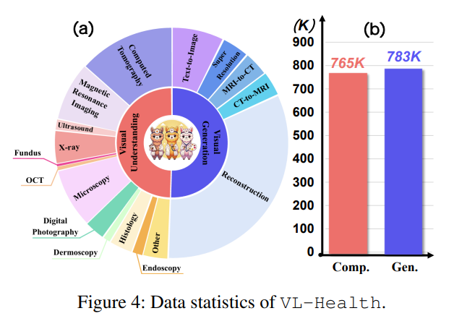
Data / Setup
Experiments
Vision Encoder: CLIP-L/14
Base LLM: phi-3-mini(3.8B), phi-4(14B)
VQGAN: f8-8192 version
C&I LAB
14

Slide 15
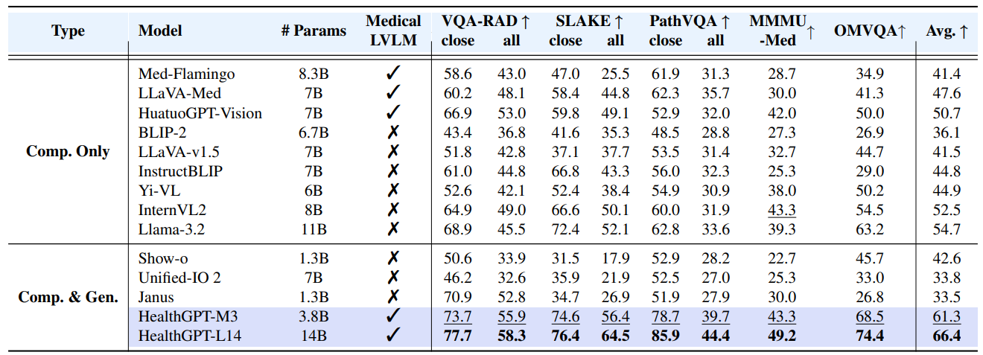
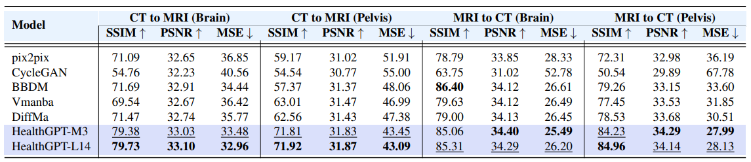
Experiments
Experiments
C&I LAB
15

Slide 16
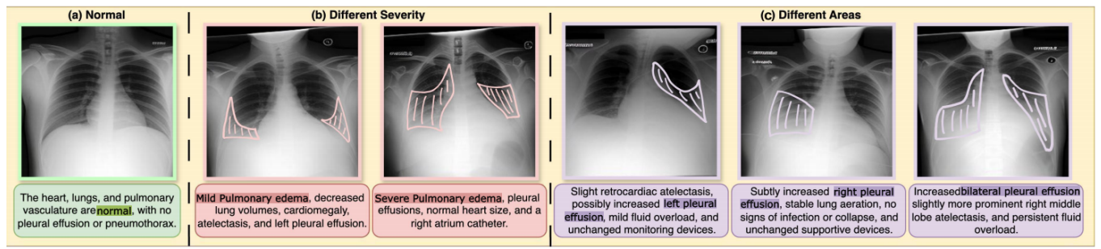
Conclusion
Conclusion
Ground Truth absent
The difficulty of performing a 1:1 comparison between generated images and real X-rays makes it challenging to validate their actual clinical reliability.
C&I LAB
16

