Slide 1
C&I LAB
On the Empirical Complexity of Reasoning and Planning in LLMs
ACL 2024
Liwei Kang, Zirui Zhao, David Hsu, Wee Sun Lee
2025.10.12
YunSung Byun

Slide 2
Contents
1.
Introduction
2.
Case Studies
3.
Conclusion
4.
Project
C&I LAB
2

Slide 3
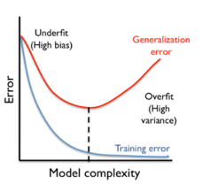
Sample Complexity
Introduction
As model complexity increases, the training error decreases but the generalization error follows a U-shaped curve.
When the model is too simple, it underfits the data, when it is too complex it overfits.
C&I LAB
3

Slide 4
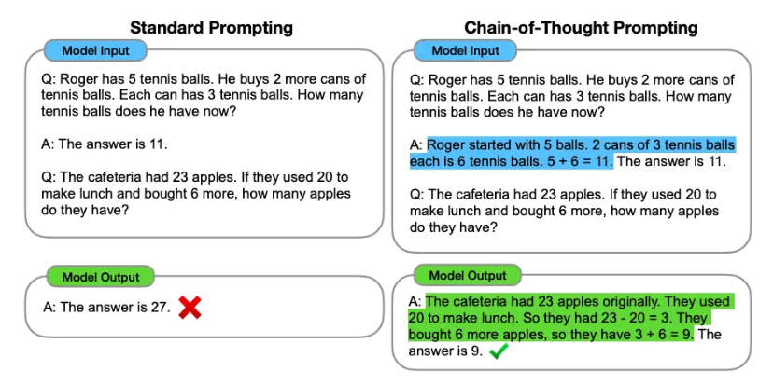
Chain-of-Thought ?
Introduction
CoT is a prompting technique that guides a LLM to generate intermediate reasoning steps before providing a final answer to a complex problem.
C&I LAB
4

Slide 5
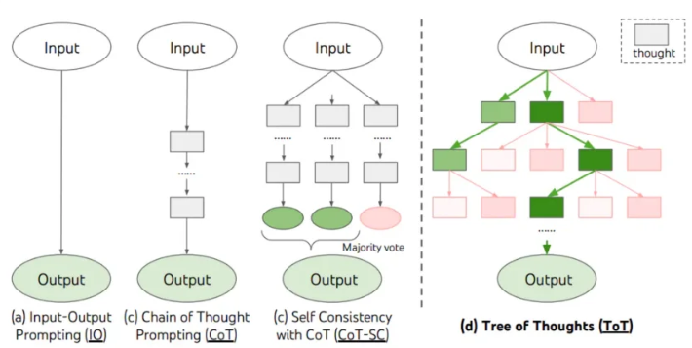
Tree-of-Thought?
Introduction
ToT finds the optimal solution by exploring multiple reasoning paths simultaneously, rather than a single one, and evaluating the validity of each path.
C&I LAB
5

Slide 6
Contribution
Introduction
Explaining the effect of problem decomposition through sample complexity.
2. Demonstrating the importance of explicitness in the reasoning process.
Providing clear criteria for choosing between CoT and ToT
- CoT : When predicting the next step of a problem is computationally easy.
- ToT : When predicting the next step is computationally hard and requires exploring multiple possibilities.
C&I LAB
6

Slide 7
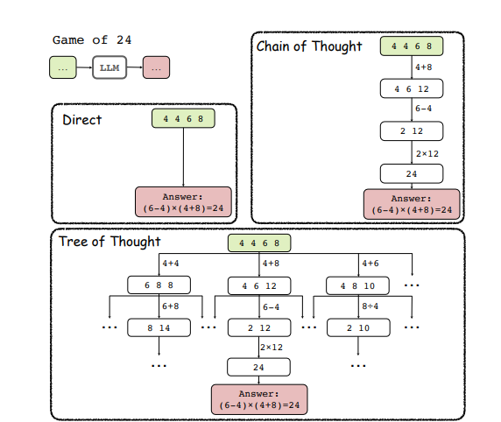
Why?
Introduction
Why does this performance difference occur and under what conditions should we use which method?
C&I LAB
7

Slide 8
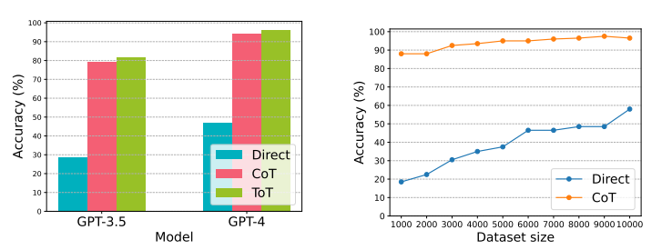
Grade School Maths
Case Studies
Both GPT-3.5 and GPT-4 show a clear performance hierarchy: ToT > CoT >> Direct prompting
C&I LAB
8

Slide 9
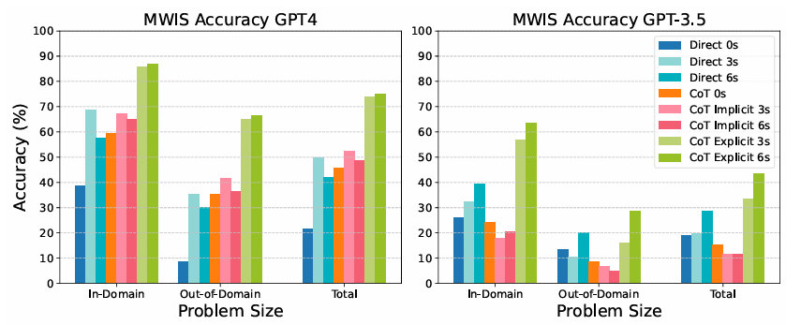
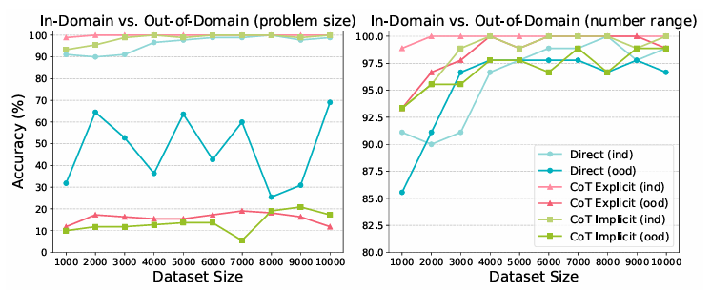
DynamicProgramming
Case Studies
In sequential, step-dependent tasks like dynamic programming the clarity of each reasoning step matters more than the breadth of exploration.
C&I LAB
9

Slide 10
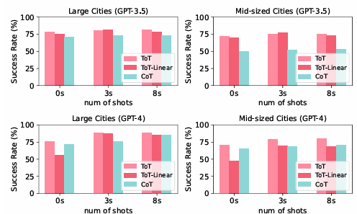
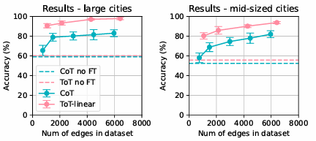
AirTravelPlanning
Case Studies
Prompt alone limits navigation structures + model adaptations must be designed together
C&I LAB
10

Slide 11
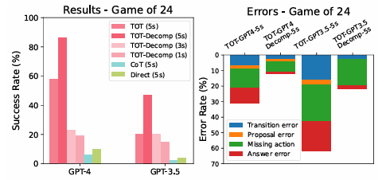
Game of 24
Case Studies
More few-shots → Greater improvement with Decomp
C&I LAB
11

Slide 12
Conclusion & Limit
Conclusion
When it is computationally difficult to predict the next step in the Chain-of-Thought reasoning process, adopting a Tree-of-Thought structure can be more effective.
But
Even if each step has low sample complexity the computational complexity of the model’s actual learning process can still be high.
High performance on a specific dataset does not necessarily guarantee consistent performance on new or different types of problems.
C&I LAB
12

Slide 13
EDA
Project
 | Male | Female | Mean_Age
NC | 57 | 120 | 72.29
MCI | 218 | 454 | 74.49
AD | 158 | 386 | 80.2
Total | 433 | 960 | 76.52
C&I LAB
13

Slide 14
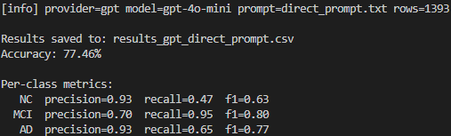
Test
Project
Direct prompt
Read the patient record below and assign one label: 0=NC, 1=MCI, 2=AD.
Use what is in the record only. Pick exactly one label.
Output exactly two lines (exactly two lines, no extra text):
Diagnosis: <0 or 1 or 2>
Rationale: <cite decisive evidence>
Patient Record:
---
{patient_note}
---
 | Precision | Recall | F1
NC | 0.93 | 0.47 | 0.63
MCI | 0.70 | 0.95 | 0.80
AD | 0.93 | 0.65 | 0.77
Accuracy: 77.46% (=1393개)
C&I LAB
15

Slide 15
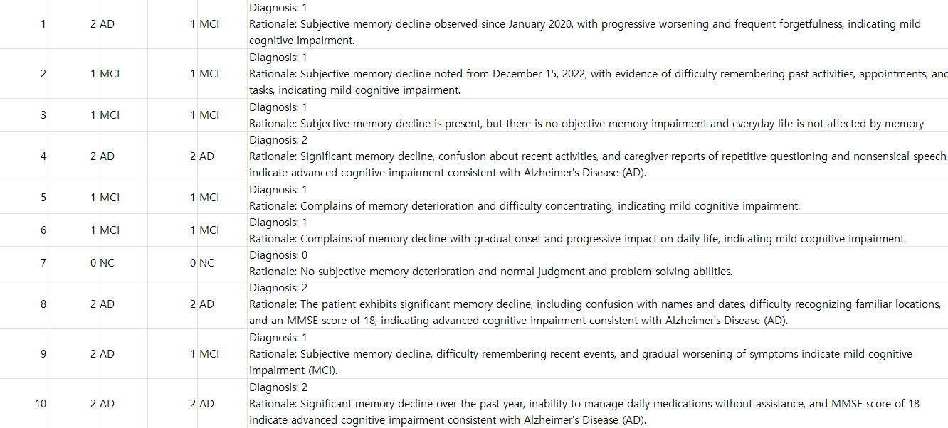
Test
Project
Direct prompt
C&I LAB
15

Slide 16
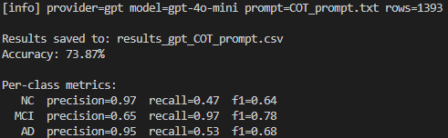
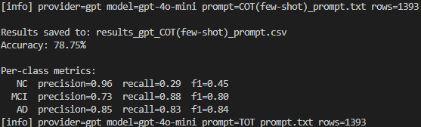
Test
Project
COT prompt
COT + Fewshot prompt
 | Precision | Recall | F1
NC | 0.97 | 0.47 | 0.64
MCI | 0.65 | 0.97 | 0.78
AD | 0.95 | 0.53 | 0.68
Accuracy: 73.87% (=1393개)
 | Precision | Recall | F1
NC | 0.96 | 0.29 | 0.45
MCI | 0.73 | 0.88 | 0.80
AD | 0.85 | 0.83 | 0.84
Accuracy: 78.75% (=1393개)
C&I LAB
15

Slide 17
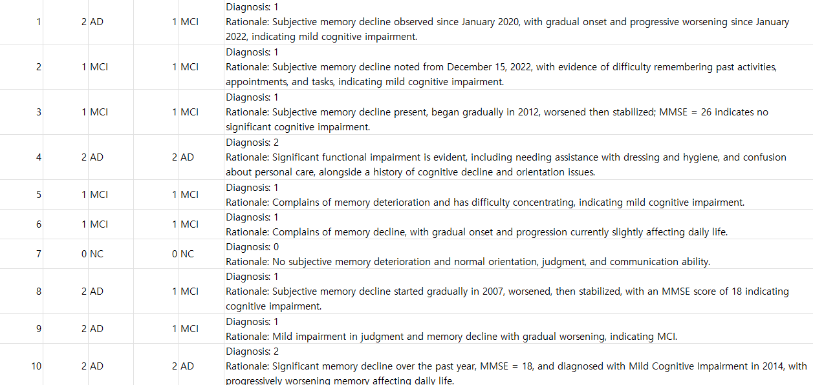
Test
Project
COT prompt
C&I LAB
15

Slide 18
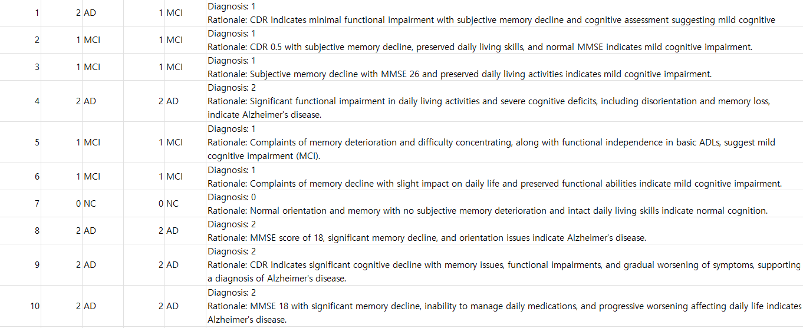
Test
Project
COT + Fewshot prompt
C&I LAB
15

Slide 19
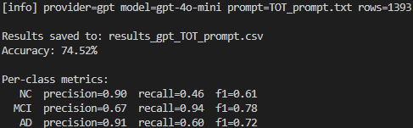
Test
Project
You are a medical classifier. Decide (0=NC, 1=MCI, 2=AD).
Internally use a Tree-of-Thoughts BFS with shallow depth:
Thought decomposition:
• Step 1 (Evidence extraction): bucket signals from the record:
A) Functional impairment (CDR, FAQ/IADL, caregiver-reported daily function)
B) Global staging (CDR)
C) Objective scores (MMSE, MoCA, ADAS-Cog; higher ADAS=worse; lower MMSE/MoCA=worse)
D) Clinical text cues (orientation, memory, executive/extrapyramidal symptoms, progression)
• Step 2 (Hypothesis thoughts): propose k=3 label-specific thoughts (NC, MCI, AD), each listing decisive evidence by priority A→D.
• Step 3 (State evaluation): for each proposed thought, assign a value in (sure, likely, impossible) for correctness given A→D, and prune “impossible”.
• Step 4 (Voting): compare remaining thoughts and select the top one (tie-breaker order: function > CDR > scores > text).
Rules:
- Use only information present; ignore missing; never invent values.
- Resolve conflicts strictly by the priority: function > global CDR > objective scores > text cues.
- Keep internal search private; DO NOT reveal thoughts/evaluations.
STRICT OUTPUT (exactly two lines, no extra text):
Diagnosis: <0 or 1 or 2>
Rationale: <cite decisive evidence>
Patient Record:
---
{patient_note}
---
TOT prompt
 | Precision | Recall | F1
NC | 0.90 | 0.46 | 0.61
MCI | 0.67 | 0.94 | 0.78
AD | 0.91 | 0.60 | 0.72
Accuracy: 74.52% (=1393개)
C&I LAB
15

Slide 20
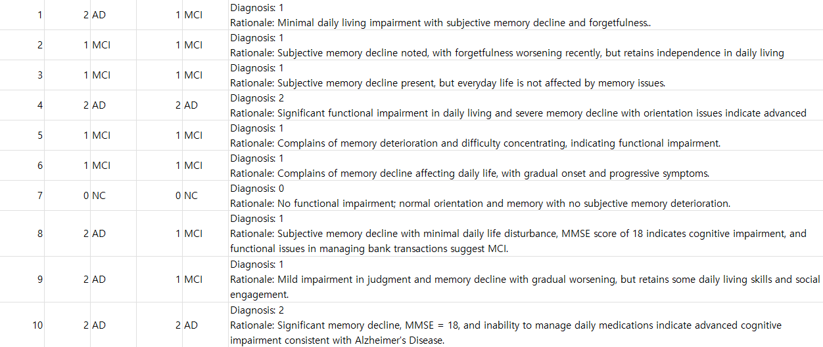
Test
Project
TOT prompt
C&I LAB
16

