Slide 1
C&I LAB
Chain of Preference Optimization: Improving Chain-of-Thought Reasoning in LLMs
NeurIPS 2024
Xuan Zhang, Chao Du, Tianyu Pang, Qian Liu, Wei Gao, Min Lin
2025.11.13
YunSung Byun

Slide 2
Contents
1.
Introduction
2.
Chain of Preference Optimization
3.
Experiments
4.
Project
C&I LAB
2

Slide 3
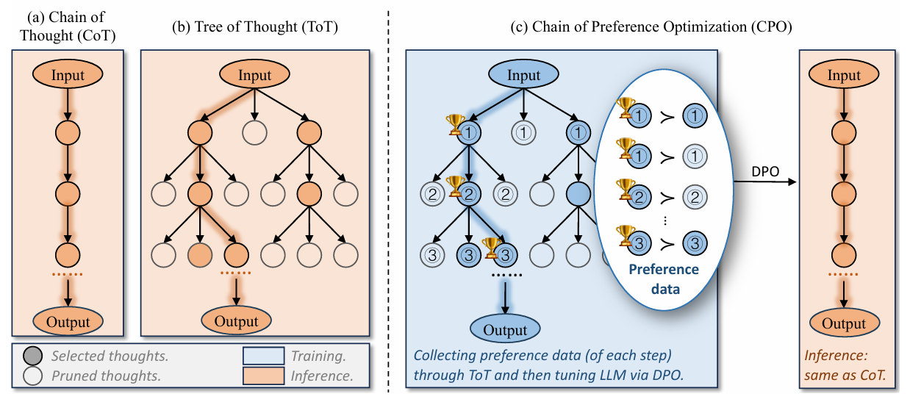
Compare
Introduction
Learning ToT's intelligence during Training to achieve CoT's speed at Inference
C&I LAB
3

Slide 4
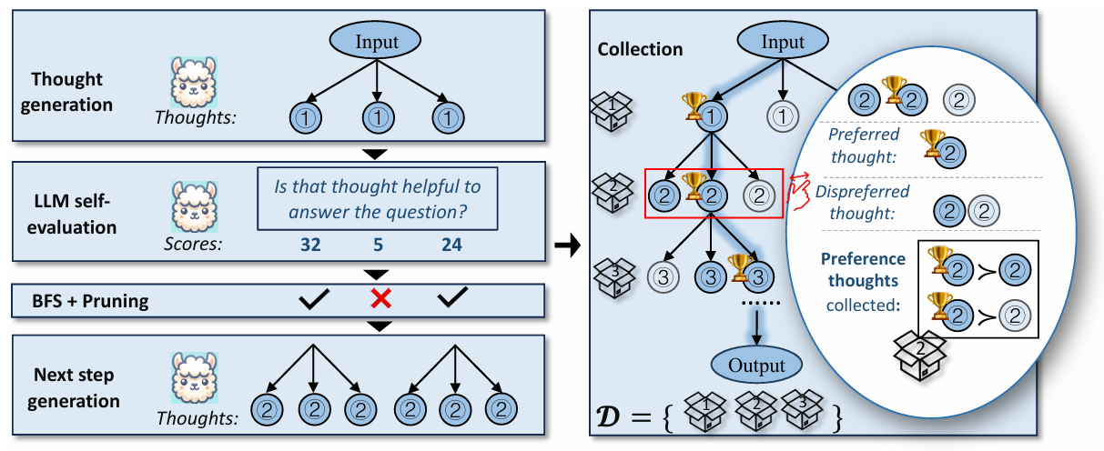
CPO?
Introduction
LLM pairs Winners(🏆) and Losers through its own self-evaluation
C&I LAB
4

Slide 5
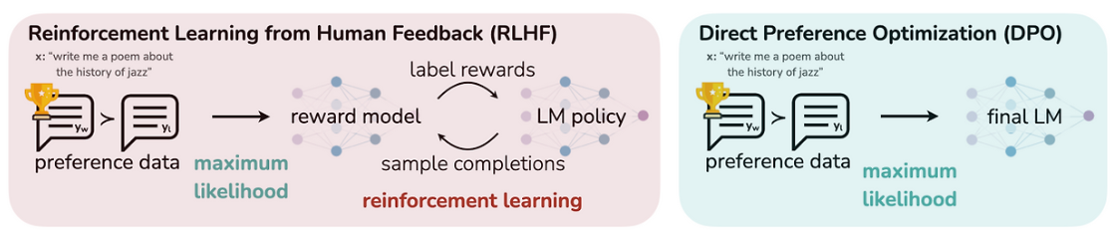
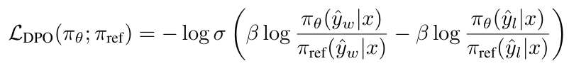
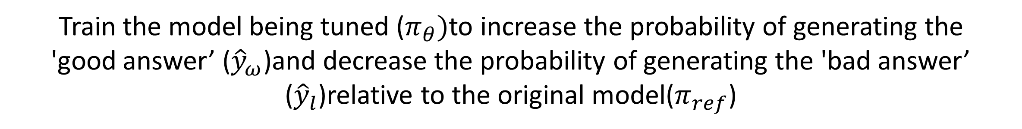
DPO?
Introduction
Train the model being tuned ($π_{θ})$to increase the probability of generating the
'good answer’ (${\hat{y}}_{ω}$)and decrease the probability of generating the 'bad answer’ (${\hat{y}}_{l}$)relative to the original model($π_{ref}$)
C&I LAB
5

Slide 6
Contribution
Introduction
A core insight into the value of ‘discarded thoughts’
- The insight that 'discarded thoughts' from ToT's search are highly valuable as learning data when compared against 'good thoughts'
2. Proposing the Chain of Preference Optimization (CPO) strategy
- A novel training strategy that converts ToT's 'step-by-step' reasoning process
(good thought vs. bad thought) into preference data and uses it to fine-tune the model via DPO.
3. Identifying and addressing the 'LCP gradient cancellation issue’
- Identifying the problem where learning signals (gradients) cancel out in the overlapping prefix (LCP) during 'full-path' optimization, which CPO solves through 'step-by-step' learning
C&I LAB
6

Slide 7
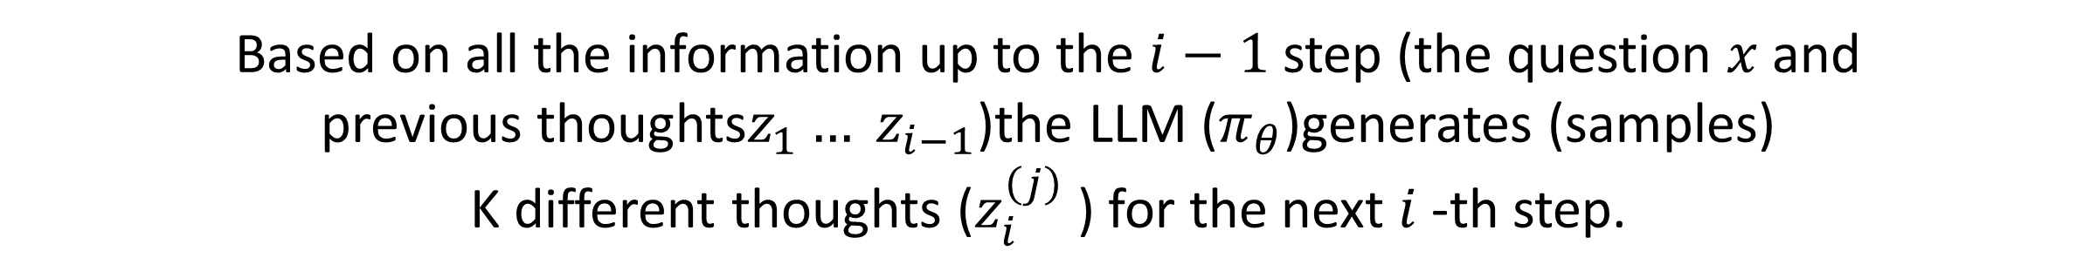
Thought generation
Chain of Preference Optimization
Based on all the information up to the $i−1$step (the question $x$and
previous thoughts$z_{1}… z_{i−1}$)the LLM ($π_{θ}$)generates (samples)
K different thoughts ($z_{i}^{\left(j\right)}$ ) for the next $i$-th step.
C&I LAB
7

Slide 8
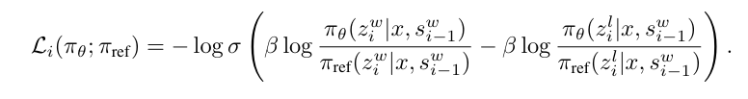
Per-Step Loss
Chain of Preference Optimization
C&I LAB
8

Slide 9

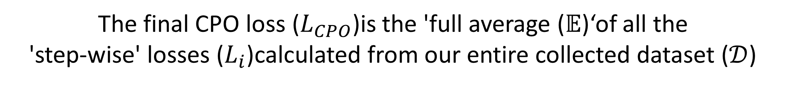
The objective function for CPO
Chain of Preference Optimization
The final CPO loss ($L_{CPO}$)is the 'full average ($𝔼$)‘of all the
'step-wise' losses ($L_{i}$)calculated from our entire collected dataset ($𝒟$)
C&I LAB
9

Slide 10
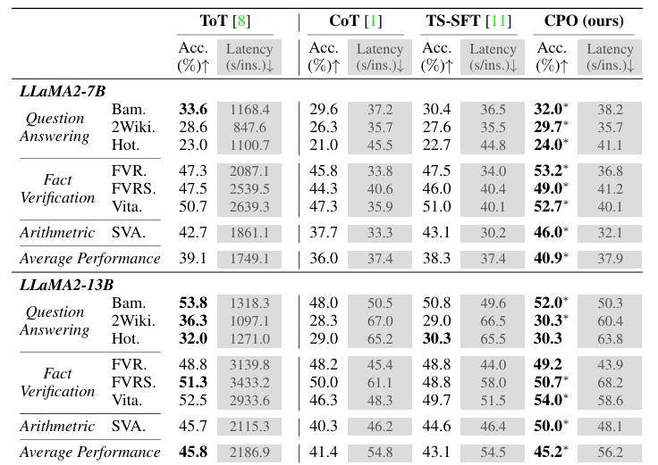
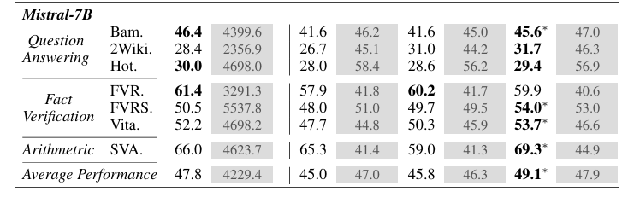
Results for ToT, CoT, TS-SFT, CPO
Experiments
C&I LAB
10

Slide 11
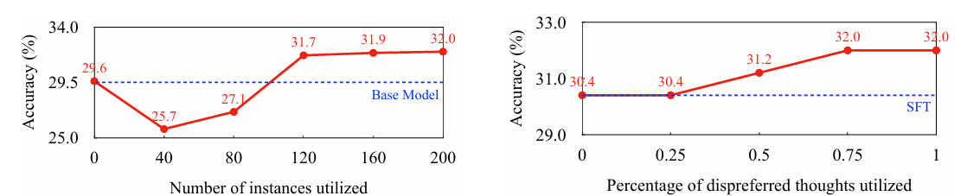
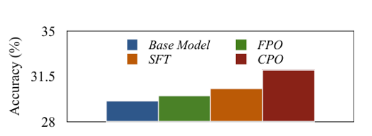
Component-wise Evaluations
Experiments
C&I LAB
11

Slide 12
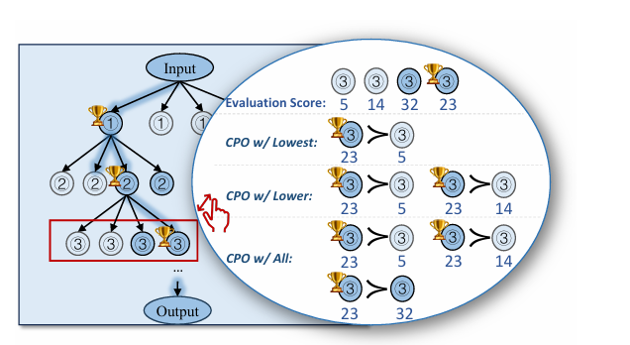
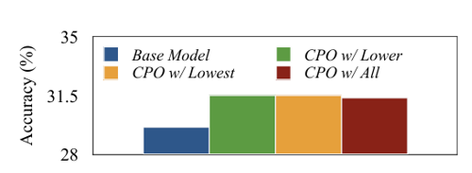
Different strategies for selecting
Experiments
C&I LAB
12

Slide 13
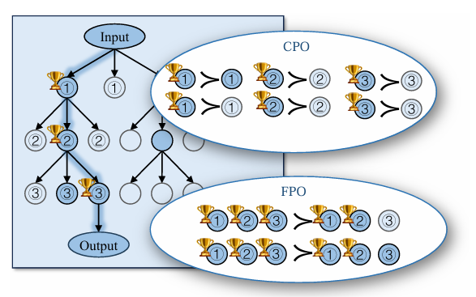
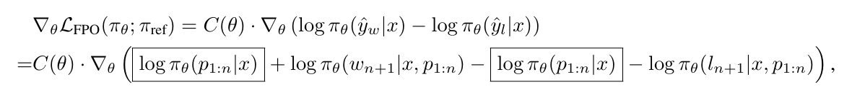

Two different ways
Experiments
$$=$$
C&I LAB
13

Slide 14
Conclusion & Limit
Conclusion
CPO demonstrates consistent performance improvements over CoT while maintaining its fast inference speed. Furthermore, our method substantially outperforms the strong TS-SFT baseline and achieves comparable or even superior performance to the ToT method.
But
Limitation is that we still need to generate data through ToT, which is a time-consuming process. Additionally, its application is limited as it has only been tested on text-language models (limited modality) and its scope remains restricted to a small set of downstream tasks.
C&I LAB
14

Slide 15
EDA
Project
 | Male | Female | Mean_Age
NC | 57 | 120 | 72.29
MCI | 218 | 454 | 74.49
AD | 158 | 386 | 80.2
Total | 433 | 960 | 76.52
C&I LAB
15

Slide 16
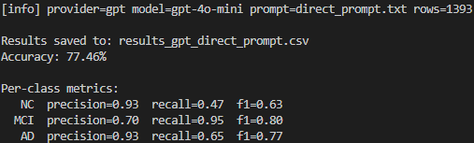
Test
Project
Direct prompt
Temperature=0, top_p=1 , Self-Consistency = 1
 | Precision | Recall | F1
NC | 0.93 | 0.47 | 0.63
MCI | 0.70 | 0.95 | 0.80
AD | 0.93 | 0.65 | 0.77
Accuracy: 77.46% (=1393개)
Read the patient record below and assign one label: 0=NC, 1=MCI, 2=AD.
Use what is in the record only. Pick exactly one label.
Output exactly two lines (exactly two lines, no extra text):
Diagnosis: <0 or 1 or 2>
Rationale: <cite decisive evidence>
Patient Record:
---
{patient_note}
---
C&I LAB
16

Slide 17
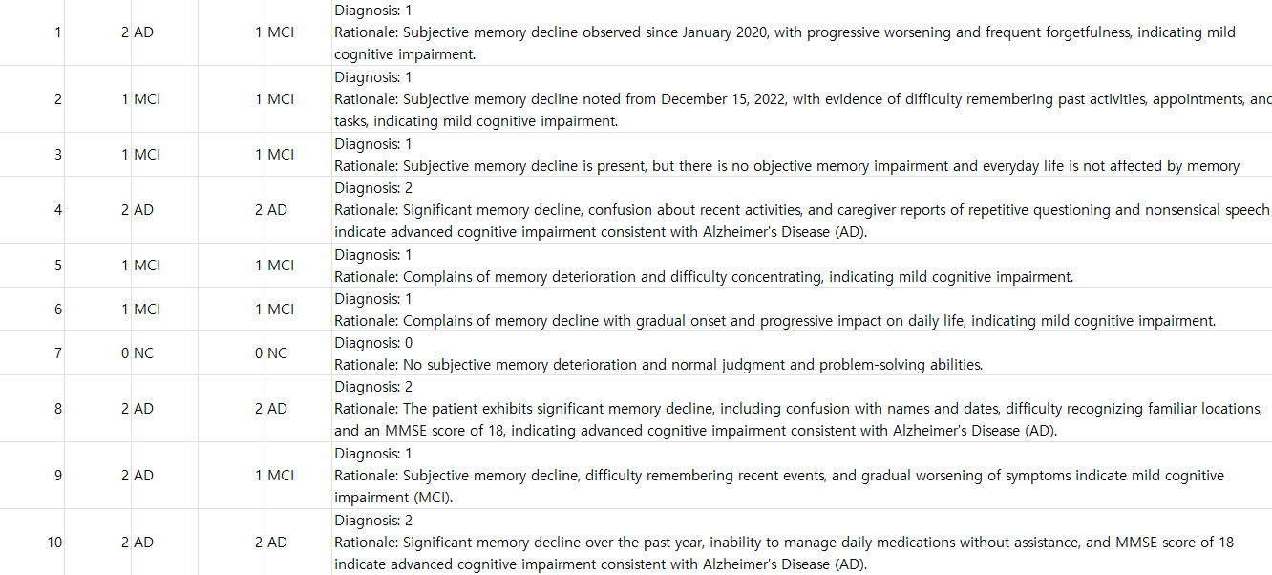
Test
Project
Direct prompt Result
C&I LAB
17

Slide 18
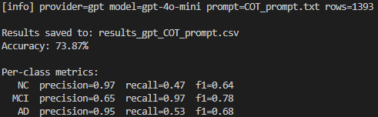
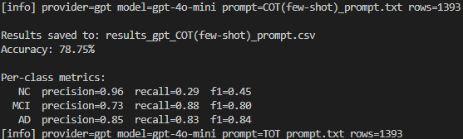
Test
Project
COT prompt
COT + Fewshot prompt
 | Precision | Recall | F1
NC | 0.97 | 0.47 | 0.64
MCI | 0.65 | 0.97 | 0.78
AD | 0.95 | 0.53 | 0.68
Accuracy: 73.87% (=1393개)
 | Precision | Recall | F1
NC | 0.96 | 0.29 | 0.45
MCI | 0.73 | 0.88 | 0.80
AD | 0.85 | 0.83 | 0.84
Accuracy: 78.75% (=1393개)
C&I LAB
18

Slide 19
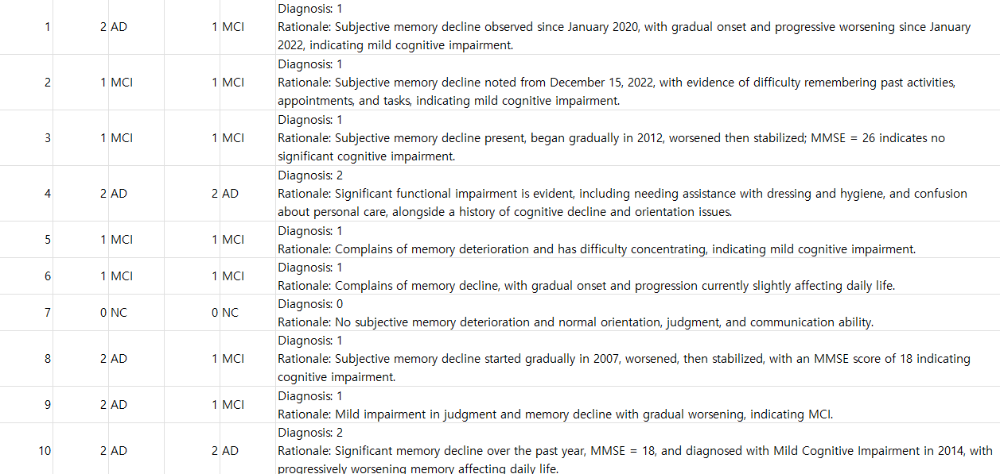
Test
Project
COT prompt Result
C&I LAB
19

Slide 20
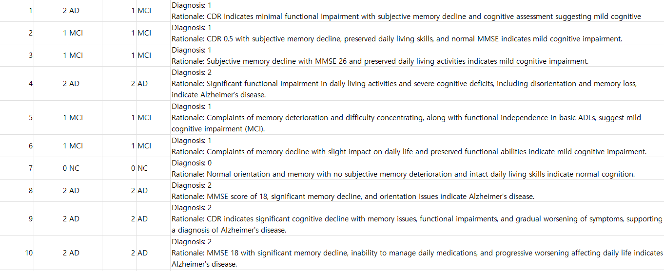
Test
Project
COT + Fewshot prompt Result
C&I LAB
20

Slide 21
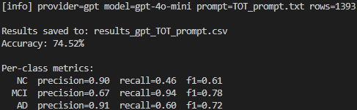
Test
Project
You are a medical classifier. Decide (0=NC, 1=MCI, 2=AD).
Internally use a Tree-of-Thoughts BFS with shallow depth:
Thought decomposition:
• Step 1 (Evidence extraction): bucket signals from the record:
A) Functional impairment (CDR, FAQ/IADL, caregiver-reported daily function)
B) Global staging (CDR)
C) Objective scores (MMSE, MoCA, ADAS-Cog; higher ADAS=worse; lower MMSE/MoCA=worse)
D) Clinical text cues (orientation, memory, executive/extrapyramidal symptoms, progression)
• Step 2 (Hypothesis thoughts): propose k=3 label-specific thoughts (NC, MCI, AD), each listing decisive evidence by priority A→D.
• Step 3 (State evaluation): for each proposed thought, assign a value in (sure, likely, impossible) for correctness given A→D, and prune “impossible”.
• Step 4 (Voting): compare remaining thoughts and select the top one (tie-breaker order: function > CDR > scores > text).
Rules:
- Use only information present; ignore missing; never invent values.
- Resolve conflicts strictly by the priority: function > global CDR > objective scores > text cues.
- Keep internal search private; DO NOT reveal thoughts/evaluations.
Output exactly two lines (exactly two lines, no extra text):
Diagnosis: <0 or 1 or 2>
Rationale: <cite decisive evidence>
Patient Record:
---
{patient_note}
---
TOT prompt
 | Precision | Recall | F1
NC | 0.90 | 0.46 | 0.61
MCI | 0.67 | 0.94 | 0.78
AD | 0.91 | 0.60 | 0.72
Accuracy: 74.52% (=1393개)
C&I LAB
21

Slide 22
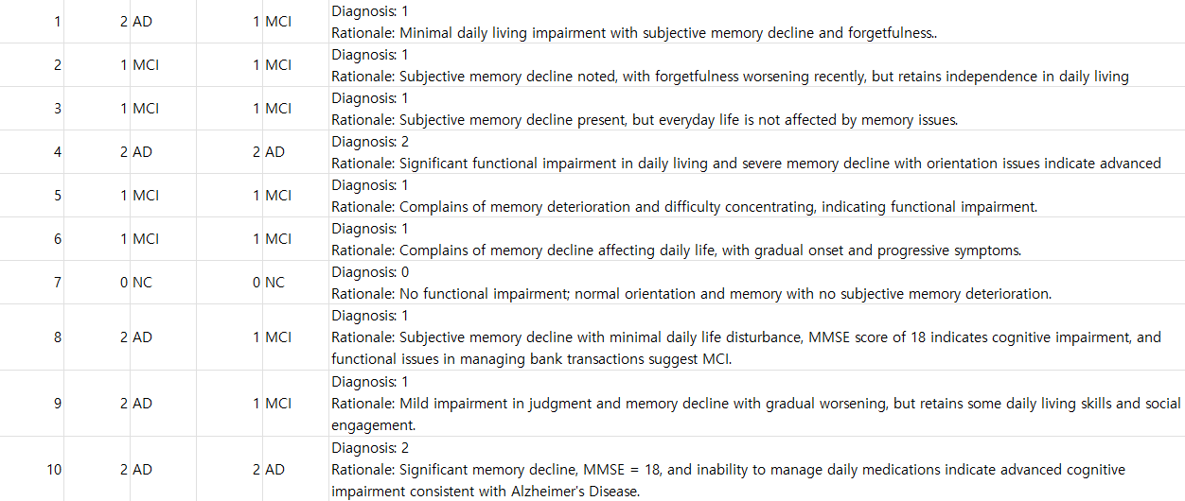
Test
Project
TOT prompt Result
C&I LAB
22

Slide 23
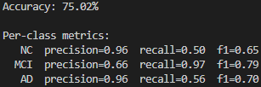

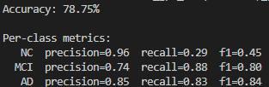
Test
Project
COT prompt Result
Temperature=0.7, top_p=0.9 , Self-Consistency = 5
TOT prompt Result
COT+few shot prompt Result
C&I LAB
23

