Slide 1
C&I LAB
Algorithm of Thoughts:
Enhancing Exploration of Ideas in Large Language Models
ICML 2024
Bilgehan Sel, Ahmad Al-Tawaha, Vanshaj Khattar, Ruoxi Jia, Ming Jin
2025.11.24
YunSung Byun

Slide 2
Contents
1.
Introduction
2.
Chain of Preference Optimization
3.
Experiments
4.
Project
C&I LAB
2

Slide 3
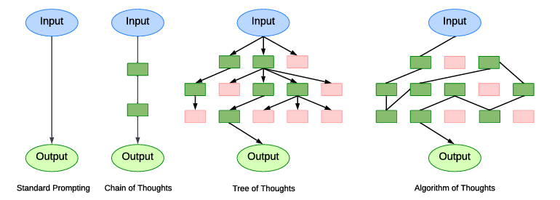
Prompt
Introduction
DFS
C&I LAB
3

Slide 4
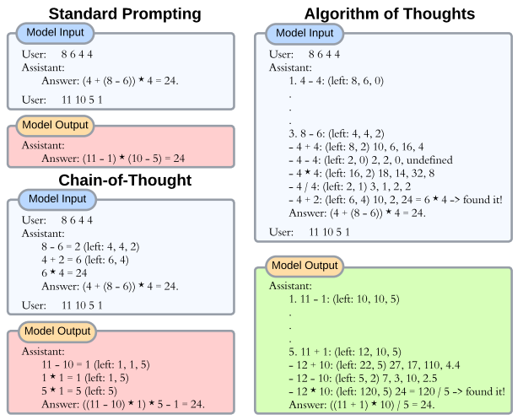
AOT?
Introduction
C&I LAB
3

Slide 5
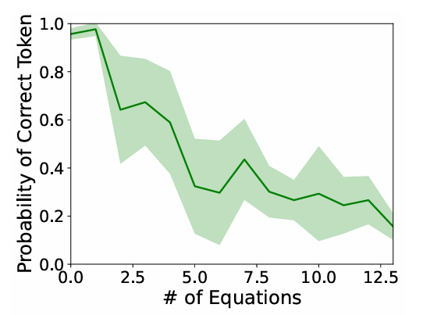
Few-shot?
Introduction
11-2?
Ex) 15−5 = 10
8+2 =10
2x5 = 10
Potential risks of Chain-of-Thought or traditional Few-shot approach
C&I LAB
5

Slide 6
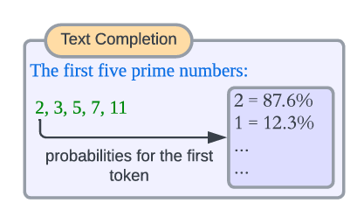

Practicality
Introduction
It is theoretically possible to solve even high computational complexity challenges (such as NP problems)
C&I LAB
6

Slide 7
Contribution
Introduction
1. Novel Prompting Paradigm
- Proposed a strategy instructing LLMs to perform algorithmic search processes (DFS/BFS) fully in-context.
2. Performance & Efficiency
- Outperforms multi-query methods like ToT while using significantly fewer queries
3. Algorithmic Intuition
- Demonstrated that LLMs go beyond mimicking algorithms; they utilize inherent intuition to optimize search and prune the search space effectively
C&I LAB
7

Slide 8
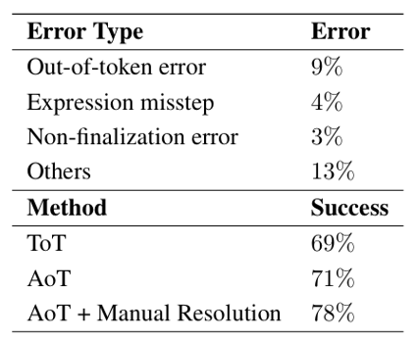
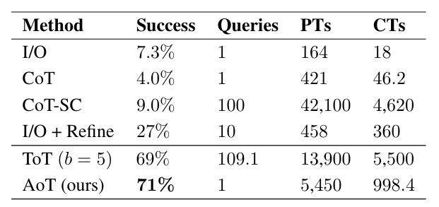
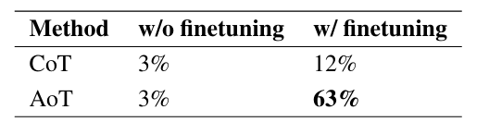
Game of 24
Experiments
C&I LAB
8

Slide 9
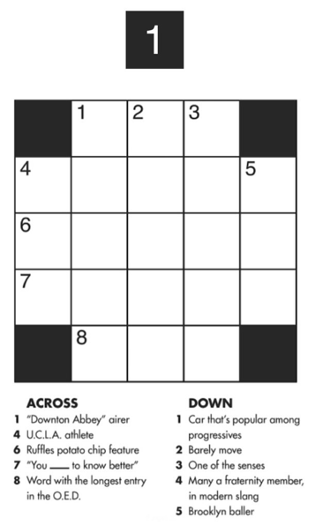
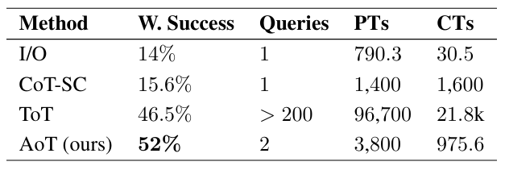
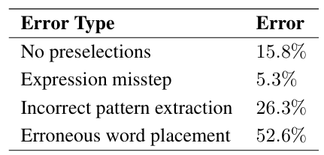
Mini Crosswords
Experiments
C&I LAB
9

Slide 10
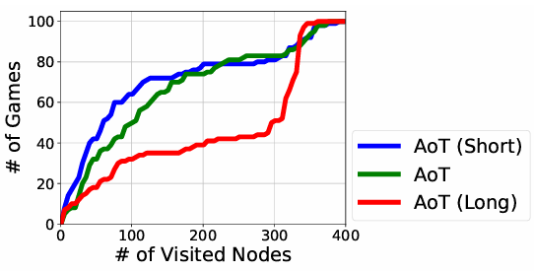
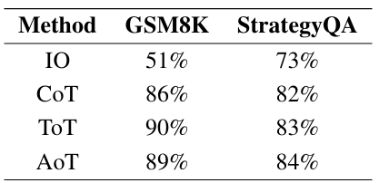
Length
Experiments
C&I LAB
10

Slide 11
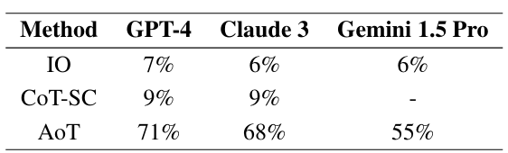
Conclusion & Limit
Conclusion
Focus on token efficiency, adaptive search mechanisms, and theoretical analysis.
But
Relies on high-performance models (GPT-4);
effectiveness on smaller models may be limited.
C&I LAB
11

Slide 12
EDA
Project
 | NC | MCI | AD | Total
female | 855 | 571 | 456 | 1469
male | 153 | 232 | 168 | 966
total | 1008 | 803 | 624 | 2435
C&I LAB
12

Slide 13
Direct
Project
Direct
 | Precision | Recall | F1
NC | 99.76% | 40.97% | 58.09%
MCI | 55.60% | 97.01% | 70.69%
AD | 95.81% | 95.19% | 95.50%
ACC: 73.35%
C&I LAB
13

