Slide 1
C&I LAB
Gated Attention for Large Language Models:
Non-linearity, Sparsity, and Attention-Sink-Free
Neurips 2025
Zihan Qiu, Zekun Wang, Bo Zheng, Zeyu Huang
2026.01.09
YunSung Byun

Slide 2
Contents
1.
Introduction
2.
Gating Mechanism
3.
Result
4.
Project
C&I LAB
2

Slide 3
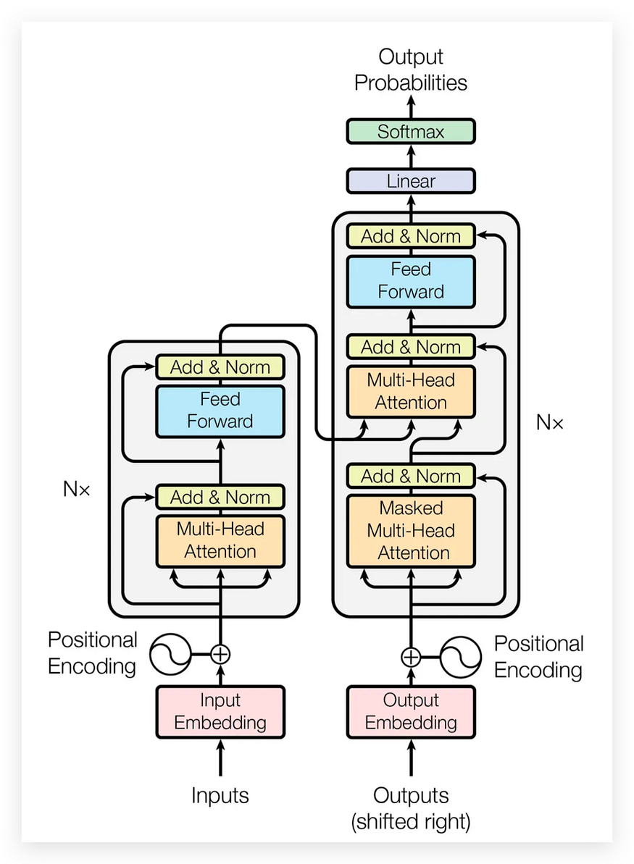
QKV Projection
Introduction
$$Q=XW_{\left\{Q\right\}}, K=XW_{\left\{K\right\}}, V=XW_{\left\{V\right\}}$$
C&I LAB
3

Slide 4
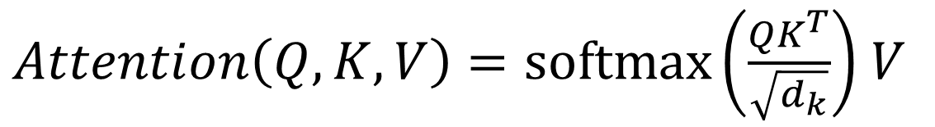
Scaled Dot-Product Attention
Introduction
$Attention\left(Q,K,V\right)=\text{softmax}\left(\frac{QK^{T}}{\sqrt{d_{k}}}\right)$ $V$
C&I LAB
4

Slide 5

Multi-Head Concatenation & Output
Introduction
$$O=\text{MultiHead}\left(Q,K,V\right)W_{o}$$
$$\text{MultiHead}\left(Q,K,V\right)=\text{Concat}\left({\text{head}}_{1},…,{\text{head}}_{h}\right)$$
C&I LAB
5

Slide 6
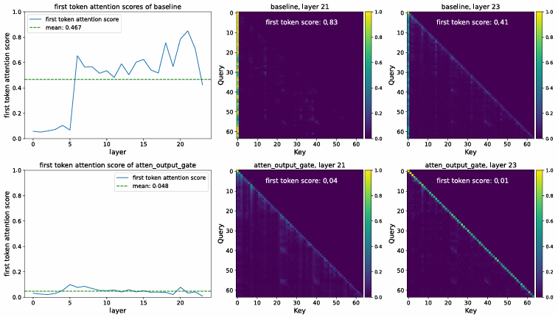
Attention Sink
Introduction
Output layer
C&I LAB
6

Slide 7
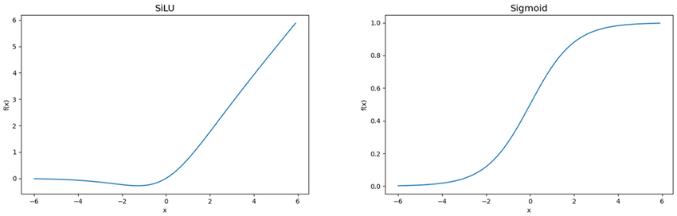
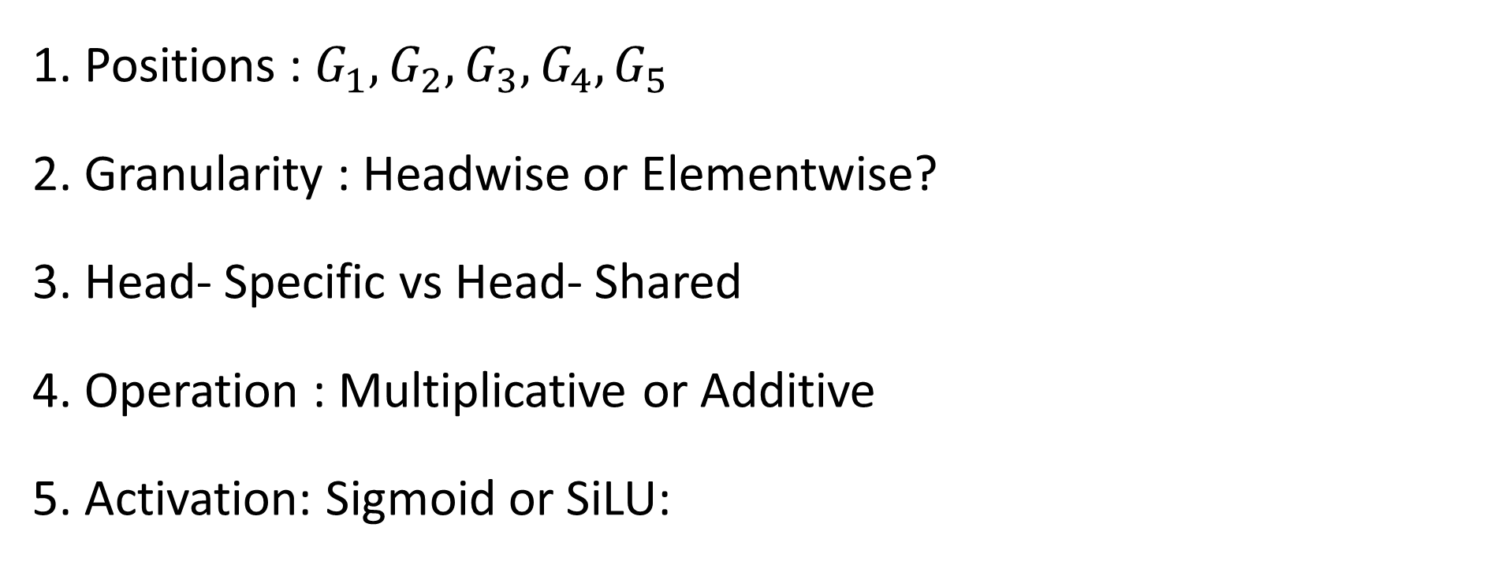

Gating Mechanism
Introduction
$$Y^{′}=g(Y,X,Wθ,σ)= Y ⊙σ\left(XW_{\left\{θ\right\}}\right)$$
$$⊙ :\text{Element}\text{−}\text{wise} \text{product}$$
1. Positions : $G_{1},G_{2}, G_{3}, G_{4},G_{5}$
2. Granularity : Headwise or Elementwise?
3. Head- Specific vs Head- Shared
4. Operation : Multiplicative or Additive
5. Activation: Sigmoid or SiLU:
C&I LAB
7

Slide 8
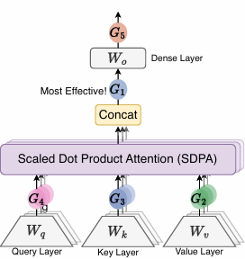
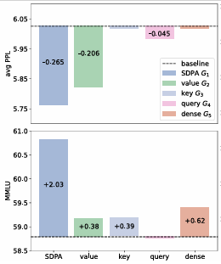
Positions
Introduction
C&I LAB
8

Slide 9
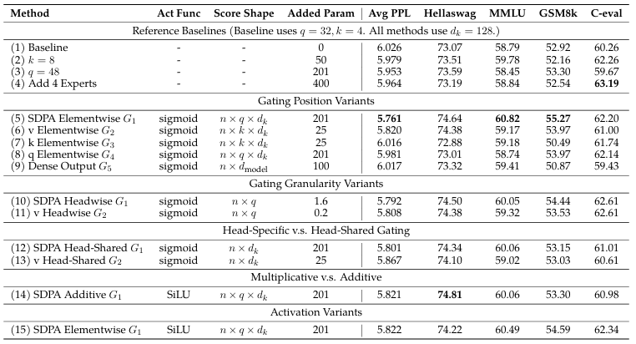
Gating Mechanism
Introduction
C&I LAB
9

Slide 10
Contribution
Introduction
Optimal Gating Placement
It demonstrated that structural fine-tuning through gating is more efficient than simply scaling up the model size.
2. Mitigating Attention Sinks
By enabling the model to focus solely on contextually critical information, it has significantly enhanced inference accuracy.
3. Facilitating Long-Context Extension
- It provides practical solutions for modern LLM applications where long-context understanding is vital, such as document summarization and extended dialogues.
C&I LAB
10

Slide 11
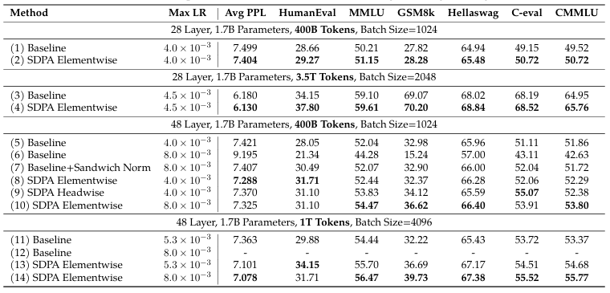
Gating Mechanism
Gating Mechanism
C&I LAB
11

Slide 12
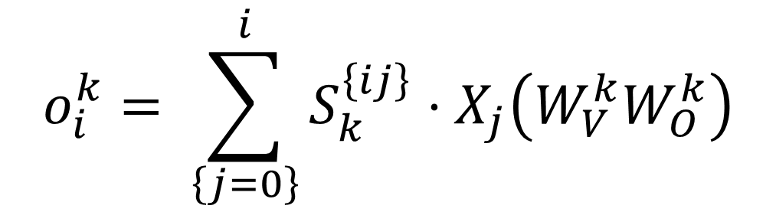
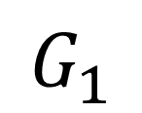
Attention Sink-Free
Gating Mechanism
$$o_{i}^{k}= \sum_{\left\{j=0\right\}}^{i}{S_{k}^{\left\{ij\right\}}}⋅X_{j}\left(W_{V}^{k}W_{O}^{k}\right)$$
$$G_{1}$$
$$o_{i}^{k}= \left\{Non−Linearity\right\}\left.\left( ∑S_{\left\{ij\right\}}⋅X_{j}W_{V}^{k}\right.\right)W_{O}^{k}$$
C&I LAB
12

Slide 13
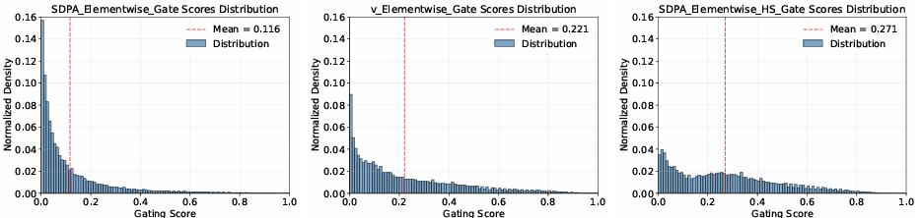
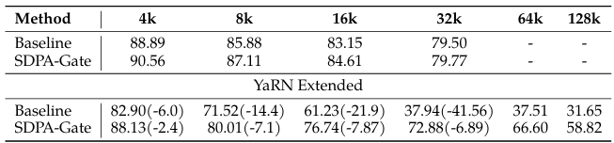
Attention Sink-Free
Gating Mechanism
C&I LAB
13

Slide 14
Conclusion & Limit
Conclusion
This simple mechanism yields the following effects:
- Enhancing Non-linearity
- Introducing Input-dependent Sparsity
- Eliminating inefficiencies like the Attention Sink phenomenon
But
We lack a rigorous mathematical or theoretical explanation for specifically by what mechanism attention sinks hinder the model's ability to generalize to long sequences.
C&I LAB
14

Slide 15
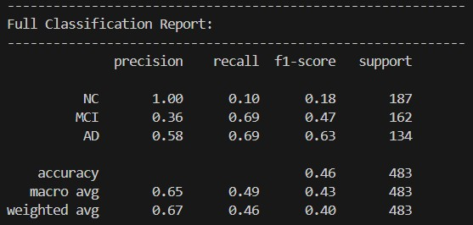
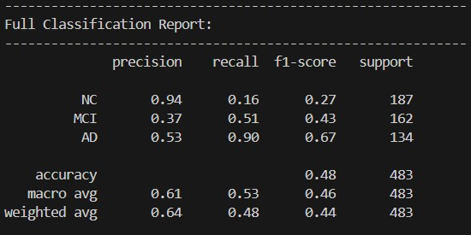
Model
Project
+ ['Gender', 'Age', 'Edu', 'Literacy and Numeracy', 'Medical History', 'Medications’, Main Complaints, 'Memory', 'Language’, ‘Orientation’ , 'Judgment and Problem Solving', 'Social Activities', 'Home and Hobbies', 'Daily Living', 'Personality and Behavior’,’MMSE’,’GDS’,’SBT’]
GPT-4o-mini
GPT-4o
C&I LAB
15

Slide 16
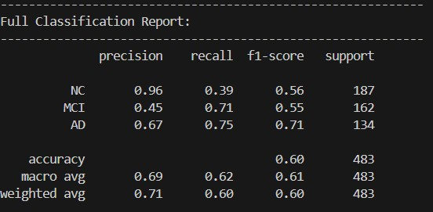
Feature
Project
- [MMSE, GDS, SBT]
NC -> MCI : 109
NC-> AD : 5
MCI -> AD : 44
MCI-> NC : 3
AD -> MCI : 33
AD -> NC : 0
C&I LAB
16

Slide 17
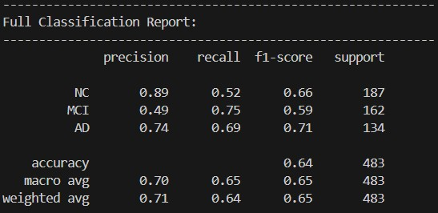
Feature
Project
- [MMSE, GDS, SBT, + Main Complaints]
NC -> MCI : 86
NC-> AD : 3
MCI -> AD : 30
MCI-> NC : 11
AD -> MCI : 41
AD -> NC : 1
C&I LAB
17

Slide 18
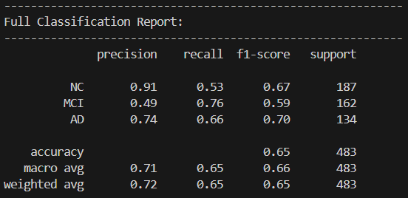
Feature
Project
+ [Memory, Language, Judgment and Problem Solving, Social Activities, Home and Hobbies, Personality and Behavior]
NC -> MCI : 85
NC-> AD : 2
MCI -> AD : 30
MCI-> NC : 9
AD -> MCI : 44
AD -> NC : 1
C&I LAB
18

