Slide 1
C&I LAB
Causal Sufficiency and Necessity Improves
Chain-of-Thought Reasoning
Neurips 2025
Bilgehan Sel, Ahmad Al-Tawaha, Vanshaj Khattar, Ruoxi Jia, Ming Jin
2026.01.22
YunSung Byun

Slide 2
Contents
1.
Introduction
2.
Algorithm
3.
Experiments
4.
Project
C&I LAB
2

Slide 3
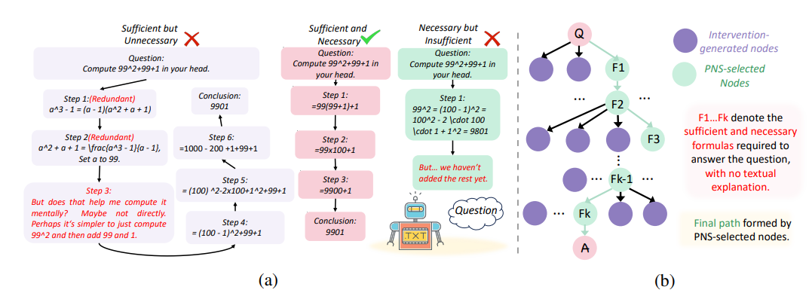
How?
Introduction
C&I LAB
3

Slide 4
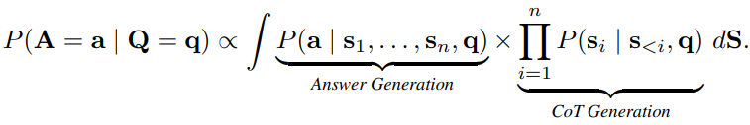
COT Definition
Introduction
C&I LAB
3

Slide 5
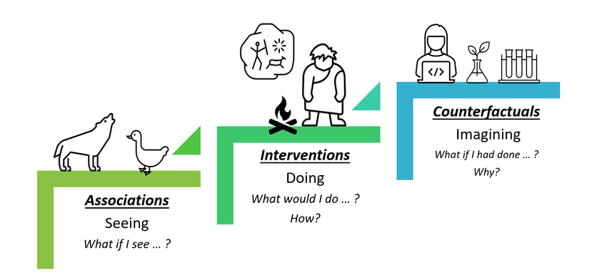
The Ladder of Causation
Introduction
C&I LAB
5

Slide 6
Sufficiency(PS), Necessity(PN)
Introduction
C&I LAB
6

Slide 7
Contribution
Introduction
Pioneering the Integration of PNS into CoT
We propose a conceptual integration of Probability of Necessary and Sufficient causation (PNS) into CoT reasoning.
Development of an Optimization Algorithm for Efficient Reasoning
We introduce a novel bi-level optimization framework based on PNS for systematically constructing efficient and accurate CoT reasoning sequences.
Performance Validation through Extensive Experiments (Empirical Contribution)
We empirically validate our approach across diverse reasoning tasks, demonstrating substantial improvements in both efficiency and accuracy through optimized CoT traces used for in-context learning and supervised fine-tuning.
C&I LAB
7

Slide 8
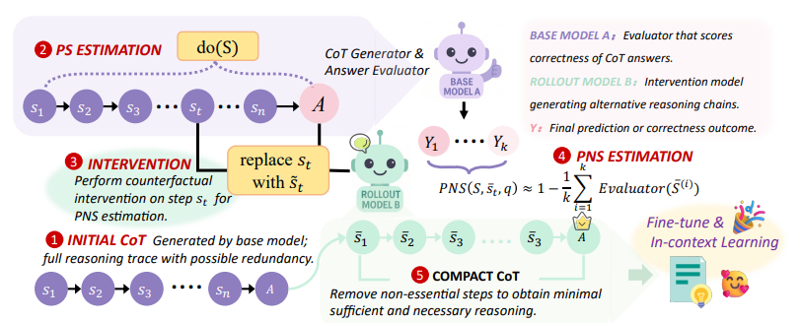

Algorithm
Experiments
C&I LAB
8

Slide 9
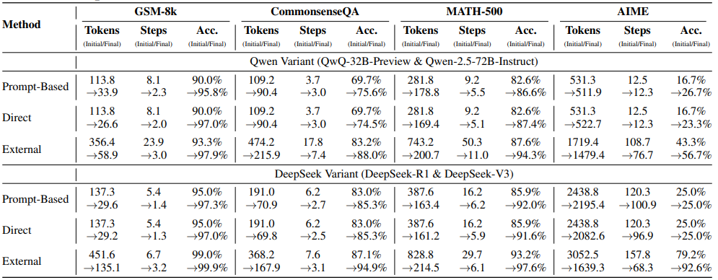
Result
Experiments
C&I LAB
9

Slide 10
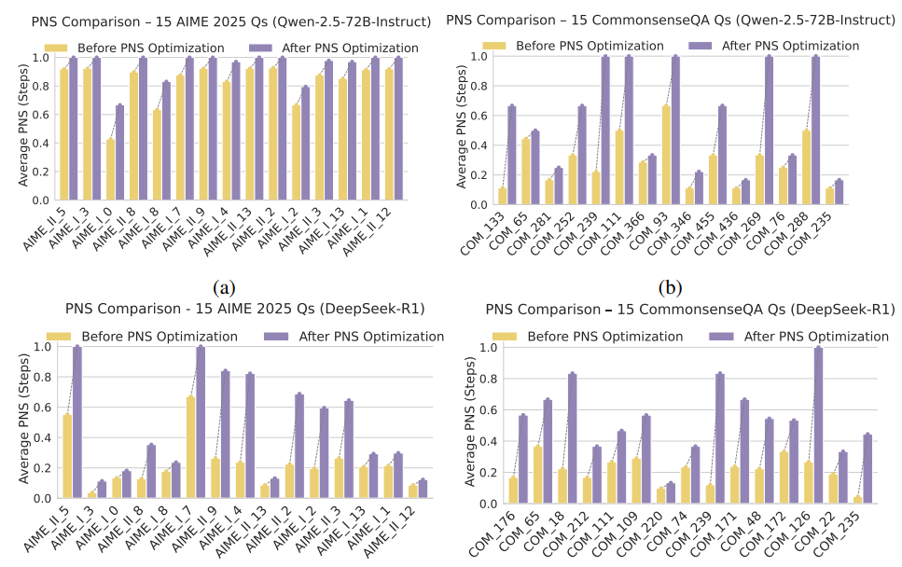
Main Result
Experiments
C&I LAB
10

Slide 11
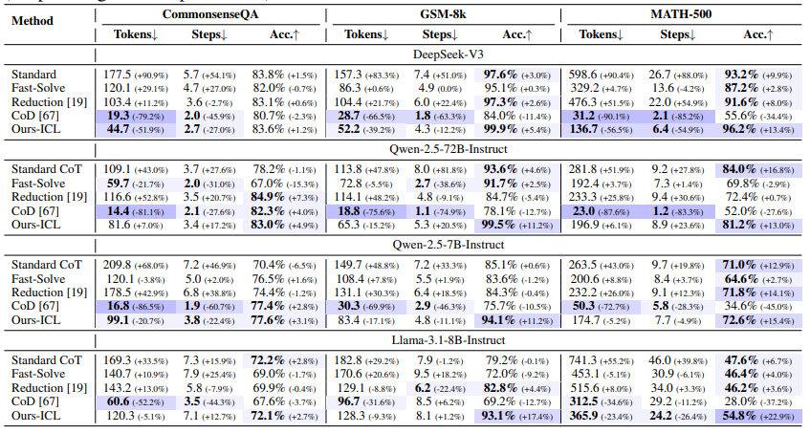
Main Result
Experiments
C&I LAB
11

Slide 12
Conclusion & Limit
Conclusion
Successfully incorporated the concept of Probability of Necessity and Sufficiency (PNS) into Chain-of-Thought reasoning.
But
The challenge of identifying optimal pruning thresholds.
Management of estimation costs associated with calculating PNS values.
C&I LAB
12

Slide 13
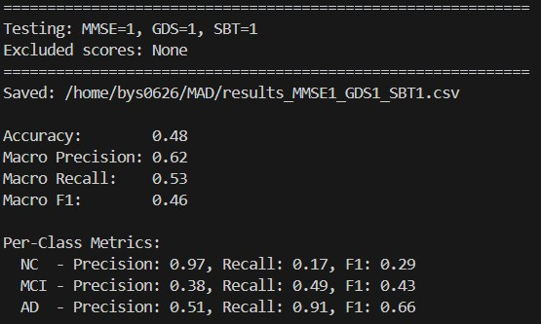
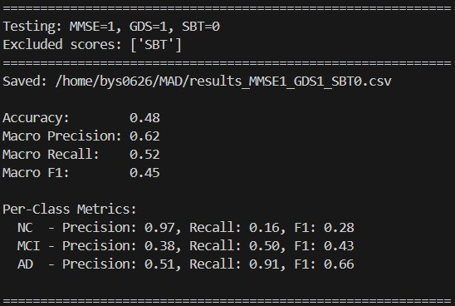
Feature (-1)
Project
C&I LAB
13

Slide 14
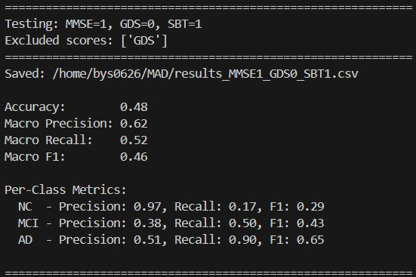
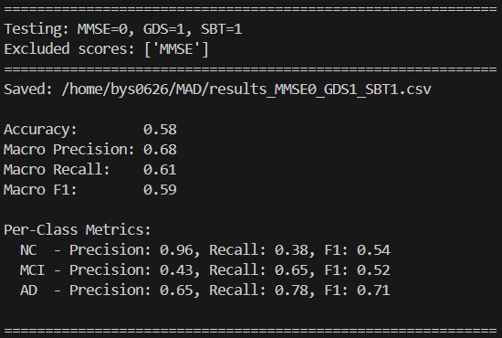
Feature (-1)
Project
C&I LAB
14

Slide 15
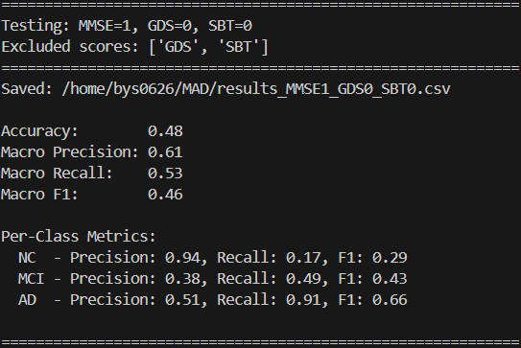
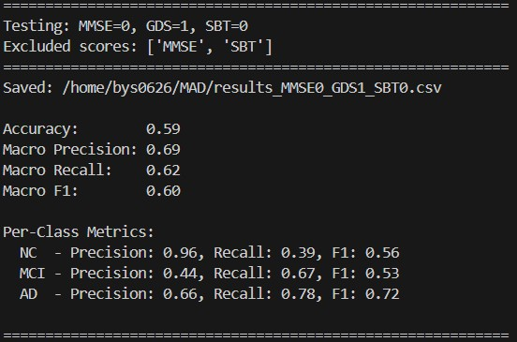
Feature (-2)
Project
C&I LAB
15

Slide 16
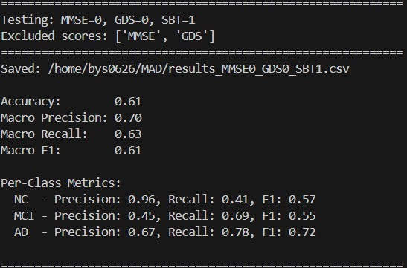
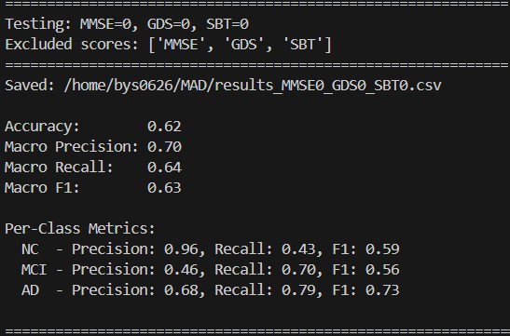
Feature (-2) , (all)
Project
C&I LAB
16

Slide 17
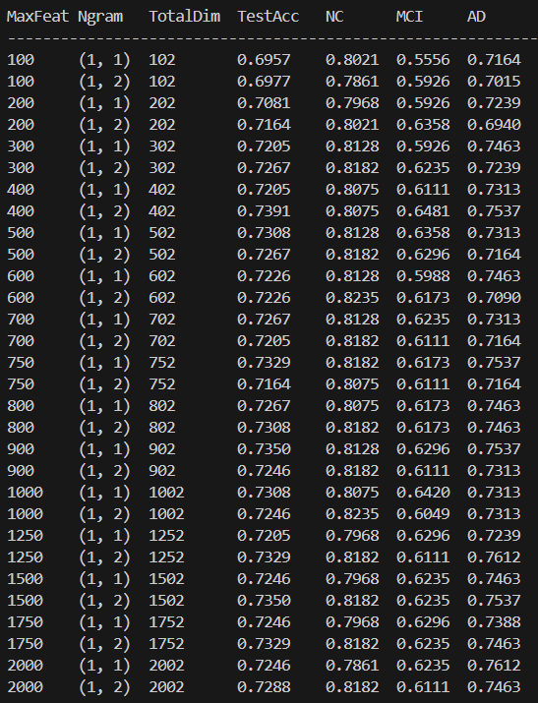
LR + COT
Project
Maximum Features
N-gram Range
Total Dimension
C&I LAB
17

Slide 18
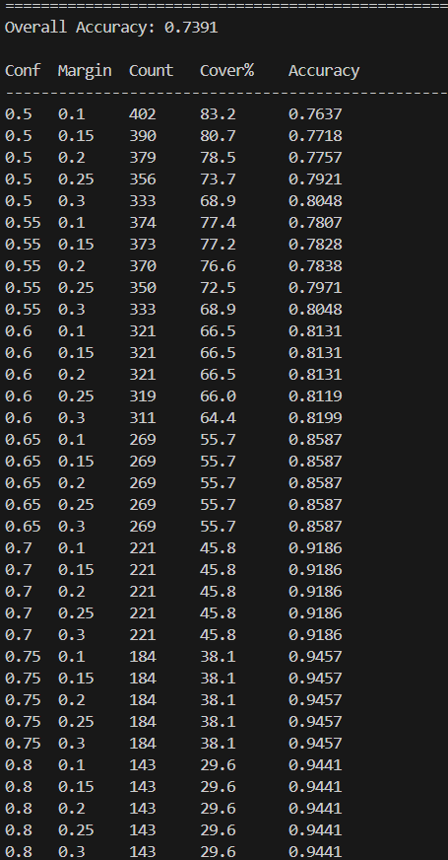
LR + COT
Project
Total : 483
Acc: 0.7391
C&I LAB
18

Slide 19
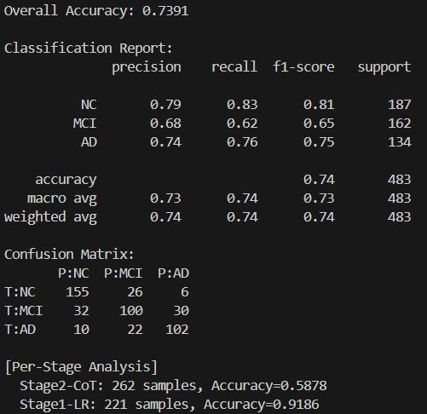
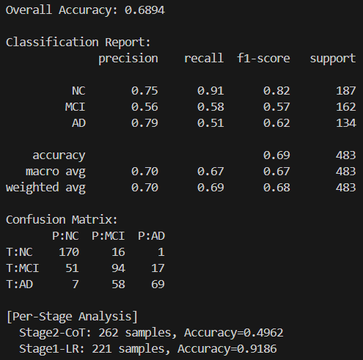
LR + COT
Project
Top-2
Total 262 / Missing valule 31 (11.8%)
Top-3
MaxFeat=400, Ngram=(1,2), Conf=0.7, Margin=0.3 / keyward TOP-5
C&I LAB
19

Slide 20
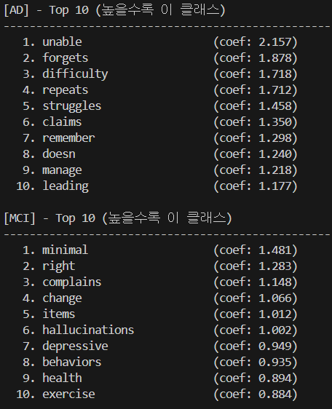
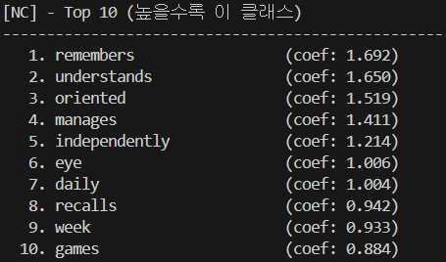
LR + COT
Project
MaxFeat=750, Ngram=(1,1), Conf=0.7, Margin=0.3
C&I LAB
20

Slide 21

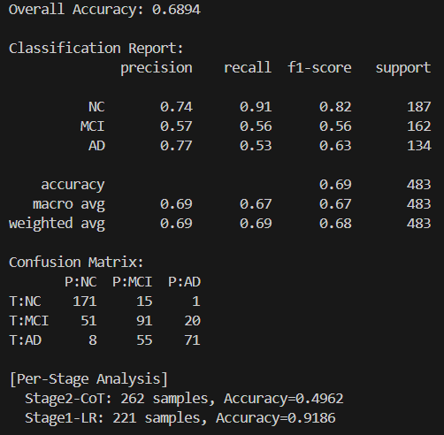
LR + COT
Project
Top-2 (No Keyward)
Total 262 / Missing valule 31 (11.8%)
Top-3(No Keyward)
MaxFeat=400, Ngram=(1,2), Conf=0.7, Margin=0.3 / Keyward TOP-5
C&I LAB
21

