Slide 1
Embeddings, Vector Similarity & Semantic Search

Slide 2
Learning Objectives
• Understand embeddings from first principles
• Learn vector similarity mathematics
• Master semantic search pipelines
• Understand vector databases
• Build RAG systems

Slide 3
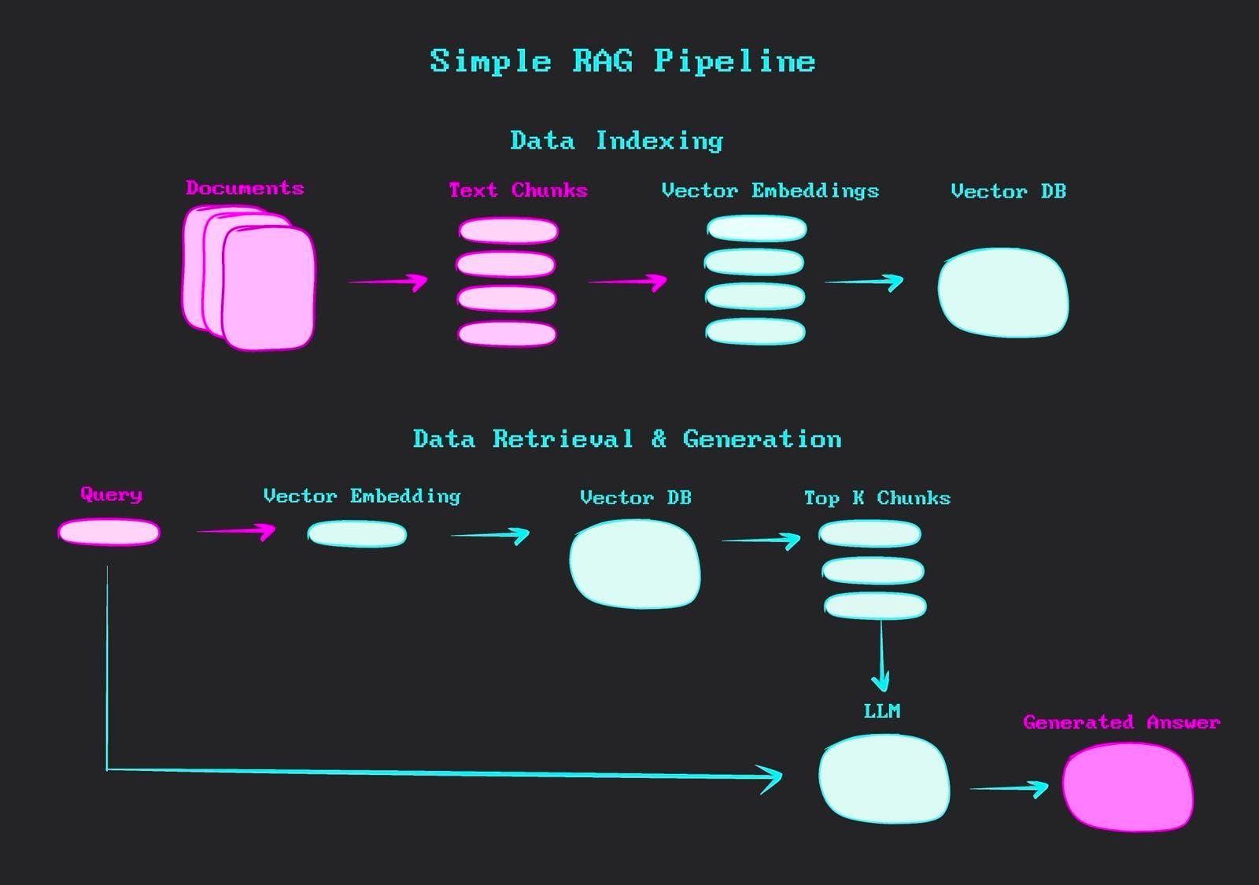

Slide 4
Why Search Matters
Traditional search systems rely on keyword matching, meaning they look for exact words in a query. This often misses relevant results when different words have the same meaning. For example, a search for "automobile repair" may not find content containing "car maintenance".
Humans search based on meaning and intent, not exact words. Modern AI achieves this using Embeddings and Vector Search.
Embeddings convert text into numerical vectors that capture its meaning and context.
Vector Search compares these vectors to find semantically similar content, even when different words are used.
This allows AI systems to understand that phrases like "Car Repair" and "Vehicle Maintenance" are related and should return similar results.
Key Takeaway
Traditional Search = Matches Words
Semantic Search = Matches Meaning
By using Embeddings + Vector Search, modern AI delivers more accurate, relevant, and human-like search experiences.

Slide 5
What is an Embedding?
Dense numerical vector An embedding is a compact list of numbers that encodes meaning in a mathematical space.
Represents semantic meaning Instead of raw text or pixels, embeddings capture relationships and context — e.g., "king" and "queen" are close in vector space.
Applies to multiple data types Words, sentences, documents, images, and audio can all be transformed into embeddings for machine learning tasks.
Enables similarity search By comparing distances between vectors, embeddings allow systems to find related items (e.g., similar documents or images).
Foundation for modern AI Embeddings are the backbone of recommendation systems, semantic search, and large language models.

Slide 6
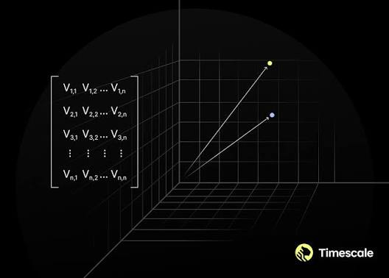

Slide 7
Why Embeddings Work
Nearby positions = similarity Concepts with related meaning occupy close positions in vector space.
Clustering of related items Example: Dog, Cat, Tiger cluster together, while Car, Truck form a different cluster.
Distance encodes meaning The numerical distance between vectors reflects semantic closeness — smaller distance = stronger similarity.
Captures relationships Embeddings preserve analogies (e.g., King – Man + Woman ≈ Queen) by geometric transformations.
Supports generalization By mapping diverse data into a shared space, embeddings allow models to generalize across unseen examples.

Slide 8
Evolution of Text Representation
One-Hot Encoding Each word represented as a sparse binary vector. No semantic meaning, only unique IDs.
Word2Vec Learns word embeddings using context (Skip-gram / CBOW). Captures semantic similarity.
GloVe Global Vectors trained on co-occurrence statistics. Preserves global corpus-level meaning.
FastText Extends Word2Vec by using subword information. Handles rare and misspelled words better.
ELMo Contextual embeddings from deep bidirectional LSTMs. Word meaning changes with context.
BERT Transformer-based, bidirectional embeddings. Revolutionized NLP with deep contextual understanding.
Modern Transformer Embeddings Models like GPT, LLaMA, Claude generate rich embeddings for sentences, documents, and tasks.

Slide 9
Transformer Embeddings
Generated via self-attention Each token attends to all others, creating context-aware representations.
Context changes meaning Unlike static embeddings, the same word can have different vectors depending on surrounding words.
Example: “bank”
Finance: “bank loan” → embedding reflects financial context.
Geography: “river bank” → embedding reflects natural landscape.
Dynamic and powerful Enables nuanced understanding for tasks like translation, summarization, and reasoning.
Foundation for LLMs Models like GPT, BERT, and LLaMA rely on these embeddings to capture meaning across sentences and documents.

Slide 10
Embedding Generation Pipeline
Text Raw input (sentence, document, etc.)
Tokenization Breaks text into smaller units (tokens)
Embedding Layer Converts tokens into initial dense vectors
Transformer Blocks Self-attention + feed-forward layers refine context-aware representations
Pooling Aggregates token embeddings into a single representation
Dense Vector Final embedding used for similarity search, clustering, or downstream tasks

Slide 11
Embedding Dimensions
Word2Vec: 300 Compact vectors, sufficient for basic semantic similarity.
BERT: 768 Larger dimensionality captures richer contextual meaning.
OpenAI Models: 1536–3072 High-dimensional embeddings encode nuanced relationships across long contexts.
Higher dimensions = richer info More capacity to represent meaning, but require more memory and storage.

Slide 12
Semantic Relationships
Learned relationships Embeddings capture semantic patterns without explicit programming.
Vector arithmetic Operations on embeddings reveal analogies and hidden structure.
Classic example King − Man + Woman ≈ Queen demonstrates how embeddings encode gender and role.
Latent semantic features Dimensions represent abstract properties like tense, plurality, or domain.
Supports reasoning Enables analogy solving, semantic search, and contextual understanding.

Slide 13
Similarity Metrics Overview
Cosine Similarity Measures the cosine of the angle between two vectors. → Best for comparing orientation, not magnitude.
Dot Product Simple multiplication of corresponding vector elements. → Sensitive to both direction and magnitude.
Euclidean Distance Straight-line distance between two points in vector space. → Captures absolute difference in position.
Manhattan Distance Sum of absolute differences across dimensions. → Think of it as “grid-like” distance.

Slide 14
Embedding Models
OpenAI text-embedding High-dimensional (1536–3072) embeddings optimized for semantic search, clustering, and retrieval-augmented generation (RAG).
BGE (BAAI General Embeddings) Strong performance on multilingual tasks and retrieval benchmarks.
E5 Designed for sentence-level embeddings, excels in semantic similarity and information retrieval.
Instructor Instruction-tuned embeddings that adapt to task-specific prompts for better alignment.
Cohere Commercial embeddings with strong performance in production-scale semantic search and classification.
Sentence Transformers Flexible, open-source library built on Hugging Face; widely used for sentence similarity, clustering, and semantic search.

Slide 15
Vector Space
Mathematical representation A structured space defined by dimensions and coordinates.
Each dimension = latent feature Dimensions capture hidden semantic properties (e.g., gender, tense, topic).
Semantic meaning encoded Words, sentences, or images are mapped into points where proximity reflects similarity.
Supports operations Enables addition, subtraction, and distance calculations (e.g., King – Man + Woman ≈ Queen).
Foundation for embeddings Provides the geometric framework that makes similarity search and clustering possible.

Slide 16
Embeddings Search
Sentence Embeddings Represent individual sentences; capture meaning beyond word-level.
Document Embeddings Encode entire documents into vectors for large-scale retrieval.
Semantic Search Finds results based on meaning, not exact keywords.
Hybrid Search Combines dense embeddings with sparse keyword-based methods (BM25).
Semantic Search Workflow
Query → Embedding → Vector Database → Similarity Matching → Ranked Results.

Slide 17
Retrieval methods
Exact Match Retrieval
Best Match Retrieval
Uses Boolean logic (AND, OR, NOT).
Documents are retrieved only if they exactly satisfy the query.
Strengths: Precise, predictable.
Weaknesses: No ranking, misses semantically related results.
Example: Searching "dogs AND training" returns only documents containing both terms.
Based on the Vector Space Model.
Documents and queries are represented as vectors; similarity measured by cosine similarity or other metrics.
Strengths: Captures related concepts (e.g., “car” ≈ “automobile”).
Weaknesses: Requires weighting schemes (TF-IDF).

Slide 18
Probabilistic Retrieval
Partial Match Retrieval
Estimates the probability that a document is relevant to a query.
Results are ranked by likelihood of relevance.
Strengths: More accurate ranking, widely used in modern search engines.
Weaknesses: Requires training data or assumptions about relevance.
Allows retrieval even if query terms don’t exactly match.
Techniques include query expansion, fuzzy matching, clustering, spreading activation.
Strengths: Handles synonyms, misspellings, and related concepts.
Weaknesses: May introduce noise or irrelevant results

Slide 19
🔍 Dense vs Sparse Retrieval
Dense Retrieval
Sparse Retrieval
Representation: Encodes queries/documents into dense vectors (768–1536 dimensions).
Matching: Uses similarity metrics (cosine, dot product) to find semantically related results.
Performance: Higher relevance (≈0.72 nDCG@10, 0.65 Recall@10).
Requirements: GPU acceleration, ~60GB memory for 10M docs.
Strengths: Captures meaning, supports multilingual queries, integrates well with RAG.
Weaknesses: Costly, slower (10–100 ms latency).
Representation: High-dimensional sparse vectors (10,000–100,000 dimensions) based on vocabulary terms.
Matching: Keyword overlap, TF‑IDF, BM25.
Performance: Lower relevance (≈0.58 nDCG@10, 0.52 Recall@10).
Requirements: CPU-based, ~0.1GB memory for 100K docs.
Strengths: Fast (sub‑millisecond latency), interpretable, cost‑efficient.
Weaknesses: Misses semantic meaning, limited recall if keywords don’t match.

Slide 20
Popular Vector Databases
FAISS Open-source by Meta. Optimized for fast similarity search and clustering on large datasets.
Pinecone Cloud-native, scalable vector database with metadata filtering and production-ready APIs.
Weaviate Open-source, schema-based vector DB with hybrid search (dense + sparse) and knowledge graph integration.
Milvus High-performance, distributed vector database designed for billion-scale embeddings.
ChromaDB Lightweight, developer-friendly vector DB often used in RAG pipelines and prototyping.

Slide 21
Why Normal Databases Struggle
Sequential comparison Traditional databases compare records row by row — inefficient for millions of vectors.
High dimensionality Embeddings often have 768–3000+ dimensions, making brute-force search computationally expensive.
No native vector support Relational databases are designed for structured tables, not dense numerical vectors.
Latency issues Querying large embedding sets leads to slow response times without specialized indexing.
Storage overhead Higher dimensions require more memory, which normal databases aren’t optimized to handle.

Slide 22
Chunking in RAG
Fixed-size chunks Split text into equal-length segments (e.g., 500 tokens). → Simple, but may break semantic meaning mid-sentence.
Recursive chunks Break text hierarchically (document → section → paragraph → sentence). → Preserves structure and context.
Semantic chunks Split based on meaning (e.g., sentence boundaries, topic shifts). → Produces higher-quality embeddings aligned with natural language.
Sliding windows Overlapping chunks ensure context continuity across boundaries. → Useful for long documents where context spans multiple segments.

Slide 23
Retrieval-Augmented Generation
Combines retrieval + generation Vector database retrieves relevant context → LLM generates answer.
Improves factual accuracy Reduces reliance on memorized knowledge by grounding responses in external data.
Reduces hallucinations Ensures outputs are supported by retrieved evidence.
Workflow Query → Embedding → Vector Search → Retrieved Context → LLM Response.
Applications
    Semantic search
    Question answering
    Knowledge management

Slide 24
RAG Pipeline
Documents Source knowledge (text, PDFs, reports, etc.).
Chunking Split into manageable segments (fixed-size, semantic, sliding windows).
Embedding Convert chunks into dense vectors using embedding models.
Vector DB Store embeddings with indexing and metadata filtering for fast retrieval.
Retrieval Query embeddings matched against stored vectors → relevant chunks returned.
LLM Large Language Model integrates retrieved context with generative reasoning.
Final Answer Context-grounded response with improved factual accuracy and reduced hallucinations.

Slide 25
Embedding Model Selection
Accuracy How well the embeddings capture semantic meaning and improve retrieval quality.
Latency Speed of generating embeddings — critical for real-time applications.
Cost Pricing per token/vector; balance between performance and budget.
Language Support Multilingual capabilities vs. English-only models.
Vector Dimension Higher dimensions capture richer information but increase storage and compute requirements.

Slide 26
Evaluation Metrics
Precision@K Fraction of top‑K retrieved results that are relevant. → Measures accuracy of the top results.
Recall@K Fraction of all relevant items retrieved within top‑K. → Measures coverage of retrieval.
MRR (Mean Reciprocal Rank) Average of reciprocal ranks of the first relevant result. → Captures how quickly a relevant item appears.
nDCG (Normalized Discounted Cumulative Gain) Considers relevance and ranking position. → Higher relevance at top positions = higher score.
Hit Rate Percentage of queries where at least one relevant item is retrieved. → Simple success measure.
Latency Time taken to return results. → Critical for real‑time applications.

Slide 27
Precision@K → Accuracy
Recall@K → Coverage
MRR → Ranking efficiency
nDCG → Ranking quality
Hit Rate → Success rate
Latency → Speed

Slide 28
Common Challenges
Embedding Drift Embeddings lose alignment over time as models or data evolve, reducing retrieval accuracy.
Poor Chunking Bad segmentation breaks semantic meaning, leading to weak embeddings and irrelevant retrieval.
Low Recall System fails to retrieve enough relevant documents, limiting context for the LLM.
Hallucinations LLM generates unsupported or fabricated information when retrieval context is insufficient.
Duplicate Retrieval Multiple overlapping chunks retrieved, wasting context window and reducing diversity of evidence.

Slide 29
Production Best Practices
Hybrid Search Combine dense embeddings with sparse keyword methods (BM25) for balanced precision and recall.
Reranking Apply a secondary model to reorder retrieved results for higher relevance.
Metadata Filtering Use structured attributes (date, author, category) to narrow down retrieval scope.
Caching Store frequent queries and embeddings to reduce latency and cost.
Evaluation Pipelines Continuously measure performance with metrics like Precision@K, Recall@K, MRR, nDCG, Hit Rate, and Latency.

Slide 30
Fine‑Tuning vs Prompting vs RAG
Introduction
Fine‑Tuning, Prompting, and RAG are three strategies to adapt LLMs.
Each has different trade‑offs in cost, flexibility, and accuracy.
Goal: Understand when to use each and basics of fine‑tuning.

Slide 31
Fine Tuning
Definition: Adjusting a pre‑trained model’s parameters using domain‑specific data to make it perform better on specialized tasks.
Goal: Transfer general knowledge into niche expertise (e.g., medical text, legal contracts, customer support).
Advantages
Tailored responses for niche domains.
Higher accuracy on repetitive, specialized tasks.
Better alignment with organizational vocabulary.
Challenges
Requires compute resources.
Risk of overfitting if dataset is too small.
Needs ongoing maintenance as domain data evolves.

Slide 32
Steps to Do Fine‑Tuning
Select Base Model
  Start with a large pre‑trained LLM (e.g., GPT‑like, BERT, Falcon, LLaMA).
  Choose based on task type (classification, summarization, Q&A).
Prepare Data
  Collect domain‑specific text (e.g., medical records, financial reports).
  Clean and format into input‑output pairs.
  Ensure balanced, representative samples.
Choose Fine‑Tuning Method
  Full fine‑tuning: Update all parameters (requires lots of compute).
  Parameter‑efficient fine‑tuning (PEFT): Use LoRA, adapters, prefix‑tuning → cheaper and faster.
Training
  Define hyperparameters (learning rate, batch size, epochs).
  Train on GPU/TPU for efficiency.
  Monitor loss and accuracy metrics.
Evaluation
  Test on validation set.
  Use metrics like accuracy, F1, BLEU, ROUGE depending on task.
  Compare against baseline (pre‑trained model without fine‑tuning).
Deployment
  Save fine‑tuned weights.
  Integrate into applications (chatbots, search engines, analytics tools).
  Monitor drift and retrain periodically.

Slide 33
Prompting
Definition: Crafting instructions to guide model behavior without retraining.
Techniques:
Zero‑shot, Few‑shot, Chain‑of‑Thought.
Pros:
No training cost.
Flexible, quick iteration.
Cons:
Limited control over outputs.
Performance depends on prompt quality.
Best Use: General tasks, experimentation, rapid prototyping.

Slide 34
RAG (Retrieval‑Augmented Generation)
Definition: Combines vector retrieval with LLM generation.
Pipeline: Documents → Chunking → Embedding → Vector DB → Retrieval → LLM → Answer.
Pros:
Reduces hallucinations.
Keeps model lightweight (no retraining).
Scales with external knowledge bases.
Cons:
Requires infrastructure (vector DB).
Retrieval quality impacts answers.
Best Use: Knowledge‑intensive tasks (chatbots, enterprise search).

Slide 35
Comparison Table
Approach | Strengths | Weaknesses | Best Use Case
Fine‑Tuning | Domain‑specific accuracy | Costly, retraining needed | Specialized industries
Prompting | Fast, flexible | Limited control | General tasks
RAG | Scalable, factual | Infra complexity | Knowledge retrieval

