Slide 1
Structured Output & Tool Calling

Slide 2
Why Structured Outputs?
Predictable responses Systems consistently produce expected outputs, making them easier to trust and integrate.
Machine-readable outputs Results are structured in formats like JSON or XML, enabling seamless communication between applications.
Reduces parsing errors Standardized outputs minimize misinterpretation, lowering the risk of data handling mistakes.
Improves automation Reliable, structured responses allow workflows to run smoothly without manual intervention.

Slide 3
What is Structured Output?
Constrained responses Large Language Model outputs are restricted to a fixed schema, ensuring consistency.
JSON format The most common structure used, making responses easy to parse and integrate.
Downstream suitability Well‑structured outputs can be directly consumed by other applications, pipelines, or APIs.

Slide 4
Unstructured vs Structured Output
Natural language output Human‑readable responses, ideal for direct communication and understanding.
JSON output Structured, machine‑readable format that supports integration with applications and APIs.
Schema validation advantages Ensures outputs follow a predefined structure, reducing errors and improving reliability in downstream systems.

Slide 5
Introduction to JSON
Objects Collections of data enclosed in { }, containing key‑value pairs. Example: { "name": "Khushboo", "role": "Trainer" }
Arrays Ordered lists of values enclosed in [ ]. Example: [ "Python", "SQL", "AI" ]
Arrays provide that ordered list capability, enclosed in [ ].
  They’re essential when you want multiple values under one key — for example, a list of skills, IDs, or records.
  Without arrays, JSON would only allow single values per key, making it impossible to represent collections naturally.
Key‑value pairs Fundamental unit of JSON: a string key mapped to a value. Example: "age": 25
Nested structures Objects or arrays inside other objects/arrays for hierarchical data. Example: { "employee": { "name": "Sara", "skills": ["Python", "ML"] } }

Slide 6
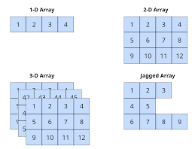

Slide 7
JSON Data Types
String Text enclosed in double quotes. Example: "city": "Pune"
Number Numeric values (integer or floating‑point). Example: "age": 25
Boolean Logical values: true or false. Example: "isStudent": true
Array Ordered list of values enclosed in [ ]. Example: "skills": ["Python", "SQL", "AI"]
Object Collection of key‑value pairs enclosed in { }. Example: { "name": "Khushboo", "role": "Trainer" }
Null Represents an empty or missing value. Example: "middleName": null

Slide 8
Why JSON is Important for AI
API communication JSON enables seamless data exchange between AI models and external services, making integration straightforward.
Workflow automation Structured outputs reduce manual intervention, allowing AI pipelines to run reliably and efficiently.
Database integration JSON maps naturally to document databases (like MongoDB) and can be easily stored, queried, and retrieved for AI tasks.

Slide 9
Schema Validation Workflow
Prompt User or system request initiates the process.
Model LLM generates output based on the prompt.
JSON Response is structured into a predefined format for consistency.
Validation Schema rules check the JSON output for correctness and completeness.
Application Validated data is consumed by downstream systems, APIs, or workflows.

Slide 10
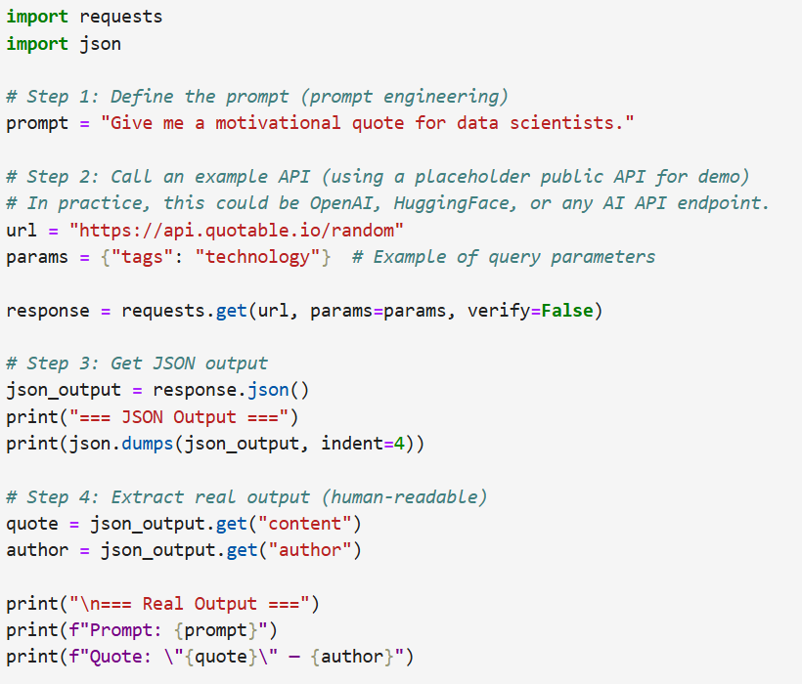
!pip install --upgrade certifi

Slide 11
Structured Output in LLMs
Schema‑guided generation Prompts enforce a predefined schema, ensuring outputs align with expected fields and types.
Guaranteed format Responses consistently follow JSON or other structured layouts, making them machine‑readable.
Reduced hallucinated fields Schema constraints prevent the model from inventing extra or irrelevant attributes.
It highlights how schema‑driven design improves reliability, integration, and trustworthiness of LLM outputs.

Slide 12
Function Calling Overview
Model selects function Based on the prompt, the LLM decides which predefined function is relevant.
Returns arguments Instead of free‑form text, the model outputs structured arguments (e.g., JSON) that match the function schema.
Application executes function The downstream system takes those arguments, runs the actual function, and delivers results back to the user or workflow.
This workflow ensures predictability, automation, and safe integration between LLMs and applications.

Slide 13
What is Tool Calling?
Extends function calling Goes beyond returning arguments — the model can trigger external tools directly.
External systems integration Connects AI outputs with APIs, databases, or enterprise software for seamless workflows.
Real‑world actions Enables the AI to perform tasks like sending emails, booking tickets, or retrieving files, bridging digital reasoning with practical execution.
This makes tool calling the bridge between AI reasoning and real‑world impact, ensuring outputs aren’t just text but actionable steps.

Slide 14
Function Calling Architecture
User Provides a prompt or request that initiates the process.
LLM Interprets the prompt and decides if a function call is needed.
Function Selection The model chooses the appropriate predefined function and prepares arguments.
Execution The application or system runs the selected function with the given arguments.
Result The output is returned to the user, either in structured JSON or human‑readable format.
This architecture ensures predictability, automation, and safe integration between LLM reasoning and application logic.

Slide 15
When to Use Function Calling
Weather lookup The LLM outputs structured arguments (e.g., { "city": "Pune" }) to call a weather API, ensuring reliable forecasts.
Database queries Instead of free‑form text, the model generates query parameters (e.g., { "table": "employees", "id": 42 }) for safe database access.
Booking systems Structured JSON ensures correct inputs for tasks like flight reservations, hotel bookings, or calendar scheduling.
Enterprise workflows Automates processes such as HR onboarding, ticket creation, or CRM updates by passing validated arguments to enterprise tools.

Slide 16
Tool Calling Workflow
User request The user provides a prompt that requires action beyond text generation.
Model chooses tool The LLM identifies the appropriate external tool (e.g., calendar, database, API).
Function selection The model chooses the right function schema and generates structured arguments.
Tool executes The selected tool runs with the structured arguments provided by the model.
Result returned The tool’s output is passed back to the user or integrated into the workflow.
This workflow shows how tool calling extends function calling by enabling real‑world actions and external system integration.

Slide 17
Example: Weather Tool
Input: “What’s the weather in Pune today?”
Function schema:
{
"name": "get_weather",
"parameters": {
"city": "string",
"date": "string"
}
}
Generated arguments:
{
"city": "Pune",
"date": "2026-06-10"
}
Tool response:
{
"temperature": "32°C",
"condition": "Sunny"
}
Human‑readable: “It’s 32°C and sunny in Pune today.”

Slide 18
Function Schema Design
Name Unique identifier for the function, used by the LLM to select the correct action. Example: "get_weather"
Description Human‑readable explanation of what the function does, guiding the model’s choice. Example: "Retrieves current weather information for a given city."
Parameters Structured inputs (with types) that the function requires. Example:
{
"city": "string",
"date": "string"
}
Required fields Mandatory parameters the model must provide for successful execution. Example: ["city"]

Slide 19
Error Handling in Tool Calling
Missing parameters If the model fails to provide required inputs, validation catches the error and prompts for correction. Example: city field missing in a weather lookup.
Invalid types Schema validation ensures arguments match expected types. Example: age provided as "twenty" instead of 20.
Tool failures External tools may fail due to network errors, expired certificates, or unavailable services. The system must log the error, retry if safe, or return a graceful fallback message.

