Slide 1
Prompting Techniques for LLMs
Zero-shot, Few-shot, Chain-of-Thought
Building Prompts for NLP Tasks

Slide 2
Learning Objectives
Understand zero-shot, few-shot and chain-of-thought prompting.
Learn to build prompts for summarization, translation, classification and reasoning.
Compare prompting techniques and best practices.

Slide 3
Zero-shot Prompting
Definition: Model performs tasks without examples, relying on pre‑training knowledge.
Use Cases: Summarization, translation, classification.
Example:
Prompt: “Translate this sentence to French: The book is on the table.”
Output: “Le livre est sur la table.”
Benefits: Fast, no labeled data needed, broad generalization.
Limitations: May struggle with nuanced or domain‑specific tasks

Slide 4
Few-shot Prompting
Definition: Provide a handful of examples to guide the model.
Use Cases: Sentiment classification, translation, summarization.
Review: "This movie was boring." → Sentiment: Negative
Review: "I loved the acting!" → Sentiment: Positive
Review: "The plot was confusing." → Sentiment: ?
Output: Mixed/Negative
Benefits: Improves accuracy, adapts quickly to specific tasks.
Limitations: Requires careful example selection.

Slide 5
Chain-of-Thought Prompting
Definition: Instructs the model to reason step‑by‑step before answering.
Use Cases: Reasoning, math, logic, multi‑step classification.
Example:
Prompt: “Solve step by step: 5 + 7 + 9 − 12.”
Output reasoning: 5+7=12, 12+9=21, 21−12=9 → Final Answer: 9
Benefits: Transparency, higher accuracy in complex reasoning.
Limitations: Slower, may generate verbose reasoning.

Slide 6
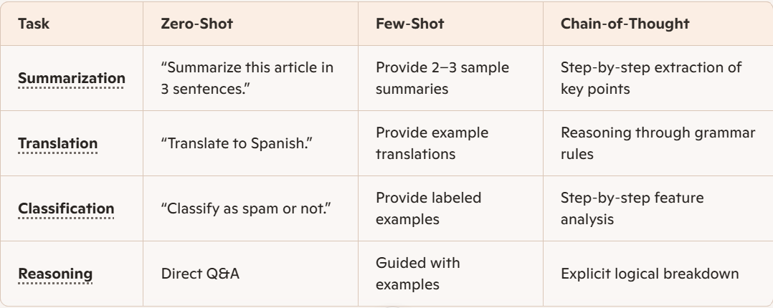
Comparison

Slide 7
Summarization Prompt
Basic Summarization
“Summarize this article in 3 sentences.”
“Provide a concise summary of the following text.”
Structured Summarization
“Return JSON with keys: title, summary, key_points.”
Bullet Point Summarization
“Summarize the document into 5 bullet points highlighting key ideas.”
Audience‑Specific Summarization
“Summarize this report for a manager who needs only high‑level insights.”
“Summarize this research paper for a student with no technical background.”
Task‑Focused Summarization
“Summarize customer reviews, focusing only on product quality and delivery speed.”
“Summarize meeting notes into action items.”

Slide 8
Translation Prompt
Zero‑Shot
“Translate this sentence into French: The book is on the table.”
Few-Shot
English: "Good morning" → Spanish: "Buenos días"
English: "Thank you" → Spanish: "Gracias"
English: "See you later" → Spanish: ?
Chain‑of‑Thought
“Translate this sentence into German. First identify nouns, verbs, and grammar structure, then provide the final translation.”

Slide 9
Classification Prompt
Zero‑Shot
“Classify the following review as Positive, Negative, or Neutral: ‘The food was cold and tasteless.’”
Few‑Shot
Review: "I loved the product." → Positive
Review: "It was broken when delivered." → Negative
Review: "The service was okay." → Neutral
Review: "The packaging was damaged." → ?
Chain‑of‑Thought
“Classify the sentiment of this review. First analyze tone and keywords step by step, then give the final label.”

Slide 10
Reasoning Prompt
Zero‑Shot
“What is 15 + 27 − 8?”
Few‑Shot
Q: 5 + 3 = ?
A: 8
Q: 10 − 4 = ?
A: 6
Q: 12 + 7 = ?
A: ?
Chain‑of‑Thought
“Solve step by step: A train leaves at 3 PM and travels 2 hours. What time does it arrive?” → Reasoning: 3 PM + 2 hours = 5 PM → Final Answer: 5 PM

Slide 11
Best Practices
Be specific.
Provide context.
Specify output format.
Use examples when needed.
Break complex tasks into steps.

Slide 12
Key Takeaways
Zero-shot: No examples.
Few-shot: Learn from examples.
Chain-of-thought: Better reasoning.
Prompt quality significantly impacts LLM performance.

