Slide 1







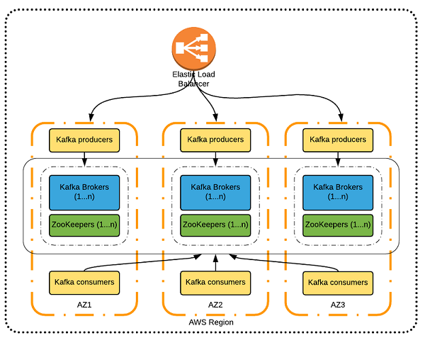




Image Processing
Web Application
Amazon Glacier
STREAM
BI Applications &
Dashboards
Image Uploading
Web Application
CONNECTORS
CLUSTER
Customers
Analysts &
Business Users

