Slide 1
Project Presentation of Co-Op Project Industry (Module-2)(22CS421)
on
AI-Based Visual Detection of Musculoskeletal Disorders with Personalized
Exercise Recommendation
Dheeraj Sharma 2210991503
Kapil 2210991745
Supervised by:-
Simarjit Kaur
Department of Computer Science and Engineering,
Chitkara University, Punjab

Slide 2
Content
1) Introduction to AI-Based Musculoskeletal Disorder Detection
2) System Overview and Functional Responsibilities
3) User Interface and Web-Based Interaction Module
4) Data Acquisition and Preprocessing Techniques
5) Technology Stack and Tools Used
6) Model Development and Implementation Details
7) Results, Performance Analysis, and Key Findings
8) Research Methodology and Workflow
9) Conclusion and Future Enhancements
10) Results, Performance Analysis (Continued)

Slide 3
Introduction
Musculoskeletal disorders (MSDs) affect muscles, joints, and bones, causing pain and reduced mobility. These disorders are increasingly common due to poor posture, long screen time, and lack of physical activity. Traditional diagnosis methods require physical visits to healthcare professionals and expensive equipment, which limits early detection.
To overcome these challenges, this research proposes an AI-based system that uses computer vision and deep learning techniques to automatically detect posture-related abnormalities. The system analyzes images or radiographic data and provides real-time detection along with personalized exercise recommendations. This approach aims to make healthcare more accessible, affordable, and efficient.
‹#›

Slide 4
Problem Statement
Musculoskeletal Disorders (MSDs) are among the most common health problems worldwide and affect millions of people across different age groups and professions. These disorders impact muscles, joints, bones, tendons, and ligaments, causing pain, discomfort, posture imbalance, reduced mobility, and sometimes permanent disability. The increasing use of computers, mobile devices, sedentary lifestyles, long working hours, repetitive physical activities, and poor ergonomic habits have significantly increased the number of posture-related disorders in modern society.
Despite the rapid growth in healthcare technologies, early detection and continuous monitoring of musculoskeletal disorders remain major challenges. Most existing diagnostic approaches depend heavily on physical examinations, expensive medical imaging systems, wearable sensors, and expert clinical evaluation. These traditional systems are often costly, time-consuming, and inaccessible to people living in rural or underdeveloped areas where advanced healthcare facilities are limited.
Another major issue is that most currently available systems focus only on disorder detection and do not provide rehabilitation support or personalized corrective guidance. Patients usually receive generalized recommendations that may not suit their body condition, posture severity, age, or lifestyle.

Slide 5
Objective
To develop an intelligent healthcare system capable of detecting musculoskeletal disorders automatically using Artificial Intelligence and computer vision technologies.
To design a real-time posture analysis framework that can identify abnormalities in body posture such as forward head posture, spinal imbalance, wrist disorders, and joint misalignment.
To implement human pose estimation techniques for accurate extraction of body landmarks, joint positions, movement patterns, and alignment information from images and video inputs.
To build an automated disorder classification system using machine learning and deep learning models such as CNN, Random Forest, SVM, Logistic Regression, and KNN for distinguishing normal and abnormal posture conditions.
To reduce dependency on expensive medical equipment and manual clinical diagnosis by creating a low-cost and accessible AI-based healthcare solution.
To utilize standard camera devices and radiographic images for musculoskeletal disorder detection without requiring specialized wearable sensors or advanced hardware systems.
To improve early-stage detection of musculoskeletal abnormalities so that users can take preventive measures before the condition becomes severe.
.

Slide 6
Proposed System
The proposed system is an AI-based healthcare framework that detects musculoskeletal disorders using Artificial Intelligence techniques. The system analyzes posture and radiographic images in real time using pose estimation, image processing, and deep learning models.
The workflow includes:
Image Upload
Image Preprocessing
Feature Extraction
Disorder Classification
Exercise Recommendation
Machine learning and deep learning models such as CNN, SVM, Random Forest, and KNN are used to classify normal and abnormal posture conditions. After detecting the disorder, the system provides personalized rehabilitation exercises and corrective guidance.
The framework offers a low-cost, real-time, and user-friendly solution for early detection of musculoskeletal disorders and preventive healthcare support.

Slide 7
Methodology
The proposed methodology uses Artificial Intelligence techniques for detecting musculoskeletal disorders and recommending personalized rehabilitation exercises. The system follows a structured workflow for posture analysis and disorder prediction.
The methodology includes:
Data Acquisition
Image Preprocessing
Feature Extraction
Model Training
Disorder Detection
Exercise Recommendation

Slide 8
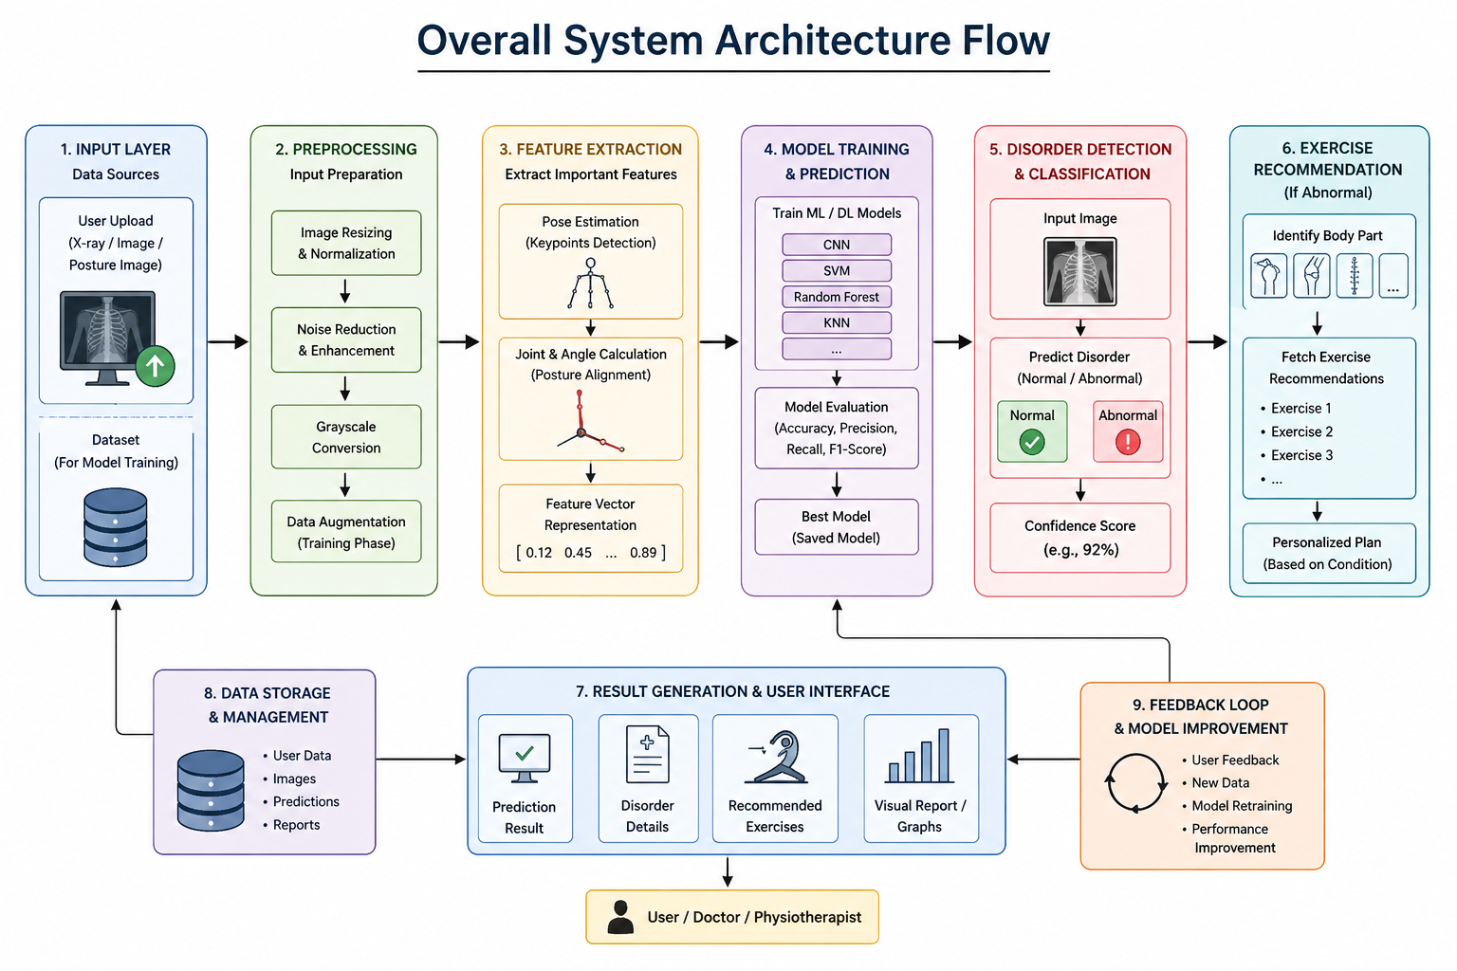
System Architecture

Slide 9
Technologies Used
Programming Languages
Python – Used for AI model development and backend processing.
Frameworks & Libraries
TensorFlow – Used for deep learning model training and prediction.
Keras – Used for building CNN and neural network models easily.
MediaPipe – Used for human pose estimation and body landmark detection.
NumPy – Used for numerical operations and matrix processing.
Scikit-Learn – Used for machine learning algorithms like SVM, Random Forest, and KNN.
Flask – Used for developing the web-based application interface.
Matplotlib – Used for graphs, charts, and visualization.
Datasets Used
MURA Dataset – Musculoskeletal radiographic image dataset.
EMG Dataset – Muscle signal dataset for posture and disorder analysis.

Slide 10
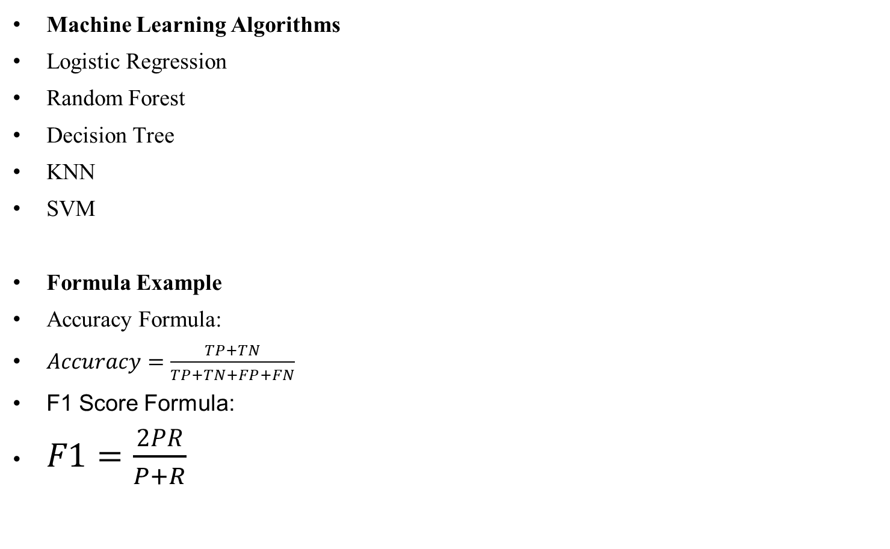
Algorithm / AI Models

Slide 11
Data Set
Trunk Extension (TE)
Trunk Flexion (TF)
Wrist Extension (WE)
Wrist Flexion (WF)

Slide 12
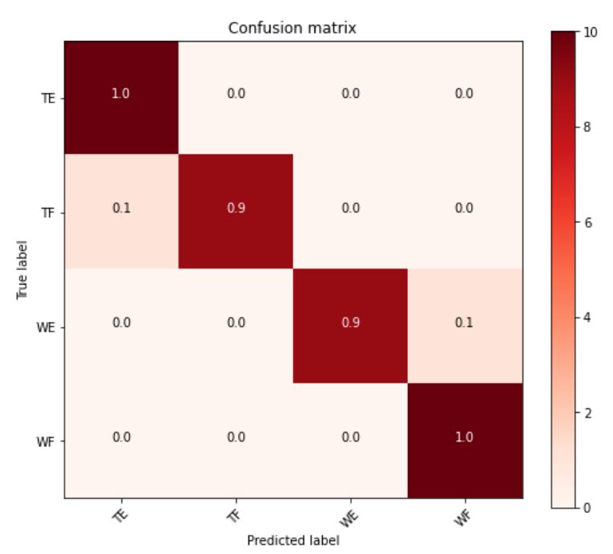
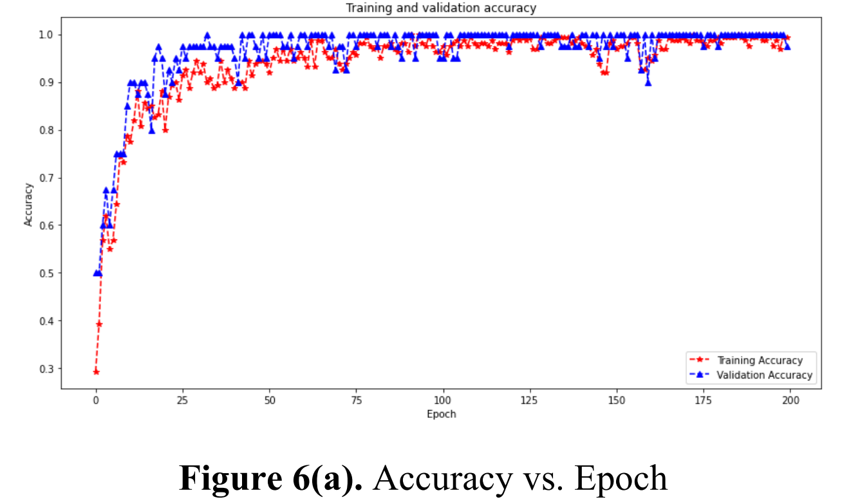
Results, Performance Analysis, and Key Findings

Slide 13
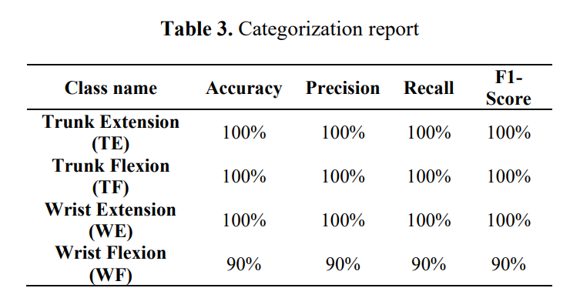
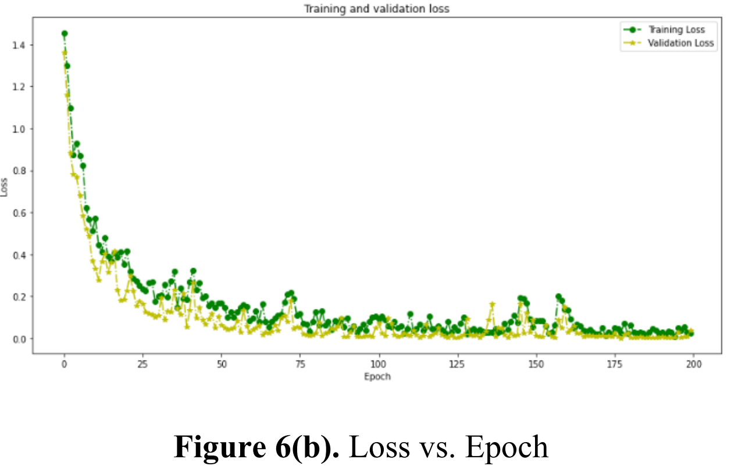
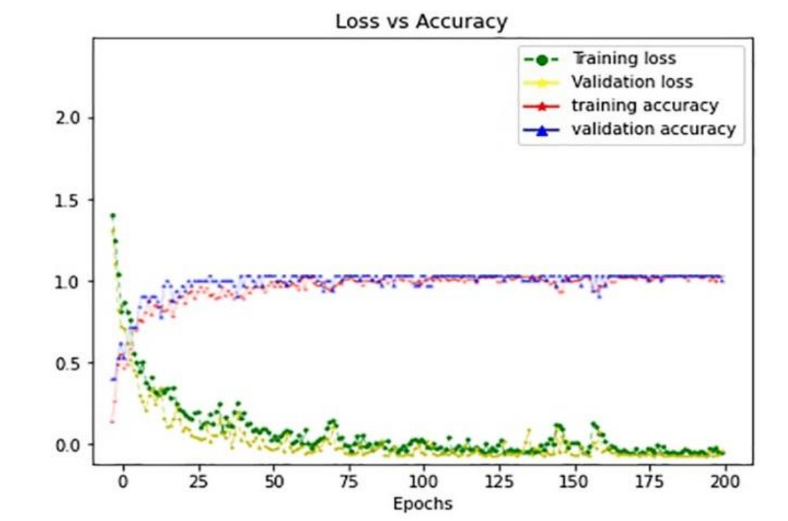
Results
Categorization Report, Loss Curves, and Combined Performance Analysis

Slide 14
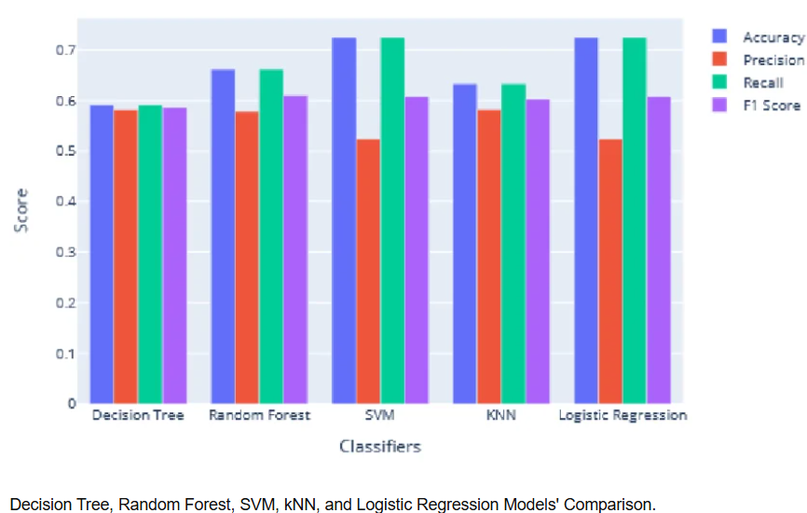
Results

Slide 15
Conclusion and Future Scope
The project successfully developed an AI-based musculoskeletal disorder detection system using Artificial Intelligence techniques. The framework integrates image preprocessing, pose estimation, feature extraction, and logistic Regression and SVM classification for accurate posture abnormality detection.
Machine learning and deep learning models achieved high accuracy with low classification error. The system also provides personalized rehabilitation exercise recommendations through a web-based real-time application, making it an efficient and low-cost intelligent healthcare solution.
In future, the system can be enhanced using advanced deep learning models, real-time webcam monitoring, wearable sensors, and mobile applications. More musculoskeletal disorders and larger datasets can be added to improve accuracy, scalability, and real-world healthcare applications.

Slide 16

Thank You
Thank you for your attention. I would be pleased to address any questions you may have.
‹#›

