Slide 1


2CSDE76 MOBILE OPERATING SYSTEM
Innovative Assignment
Project Title : College App
Group Members :
20BCE128 Khushi Jain
20BCE134 Vidhi Kothari
20BCE204 Dhyan Patel

Slide 2
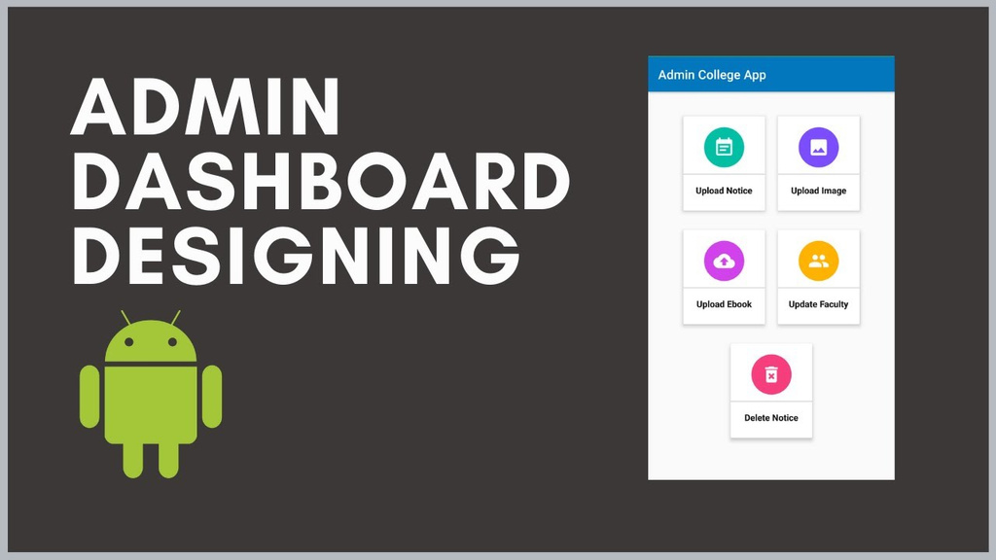
INTRODUCTION
This is a College App Which is designed for college purposes like showing introduction about college, showing various important Notices, Ebook for providing study materials to its students, A gallery for College Related Images, Faculty Details of every department and many more. Basically this app is Prototype for our College App.
We developed this Application using JAVA and XML and FIREBASE for Database Connectivity.
There are two apps : USER APP and ADMIN APP.

Slide 3
NEED FOR THE APPLICATION
Manual and time-consuming administrative tasks.
Disjointed communication between students, faculty, and administrators.
Limited accessibility to important campus information.
Growing administrative workload with increasing student numbers.

Slide 4

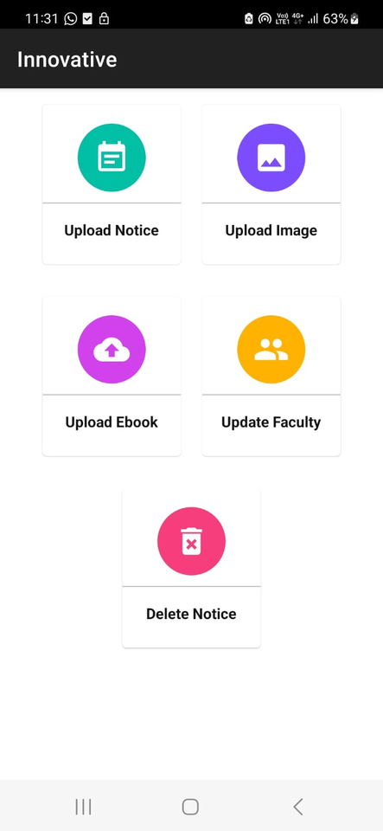
FEATURES
Notice Upload:
Image Upload:
Ebook Upload:
Faculty Management:
Notice Deletion:

Slide 5
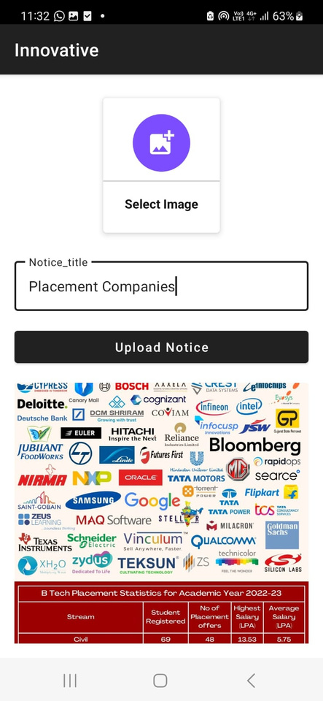
UPLOAD NOTICE
Admins can upload important notices, announcements, and updates to inform users about events and news.

Slide 6
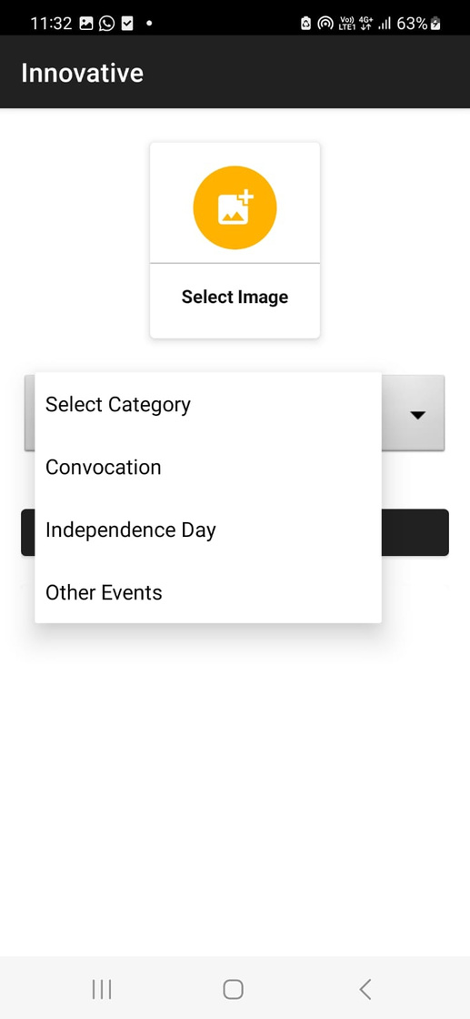
IMAGE UPLOAD
Administrators can upload images for various purposes, such as event promotions and visual content for the user app.

Slide 7
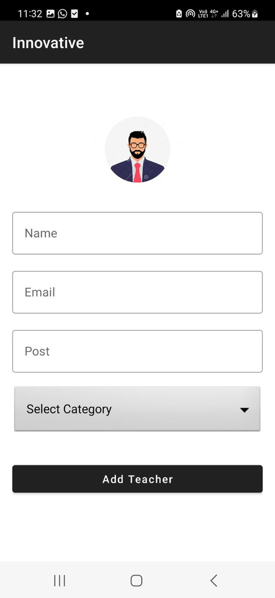
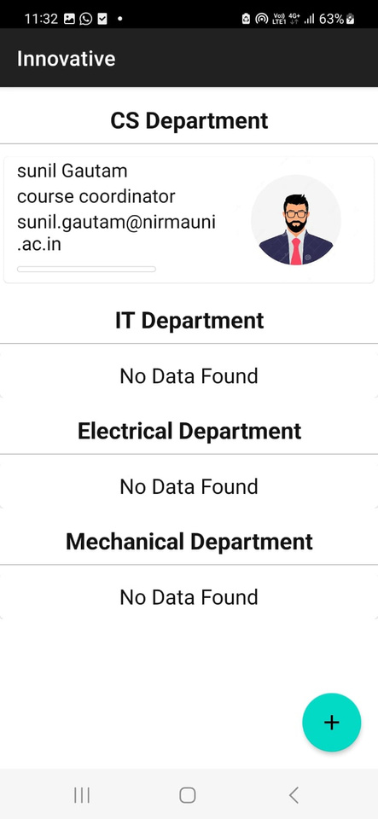
FACULTY MANAGEMENT
Admins can add new faculty members and update existing faculty details, ensuring accurate information in the user app.

Slide 8
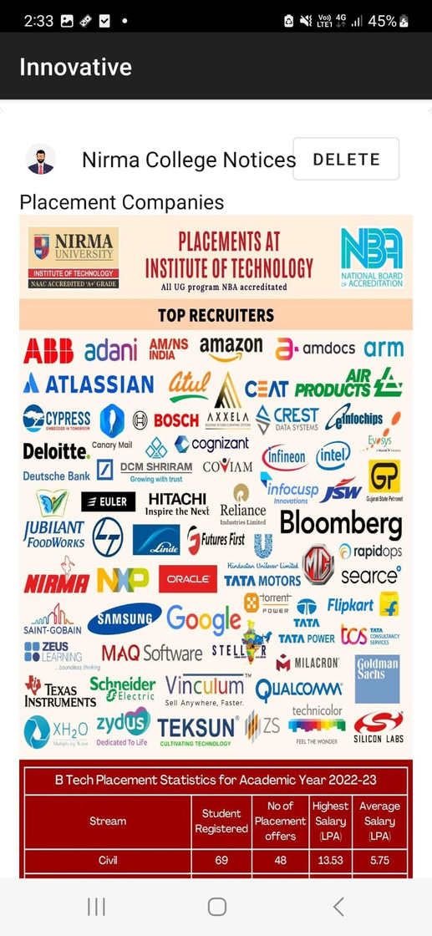
NOTICE DELETION
Admins can remove outdated or expired notices, keeping the app's content relevant and up-to-date

Slide 9
COMPONENTS USED
Firebase
Intent
Spinner
Adapter
Fragments
Layouts
Navigation Bar
Media Store
Permissions
Mapview

Slide 10
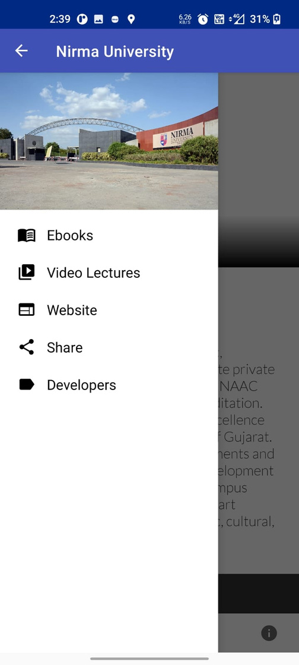
USER APP
The User app is designed to empower individuals with timely access to important information and resources. Users can effortlessly view notices, announcements, images, ebooks, and faculty details uploaded by administrators. The app ensures that users stay informed about the latest updates and events while providing easy access to educational materials. Users do not have the ability to edit or modify the content, ensuring the integrity of the information while offering a seamless and convenient way to stay updated and engaged with their institution or organization.

Slide 11
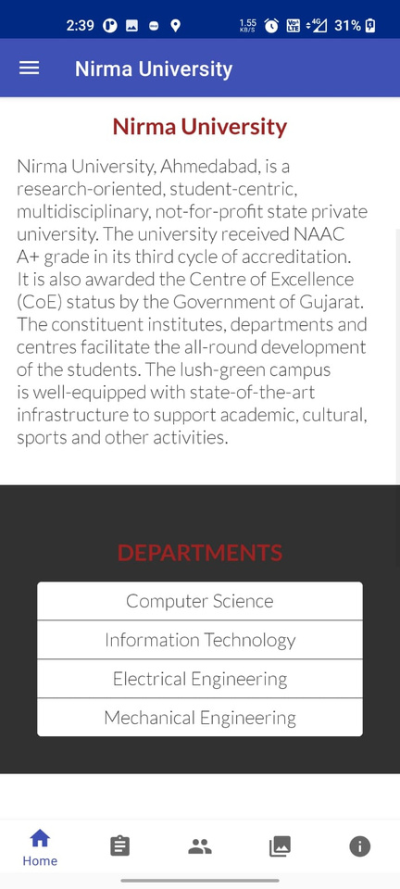
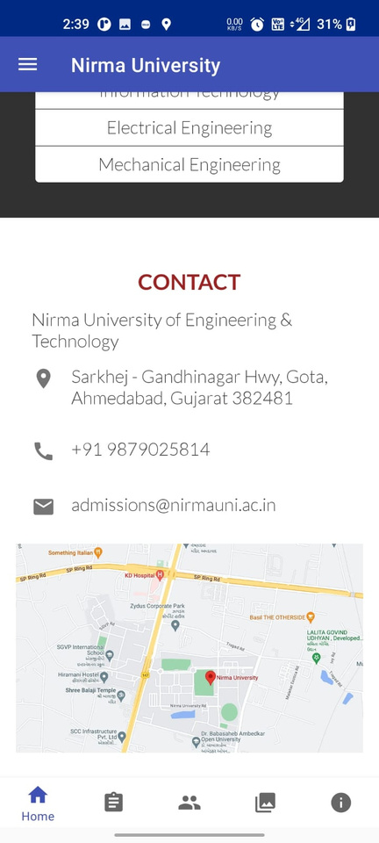
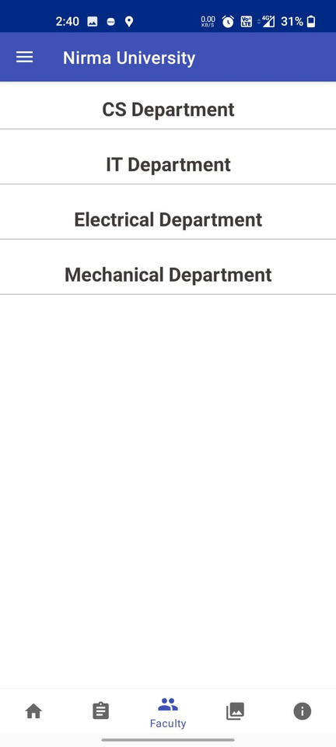
USER APP

Slide 12

HOW WILL OUR APPLICATION SOLVE THIS PROBLEM
Centralized Administration:
The app offers a centralized platform for all administrative tasks, including student records, scheduling, and resource management.
Seamless Communication:
Real-time communication among students, faculty, and administration, ensuring everyone is on the same page.
Mobile Accessibility:
Easy access to vital campus information, schedules, and updates through mobile devices, making information available anytime, anywhere.
Efficiency and Automation:
Automating routine administrative processes, reducing manual workload and potential errors.

Slide 13
FUTURE SCOPE
1. Integration with IoT and AI:
Leveraging the power of IoT for smart campus management, and AI for predictive analytic
2. Enhanced Security Features:
Continuously improving data security and privacy to protect sensitive information.
3. Feedback and Improvement Loop:
Regularly gathering user feedback to refine and expand features to meet evolving needs.
4. Expansion to Multiple Campuses:
Scaling the application to serve multiple educational institutions, creating a network of interconnected campuses.

Slide 14
THANK YOU

