Slide 1
Create Calculator App In Android Studio

Slide 2
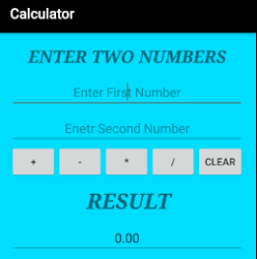

Slide 3
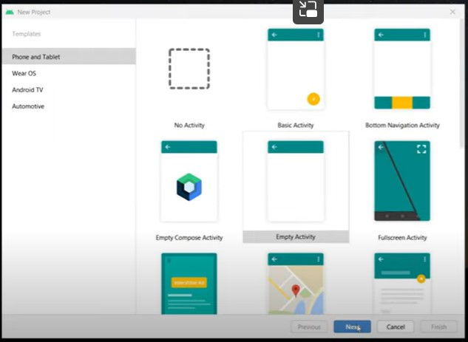

Slide 4
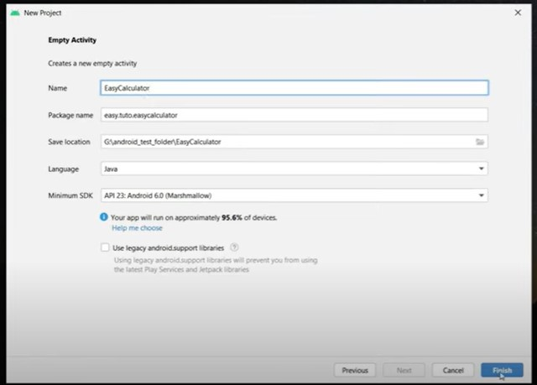

Slide 5
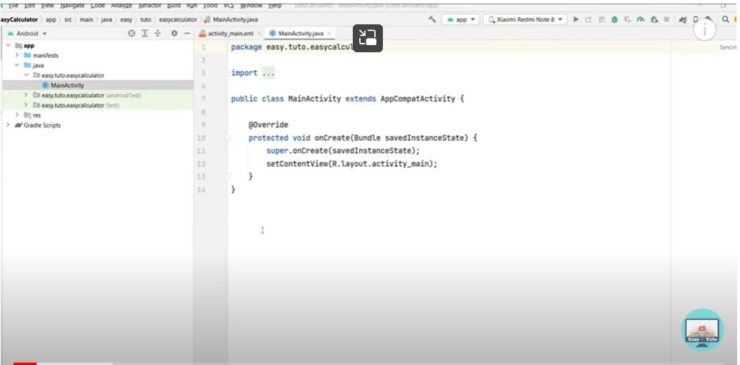

Slide 6
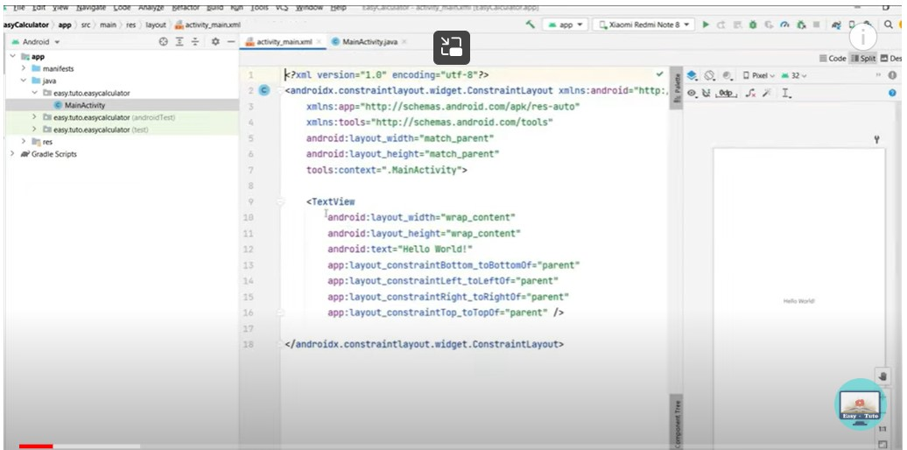

Slide 7
In this Calculator App tutorial we are going use of multiple Android UI components to design and step by step developing a Basic Calculator application in Android Studio.
Topics Used For Creating Calculator App – Before following the below steps it is recommended you check out EditText, TextView, Button & Linear Layout topics. Also go through JAVA OOPS concept once.

Slide 8
Step 1: Firstly get the android studio downloaded in your system, then open it. Step 2: Create a new project and name it Calculator. Step 3: Open res -> layout -> activity_main.xml (or) main.xml. Here we are going to create the application interface like add layouts, Button , TextView and EditText.

Slide 9
1 of Step 3 – Create a Linearlayout vertical, add a textview followed by two textfields Number(decimal) for writing numbers in it. Starting code of activity_main.xml

Slide 10
<?xml version="1.0" encoding="utf-8"?> <LinearLayout xmlns:android="http://schemas.android.com/apk/res/android" xmlns:tools="http://schemas.android.com/tools" android:id="@+id/activity_main" android:layout_width="match_parent" android:layout_height="match_parent" android:paddingBottom="@dimen/activity_vertical_margin" android:paddingLeft="@dimen/activity_horizontal_margin" android:paddingRight="@dimen/activity_horizontal_margin" android:paddingTop="@dimen/activity_vertical_margin" tools:context="abhiandroid.com.calculater.MainActivity" android:orientation="vertical" android:gravity="top" android:textAlignment="center" android:background="@android:color/holo_blue_bright" android:weightSum="1">

Slide 11
<TextView android:text="@string/enter_two_numbers" android:layout_width="match_parent" android:id="@+id/textView" android:layout_height="30dp" android:gravity="center_horizontal" android:textColorLink="?android:attr/editTextColor" tools:textStyle="bold|italic" android:textStyle="bold|italic" android:fontFamily="serif" android:visibility="visible" android:textSize="24sp" android:layout_weight="0.07" />

Slide 12
<EditText android:layout_width="match_parent" android:layout_height="wrap_content" android:inputType="number" android:ems="10" android:id="@+id/editOp1" android:textSize="18sp" android:gravity="center_horizontal" android:layout_marginBottom="5dp" android:visibility="visible" />

Slide 13
<EditText android:layout_width="match_parent" android:layout_height="wrap_content" android:inputType="number" android:ems="10" android:id="@+id/editOp2" android:textSize="18sp" android:gravity="center_horizontal" android:elevation="1dp" /> </LinearLayout>

Slide 14
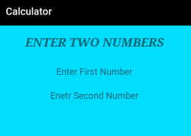
The UI will currently look like this:

Slide 15
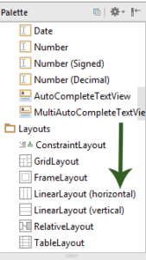
ii of Step 3 – Then before closing the above layout define another layout as Linear layout horizontal, add five button ( +, -, *, / and Clear) define their properties like id , width, height etc. in it and close the linear layout.

Slide 16
<Button android:text="+" android:layout_width="78dp" android:layout_height="wrap_content" android:id="@+id/btnadd" android:layout_weight="0.03" />
Following code of activity_main.xml . This code will be inserted in main layout:
<LinearLayout android:orientation="horizontal" android:layout_width="match_parent" android:layout_height="wrap_content">

Slide 17
<Button android:text="*" android:layout_width="78dp" android:layout_height="wrap_content" android:id="@+id/btnmul" android:layout_weight="0.03"/>
<Button android:text="/" android:layout_height="wrap_content" android:id="@+id/btndiv" android:layout_width="78dp" android:layout_weight="0.03" />
<Button android:text="Clear" android:layout_width="80dp" android:layout_height="wrap_content" android:id="@+id/btnclr" android:layout_weight="0.03" /> </LinearLayout>

Slide 18
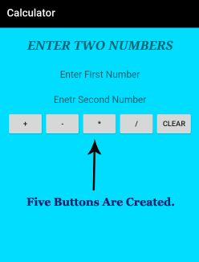
The UI will now look like this:

Slide 19
iii of Step 3 – Further in continuation with previous linearlayout add a textview, textfield (Number) for displaying result which makes the interface complete.
The complete interface code of activity_main.xml:

Slide 20
<?xml version="1.0" encoding="utf-8"?> <LinearLayout xmlns:android="http://schemas.android.com/apk/res/android" xmlns:tools="http://schemas.android.com/tools" android:id="@+id/activity_main" android:layout_width="match_parent" android:layout_height="match_parent" android:paddingBottom="@dimen/activity_vertical_margin" android:paddingLeft="@dimen/activity_horizontal_margin" android:paddingRight="@dimen/activity_horizontal_margin" android:paddingTop="@dimen/activity_vertical_margin" tools:context="abhiandroid.com.calculater.MainActivity" android:orientation="vertical" android:gravity="top" android:textAlignment="center" android:background="@android:color/holo_blue_bright" android:weightSum="1">

Slide 21
<TextView android:text="@string/enter_two_numbers" android:layout_width="match_parent" android:id="@+id/textView" android:layout_height="30dp" android:gravity="center_horizontal" android:textColorLink="?android:attr/editTextColor" tools:textStyle="bold|italic" android:textStyle="bold|italic" android:fontFamily="serif" android:visibility="visible" android:textSize="24sp" android:layout_weight="0.07" />

Slide 22
<EditText android:layout_width="match_parent" android:layout_height="wrap_content" android:inputType="number" android:ems="10" android:id="@+id/editOp1" android:textSize="18sp" android:gravity="center_horizontal" android:layout_marginBottom="5dp" android:visibility="visible" />

Slide 23
<EditText android:layout_width="match_parent" android:layout_height="wrap_content" android:inputType="number" android:ems="10" android:id="@+id/editOp2" android:textSize="18sp" android:gravity="center_horizontal" android:elevation="1dp" />

Slide 24
<LinearLayout android:orientation="horizontal" android:layout_width="match_parent" android:layout_height="wrap_content"> <Button android:text="+" android:layout_width="78dp" android:layout_height="wrap_content" android:id="@+id/btnadd" android:layout_weight="0.03" />

Slide 25
<Button android:text="*" android:layout_width="78dp" android:layout_height="wrap_content" android:id="@+id/btnmul" android:layout_weight="0.03"/> <Button android:text="/" android:layout_height="wrap_content" android:id="@+id/btndiv" android:layout_width="78dp" android:layout_weight="0.03" />

Slide 26
<Button android:text="Clear" android:layout_width="80dp" android:layout_height="wrap_content" android:id="@+id/btnclr" android:layout_weight="0.03" /> </LinearLayout>

Slide 27
<TextView android:text="@string/result" android:layout_width="332dp" android:id="@+id/textView1" android:layout_marginTop="10dp" android:layout_height="50dp" android:gravity="center_horizontal" android:textColorLink="?android:attr/editTextColor" tools:textStyle="bold|italic" android:textStyle="bold|italic" android:fontFamily="serif" android:visibility="visible" android:textSize="30sp" />

Slide 28
<EditText android:layout_width="match_parent" android:layout_height="wrap_content" android:inputType="number" android:ems="10" android:id="@+id/result" android:textSize="18sp" android:text="0.00" android:gravity="center_horizontal" /> </LinearLayout>

Slide 29
So now we have designed the complete UI of the Calculator App.

Slide 30
Step 4: Open src -> package -> MainActivity.java. The interface part of the application is over, let’s focus on adding functionality to the application. This calculator app basically perform five operations i.e addition, subtraction, multiplication, division and reset. So for that we need to define these operation over button click. For that we use setOnClickListener() function.
parseDouble() is used to convert String value to double. By default the value is String and we need to convert it into Double to perform operation over it.

Slide 31
If person doesn’t enter the value and directly click on the any button then a Toast message will appear on the screen telling user to enter the required numbers.
package abhiandroid.com.calculater;
import android.support.v7.app.AppCompatActivity; import android.os.Bundle;
import android.view.View;
import android.widget.Button;
import android.widget.EditText;
import android.widget.TextView;
import android.widget.Toast;

Slide 32
public class MainActivity extends AppCompatActivity { private EditText opr1;
private EditText opr2;
private Button btnadd;
private Button btnsub;
private Button btnmul;
private Button btndiv;
private Button btnclr;
private TextView txtresult;

Slide 33
@Override protected void onCreate(Bundle savedInstanceState) { super.onCreate(savedInstanceState); setContentView(R.layout.activity_main);
opr1 = (EditText) findViewById(R.id.editOp1);
opr2 = (EditText) findViewById(R.id.editOp2);
btnadd = (Button) findViewById(R.id.btnadd);
btnsub = (Button) findViewById(R.id.btnsub);
btnmul = (Button) findViewById(R.id.btnmul);
btndiv = (Button) findViewById(R.id.btndiv);
btnclr = (Button) findViewById(R.id.btnclr);
txtresult= (TextView) findViewById(R.id.result);

Slide 34
// Addition btnadd.setOnClickListener(new View.OnClickListener() {
@Override
public void onClick(View v) { if((opr1.getText().length()>0) && (opr2.getText().length()>0))
{
double oper1 =Double.parseDouble(opr1.getText().toString());
double oper2 = Double.parseDouble(opr2.getText().toString()); double result = oper1 + oper2;
txtresult.setText(Double.toString(result));
}
else
{ Toast toast= Toast.makeText(MainActivity.this,"Enter The Required Numbers",Toast.LENGTH_LONG);
toast.show(); } } });

Slide 35
//Subtraction
btnsub.setOnClickListener(new View.OnClickListener()
{ @Override public void onClick(View v)
{
if((opr1.getText().length()>0) && (opr2.getText().length()>0)) {
double oper1=Double.parseDouble(opr1.getText().toString()); double oper2 =Double.parseDouble(opr2.getText().toString()); double result = oper1 - oper2; txtresult.setText(Double.toString(result));
}
else{
Toast toast= Toast.makeText(MainActivity.this,"Enter The Required Numbers",Toast.LENGTH_LONG);
toast.show();
} } });

Slide 36
// Multiplication
btnmul.setOnClickListener(new View.OnClickListener()
{ @Override
public void onClick(View v) {
if((opr1.getText().length()>0) && (opr2.getText().length()>0)) {
double oper1 =Double.parseDouble(opr1.getText().toString()); double oper2 =Double.parseDouble(opr2.getText().toString()); double result = oper1 * oper2; txtresult.setText(Double.toString(result));
}
else{
Toast toast= Toast.makeText(MainActivity.this,"Enter The Required Numbers",Toast.LENGTH_LONG);
toast.show(); } } });

Slide 37
// Multiplication
btnmul.setOnClickListener(new View.OnClickListener()
{ @Override
public void onClick(View v) {
if((opr1.getText().length()>0) && (opr2.getText().length()>0)) {
double oper1 =Double.parseDouble(opr1.getText().toString()); double oper2 =Double.parseDouble(opr2.getText().toString()); double result = oper1 * oper2; txtresult.setText(Double.toString(result));
}
else{
Toast toast= Toast.makeText(MainActivity.this,"Enter The Required Numbers",Toast.LENGTH_LONG);
toast.show(); } } });

Slide 38
// Division
btndiv.setOnClickListener(new View.OnClickListener()
{ @Override
public void onClick(View v) { if((opr1.getText().length()>0) && (opr2.getText().length()>0))
{
double oper1 =Double.parseDouble(opr1.getText().toString()); double oper2 =Double.parseDouble(opr2.getText().toString()); double result = oper1 / oper2; txtresult.setText(Double.toString(result));
}
Else
{ Toast toast= Toast.makeText(MainActivity.this,"Enter The Required Numbers",Toast.LENGTH_LONG);
toast.show();
} } });

Slide 39
// Reset Feilds
btnclr.setOnClickListener(new View.OnClickListener()
{ @Override
public void onClick(View v) {
opr1.setText("");
opr2.setText("");
txtresult.setText("0.00");
opr1.requestFocus();
} }); } }

