Slide 1
Security

Slide 2
Mobile Application Security
Variety of security threats that can affect mobile devices.
Mobile threats are ever evolving with the advancement in technologies.
It can be physical or software based and can target mobile applications, the mobile device, the network, the data center or any combination of these
Building security in development process
Secure applications by integrating security very early into the SDLC
Mobile device security refers to being free from danger or risk of an asset loss or data loss using mobile computers and communication hardware.

Slide 3
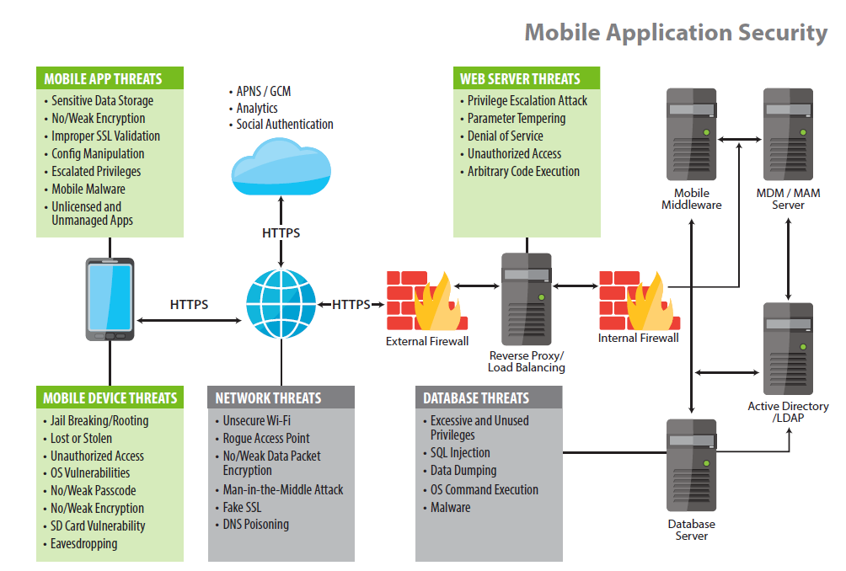
Mobile Security Threats/Vulnerabilities

Slide 4
Mobile Security Threats/Vulnerabilities
Vulnerability : Refers to weakness
Threat : Refers to the one that attacks on weakness/ causes damage to the vulnerability

Slide 5
Mobile Device Security Vulnerabilities
Mobile devices face security threats that take advantage of vulnerabilities found in these devices. These vulnerabilities can be the result of poorly implemented technical controls or lack of awareness.
Lost or stolen devices
With a growing mobile device usage, there is a huge security risk to the lost or stolen devices
Mobile device password
Mobile devices often lack passwords to authenticate users and control access to data stored on the devices.
Many devices have the technical capability to support passwords, personal identification numbers (PIN), or pattern screen locks for authentication
Some mobile devices also include a biometric reader to scan a fingerprint for authentication
But users seldom employ these mechanisms

Slide 6
Mobile Device Security Vulnerabilities
Wi-Fi Transmission
Wireless transmissions are not always encrypted.
Information such as e-mails sent by a mobile device is usually not encrypted while in transit. In addition, many applications do not encrypt the data they transmit and receive over the network, making it easy for the data to be intercepted
Mobile devices Malware
Users may download applications that contain malware.
It is difficult for users to tell the difference between a legitimate application and one containing malware

Slide 7
Mobile Device Security Vulnerabilities
OS Vulnerabilities
Security vulnerabilities have been discovered in popular operating systems like ios, android.
Outdated OS are the main reason of this vulnerabilities.
Security patches or fixes for mobile devices' operating systems are not always installed on mobile devices in a timely manner due to device or vendor restriction.
Jail-breaking/Rooting Mobile Device
Mobile devices may have unauthorized modifications. The process of modifying a mobile device to remove its limitations so consumers can add features, however this could increase security risks.

Slide 8
Mobile Device Security Threat & their consequence
Lost or stolen devices
Threat Consequences :
Loss of sensitive personal and employer information such as contacts, calendars and photos
Breach of your privacy, and in a worst-case scenario, you could become a victim of identity theft
Compromised online accounts
Payment to replace the device, and/or possible calls or texts charged to your account

Slide 9
Mobile Device Security Threat
Phishing scams (often delivered via emails, texts and social networking sites)
Sensitive information revealed such as account numbers and login credentials
Unauthorized withdrawals made from your bank account
Malware and spyware
Compromised personal information—you could even become a victim of identity theft
Unauthorized charges could appear on your mobile bill
Others may listen in on your phone calls and retrieve your voicemails

Slide 10
Mobile Device Security Threat
Quick Response (QR) codes
You could accidentally download a malicious application
Your personal information could be compromised, or your device could cease to function properly
Wi-Fi networks
Device could connect to an unsecured network, and the data you send, including sensitive information such as passwords and account numbers, could potentially be intercepted

Slide 11
Mobile Device Security Threat
Quick Response (QR) codes
You could accidentally download a malicious application
Your personal information could be compromised, or your device could cease to function properly
Wi-Fi networks
Device could connect to an unsecured network, and the data you send, including sensitive information such as passwords and account numbers, could potentially be intercepted

Slide 12
Mobile Device Security Risk Mitigation
Security threats to the mobile device can be largely mitigated with the implementation of mobile device management tools (MDM). The following is a sample of some of the controls provided by MDM.
The ability to:
Remotely lock a mobile device or erase data from a lost or stolen mobile device.
Configure or disable Wi-Fi and VPN.
Enforce folder, device or email encryption settings.
Use geo-fencing or time-fencing rules to enforce location or time related compliances.
Detect and restrict jail broken and rooted devices.
Enforce password policies.
Blacklist/ Whitelist applications.
Disable risky interfaces on the device.

Slide 13
Mobile Application Security Vulnerabilities
Insecure data storage
This can result in stolen user data from an application that is improperly secured.
Examples of data that are at risk are - usernames, passwords, authentication tokens, location data, personal information or application data.
No encryption or weak encryption
Encryption systems are constantly evolving because they are constantly being “solved” or broken. Apps that allow the transmission of unencrypted or weakly encrypted data are vulnerable to attack.
Poor Authorization and authentication
Apps and the systems they connect with should be properly protected with authorization and authentication best practices. This ensures that un-authorized devices, users and scripts are identified and blocked.

Slide 14
Mobile Application Security Vulnerabilities
Improper or insufficient transport layer protection
If the application is coded poorly, and not secured, “threat agents” can use techniques to view sensitive data while it’s traveling across the network.
These threat agents can be users or entities on a network; or they may be malware that pre-exist on the user’s mobile device
Client side injection : If an app is improperly coded, attackers can mount simple text-based attacks that target almost any source of data including resource files or the application itself.
Unintended permissions : Misconfigured apps can sometimes open the door to attackers by granting unintended permissions.
Escalated privileges : A hacker could exploit a bug, design flaw or configuration oversight in an app to gain access to resources normally protected from an application or user.

Slide 15
Mobile Application Security Risk Mitigation
Security threats can be mitigated with strong, well-understood solutions. The following list encompasses some of the most commonly used measures designed to protect data and systems from a variety of different attack methods.
Storing sensitive data securely, or not at all.
Handling authentication and sessions properly.
The correct use of security and encryption tools.
Avoiding unintended information leakage.
Resisting runtime manipulation.
Anti-tampering to prevent reverse engineering.
Validating the security/authenticity of 3rd party code/libraries.
Using tools to perform security tests and security code scans.
Following the Open Web Application Security Project (OWASP) mobile security project to keep you updated with evolving mobile security risks and ways to protect yourself.

Slide 16
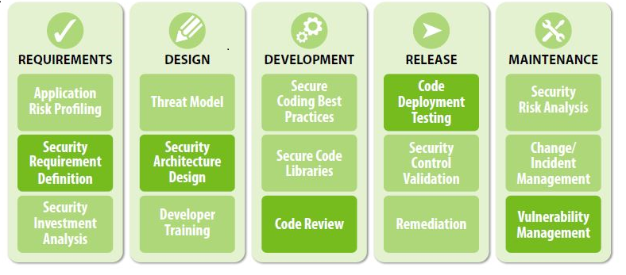
Secure-SDLC (S-SDLC)

Slide 17
S-SDLC
Security Requirement Definition is focused on specifying the behavior of an application with respect to security. Organizations must ensure that the requirements are specific, measurable and reasonable and that they conform to their security, risk and compliance strategy.
Secure Architecture Design is focused on proactive steps for an organization to design and build a secure application. By enhancing the design process with reusable secure services and components, the subsequently developed application will be more secure, whilst the time and effort will be dramatically reduced.

Slide 18
S-SDLC
Code Review is focused on the inspection of the application at the source code level in order to find security vulnerabilities. Organizations should use lightweight checklists for common problem and also use automation technology to improve coverage and efficacy of code review activities.
Security Testing is focused on the inspection of the application in the runtime environment in order to find security problems. Organizations should specify security test cases based on known requirements and common vulnerabilities, and also perform application penetration testing before each major release.
Vulnerability Management is focused on the processes within an organization that handle vulnerability reports and operational incidents related to security. To effectively implement these processes, an organization should define a security point of contact for the application and also create an informal security response team to handle security incidents.

Slide 19
Advantages of Secure-SDLC
Save time from re-engineering the application as security leaks discovered during testing
Development time can be reduced by leveraging secure, reusable application components and through the use of automation tools for scan, test and delivery processes.
Using S-SDLC, mobile application vulnerabilities can be identified and eliminated well in advance of deploying the application

Slide 20
Safety Tips
Lock device with password or pin
Only install apps from trusted sources
Data Backup in timely fashion
Keep the system updated
Don’t tamper with your device
Log out from banking/shopping sites
Turn on services like Wi-Fi, Data
Don’t click on links or attachments in unsolicited emails or text messages

Slide 21
Disclaimer
All the content is curated from Android Documentation and Mobile Application Security by Rajneesh Mishra.

