Slide 1
Broadcast Receiver

Slide 2
Broadcast
Broadcasts are messages sent by Android system and other Android apps, when an event of interest occurs.
Broadcasts are wrapped in an Intent object. This Intent object’s contains the event details such as, android.intent.action.HEADSET_PLUG, sent when a wired headset is plugged or unplugged.

Slide 3
Types of broadcasts
Types of broadcast:
System broadcast.
Custom broadcast.

Slide 4
System broadcasts
System broadcast are the messages sent by the Android system, when a system event occurs, that might affect your app.
Few examples:
An Intent with action, ACTION_BOOT_COMPLETED is broadcasted when the device boots.
An Intent with action, ACTION_POWER_CONNECTED is broadcasted when the device is connected to the external power.

Slide 5
Custom broadcasts
Custom broadcasts are broadcasts that your app sends out, similar to the Android system.
For example, when you want to let other app(s) know that some data has been downloaded by your app, and its available for their use.

Slide 6
Send a custom broadcast
Android provides three ways for sending a broadcast:
Ordered broadcast.
Normal broadcast.
Local broadcast.

Slide 7
Ordered Broadcast
Ordered broadcast is delivered to one receiver at a time.
To send a ordered broadcast, use the sendOrderedBroadcast() method.
Receivers can propagate result to the next receiver or even abort the broadcast.
Control the broadcast order with android:priority attribute in the manifest file.
Receivers with same priority run in arbitrary order.

Slide 8
Normal Broadcast
Delivered to all the registered receivers at the same time, in an undefined order.
Most efficient way to send a broadcast.
Receivers can’t propagate the results among themselves, and they can’t abort the broadcast.
The sendBroadcast() method is used to send a normal broadcast.

Slide 9
Local Broadcast
Sends broadcasts to receivers within your app.
No security issues since no interprocess communication.
To send a local broadcast:
To get an instance of LocalBroadcastManager.
Call sendBroadcast() on the instance.
LocalBroadcastManager.getInstance(this)
.sendBroadcast(customBroadcastIntent);

Slide 10
Custom broadcasts
Sender and receiver must agree on unique name for intent (action name)
Define in activity and broadcast receiver
private static final String ACTION_CUSTOM_BROADCAST = "com.example.android.powerreceiver.ACTION_CUSTOM_BROADCAST";

Slide 11
What is a broadcast receiver?
Broadcast receivers are app components.
They register for various system broadcast and or custom broadcast.
They are notified (via an Intent):
By the system, when an system event occurs that your app is registered for.
By another app, including your own if your app is registered for that custom event.

Slide 12
Register your broadcast receiver
Broadcast receivers can be registered in two ways:
Static receivers
Registered in your AndroidManifest.xml, also called as Manifest-declared receivers.
Dynamic receivers
Registered using app or activities' context in your Java files, also called as Context-registered receivers.

Slide 13
Receiving a system broadcast
Starting from Android 8.0 (API level 26), static receivers can't receive most of the system broadcasts.
Use a dynamic receiver to register for these broadcasts.
If you register for the system broadcasts in the manifest, the Android system won't deliver them to your app.
A few broadcasts, are excepted from this restriction. See the complete list of implicit broadcast exceptions.

Slide 14
To create a broadcast receiver
Subclass the BroadcastReceiver class and override its onReceive() method.
Register the broadcast receiver and specify the intent-filters:
Statically, in the Manifest.
Dynamically, with registerReceiver().

Slide 15
What are Intent-filters
Intent-filters specify the types of intents a broadcast receiver can receive. They filter the incoming intents based on the Intent values like action.
To add an intent-filter:
To your AndroidManifest.xml file, use <intent-filter> tag.
To your Java file use the IntentFilter object.

Slide 16
Subclass a broadcast receiver
public class CustomReceiver extends BroadcastReceiver {
@Override
public void onReceive(Context context, Intent intent) {
// This method is called when the BroadcastReceiver
// is receiving an Intent broadcast.
throw new UnsupportedOperationException("Not yet implemented");
}
}

Slide 17
Implement onReceive()
Example implementation of onReceive() method which handles power connected and disconnected.
@Override
public void onReceive(Context context, Intent intent) {
String intentAction = intent.getAction();
switch (intentAction){
case Intent.ACTION_POWER_CONNECTED:
break;
case Intent.ACTION_POWER_DISCONNECTED:
break;
}
}

Slide 18
Register statically in Android manifest
<receiver> element inside <application> tag.
<intent-filter> registers receiver for specific intents.
<receiver
android:name=".CustomReceiver"
android:enabled="true"
android:exported="true">
<intent-filter> <action android:name="android.intent.action.BOOT_COMPLETED"/> </intent-filter>
</receiver>

Slide 19
Register dynamically
Register your receiver in onCreate() or onResume().
// Register the receiver using the activity context.
this.registerReceiver(mReceiver, filter);
Unregister in onDestroy() or onPause().
// Unregister the receiver
this.unregisterReceiver(mReceiver);

Slide 20
Register a Local broadcast receiver
Register local receivers dynamically, because static registration in the manifest is not possible for a local broadcasts.

Slide 21
Register a Local broadcast receiver
To register a receiver for local broadcasts:
Get an instance of LocalBroadcastManager.
Call registerReceiver().
LocalBroadcastManager.getInstance(this).registerReceiver
(mReceiver,
new IntentFilter(CustomReceiver.ACTION_CUSTOM_BROADCAST));

Slide 22
Unregister a Local broadcast receiver
To unregister a local broadcast receiver:
Get an instance of the LocalBroadcastManager.
Call LocalBroadcastManager.unregisterReceiver().
LocalBroadcastManager.getInstance(this)
.unregisterReceiver(mReceiver);

Slide 23
Restricting broadcasts
Restricting your broadcast is strongly recommended.
An unrestricted broadcast can pose a security threat.
For example: If your apps’ broadcast is not restricted and includes sensitive information, an app that contains malware could register and receive your data.

Slide 24
Ways to restrict a broadcast
If possible, use a LocalBroadcastManager, which keeps the data inside your app, avoiding security leaks.
Use the setPackage() method and pass in the package name. Your broadcast is restricted to apps that match the specified package name.
Access permissions can be enforced by sender or receiver.

Slide 25
Enforce permissions by sender
To enforce a permission when sending a broadcast:
Supply a non-null permission argument to sendBroadcast().
Only receivers that request this permission using the <uses-permission> tag in their AndroidManifest.xml file can receive the broadcast.

Slide 26
Enforce permissions by receiver
To enforce a permission when receiving a broadcast:
If you register your receiver dynamically, supply a non-null permission to registerReceiver().
If you register your receiver statically, use the android:permission attribute inside the <receiver> tag in your AndroidManifest.xml.

Slide 27
Disclaimer
All the content is curated from Android Documentation and Google Developer Fundamentals.
Refer to the shared code.

Slide 28
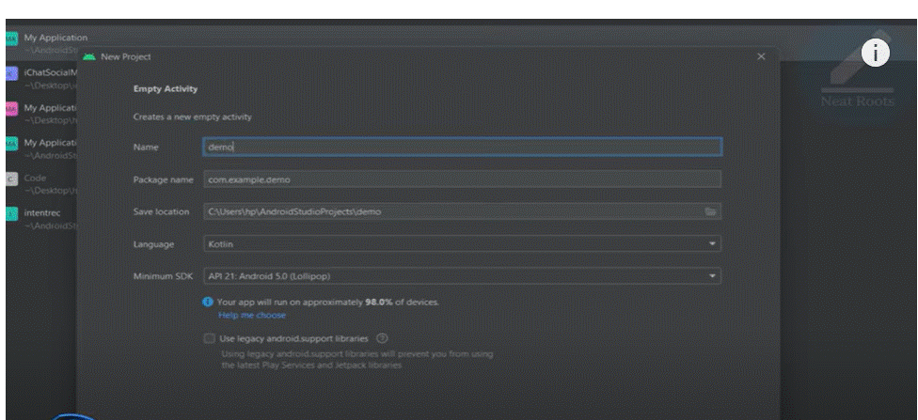
Image Gallery

Slide 29
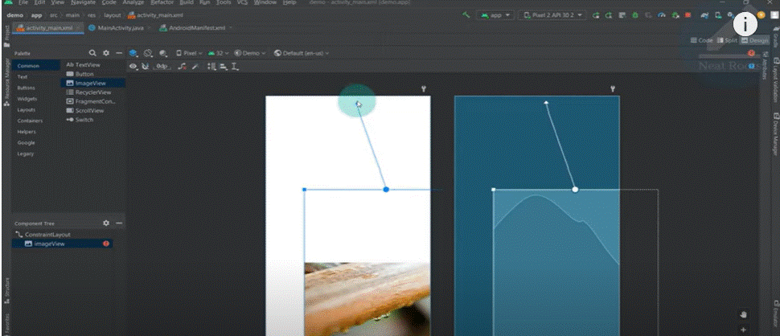

Slide 30
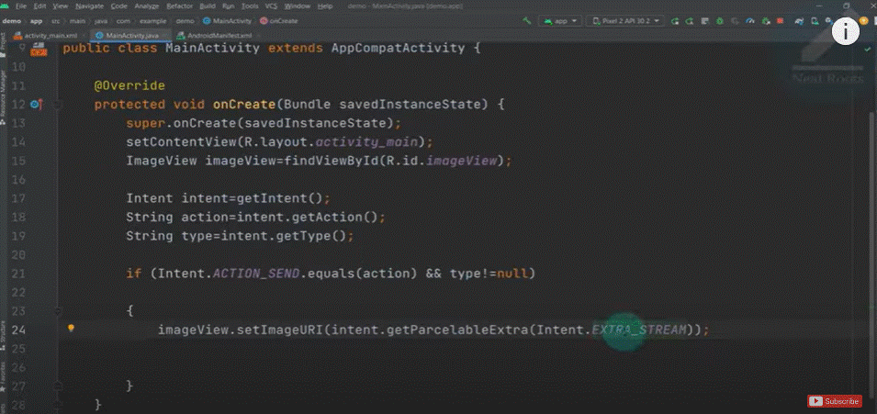

Slide 31
