Slide 1
Android Testing
Sunil Gautam

Slide 2
Android Debugging and Testing
Why do we need Debugging ?
Why do we need testing ?
What is Bug ?

Slide 3
Android Debugging & Testing
What is Bug ?
Incorrect or unexpected result, wrong values
Crashes, exceptions, freezes, memory leaks
Causes
Human Design or Implementation Error > Fix your code
Software fault, but in libraries > Work around limitation
Hardware fault or limitation -> Make it work with what's available

Slide 4
Android Debugging
Debugging is the process of finding and fixing errors (bugs) or unexpected behavior in your code.
All code has bugs, from incorrect behavior in your app, to behavior that excessively consumes memory or network resources, to actual app freezing or crashing.

Slide 5
Android Debugging
The debugging, testing, and profiling capabilities in Android Studio helps us reproduce, find, and resolve all of these problems. Those capabilities include:
The Logcat pane for log messages
The Debugger pane for viewing frames, threads, and variables
Debug mode for running apps with breakpoints
Test frameworks such as JUnit or Espresso
Dalvik Debug Monitor Server (DDMS), to track resource usage

Slide 6
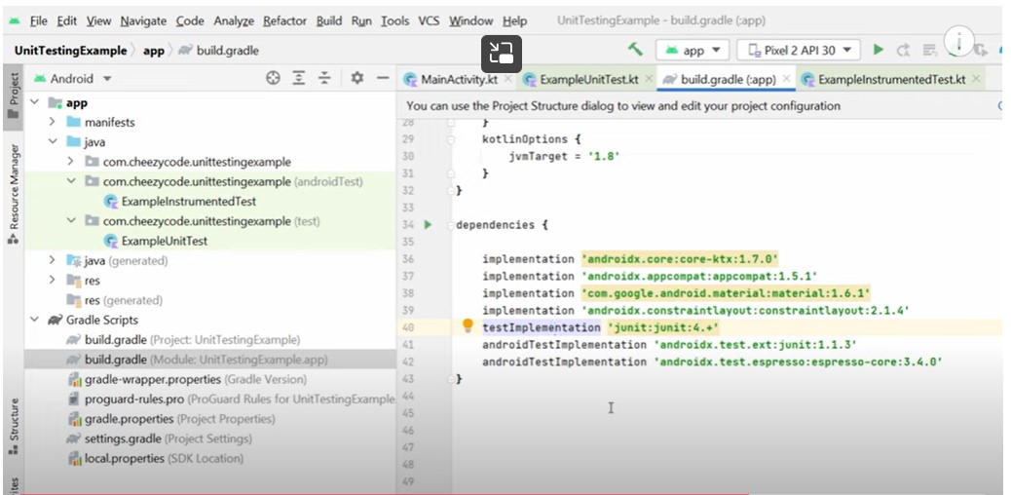

Slide 7
Logging ( How to write log code)
import android.util.Log;
// Use class variable with class name as tag
private static final String TAG = MainActivity.class.getSimpleName();
// Show message in Logcat pane of Android Studio
// Log.<log-level>(TAG, "Message");
Log.d(TAG, “Hello World”);
`

Slide 8
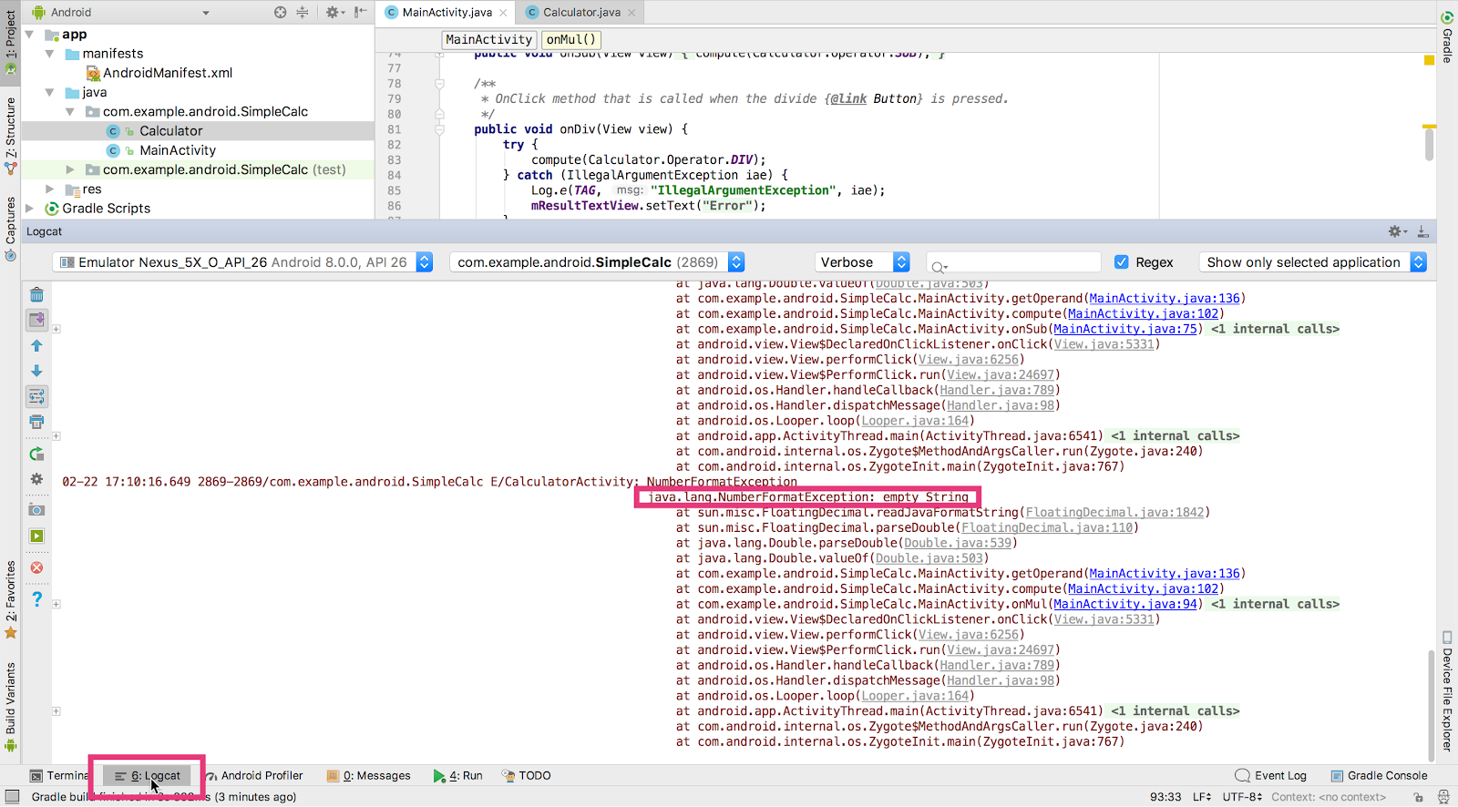
Logging in Android

Slide 9
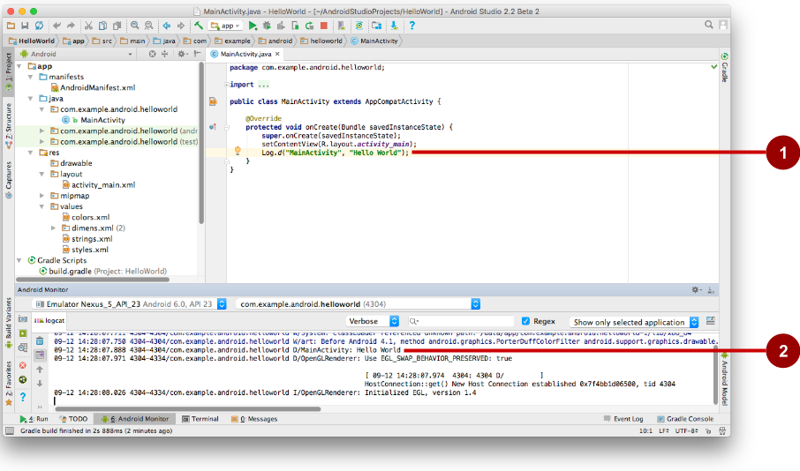
Logging in Android

Slide 10
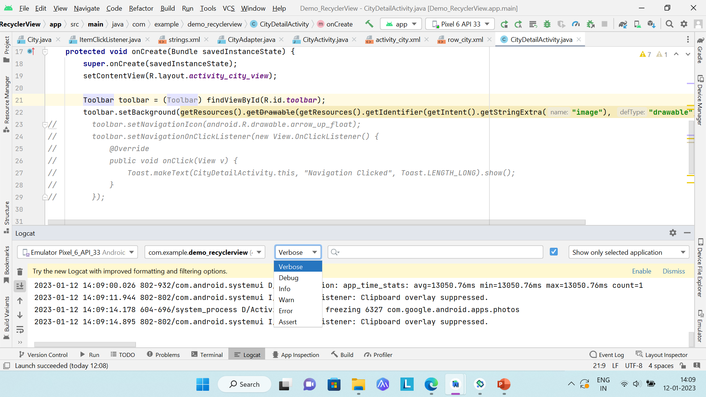
Logging in Android
Verbose - All verbose log statements and comprehensive system
Debug - All debug logs, variable values, debugging notes
Info - Status info, such as database connection
Warning - Unexpected behavior, non-fatal issues
Error - Serious error conditions, exceptions, crashes only

Slide 11
Logging in Android
Error: Log.e(String, String)
Warning: Log.w(String, String)
Information: Log.i(String, String)
Debug: Log.d(String, String)
Verbose: Log.v(String, String)

Slide 12
What is Breakpoint ?
Android Studio supports several types of breakpoints that trigger different debugging actions. The most common type is a breakpoint that pauses the execution of your app at a specified line of code. While paused, you can examine variables, evaluate expressions, then continue execution line by line to determine the causes of runtime errors.

Slide 13
Types of Breakpoint
Breakpoint triggers different debugging actions. There are a several types types of breakpoint:
Line breakpoint : The most common type is a line breakpoint that pauses the execution of your app at a specified line of code. While paused, you can examine variables, evaluate expressions, and then continue execution line by line to determine the causes of runtime errors.
Method breakpoint : A method breakpoint pauses the execution of your app when it enters or exits a specific method. While paused, you can examine variables, evaluate expressions, and then continue execution line by line to determine the causes of runtime errors.
Field breakpoint : A field breakpoint pauses the execution of your app when it reads from or writes to a specific field.
Exception breakpoint : An exception breakpoint pauses the execution of your app when it reads from or writes to a specific field.
One can set conditional breakpoints that will only suspend execution if specific conditions are met. You can also set logging breakpoints that write to Logcat without suspending execution.

Slide 14
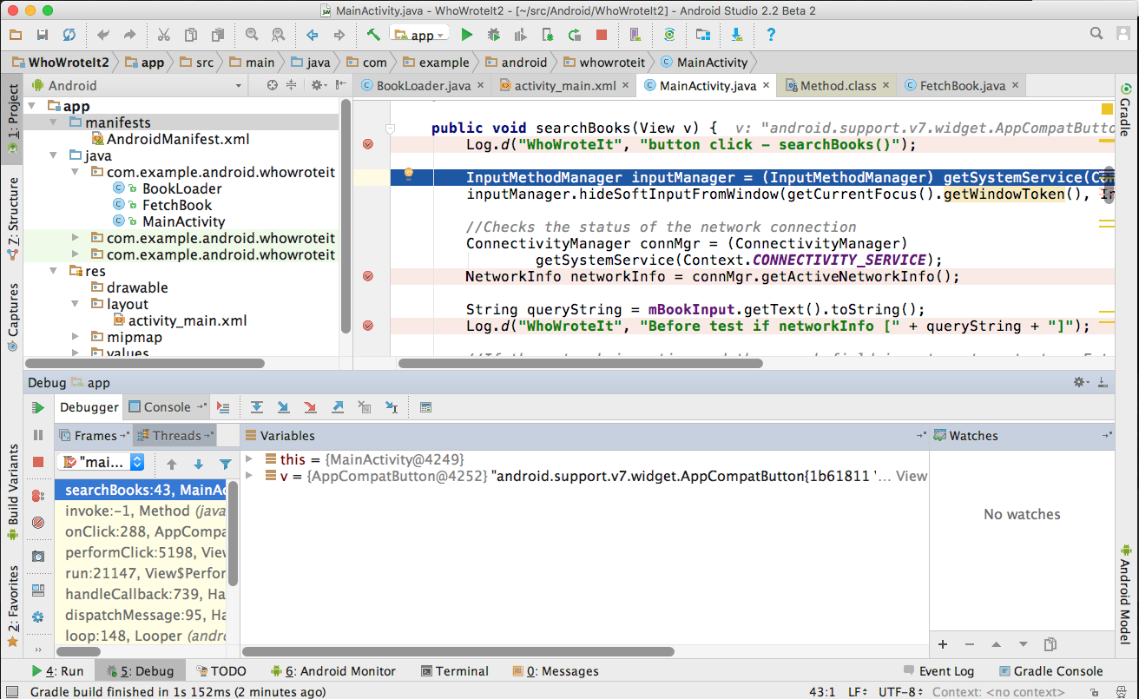
Set breakpoints
Click in the left margin next to executable line of code

Slide 15
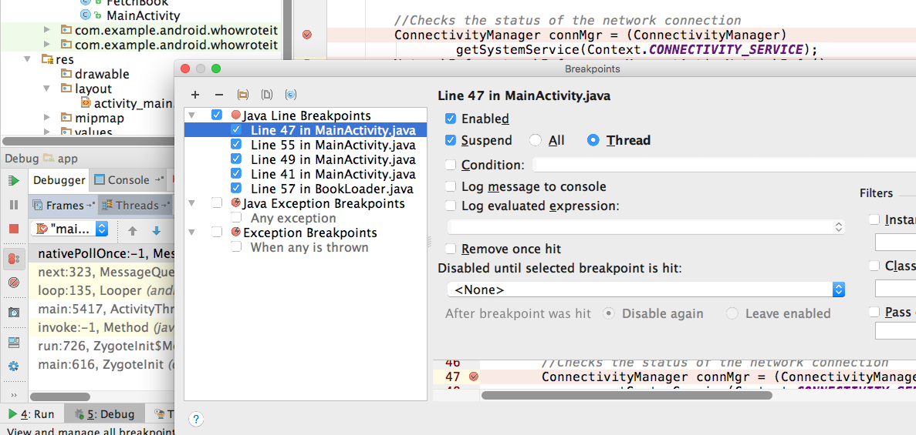
Edit breakpoint properties
2
1

Slide 16
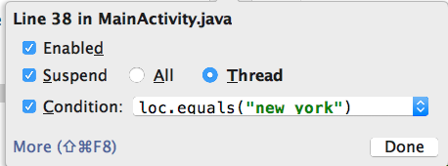
Make breakpoints conditional
In properties dialog or right -click existing breakpoint
Any Java expression that returns a boolean
Code completion helps you write conditions

Slide 17
Steps for Debugging
Run in debug mode with attached debugger
Set and configure breakpoints
Halt execution at breakpoints
Inspect execution stack frames and variable values
Change variable values
Step through code line by line
Pause and resume a running program

Slide 18
Run in debug mode
1
Debugger pane opens
Menu:
Run > Debug 'your app'
2

Slide 19
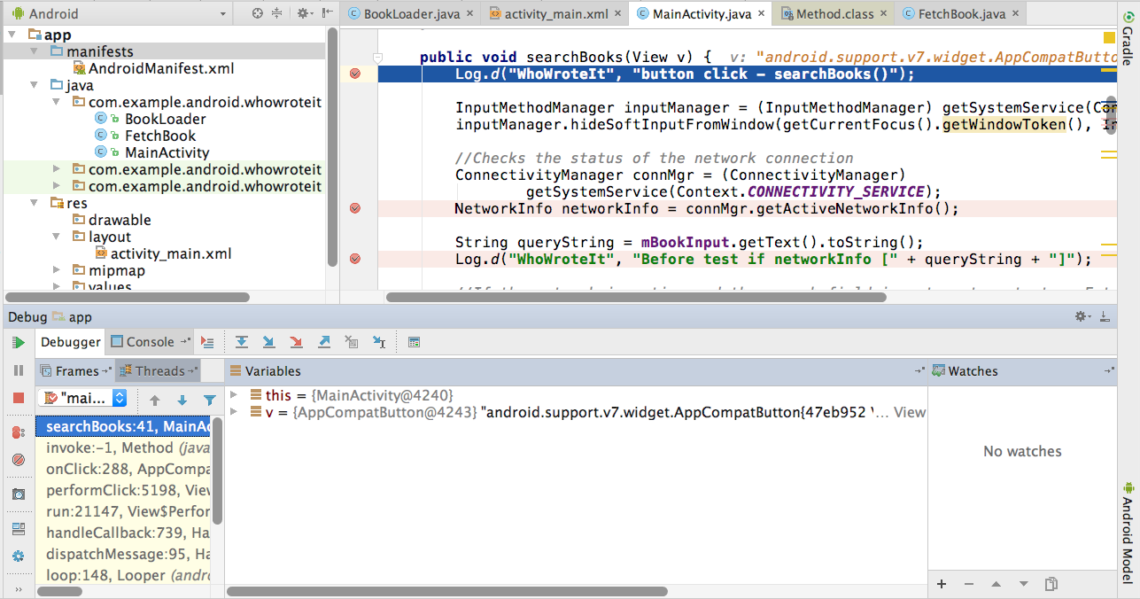
Run until app stops at breakpoint
First Breakpoint
Frames
Variables in scope
Watches (C/C++)

Slide 20
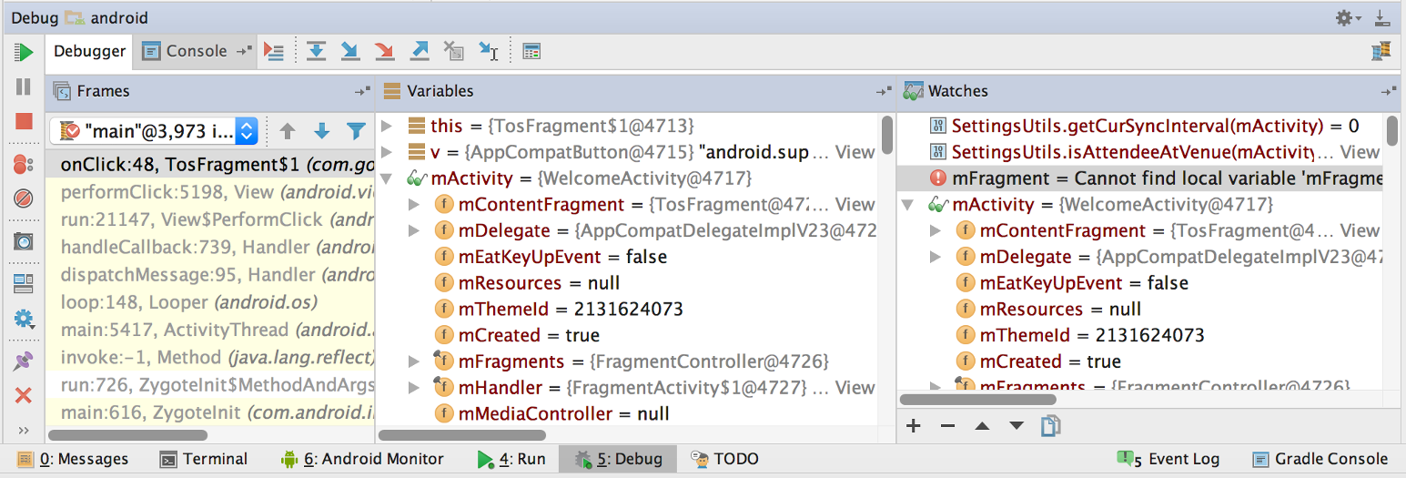
Inspect frames
Top frame is where execution is halted in your code

Slide 21
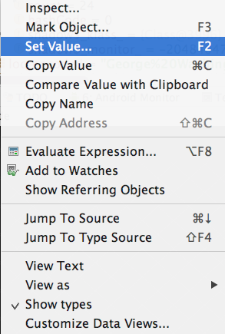
Inspect and edit variables
Right-click on variable for menu

Slide 22
Basic Stepping Commands
Step Over | F8 | Step to the next line in current file
Step Into | F7 | Step to the next executed line
Force Step Into | ⇧F7 | Step into a method in a class that you wouldn't normally step into, like a standard JDK class
Step Out | ⇧F8 | Step to first executed line after returning from current method
Run to Cursor | ⌥F9 | Run to the line where the cursor is in the file
Notes:
There are other stepping commands.

Slide 23
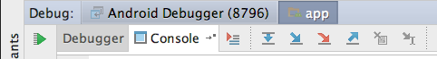
Stepping through code
Show execution point
Drop frame
Run to cursor
Step over
Step into
Step out
Force step into

Slide 24
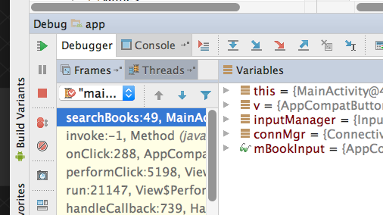
Resume and Pause
Resume
Pause
Mute all breakpoints
Menu:

Slide 25
Android Testing
Testing is an integral part of the app development process. By running tests against your app consistently, you can verify your app's correctness, functional behavior, and usability before you release it publicly.
Manual Testing
Automated testing involves using tools that perform tests for you, which is faster, more repeatable, and generally gives you more actionable feedback about your app

Slide 26
Types of Test : Subject
There are different types of tests depending on the subject:
Functional testing: does my app do what it's supposed to?
Performance testing: does it do it quickly and efficiently?
Accessibility testing: does it work well with accessibility services?
Compatibility testing: does it work well on every device and API level?

Slide 27
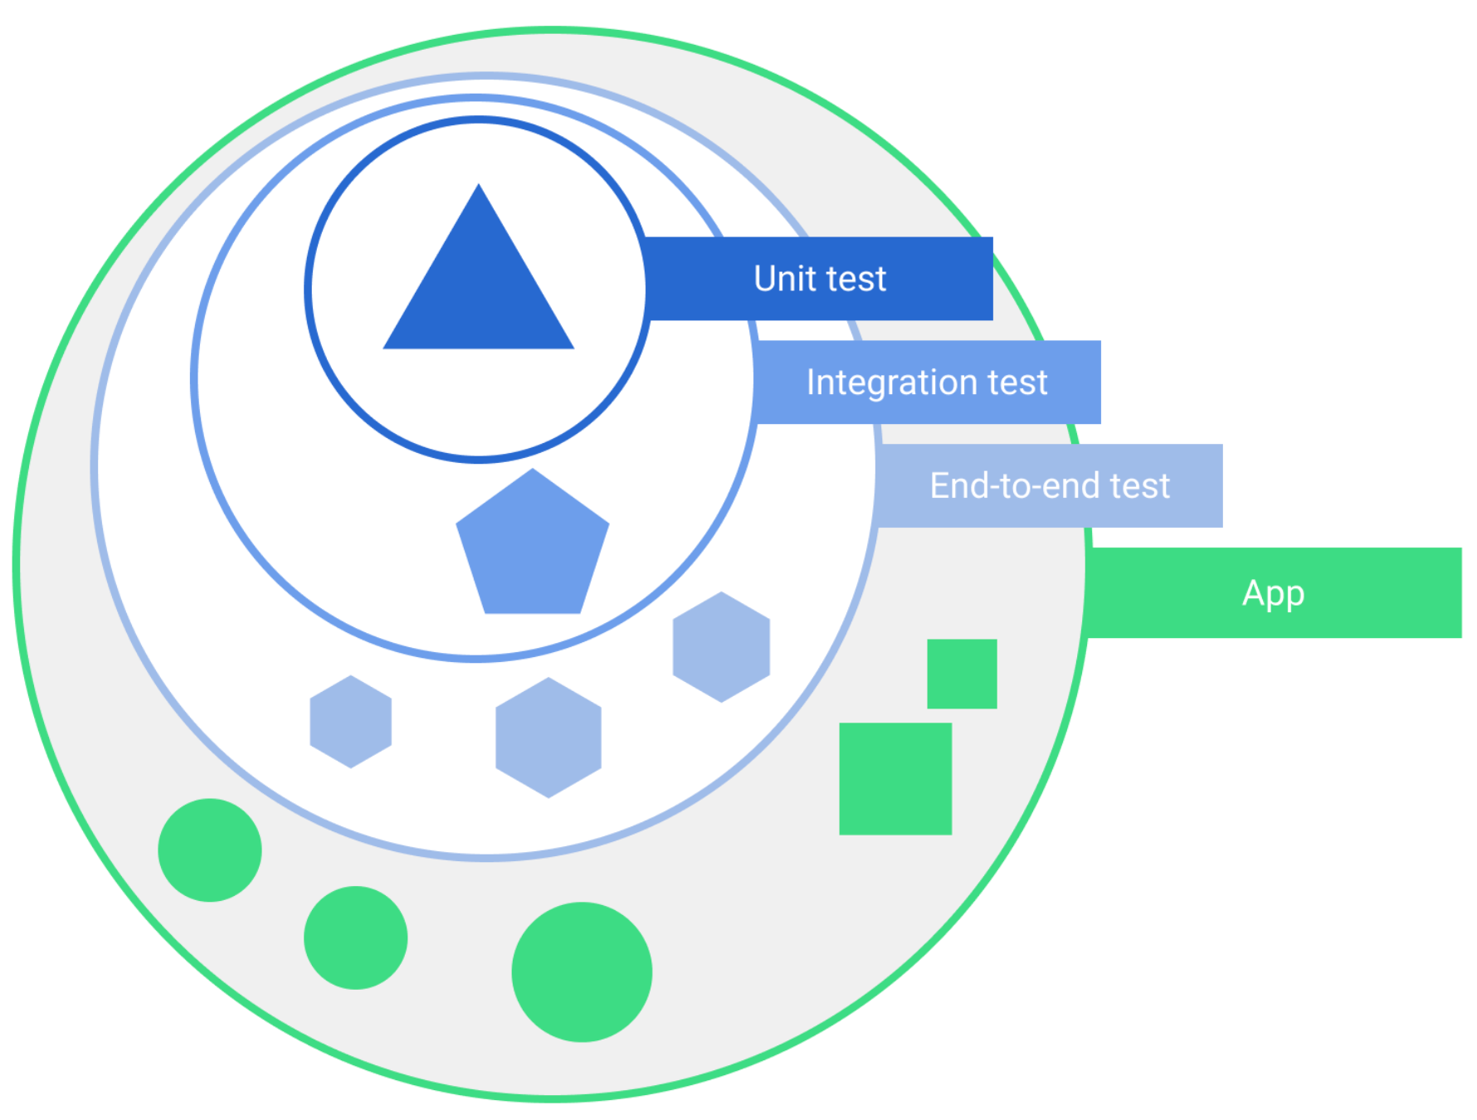
Types of Test : Scope
Tests also vary depending on size, or degree of isolation:
Unit tests or small tests only verify a very small portion of the app, such as a method or class.
End-to-end tests or big tests verify larger parts of the app at the same time, such as a whole screen or user flow.
Medium tests are in between and check the integration between two or more units.

Slide 28
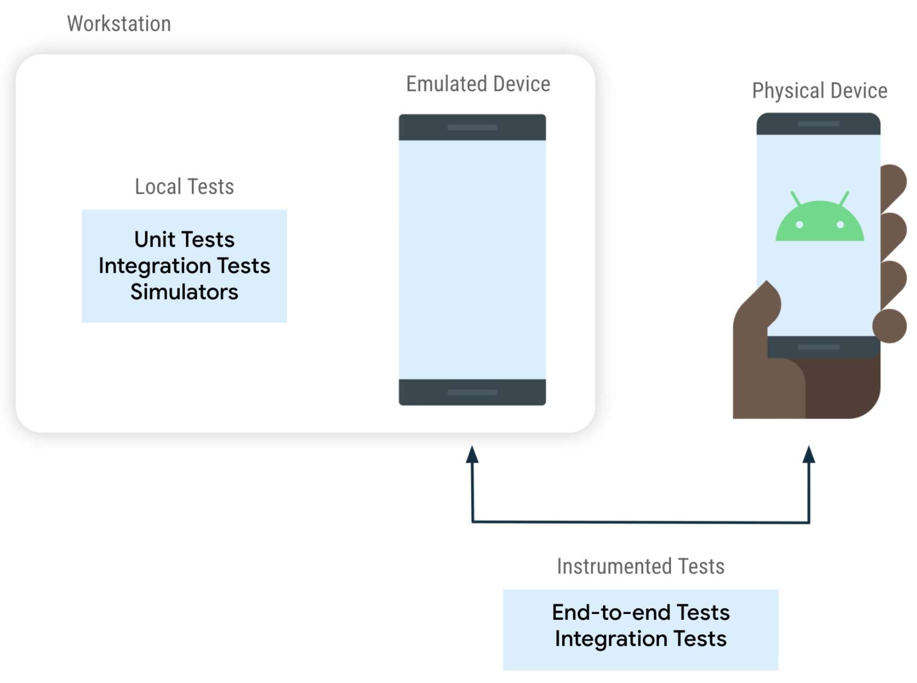
Instrumented Test vs Local Test
Instrumented tests run on an Android device, either physical or emulated. The app is built and installed alongside a test app that injects commands and reads the state. Instrumented tests are usually UI tests, launching an app and then interacting with it.
Local tests execute on your development machine or a server, so they're also called host-side tests. They're usually small and fast, isolating the subject under test from the rest of the app.

Slide 29
Test-Driven Development (TDD)
Define a test case for a requirement
Write tests that assert all conditions of the test case
Write code against the test
Iterate on and refactor code until it passes the test
Repeat until all requirements have test cases, all tests pass, and all functionality has been implemented

Slide 30
Tests in your project
Android Studio creates three source sets for your project
main—code and resources
(test)—local unit tests
(androidTest)—instrumented tests – UI

Slide 31
Local Unit tests
Smallest testable parts of your program
Isolate each component and demonstrate the individual parts are correct
Java Method tests
Results
Inputs
Java method
Graceful Failure

Slide 32
Local unit tests in JUnit
Compiled and run entirely on your local machine with the Java Virtual Machine (JVM)
Use to test the parts of your app (such as the internal logic):
you don't need access to Android framework or device/emulator
you can create fake (mock) objects that pretend to behave like the framework equivalents
Unit tests are written with JUnit, a common unit testing framework for Java.

Slide 33
Local unit tests in your project
Tests are in the same package as the associated application class
Only org.junit imported — no Android classes
Project path for test classes: .../module-name/src/test/java/

Slide 34
Imports for JUnit
// Annotations
import org.junit.Before;
import org.junit.Test;
import org.junit.runner.RunWith;
// Basic JUnit4 test runner
import org.junit.runners.JUnit4;
// assert method
import static org.junit.Assert.*;

Slide 35
Testing class
/**
* JUnit4 unit tests for the calculator logic.
* These are local unit tests; no device needed
*/
@RunWith(JUnit4.class) // Specify the test runner
public class CalculatorTest { // Name it what you are testing
}

Slide 36
ExampleTest
/
**
* Test for simple addition.
* Each test is identified by a @Test annotation.
*/
@Test
public void addTwoNumbers() {
double resultAdd = mCalculator.add(1D, 1D);
assertEquals(resultAdd, 2D, 0D);
}

Slide 37
@Test Annotation
Tells JUnit this method is a test method (JUnit 4)
Information to the test runner
Not necessary anymore to prefix test methods with "test"

Slide 38
setUp() method
/**
* Set up the environment for testing
*/
@Before
public void setUp() {
mCalculator = new Calculator();
}
Sets up environment for testing
Initialize variables and objects used in multiple tests

Slide 39
tearDown() method
/**
* Release external resources
*/
@After
public void tearDown() {
....
}
Frees resources

Slide 40

Starting a test run
Right-click test class and select Run 'app_name' test
Right-click test package and select Run tests in 'package'

Slide 41
UI testing
Perform all user UI actions with View elements
Tap a View, and enter data or make a choice
Examine the values of the properties of each View
Provide input to all View elements
Try invalid values
Check returned output
Correct or expected values?
Correct presentation?

Slide 42
Problems with testing manually
Time consuming, tedious, error-prone
UI may change and need frequent retesting
Some paths fail over time
As app gets more complex, possible sequences of actions may grow non-linearly

Slide 43
Benefits of testing automatically
Free your time and resources for other work
Faster than manual testing
Repeatable
Run tests for different device states and configurations

Slide 44
Espresso for single app testing
Verify that the UI behaves as expected
Check that the app returns the correct UI output in response to user interactions
Navigation and controls behave correctly
App responds correctly to mocked-out dependencies

Slide 45
UI Automator for multiple apps
Verify that interactions between different user apps and system apps behave as expected
Interact with visible elements on a device
Monitor interactions between app and system
Simulate user interactions
Requires instrumentation

Slide 46
What is instrumentation?
Android instrumentation is a set of control methods, or hooks, in the Android system, which control Android components and how the Android system loads apps.
Loads test package and app into same process, allowing tests to call methods and examine fields
Control components independently of app’s lifecycle
Control how Android loads apps

Slide 47
Benefits of instrumentation
Tests can monitor all interaction with Android system
Tests can invoke methods in the app
Tests can modify and examine fields in the app independent of the app’s lifecycle

Slide 48
Add dependencies to build.gradle
Android Studio templates include dependencies
If needed, add the following dependencies:
testImplementation 'junit:junit:4.12'
androidTestImplementation 'com.android.support.test:runner:1.0.1'
androidTestImplementation
'com.android.support.test.espresso:espresso-core:3.0.1'

Slide 49
Add defaultConfig to build.gradle
Android Studio templates include defaultConfig setting
If needed, add the following to defaultConfig section:
testInstrumentationRunner
"android.support.test.runner.AndroidJUnitRunner"

Slide 50
Prepare your device
Turn on USB Debugging
Turn off all animations in Developer Options > Drawing
Window animation scale
Transition animation scale
Animator duration scale

Slide 51
Create tests
Store in module-name/src/androidTests/java/
In Android Studio: app > java > module-name (androidTest)
Create tests as JUnit classes

Slide 52
Test class definition
@RunWith(AndroidJUnit4.class) — Required annotation for tests
@LargeTest — Based on resources the test uses and time to run
public class ChangeTextBehaviorTest {}
@SmallTest — Runs in < 60s and uses no external resources
@MediumTest — Runs in < 300s, only local network
@LargeTest — Runs for a long time and uses many resources

Slide 53
@Rule specifies the context of testing
@Rule
public ActivityScenarioRule<MainActivity> mActivityRule =
new ActivityScenarioRule<>(MainActivity.class);

Slide 54
@Before and @After set up and tear down
@Before
public void initValidString() {
mStringToBetyped = "Espresso";
}
@Before — Setup, initializations
@After — Teardown, freeing resources

Slide 55
@Test method structure
@Test
public void changeText_sameActivity() {
// 1. Find a View
// 2. Perform an action
// 3. Verify action was taken, assert result
}

Slide 56
"Hamcrest" simplifies tests
“Hamcrest” an anagram of “Matchers”
Framework for creating custom matchers and assertions
Match rules defined declaratively
Enables precise testing

Slide 57
Hamcrest Matchers
ViewMatchers: Hamcrest matcher expressions in the ViewMatchers class that lets you find a View in the current View hierarchy so that you can examine something or perform some action.
ViewActions: Hamcrest action expressions in the ViewActions class that lets you perform an action on a View found by a ViewMatcher.
ViewAssertions: Hamcrest assertion expressions in the ViewAssertions class that lets you assert or check the state of a View found by a ViewMatcher

Slide 58
Hamcrest Matchers
ViewMatcher — find Views by id, content, focus, hierarchy
ViewAction — perform an action on a view
ViewAssertion — assert state and verify the result

Slide 59
Basic example test
@Test
public void changeText_sameActivity() {
// 1. Find view by Id
onView(withId(R.id.editTextUserInput))
// 2. Perform action—type string and click button
.perform(typeText(mStringToBetyped), closeSoftKeyboard());
onView(withId(R.id.changeTextBt)).perform(click());
// 3. Check that the text was changed
onView(withId(R.id.textToBeChanged))
.check(matches(withText(mStringToBetyped)));
}

Slide 60
Finding views with onView
withId() — find a view with the specified Android id
onView(withId(R.id.editTextUserInput))
withText() — find a view with specific text
allOf() — find a view to that matches multiple conditions
Example: Find a visible list item with the given text:
onView(allOf(withId(R.id.word),
withText("Clicked! Word 15"),
isDisplayed()))

Slide 61
onView returns ViewInteraction object
If you need to reuse the View returned by onView
Make code more readable or explicit
check() and perform() methods
ViewInteraction textView = onView(
allOf(withId(R.id.word), withText("Clicked! Word 15"), isDisplayed()));
textView.check(matches(withText("Clicked! Word 15")));

Slide 62
Perform actions
Perform an action on the View found by a ViewMatcher
Can be any action you can perform on the View
// 1. Find view by Id
onView(withId(R.id.editTextUserInput))
// 2. Perform action—type string and click button
.perform(typeText(mStringToBetyped), closeSoftKeyboard());
onView(withId(R.id.changeTextBt)).perform(click());

Slide 63
Check result
Asserts or checks the state of the View
// 3. Check that the text was changed
onView(withId(R.id.textToBeChanged))
.check(matches(withText(mStringToBetyped)));

Slide 64
When a test fails
Test
onView(withId(R.id.text_message))
.check(matches(withText("This is a failing test.")));
Result snippet
android.support.test.espresso.base.DefaultFailureHandler$AssertionFailedWithCauseError: 'with text: is "This is a failing test."' doesn't match the selected view.
Expected: with text: is "This is a failing test."
Got: "AppCompatTextView{id=2131427417, res-name=text_message ...

Slide 65
Disclaimer
All the content is curated from Android Documentation and Google Developer Fundamentals.
Rachana Mehta

