Slide 1
iOS
Date - 30-09-2023
Nov 22, 2022
Confidential Information – For intended recipients only. Apexon, Copyright © 2022 Infostretch Corporation. All rights reserved.

Slide 2
Agenda
Theory
Tools Required for iOS Development
iOS Architecture
iOS Security
iOS App lifecycle
How does Xcode work when we build the iOS app project.
App Store
Advantages of iOS
iOS Challenges
Programming language – Swift
Frameworks – UIKit, SwiftUI
Map
Hands-On Exercises

Slide 3
Tools Required for iOS Development
Apple Device:
You'll need an Apple device, preferably a Mac computer, as iOS app development primarily takes place on macOS. A Mac desktop or laptop is essential for running the necessary development tools.
Operating System:
Ensure that your Mac is running the latest macOS version or a compatible version for iOS app development. You'll need a recent version to use the latest development tools.
Xcode:
Xcode is the official integrated development environment (IDE) provided by Apple for iOS app development. It includes tools for coding, debugging, testing, and deploying apps. You can download Xcode for free from the Mac App Store.
iOS SDK (Software Development Kit):
Xcode includes the iOS SDK, which contains essential libraries, frameworks, and tools required for iOS app development.
Apple Developer Account:
You'll need to sign up for an Apple Developer account, which is essential for creating and distributing iOS apps. There are free and paid developer account options available.
Programming Knowledge:
To develop iOS apps, you'll need to have programming knowledge. Apple's primary programming languages for iOS development are Swift and Objective-C. Familiarity with these languages is crucial.

Slide 4
iOS Architecture
The iOS architecture refers to the underlying structure and design of the Apple iOS operating system, which powers iPhones, iPads, and iPod Touch devices.
Core OS Layer: It manages tasks like memory management, process scheduling, and hardware abstraction.
Core Services Layer: This layer includes fundamental system services and frameworks
Media Layer: OS provides a suite of media for audio and video handling, graphics rendering animation rendering.
Cocoa Touch Layer: Cocoa Touch is responsible for the user interface (UI) components and interactions on iOS devices.

Slide 5
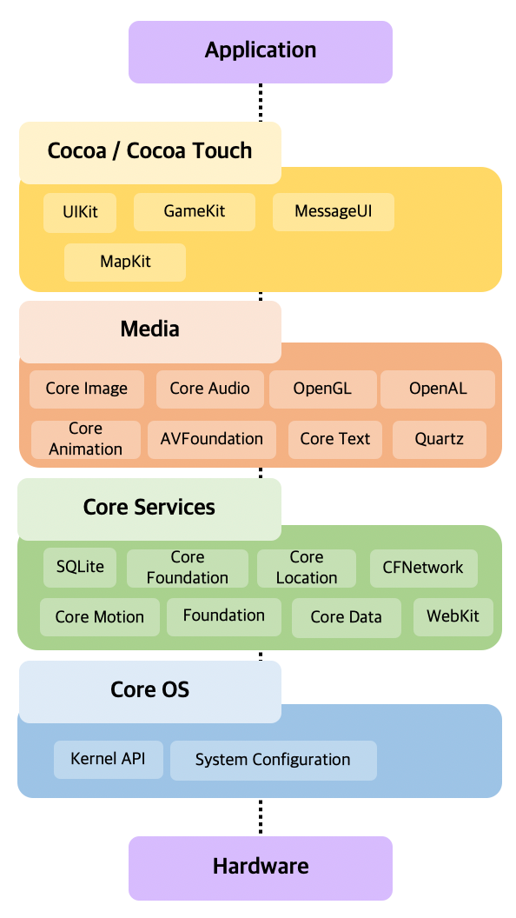

Slide 6
iOS Security
Device Encryption:
iOS employs hardware-based encryption to protect user data. All data stored on the device is encrypted with a unique key tied to the device's hardware. This encryption includes user files, app data, and system data.
App Sandboxing:
Each iOS app runs in its own sandboxed environment, isolated from other apps and the underlying operating system. This sandboxing restricts an app's access to system resources and data, enhancing security and privacy.
Code Signing:
All iOS apps must be signed with a digital certificate issued by Apple. The code signature ensures that apps have not been tampered with and verifies their authenticity before installation.
App Permissions:
iOS employs a permission model where apps must request user permission to access sensitive data or device features, such as the camera, microphone, location, and contacts. Users have granular control over these permissions.
Face ID and Touch ID:
Apple's biometric authentication methods, Face ID and Touch ID, provide secure and convenient ways for users to unlock their devices, make payments, and authenticate within apps. Biometric data is stored in a secure enclave and never leaves the device.

Slide 7
iOS Security
App Store Review Process:
Before apps are published on the App Store, they undergo a rigorous review process by Apple. This process checks for security vulnerabilities, malicious code, and adherence to App Store guidelines.
Data Protection APIs:
iOS provides Data Protection APIs that allow app developers to encrypt sensitive user data with a user's passcode. This encryption ensures that data is inaccessible when the device is locked.
Secure Enclave:
iOS devices incorporate a hardware-based Secure Enclave, a separate processor that handles cryptographic operations related to biometrics, device encryption, and secure key storage. It is isolated from the main processor.

Slide 8
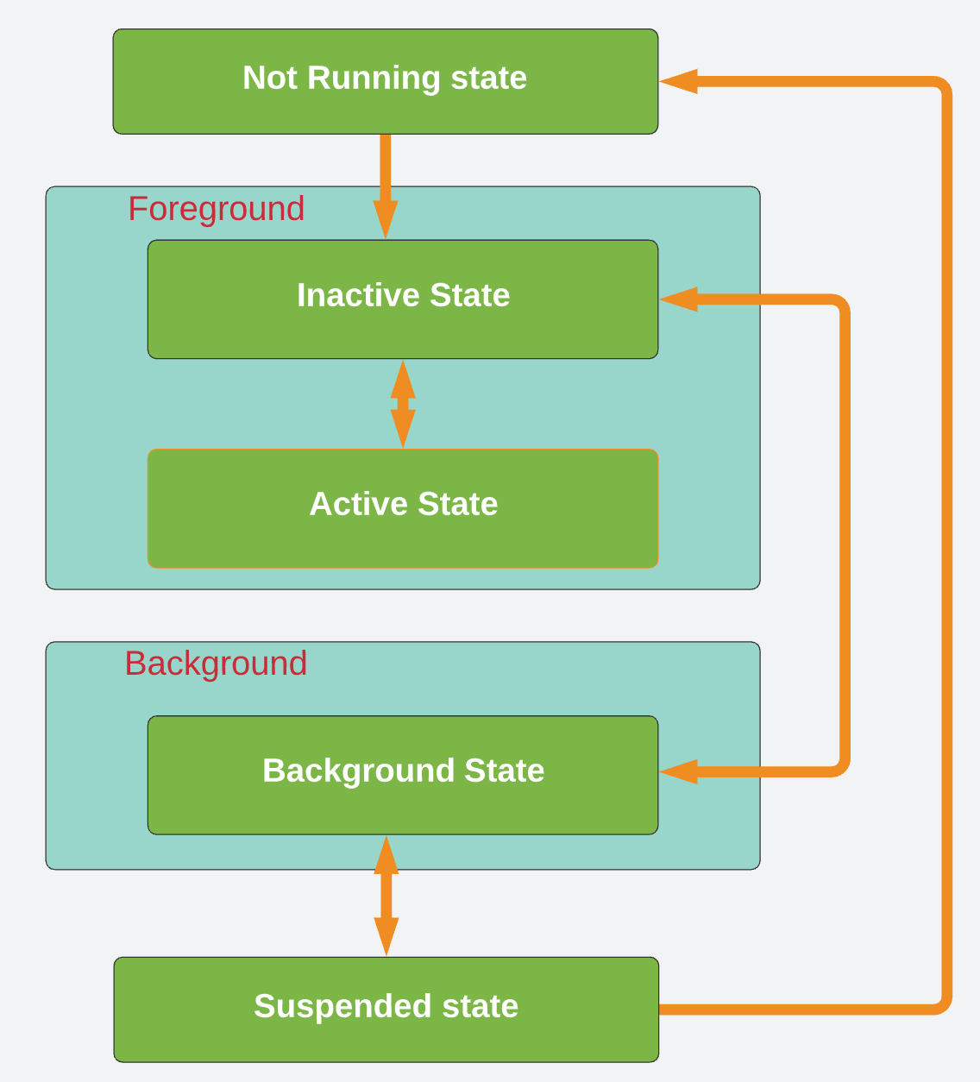
iOS App lifecycle

Slide 9
iOS App lifecycle
Not Running:
When the app is not in use, it is in the "Not Running" state. This typically occurs when the app has not been launched or has been terminated by the user or the system.
Inactive:
The "Inactive" state occurs briefly when the app is transitioning from the background to the foreground or vice versa. During this state, the app is not actively executing code.
Active:
The "Active" state is when the app is in the foreground and actively executing code in response to user interactions. This is the state where the app's user interface is visible and responsive to user input.
Background:
When the user presses the home button or switches to another app, the app enters the "Background" state. In this state, the app is not actively visible but can continue to execute code and perform tasks such as playing music or updating location data.
Suspended:
Apps that are in the "Background" state may eventually transition to the "Suspended" state. In this state, the app is not actively running any code. However, it remains in memory, allowing it to resume quickly when brought back to the foreground. Suspended apps do not consume CPU resources.

Slide 10
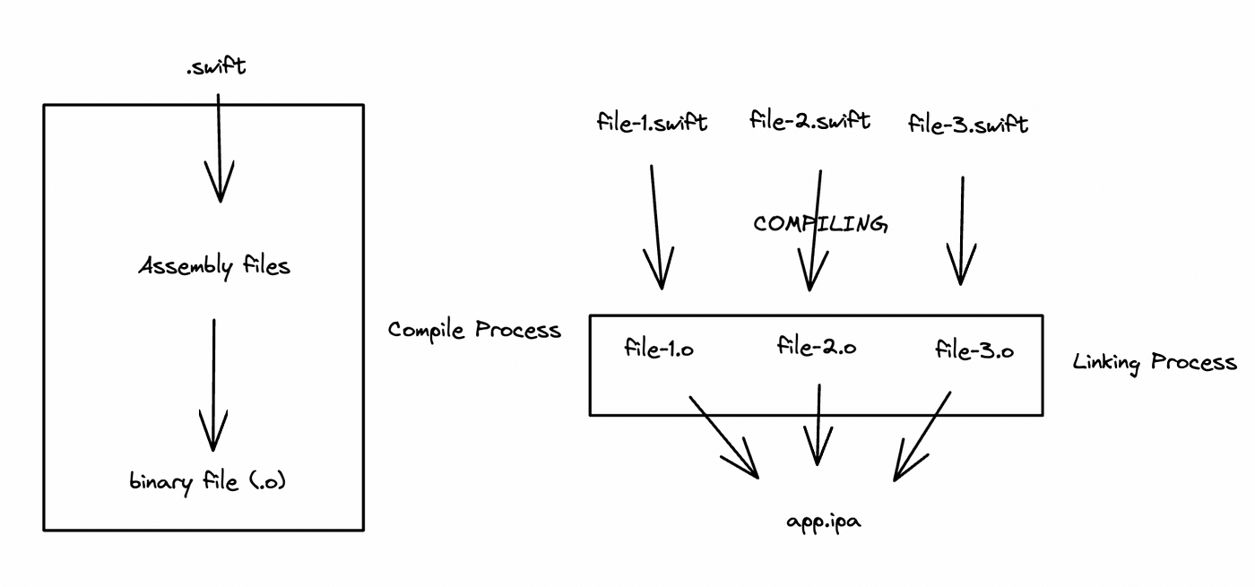
How does Xcode work when we build the iOS app project How does Xcode work when we build the iOS app project
Next Milestone: New Architectural Framework for Reporting DB initiative
Milestone Estimation Date: 25-Nov-2022
Summary:
Completed
Optimization of report queries shared
Best practice recommendations for queries shared.
Draft Architectural Framework for Reporting DB initiative
On going
Optimizing new queries. Will start once we receive these from Nikunj (expected EOD 22/Nov)
Analysis of exiting all reports and related tables in Dev DB for modeling Target DB in progress.
Identifying resources for the initiative - in progress - roles – Team Lead/QA Analyst, Data Modeler (50%), Data Engineers(2), DB developer(1)
Working draft Project Plan for Phase 1 in progress.
Challenge/Help required

Slide 11
How does Xcode work when we build the iOS app project
.swift will be translated into the assembly files by the LLVM in the swift compiler process, and finally become a binary file (.o), which is a binary file is used to create an executable app. and how to create the executable app from the binary file ? in here we need the linking process, so basically Linker is the computer system program that combines one or more object files into a single binary or executable.

Slide 12
App Store
The App Store for iOS is a digital marketplace and distribution platform created and managed by Apple. It is the primary source for iOS users to discover, download, and update mobile applications designed for iPhones, iPads, and iPod Touch devices. The App Store plays a central role in the iOS ecosystem and has several key features and functions:
App Discovery:
The App Store provides a vast catalog of iOS applications across various categories, including games, productivity, entertainment, education, and more. Users can browse and search for apps to discover new and useful software.
App Download and Installation:
Users can download apps from the App Store and install them on their iOS devices with just a few taps. App installations are secure, and users can review app permissions before installation.
App Updates:
App developers regularly release updates to enhance functionality, fix bugs, and improve security. The App Store notifies users when app updates are available, and they can easily update all apps or select specific ones.

Slide 13
App Store
App Ratings and Reviews:
Users can rate and review apps based on their experiences. These ratings and reviews help others make informed decisions about which apps to download. Developers value positive reviews and feedback.
App Categories:
The App Store categorizes apps to make it easier for users to find what they're looking for. Categories include Top Charts, Featured Apps, Games, Productivity, Health & Fitness, and many more.
Editorial Recommendations:
Apple's editorial team curates collections of apps, highlighting those they consider noteworthy or innovative. These collections appear in the App Store's Today, Games, and Apps sections.
In-App Purchases and Subscriptions:
Many apps offer in-app purchases (IAPs) and subscriptions to access premium features or content. Users can make these purchases securely through the App Store, and Apple manages the billing process.

Slide 14
App Store
App Store Connect:
App developers and publishers use the App Store Connect portal to submit and manage their apps, monitor performance, and access resources and tools for app development.
App Review Process:
Apple conducts a thorough review of each app submitted to the App Store to ensure it meets quality and security standards. This process helps maintain a secure and reliable app ecosystem.
App Store on Multiple Platforms:
The App Store is available not only on iOS devices but also on macOS, watchOS, and tvOS platforms, allowing users to access apps across their Apple ecosystem.

Slide 15
iOS Advantages
User-Friendly Interface:
iOS is known for its intuitive and user-friendly interface. The clean design, consistent layout, and easy navigation make it accessible to users of all ages and backgrounds.
App Ecosystem:
The App Store provides access to a vast library of high-quality apps that are carefully curated and reviewed. This extensive app ecosystem ensures users can find apps for virtually any need or interest.
Security and Privacy:
iOS is renowned for its robust security features. It includes built-in encryption, regular security updates, and app sandboxing to protect user data and privacy. Users have control over app permissions.
Regular Updates:
Apple provides regular iOS updates that include bug fixes, performance improvements, and new features. Users can keep their devices up-to-date with the latest software enhancements.
Accessibility Features:
iOS offers a wide range of accessibility features, making it inclusive for users with disabilities. Features like VoiceOver, Magnifier, and Guided Access enhance usability.

Slide 16
iOS Advantages
Multitasking and Productivity:
iOS supports multitasking features, such as split-screen and slide-over, which enhance productivity. Users can work on multiple apps simultaneously, making the iPad a versatile tool for professionals.
iCloud Integration:
iCloud seamlessly syncs data, photos, and documents across iOS devices and Macs. It simplifies data backup, sharing, and access across the Apple ecosystem.
Strong Developer Support:
iOS offers robust development tools, such as Xcode and Swift, making it attractive to app developers. This results in a rich selection of high-quality apps.

Slide 17
iOS Challenges
Cost of Ownership:
iOS devices, such as iPhones and iPads, tend to be more expensive than many Android alternatives. This can be a barrier for budget-conscious consumers.
Closed Ecosystem:
Apple maintains a tightly controlled ecosystem, which limits customization and flexibility compared to open-source platforms like Android. Users have less control over device settings and app installations.
App Store Regulations:
Apple's strict guidelines for the App Store review process can lead to the rejection of apps that don't meet specific criteria. This can be frustrating for developers and limit the types of apps available to users.
Limited File Management:
iOS restricts users from accessing the file system in the same way as desktop operating systems. This can make it challenging to manage files and perform certain tasks.
Interoperability with Non-Apple Devices:
iOS devices may not seamlessly integrate with non-Apple devices and services. Compatibility with Windows PCs and some third-party products can be limited.

Slide 18
iOS Challenges
Limited Customization:
iOS limits the level of customization compared to Android. Users cannot change default apps, alter the home screen layout extensively, or install apps from outside the App Store without jailbreaking (which has its own risks).
Repairability and Upgradability:
Apple's designs prioritize slimness and aesthetics over repairability and upgradability. This can result in higher repair costs and limited options for hardware upgrades.
Fragmentation (to a Lesser Extent):
While iOS devices tend to receive updates for several years, fragmentation can still be an issue as older devices may not support the latest iOS versions or features.
Learning Curve for New Users:
iOS, while user-friendly, can have a learning curve for users transitioning from other platforms due to its unique interface and gestures.

Slide 19
iOS UI Controls
Label: Displays static text.
Text Field: Accepts user input as single-line text.
Text View: Allows multiple lines of user input.
Button: Triggers actions when tapped.
Image View: Displays images or icons.
Table View: Organizes and displays data in a list.
Collection View: Presents data in a grid or custom layout.
Picker View: Provides a selection interface with a wheel or list.
Switch: Toggles between two states.
Slider: Adjusts values within a range.
Progress View: Indicates progress of a task.
Segmented Control: Allows selecting from a segmented set of options.
Stepper: Increments or decrements a value.
Activity Indicator: Indicates that a task is in progress.
Date Picker: Selects dates or times.

Slide 20
iOS UI Controls
Web View: Displays web content within the app.
Map View: Embeds maps and location services.
Scroll View: Enables scrolling for content that doesn't fit.
Page Control: Navigates between pages or content.
Alert Controller: Displays alert messages or prompts.
Navigation Bar: Provides navigation controls in a bar at the top.
Tab Bar: Switches between different app sections or views.
Toolbar: Contains additional controls in a bar at the bottom.
Search Bar: Adds search functionality to a view.
Stack View: Arranges subviews in a stack or grid.
Container View: Contains and manages child view controllers.

Slide 21
Swift
Swift is a powerful and user-friendly programming language developed by Apple. It's known for its speed and safety features, making it ideal for iOS, macOS, watchOS, and tvOS app development. Swift combines modern syntax with advanced features like optionals and type inference, making code concise and easy to read. It also supports object-oriented and functional programming paradigms, offering a versatile choice for developers to create robust and efficient software for Apple's ecosystem.

Slide 22
UIKit and SwiftUI
UIKit: UIKit is Apple's traditional framework for building user interfaces in iOS and macOS applications. It offers a wide range of components and tools to create visually appealing and interactive interfaces. UIKit has been the primary UI framework for iOS development for many years, providing developers with extensive customization options and flexibility. While it has a steeper learning curve, it remains a powerful choice for building complex and highly customized app interfaces.
SwiftUI: SwiftUI is Apple's modern and declarative framework for building user interfaces in iOS, macOS, watchOS, and tvOS applications. Introduced in 2019, it simplifies UI development by allowing developers to describe the interface and its behavior in a concise and readable manner using Swift code. SwiftUI is known for its simplicity, real-time previews, and cross-platform capabilities. It's an excellent choice for developers looking to create dynamic and responsive user interfaces efficiently, and it's gaining popularity as the future of UI development in the Apple ecosystem.

Slide 23
Mapkit
MapKit is a framework provided by Apple for iOS app developers, offering a set of tools and APIs for integrating mapping and location-based services into iOS applications. It enables developers to embed interactive maps, annotate specific locations, and leverage various features related to mapping and geolocation.
Key Features of MapKit for iOS:
Map Display:
Developers can embed interactive maps directly within their iOS applications.
Users can view standard map views or switch to satellite views.
Annotations:
MapKit allows developers to add markers, pins, and custom annotations to specific locations on the map.
Customization options are available for the appearance of annotation views.
User Location:
Developers can display the user's current location on the map.
Real-time tracking of the user's location is supported.
Geocoding and Reverse Geocoding:
Geocoding converts addresses or place names into geographic coordinates (latitude and longitude).
Reverse geocoding retrieves location information from a set of coordinates

Slide 24
Mapkit
Routing and Directions:
MapKit enables developers to display routes and directions between two or more locations.
While it doesn't provide turn-by-turn navigation itself, it can launch the Apple Maps app for navigation.
Search and Points of Interest:
Users can perform searches for locations, businesses, and points of interest using the search bar.
Detailed information about businesses, restaurants, and other places is available, including reviews and contact information.
Overlay and Shapes:
Developers can overlay custom shapes, lines, and polygons on the map.
Tile overlays allow the display of custom tile-based map overlays.
Map Interaction:
MapKit supports gesture recognition, allowing users to interact with the map using gestures such as pinch-to-zoom and panning.
Integration with Core Location:
MapKit integrates with the Core Location framework to provide detailed location information.

Slide 25
Hands-On Exercises
1. Develop an iPhone application to demonstrate use of buttons and labels. While tapping a button, a message should be displayed in the label. Put button and label on view using drag and drop.
2. Develop iPhone application to demonstrate use of alert view. While tapping a button, an alert view should be displayed with two different buttons. Also handle events generated by buttons of alert view to demonstrate use of alert view. While tapping a button, an alert view should be displayed with two different buttons. Also handle events generated by buttons of alert view.
3. Develop an iPhone application to demonstrate use of an action sheet. While tapping a button, the action sheet should be displayed with three different buttons. Also handle events generated by buttons of the action sheet.

Slide 26
References
https://developer.apple.com/documentation/uikit
https://developer.apple.com/documentation/swiftui/
https://developer.apple.com/design/human-interface-guidelines/components
https://developer.apple.com/swift/

Slide 27
Thank You
Nov 22, 2022
Confidential Information – For intended recipients only. Apexon, Copyright © 2022 Infostretch Corporation. All rights reserved.

