Slide 1

Cloud Computing Tool: Cloud Analyst
Dr Vivek Kumar Prasad
Assistant Professor
Nirma University
Ahmedabad, Gujarat

Slide 2
Layout of the presentation
Cloud Computing introduction and its essential characteristics
Hands-on session
Cloud Analyst

Slide 3
Cloud Computing introduction and its essential characteristics
Cloud computing is the on-demand availability of computer system resources, especially data storage and computing power, without direct active management by the user [1].
Essential Properties[2]:
Cloud Computing
SaaS
Resource pooling (Overbooking)
Available on demand
PaaS
IaaS
Scalability
Accessible from Network
Measured Services
Multi-tenancy

Slide 4
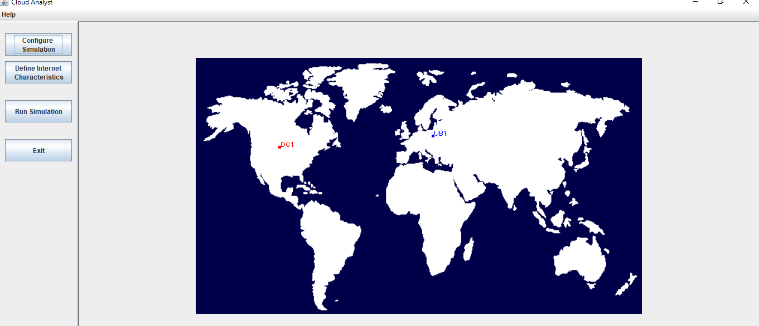
i) Hands-on: Cloud Analyst
Downloading Cloud Analyst:
http://cloudsim-setup.blogspot.com/2013/01/running-and-using-cloud-analyst.html
About the tool- Cloud Analyst is a tool developed at the University of Melbourne whose goal is to support evaluation of social networks tools according to geographic distribution of users and data centers.

Slide 5
Cloud analyst in details [3]:
http://jarrett.cis.unimelb.edu.au/students/MEDC_Project_Report_Bhathiya_318282.pdf
Important Keywords:-
Regions are based on the 6 main continents in the World.
User Base models a group of users that is considered as a single unit in the simulation and its main responsibility is to generate traffic for the simulation.
DataCenter management activities will be VM creation and destruction and does the routing of user requests received from User Bases via the Internet to the VMs.
Service broker policy:VM management and routing traffic to appropriate data centers.
Load balancing policy: Used by all data centers in allocating requests to virtual machines

Slide 6
Service broker policy:-
Closest data center – The data center with the least network latency (disregarding network bandwidth) from a particular user base is sent all the requests from that user base.
Optimize response time – This policy attempts to balance the load between data centers when one data center gets over loaded.
Dynamically reconfiguring: taking under consideration the current processing times and best processing time ever achieved.
Load balancing policy:-
Round-robin Load Balancer – uses a simple round-robin algorithm to allocate VMs.
Active Monitoring Load Balancer –load balances the tasks among available VM's in a way to even out the number of active tasks on each VM at any given time (server consolidation).
Throttled Load Balancer – this ensures only a pre-defined number of Internet Cloudlets are allocated to a single VM at any given time and some of the requests will have to be queued until the next VM becomes available.
Let’s start the demo……..

